Slide 1

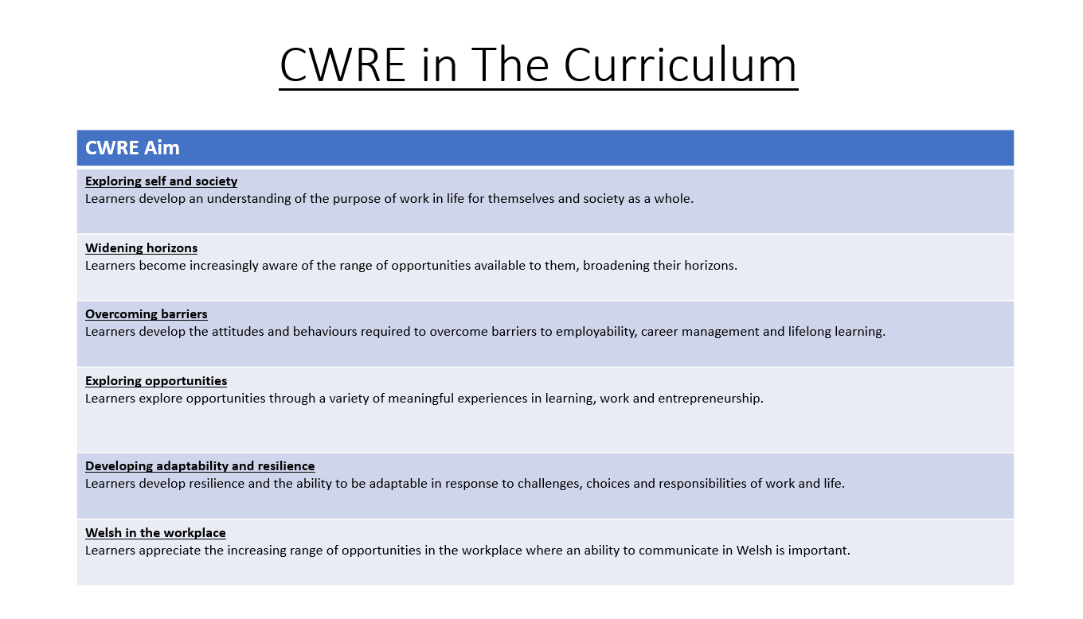

Slide 2
Lower School Plan
Subject: CWRE Progression
Term | 1 | 2 | 3
Year 7 | 1a: Who am I? 1b. Exploring Possibilities – Dream Jobs! | 2a. What is a career in my subject? 2b. What is an entrepreneur? Can my subject lead me to be one? | 3a. What is work-life balance? 3b. Careers and the future
Year 8 | 1a. What are my interests? 1b. Job applications and CV’s – how can my subject enhance mine? | 2a. Challenges and rewards of work 2b. Creating the life you want – how can skill development in my subject help? Create a vision board | 3a. What does success mean to me? What does it look like in my subject? 3b. Careers and the climate
Year 9 | 1a. What are my skills? 1b. What comes after school? Learning pathways for my subject | 2a. Decision making – choosing what to study at KS4. 2b. Taking control of your career journey. How to overcome potential barriers | 3a. Working and earning, managing your money 3b. What is the labour market and what is it saying about jobs in your subject sector?

Slide 3
Upper School Plan
Subject: CWRE Progression
Term | 1 | 2 | 3
Year 10 | 1a: Interests and Skills Profile – what makes you good at this subject? How will your skills transfer into the world of work? 1b. Preparing to go on work experience. How is skill development in my subject helping you prepare? | 2a. In person, hybrid, remote. What works best for your subject sector? 2b. Taking control of your career journey. How to overcome potential barriers | 3a. Wellbeing in the workplace. Discuss jobs linked to your subject and the possible challenges employees may face. 3b. What are my employability skills? How does my subject make students employable.
Year 11 | 1a. Post 16 Choices in my subject 1b. Decision making – choosing your post 16 pathway. What pathways are available linked to your subject? | 2a. Money talks – apprenticeships vs higher education in your subject

