Slide 1

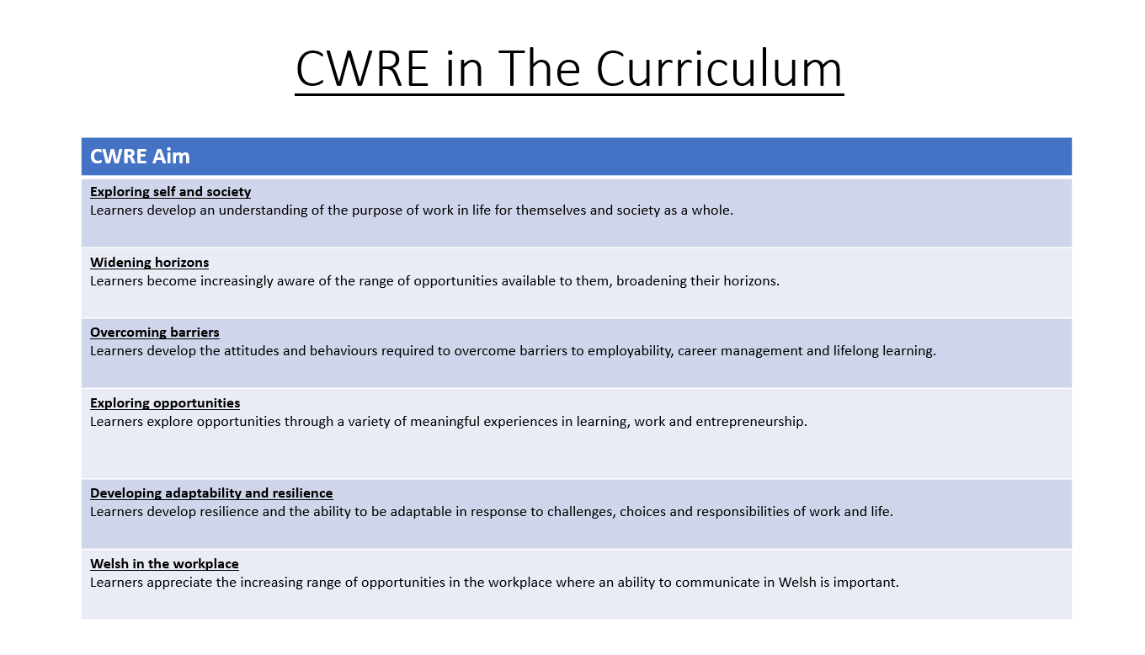

Slide 2
Lower School Plan
Subject: English
CWRE Progression
Term | 1 | 2 | 3
Year 7 | 1a: Who am I? 1b. Exploring Possibilities – Dream Jobs! | 2a. What is a career in my subject? 2b. What is an entrepreneur? Can my subject lead me to be one? | 3a. What is work-life balance? 3b. Careers and the future
Year 8 | 1a. What are my interests? 1b. Job applications and CV’s – how can my subject enhance mine? | 2a. Challenges and rewards of work 2b. Creating the life you want – how can skill development in my subject help? Create a vision board | 3a. What does success mean to me? What does it look like in my subject? 3b. Careers and the climate
Year 9 | 1a. What are my skills? 1b. What comes after school? Learning pathways for my subject | 2a. Decision making – choosing what to study at KS4. 2b. Taking control of your career journey. How to overcome potential barriers | 3a. Working and earning, managing your money 3b. What is the labour market and what is it saying about jobs in your subject sector?

Slide 3
Upper School Plan
Subject: English
CWRE Progression
Term | 1 | 2 | 3
Year 10 | 1a: Interests and Skills Profile – what makes you good at this subject? How will your skills transfer into the world of work? 1b. Preparing to go on work experience. How is skill development in my subject helping you prepare? | 2a. In person, hybrid, remote. What works best for your subject sector? 2b. Taking control of your career journey. How to overcome potential barriers | 3a. Wellbeing in the workplace. Discuss jobs linked to your subject and the possible challenges employees may face. 3b. What are my employability skills? How does my subject make students employable.
Year 11 | 1a. Post 16 Choices in my subject 1b. Decision making – choosing your post 16 pathway. What pathways are available linked to your subject? | 2a. Money talks – apprenticeships vs higher education in your subject

Slide 4
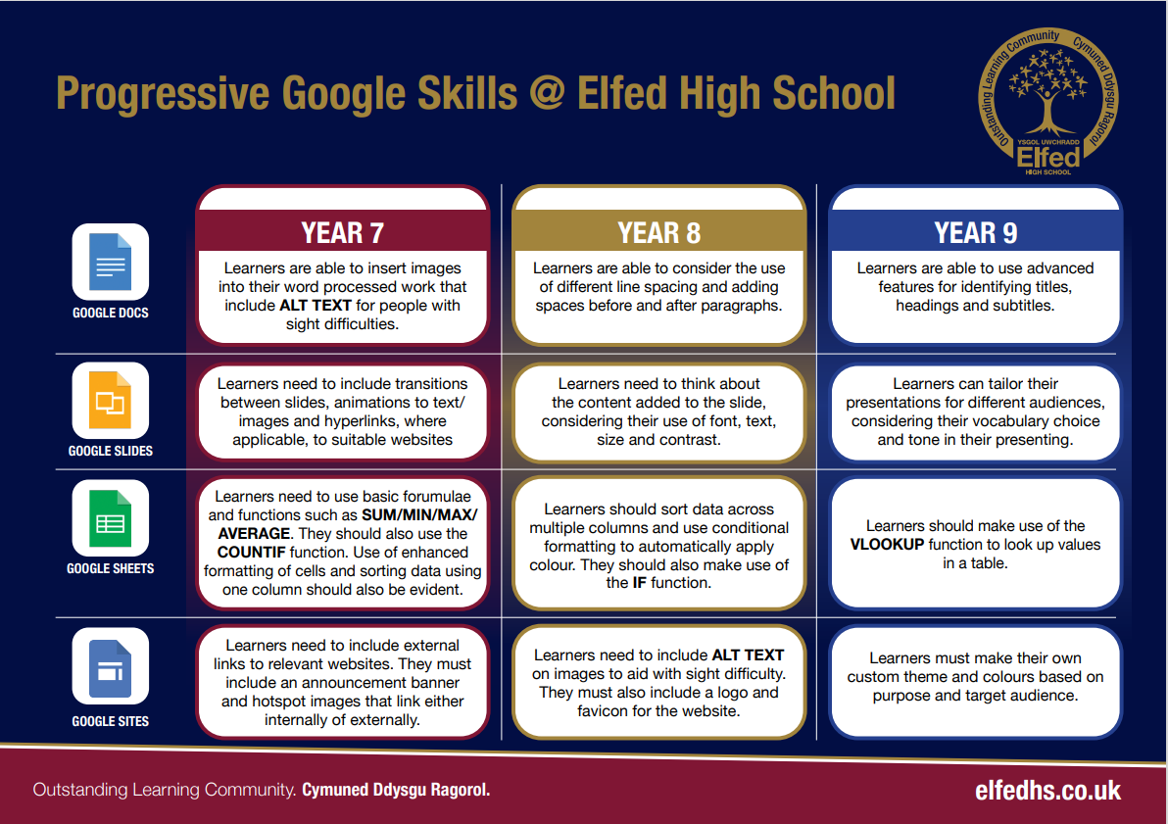


Slide 5
Lower School Plan
Subject: English
Skill: Digital Skills Progression
Term | 1 | 2 | 3
Year 7 |  |  | Learners will create a Google slides presentation for their group presentation promoting Elfed High school. Learners need to think about the transitions between slides, animations to text/images and include hyperlinks to suitable websites.
Year 8
Year 9 |  |  | Learners will create a video news report using Adobe Express including multiple videos in a scene

Slide 6
Lower School
Subject: English
Skill: Literacy Progression
Term | 1 | 2 | 3
Year 9 | GCSE Skills & Poetry I can decode printed and digital texts, considering context, genre and implied meaning. I can read a text aloud varying tone as appropriate. I can identify a wide range of quotations to support a point of view and explore alternative interpretations. I have read at least 6 age-appropriate books by the end of year 9. I can use more complex punctuation (semi colons, colons, brackets, apostrophes) for effect. I spell the high frequency words used in the English language correctly. I can use and spell more sophisticated vocabulary. I know the key terminology in each subject and can accurately spell these words in my books. | Short Stories & Fast Fashion I can decode printed and digital texts, considering context, genre and implied meaning. I can read a text aloud varying tone as appropriate. I can identify a wide range of quotations to support a point of view and explore alternative interpretations. I can use Standard English appropriately to present a point of view. I can organise my talk in a detailed and accurate manner. I can vary my register for a variety of purposes and audiences. I can use Standard English appropriately to present a point of view. I can organise my talk in a detailed and accurate manner. I can vary my register for a variety of purposes and audiences. | Mock Trial & A Christmas Carol I can decode printed and digital texts, considering context, genre and implied meaning. I can read a text aloud varying tone as appropriate. I can identify a wide range of quotations to support a point of view and explore alternative interpretations. I have read at least 6 age-appropriate books by the end of year 9. I can use more complex punctuation (semi colons, colons, brackets, apostrophes) for effect. I spell the high frequency words used in the English language correctly. I can use and spell more sophisticated vocabulary. I know the key terminology in each subject and can accurately spell these words in my books.

Slide 7
Lower School Plan
Subject: English
Skill: Numeracy Progression
Year | Term | Numeracy Task
Year 7
Year 8
Year 9 | 2 | I can interpret a frequency diagram.

Slide 8

Subject: English
Topic: Language Skills
Key Question: What makes an effective description?
Consider what progression step you are pitching your content at when planning your lessons
Knowledge and understanding: Using a range of word classes is required to communicate effectively.
Skills (Writing)
Overview In this unit, the students will be developing their descriptive writing skills through the lens of the adventure genre. They will begin by creating detailed, believable characters who could realistically exist within a high-stakes or challenging setting. Through focused writing activities, students will explore how to bring these characters to life using rich vocabulary, varied sentence structures, and deliberate language choices to convey personality, emotion, and motivation. These characters will serve as strong foundations for future literary tasks, including narrative and extended writing assignments.
The unit will then move into reading skills, with a continued focus on the adventure theme. Students will engage with a range of fiction and non-fiction texts, such as extracts from adventure novels, travel writing, survival accounts, and autobiographical experiences. They will develop key reading skills including synthesis of ideas across texts, comparison of themes and character responses, and drawing impressions using evidence. In preparation for their GCSEs, students will also deepen their understanding of how writers use word class and structural choices for effect, and will be encouraged to analyse language precisely to support thoughtful interpretations.
No. of lessons: 28 Lesson objectives
Limited ability to produce a developed piece of writing
Some ability to produce a developed piece of writing
Secure ability to produce a developed piece of writing to a sophisticated standard
Content
Descriptive techniques | I can identify descriptive techniques. I can use descriptive techniques for effect.
QMA: Character Description | I can demonstrate my understanding of SPaG rules and descriptive techniques.
Reading skills | I can discuss the use of specific sentence structures/words by effectively answering how and impressions questions. I can effectively summarise and synthesise a range of texts. I can compare texts.
SA: Developed character description within narrative extract | I can demonstrate my understanding of SPaG rules and descriptive techniques. I can create a developed and sustained character using language for effect
Displays limited subject knowledge and understanding
Displays some subject knowledge and understanding
Displays secure subject knowledge and understanding
Key Words
Alliteration, simile, personification, repetition, adjective, adverb, verb, noun, connotation, impression, summarise, synthesise, compare.
Health and wellbeing
Information about fitness and the benefits of exercise
Humanities
Discussion of natural world through adventure themed texts
Exploration of Welsh culture through reading texts about Wales
Welsh
Assessments (linked to progression steps)
QMA: Character description S : Writing an effective character description K&U: Demonstrating understanding of SPaG and using wordclass for effect.
SA: Character Description S : Writing an effective character description K&U: Demonstrating understanding of SPaG and using wordclass for effect.
Learning Experiences
Develop an understanding of real life adventure experiences and the emotions that come with them.

