Slide 1
Term​ | 1​ | 2​ | 3​
Biology | 1a DNA and inheritance, Evolution 1b Evolution, response and regulation | 2a Practical exam, treatment and prevention of disease 2b Classification | 3a Revision and exam
Chemistry | 1a Metals and their extraction 1b Bonding, structure and properties | 2a Practical exam, bonding, structure and properties 2b Crude oil | 3a Revision and exam
Physics | 1a Distance, speed and acceleration and Newton’s laws 1b Work and energy | 2a Practical exam, types of radiation, half-life 2b Revision | 3a Revision and exam
Applied Science | 1a Food, materials and processes 1b Task based assessment | 2a Energy, resources and the environment 2b Space, health and life | 3a Revision and exams
We are here

Slide 2
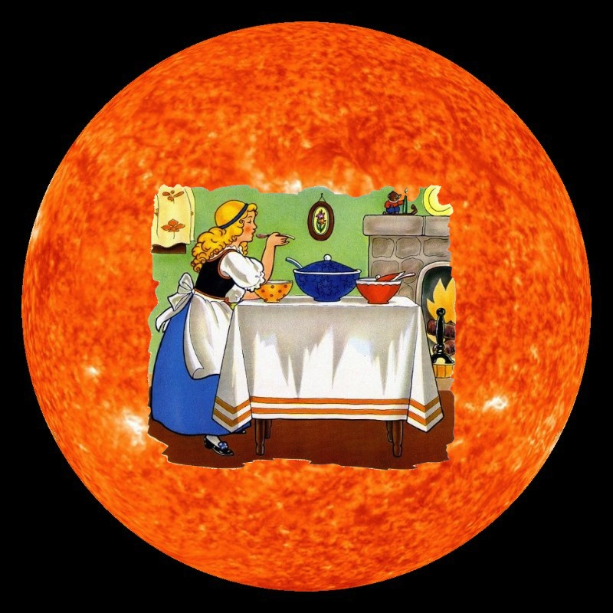
Year 11 Term 1a
Essential Skills for GCSE Science
Knowledge – Understand and recall key biology, chemistry, and physics concepts, facts, and formulae.
Practical Skills – Plan, carry out, and evaluate experiments; measure accurately; record, present, and analyse data.
Maths in Science – Use equations, ratios, percentages, graphs, standard form, and significant figures.
Problem-Solving – Apply knowledge to new situations, interpret data, spot patterns, and evaluate methods.
Communication – Use correct scientific terms, write clear explanations, and respond accurately to exam command words.
Study Skills – Revise effectively, practise exam-style questions, and manage time well.

Slide 3
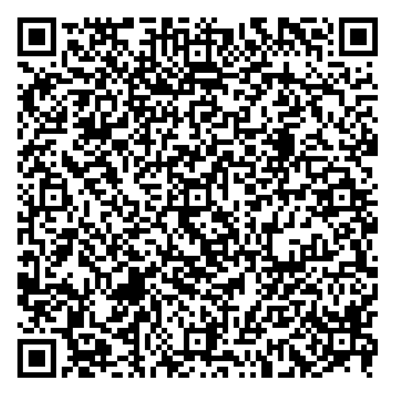
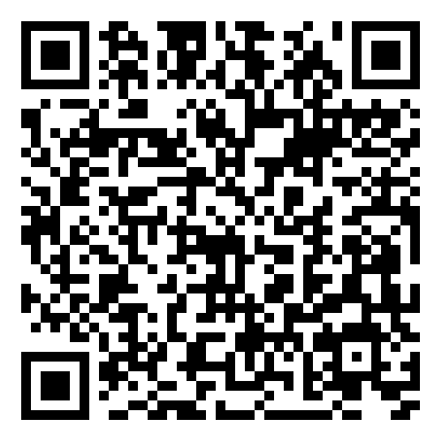
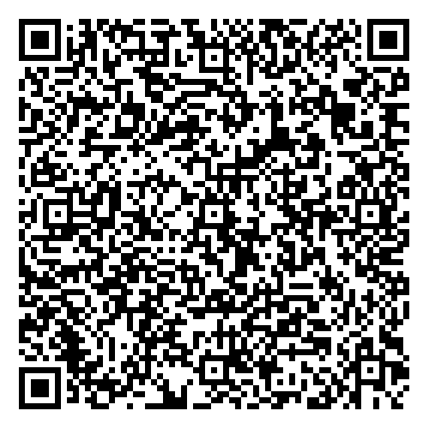
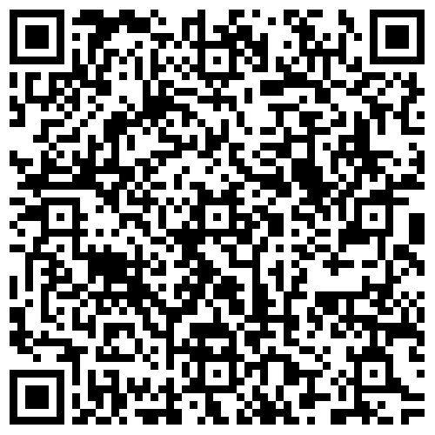
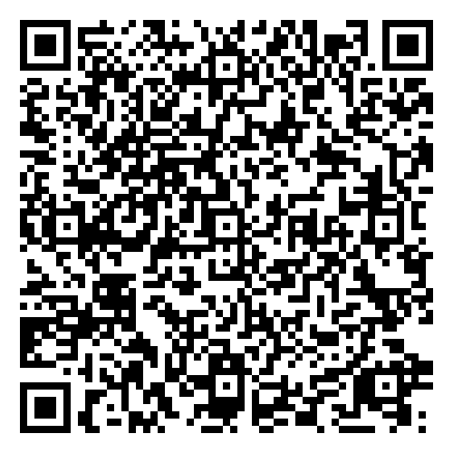
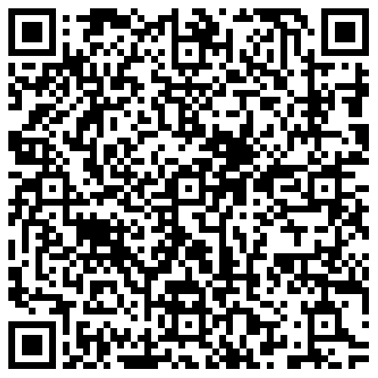
Year 11 Term 1a
Support materials for this unit can be found at:
Subject | Link | QR Code
Biology | https://resources-legacy.wjec.co.uk/Pages/ResourceByArgs.aspx?subId=3&lvlId=2&_gl=1*xlvyx6*_ga*MTkxNjczMjU4Ny4xNzU3NDk0Nzgy*_ga_WVT2ZYV72W*czE3NTgxMDExNTkkbzQkZzEkdDE3NTgxMDExODQkajM1JGwwJGgw
Chemistry | https://filter.resources.wjec.co.uk/en/s/Chemistry?qualification=gcse
Physics | https://resources-legacy.wjec.co.uk/Pages/ResourceByArgs.aspx?subId=24&lvlId=2&_gl=1*88ccfb*_ga*MTkxNjczMjU4Ny4xNzU3NDk0Nzgy*_ga_WVT2ZYV72W*czE3NTgxMDExNTkkbzQkZzEkdDE3NTgxMDE0MDckajU3JGwwJGgw
Applied Science | https://resource.download.wjec.co.uk/vtc/2015-16/15-16_52/eng/Book%201%20-%20PDF/1.%20Applied%20science%20part%201.pdf https://resource.download.wjec.co.uk/vtc/2015-16/15-16_52/eng/Book%202%20-%20PDF/1.%20Applied%20science%20part%202%20EDITED%202.pdf https://resource.download.wjec.co.uk/vtc/2015-16/15-16_52/eng/Book%203%20-%20PDF/1.%20Applied%20science%20part_3.pdf

Slide 4
How can I support my child?
Here are some clear, succinct ways parents/carers can support their child with GCSE Science:
Encourage routine – Set regular times for revision and homework.
Provide resources – Ensure access to revision guides, past papers, and online tools.
Discuss learning – Ask your child to explain topics in their own words.
Support practice – Encourage use of flashcards, quizzes, and exam questions.
Promote organisation – Help create revision timetables and keep notes tidy.
Reinforce maths skills – Support practice with equations, graphs, and calculations.
Boost confidence – Praise effort, not just results, to build resilience.
Create the right environment – Provide a quiet, distraction-free study space.
Stay informed – Know exam dates and key topics to help keep your child on track.

Slide 5
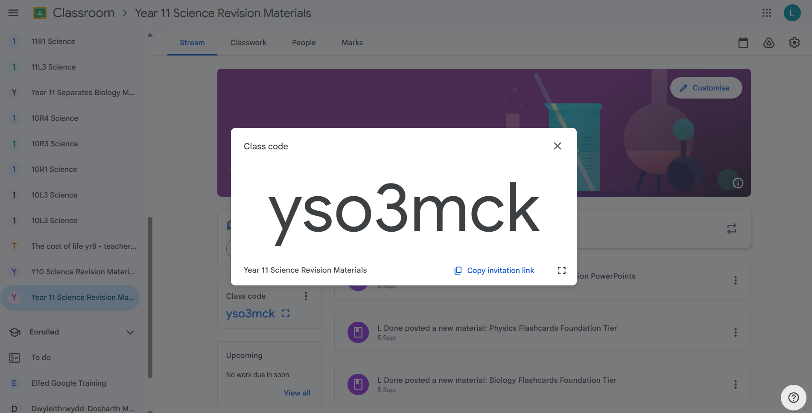
Y11 Science Revision
Google Classroom

Slide 6
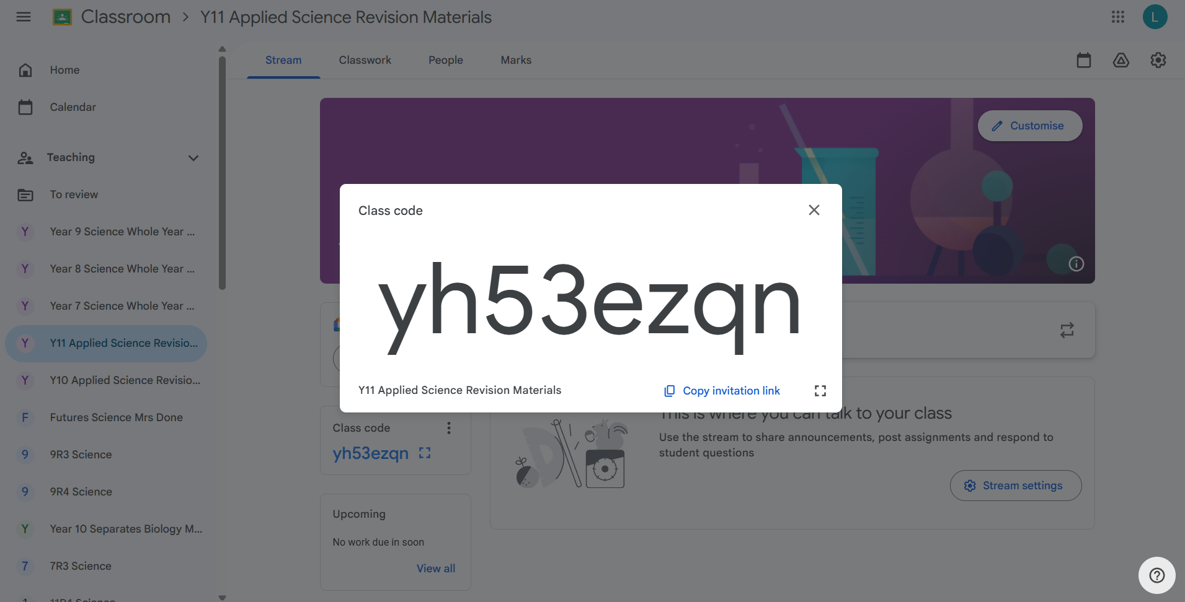
Y11 Applied Science Revision
Google Classroom

Slide 7




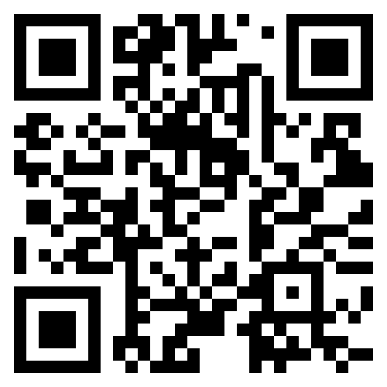
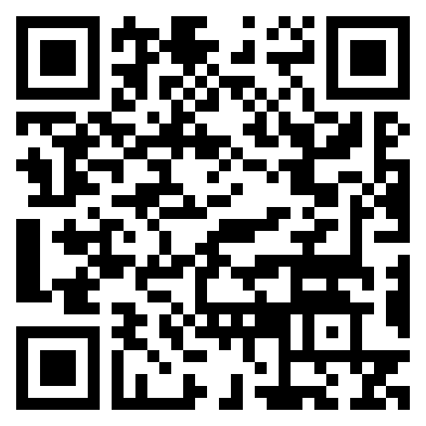
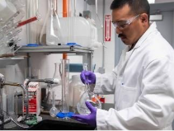
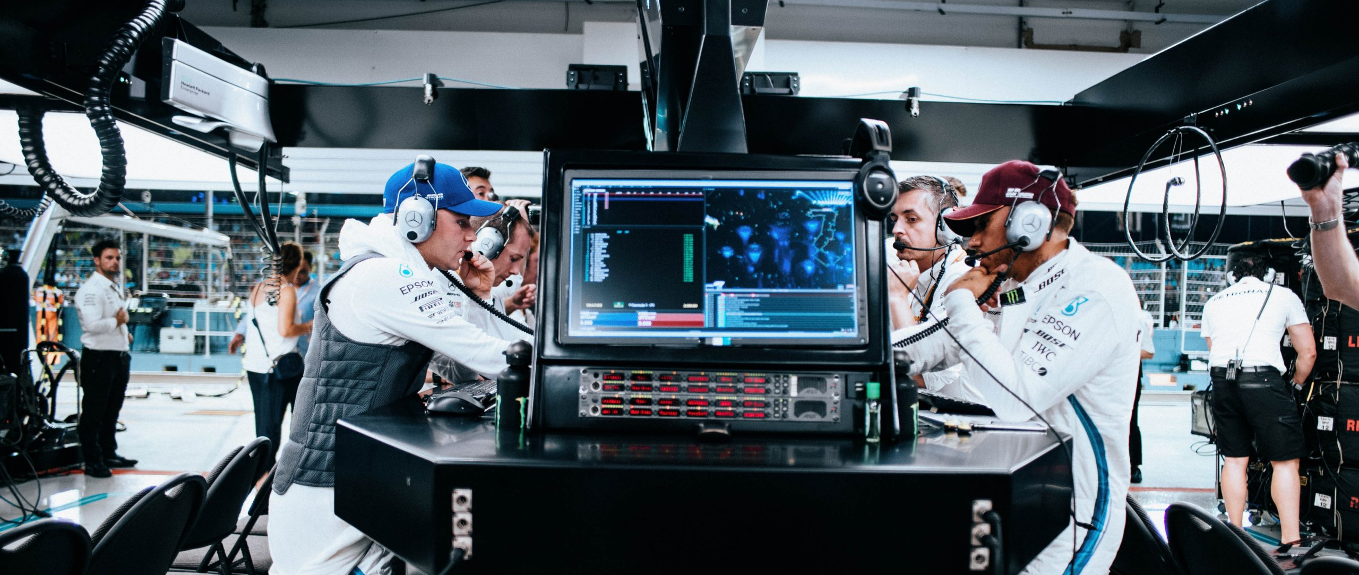

CWRE
STEM careers in Wales span diverse fields like IT, engineering, data science, biology, environmental science, and mathematics, with opportunities found through resources like Careers Wales and Indeed. Key job roles include software developer, civil engineer, data analyst, biomedical scientist, and agricultural consultant. The demand for STEM skills is high in Wales, indicating strong employment prospects for individuals with these qualifications.

Slide 8
The Science Team
Mrs L Simpson Science Technician
Mr R Head Director of Learning Science & Technology
Mrs L Done Science Achievement Lead
Miss K Mort Head of KS3 Science
Miss K Darlington Head of Y10
Mr M Breeze Teacher of Science
Mr N Copping Teacher of Science
Miss S Sage Teacher of Science
Mrs M Davies Teacher of Science

