Slide 1
Term​ | 1​ | 2​ | 3​
Biology | 1a Cells, membrane transport, enzymes and the digestive system 1b Respiratory system | 2a Circulatory system and photosynthesis 2b Ecology | 3a Ecology and revision 3b Exam and Y11 cell division and stem cells
Chemistry | 1a Atomic structure and the periodic table 1b Foundation calculations | 2a Water 2b Rates of reaction | 3a Group 1,7 and 0, higher calculations and revision 3b Exam and Y11 endo and exothermic reactions
Physics | 1a Electric circuits 1b Generating electricity | 2a Domestic electricity 2b Features of waves | 3a Making use of energy and revision 3b Exam and Y11 Earth and space
Applied Science | 1a/b Energy resources and the environment | 2a/b Space, health and life | 3a Revision and study of pre-release paper 3b Exam and Y11 food, materials and processes
We are here

Slide 2
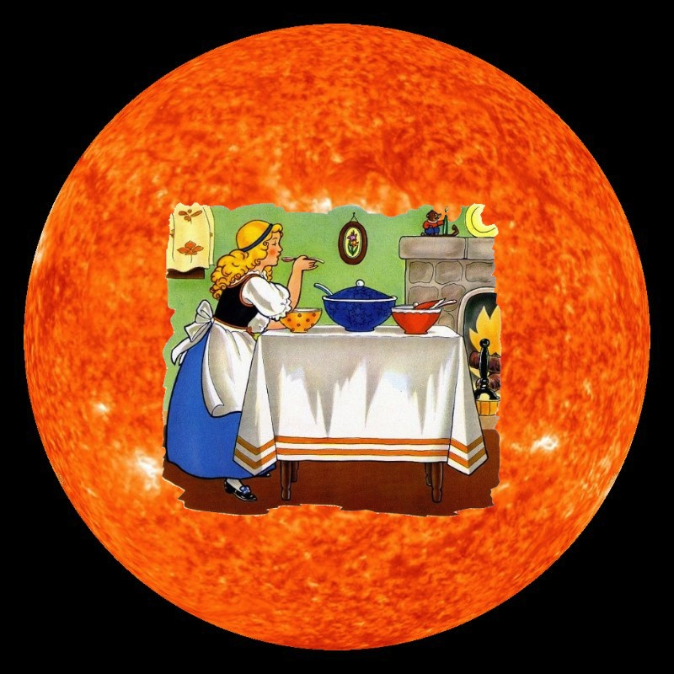
Year 10 Term 1a
Essential Skills for GCSE Science
Knowledge – Understand and recall key biology, chemistry, and physics concepts, facts, and formulae.
Practical Skills – Plan, carry out, and evaluate experiments; measure accurately; record, present, and analyse data.
Maths in Science – Use equations, ratios, percentages, graphs, standard form, and significant figures.
Problem-Solving – Apply knowledge to new situations, interpret data, spot patterns, and evaluate methods.
Communication – Use correct scientific terms, write clear explanations, and respond accurately to exam command words.
Study Skills – Revise effectively, practise exam-style questions, and manage time well.

Slide 3
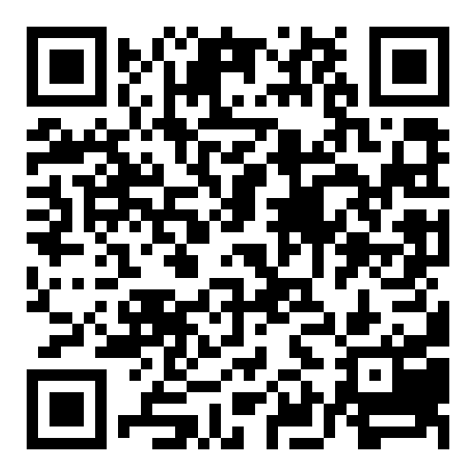
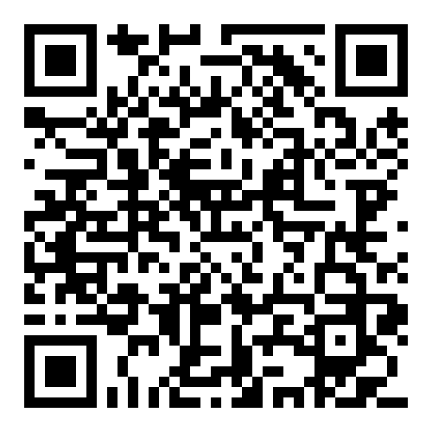
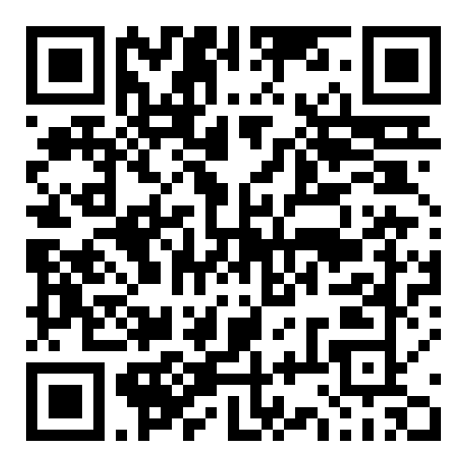
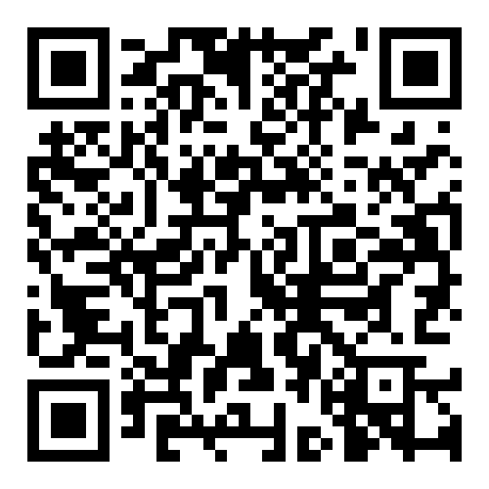
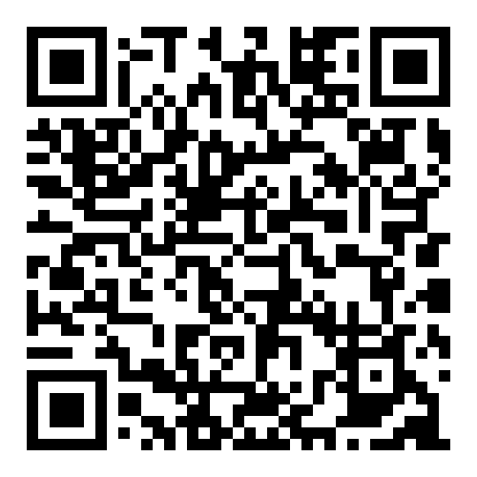
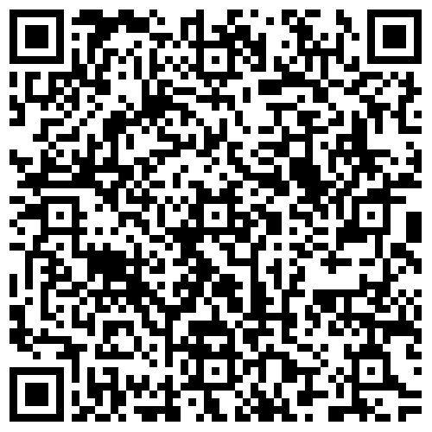
Year 10 Term 1a
Support materials for this unit can be found at:
Subject | Link | QR Code
Biology | https://d3kp6tphcrvm0s.cloudfront.net/el21-22_1-8 https://d3kp6tphcrvm0s.cloudfront.net/el21-22_1-10
Chemistry | https://dzwti2kfl5pz5.cloudfront.net/el21-22_2-2 https://d3kp6tphcrvm0s.cloudfront.net/el21-22_2-5
Physics | https://d3kp6tphcrvm0s.cloudfront.net/el21-22_3-6
Applied Science | https://resource.download.wjec.co.uk/vtc/2015-16/15-16_52/eng/Book%201%20-%20PDF/1.%20Applied%20science%20part%201.pdf

Slide 4
How can I support my child?
Here are some clear, succinct ways parents/carers can support their child with GCSE Science:
Encourage routine – Set regular times for revision and homework.
Provide resources – Ensure access to revision guides, past papers, and online tools.
Discuss learning – Ask your child to explain topics in their own words.
Support practice – Encourage use of flashcards, quizzes, and exam questions.
Promote organisation – Help create revision timetables and keep notes tidy.
Reinforce maths skills – Support practice with equations, graphs, and calculations.
Boost confidence – Praise effort, not just results, to build resilience.
Create the right environment – Provide a quiet, distraction-free study space.
Stay informed – Know exam dates and key topics to help keep your child on track.

Slide 5
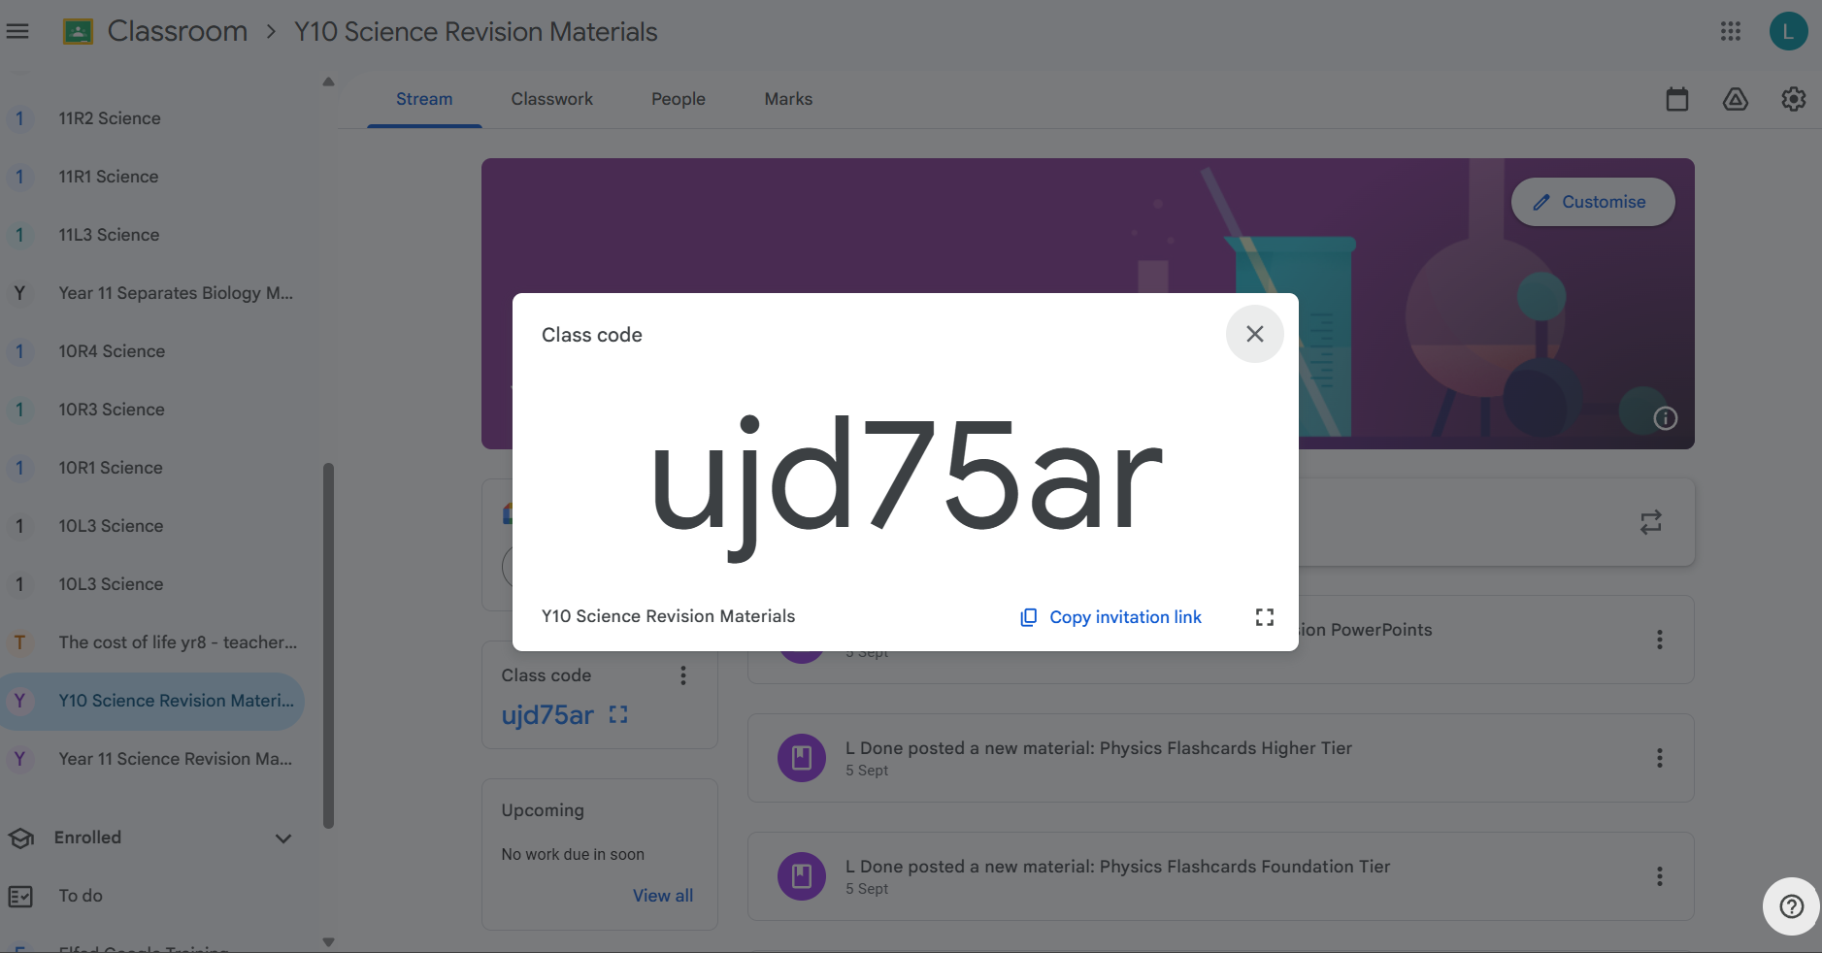
Y10 Science Revision
Google Classroom

Slide 6
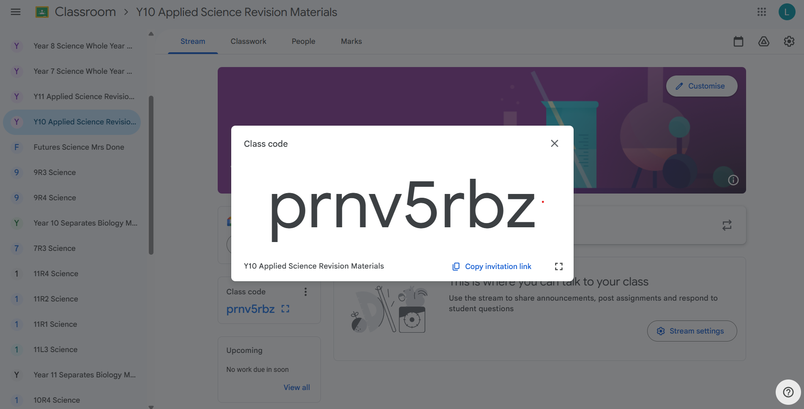
Y10 Applied Science Revision
Google Classroom

Slide 7




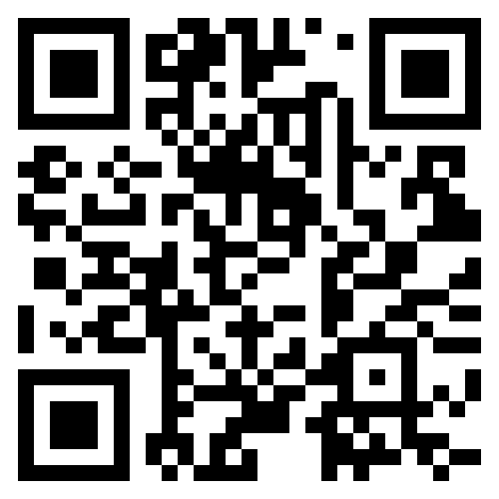
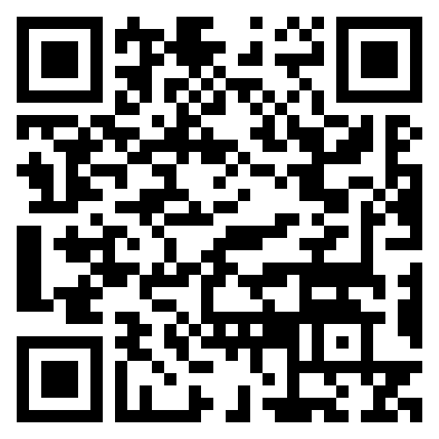
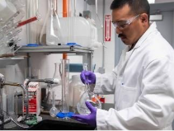
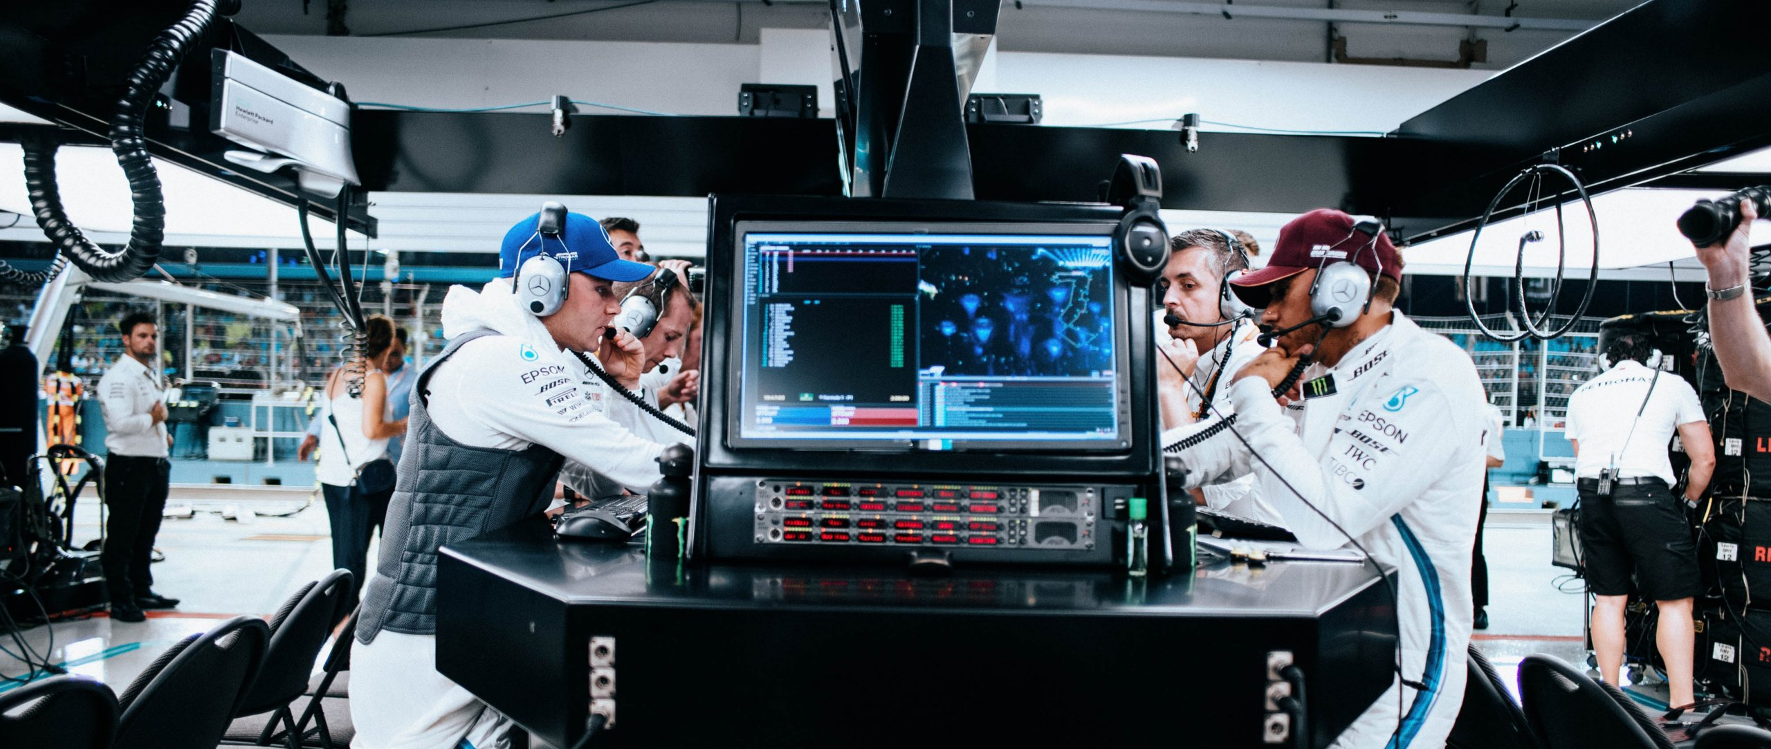

CWRE
STEM careers in Wales span diverse fields like IT, engineering, data science, biology, environmental science, and mathematics, with opportunities found through resources like Careers Wales and Indeed. Key job roles include software developer, civil engineer, data analyst, biomedical scientist, and agricultural consultant. The demand for STEM skills is high in Wales, indicating strong employment prospects for individuals with these qualifications.

Slide 8
The Science Team
Mrs L Simpson Science Technician
Mr R Head Director of Learning Science & Technology
Mrs L Done Science Achievement Lead
Miss K Mort Head of KS3 Science
Miss K Darlington Head of Y10
Mr M Breeze Teacher of Science
Mr N Copping Teacher of Science
Miss S Sage Teacher of Science
Mrs M Davies Teacher of Science

