Slide 1

WB Plan – Lower School
Careers
Term | 1 | 2 | 3
Year 7 | 1a: Who am I? 1b. Exploring Possibilities – Dream Jobs! | 2a. What is a career in my subject? 2b. What is an entrepreneur? Can my subject lead me to be one? | 3a. What is work-life balance? 3b. Careers and the future
Year 8 | 1a. What are my interests? 1b. Job applications and CV’s – how can my subject enhance mine? | 2a. Challenges and rewards of work 2b. Creating the life you want – how can skill development in my subject help? Create a vision board | 3a. What does success mean to me? What does it look like in my subject? 3b. Careers and the climate
Year 9 | 1a. What are my skills? 1b. What comes after school? Learning pathways for my subject | 2a. Decision making – choosing what to study at KS4. 2b. Taking control of your career journey. How to overcome potential barriers | 3a. Working and earning, managing your money 3b. What is the labour market and what is it saying about jobs in your subject sector?

Slide 2
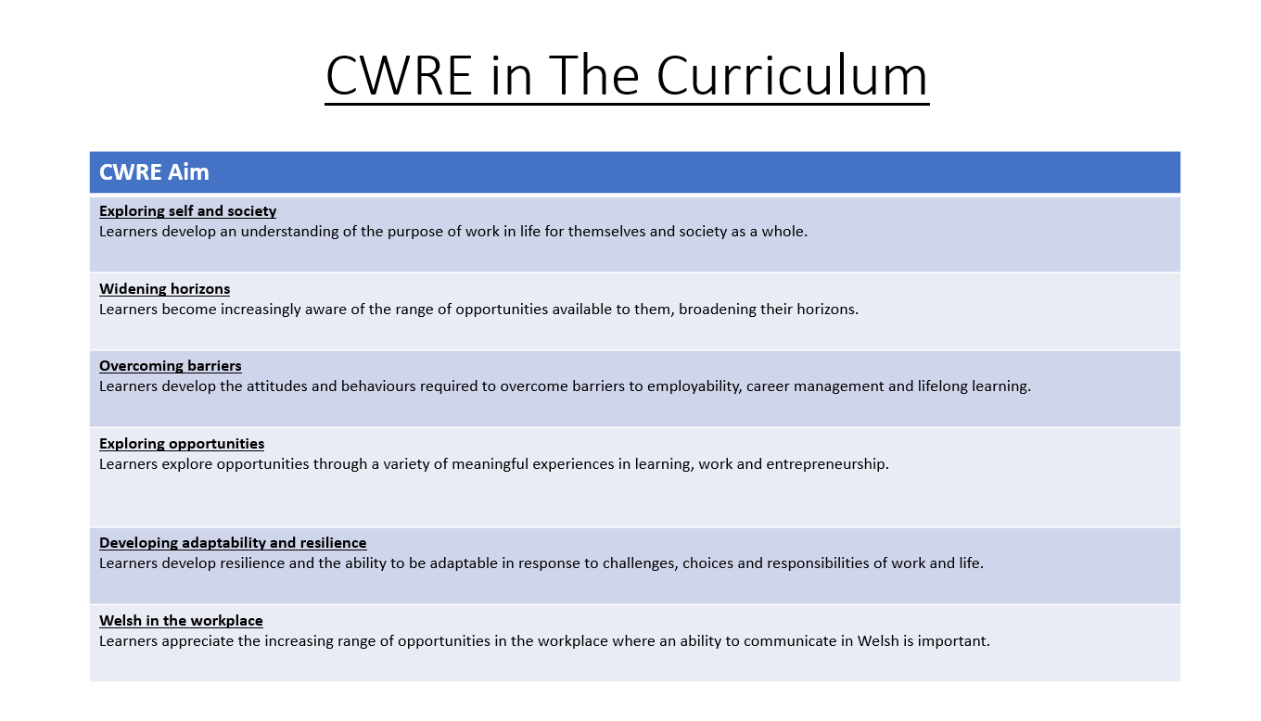

Slide 3
WB Plan Upper School
Careers
Term | 1 | 2 | 3
Year 10 | 1a: Interests and Skills Profile – what makes you good at this subject? How will your skills transfer into the world of work? 1b. Preparing to go on work experience. How is skill development in my subject helping you prepare? | 2a. In person, hybrid, remote. What works best for your subject sector? 2b. Taking control of your career journey. How to overcome potential barriers | 3a. Wellbeing in the workplace. Discuss jobs linked to your subject and the possible challenges employees may face. 3b. What are my employability skills? How does my subject make students employable.
Year 11 | 1a. Post 16 Choices in my subject 1b. Decision making – choosing your post 16 pathway. What pathways are available linked to your subject? | 2a. Money talks – apprenticeships vs higher education in your subject

Slide 4
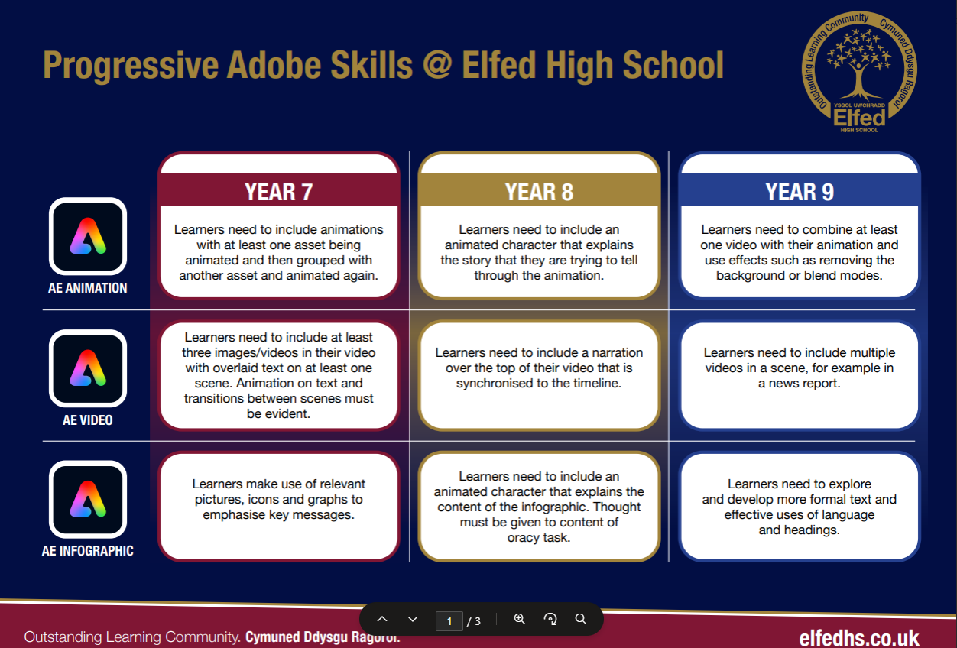

Slide 5
WB Plan
DCF Tasks
Year Group | Task
Year 7 | Term 3A – relationships Students to create an infographic using Adobe software about healthy and safe relationships. Students will use picture, icon and graphs in their infographic Link with further info about the task and resources:
Year 8 | Term 3A – relationships Students to create an infographic using Adobe software about healthy and safe relationships. Students will use picture, icon and graphs in their infographic, it will also include an animated character. Link with further info about the task and resources:
Year 9 | Term 3A – relationships Students to create an infographic using Adobe software about healthy and safe relationships. Students will use picture, icon and graphs in their infographic, it will also include an animated character. Text must have headings and laguage must be formal. Link with further info about the task and resources:

Slide 6
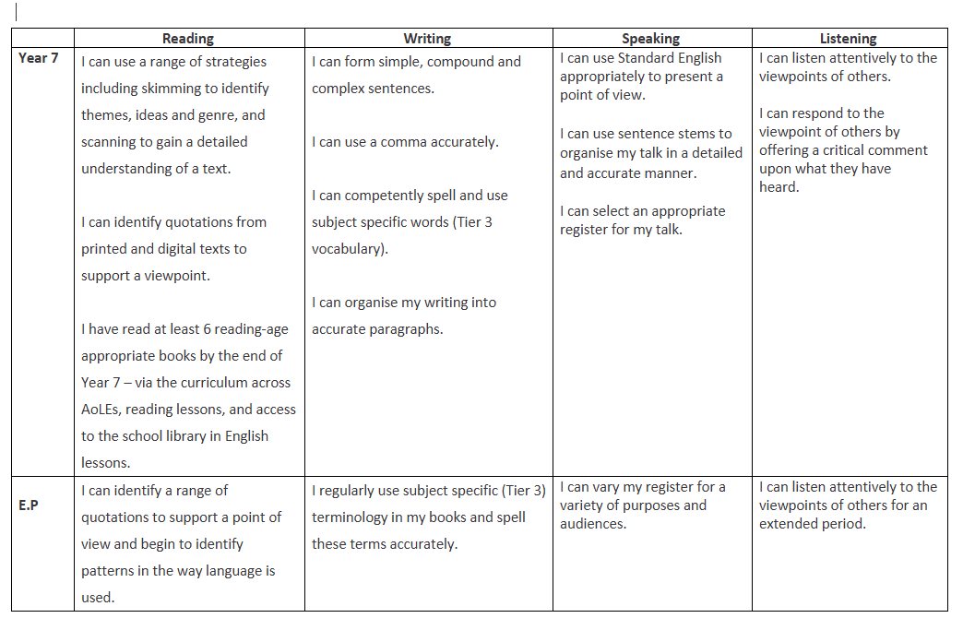
WB Plan
Literacy Progression

Slide 7
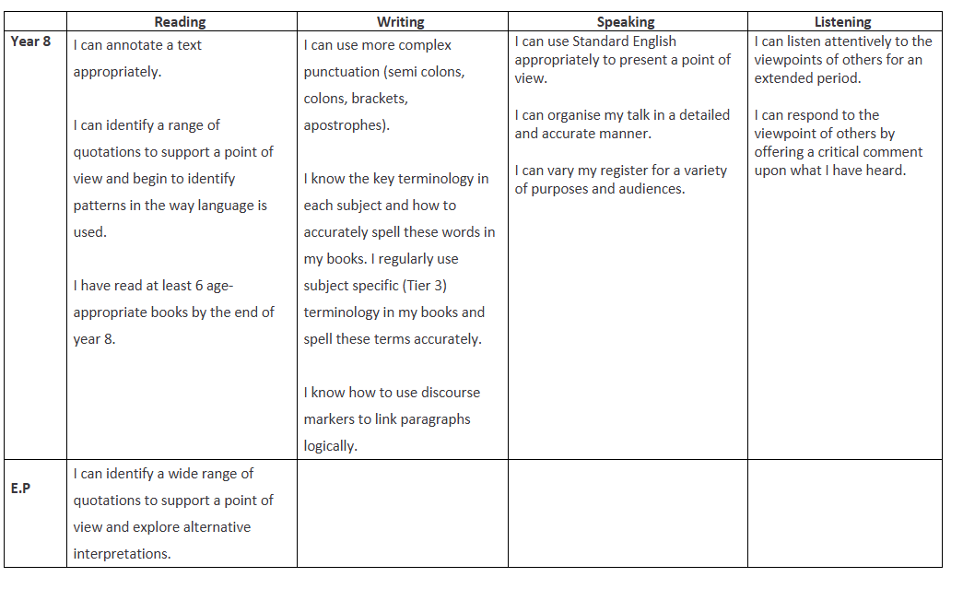
WB Plan
Literacy Progression

Slide 8
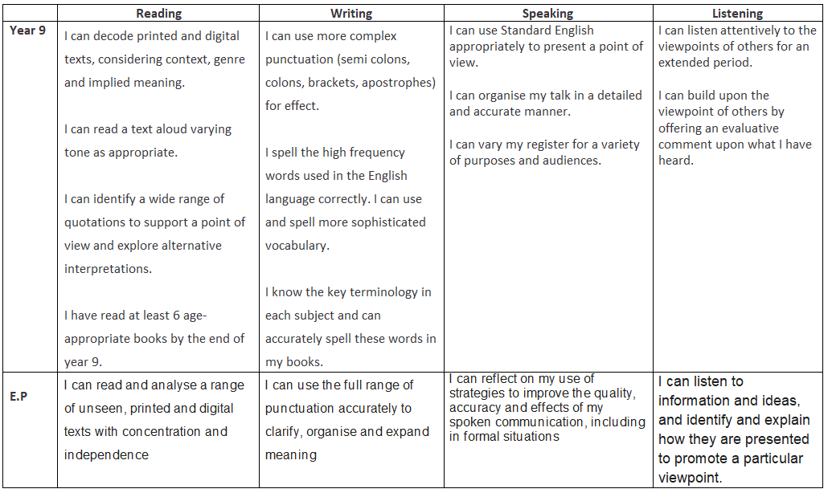
WB Plan
Literacy Progression

Slide 9
WB Plan
Literacy Progression
Year Group | Term 1: Changing Me | Term 2: Dreams and Goals | Term 3: Relationships
Year 7 | Vocabulary: growth, puberty, emotions Literacy: Label diagrams, storytelling Oracy: Express feelings, share ideas, listen actively | Vocabulary: goals, ambition, resilience Literacy: Simple paragraphs, word banks Oracy: Discuss aspirations, use sentence starters | Vocabulary: friendship, trust, empathy Literacy: Role-play, dialogue writing Oracy: Turn-taking, expressing opinions, asking questions
Year 8 | Vocabulary: reproduction, consent, body image Literacy: Cause/effect writing, descriptive texts Oracy: Ask probing questions, confident group sharing | Vocabulary: perseverance, challenges, teamwork Literacy: Persuasive language intro, paragraph writing Oracy: Present arguments, polite disagreement | Vocabulary: boundaries, support, conflict Literacy: Formal/informal tone, case studies Oracy: Negotiate viewpoints, clarify ideas
Year 9 | Vocabulary: fertilisation, contraception, relationships Literacy: Research projects, explanatory texts Oracy: Present findings, use technical language | Vocabulary: ambition, motivation, self-belief Literacy: Narrative writing, conditional sentences Oracy: Persuade and negotiate, use direct speech | Vocabulary: intimacy, peer pressure, negotiation Literacy: Narrative writing, conditional sentences Oracy: Manage turn-taking, reasoned arguments
Year 10 | Vocabulary: sexual health, emotional wellbeing Literacy: Reflective journaling, varied sentences Oracy: Facilitate discussions, articulate viewpoints | Vocabulary: equality, justice, wellbeing Literacy: Analytical writing, persuasive techniques Oracy: Lead discussions, evaluate viewpoints | Vocabulary: commitment, consent, healthy/unhealthy Literacy: Formal reports, subjunctive voice Oracy: Deliver presentations, summarize orally
Year 11 | Vocabulary: parenthood, body autonomy, lifelong changes Literacy: Research presentations, comparative writing Oracy: Confident presentations, handle questions | Vocabulary: identity, social justice, mental health Literacy: Critical analysis, audience adaptation Oracy: Sophisticated debates, rhetorical techniques | Vocabulary: long-term relationships, self-respect, consent Literacy: Evaluative essays, advanced discourse markers Oracy: Lead formal discussions, synthesize ideas

Slide 10
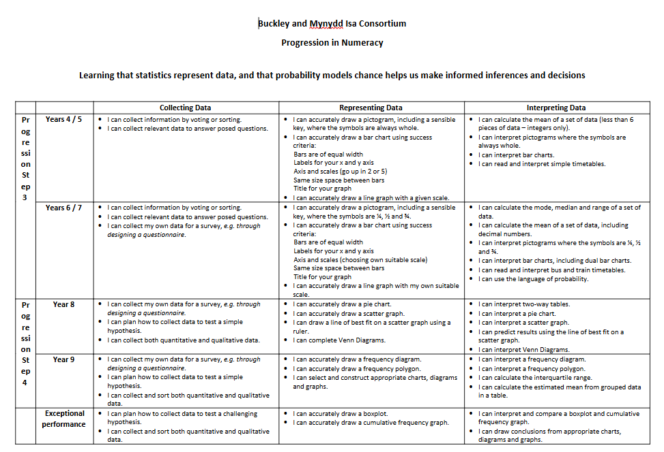

Slide 11
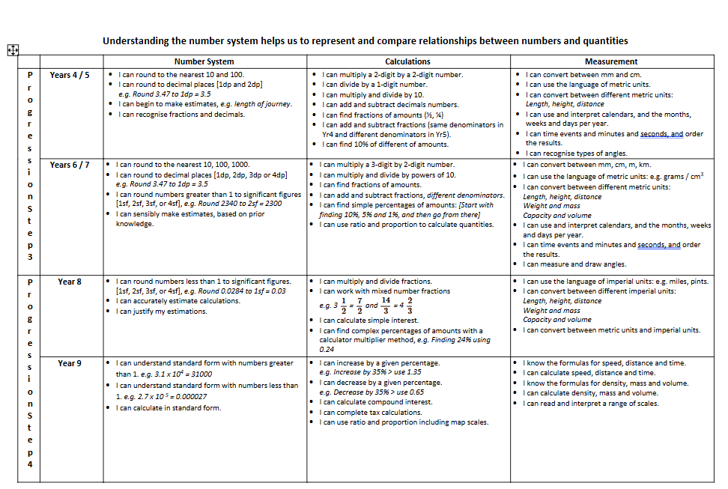

Slide 13
WB Plan
Numeracy Progression
Year Group | Task
Year 7 | Pictograms – Healthy Me topic Pictogram: Students will represent data visually using symbols or pictures, making it easy to compare quantities at a glance. Link with further info about the task and resources: Numeracy - Wellbeing (2)
Year 8 | 2 way tables – Healthy Me Two-Way Table: Students will organise and compare data involving two different categories to identify patterns or relationships. Link with further info about the task and resources: Numeracy - Wellbeing (2)
Year 9 | Graphs - Healthy Me Selecting which type of graph they can use and will best show their set of data about medicating Link with further info about the task and resources: Numeracy - Wellbeing (2)

Slide 14
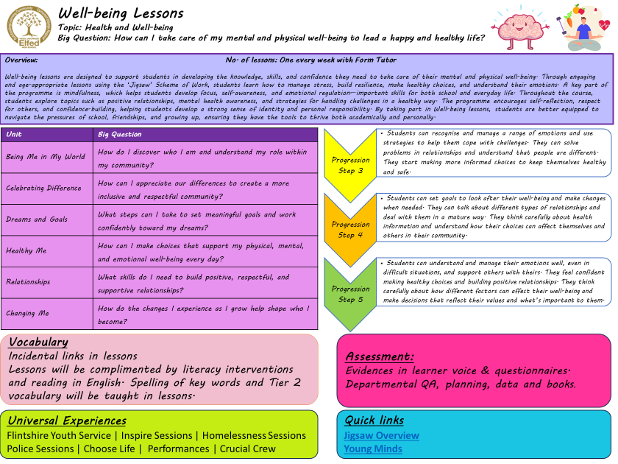

Slide 15
Subject: Well-being
Overview of Topics
Term | 1A | 1B | 2A | 2B | 3A | 3B
Year 7 | Being me in My World | Celebrating Difference | Dreams and Goals | Healthy me | Relationships | Changing me
Year 8 | Being me in My World | Celebrating Difference | Dreams and Goals | Healthy me | Relationships | Changing me
Year 9 | Being me in My World | Celebrating Difference | Dreams and Goals | Healthy me | Relationships | Changing me
Year 10 | Being me in My World | Celebrating Difference | Dreams and Goals | Healthy me | Relationships | Changing me
Year 11 | Being me in My World | Dreams and Goals | Healthy me | Relationships

