Slide 1

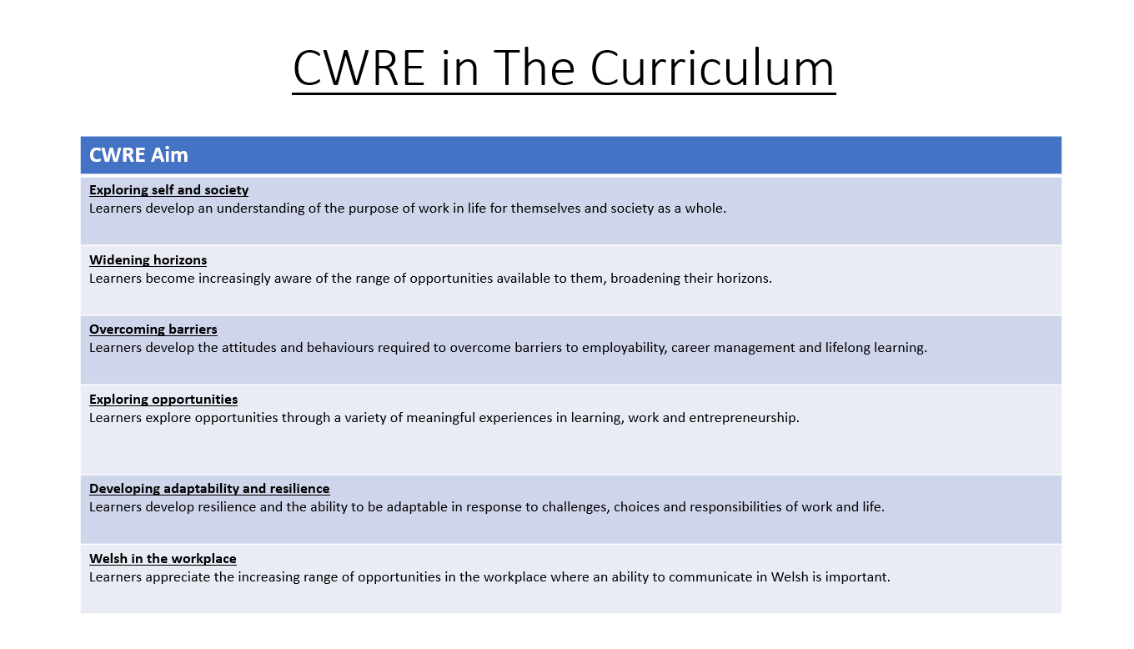

Slide 2
Lower School Plan
Subject: English
CWRE Progression
Term | 1 | 2 | 3
Year 7 | 1a: Who am I? 1b. Exploring Possibilities – Dream Jobs! | 2a. What is a career in my subject? 2b. What is an entrepreneur? Can my subject lead me to be one? | 3a. What is work-life balance? 3b. Careers and the future
Year 8 | 1a. What are my interests? 1b. Job applications and CV’s – how can my subject enhance mine? | 2a. Challenges and rewards of work 2b. Creating the life you want – how can skill development in my subject help? Create a vision board | 3a. What does success mean to me? What does it look like in my subject? 3b. Careers and the climate
Year 9 | 1a. What are my skills? 1b. What comes after school? Learning pathways for my subject | 2a. Decision making – choosing what to study at KS4. 2b. Taking control of your career journey. How to overcome potential barriers | 3a. Working and earning, managing your money 3b. What is the labour market and what is it saying about jobs in your subject sector?

Slide 3
Upper School Plan
Subject: English
CWRE Progression
Term | 1 | 2 | 3
Year 10 | 1a: Interests and Skills Profile – what makes you good at this subject? How will your skills transfer into the world of work? 1b. Preparing to go on work experience. How is skill development in my subject helping you prepare? | 2a. In person, hybrid, remote. What works best for your subject sector? 2b. Taking control of your career journey. How to overcome potential barriers | 3a. Wellbeing in the workplace. Discuss jobs linked to your subject and the possible challenges employees may face. 3b. What are my employability skills? How does my subject make students employable.
Year 11 | 1a. Post 16 Choices in my subject 1b. Decision making – choosing your post 16 pathway. What pathways are available linked to your subject? | 2a. Money talks – apprenticeships vs higher education in your subject

Slide 4
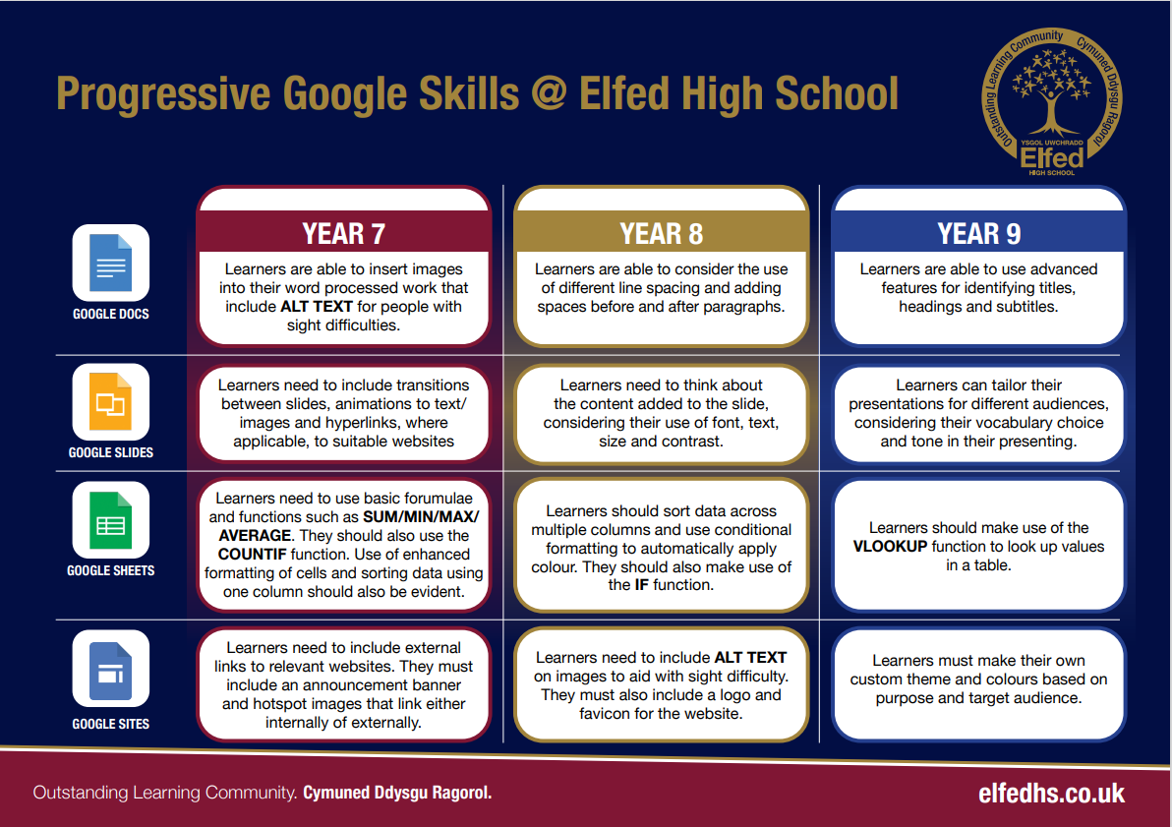


Slide 5
Lower School Plan
Subject: English
Skill: Digital Skills Progression
Term | 1 | 2 | 3
Year 7 |  |  | Learners will create a Google slides presentation for their group presentation promoting Elfed High school. Learners need to think about the transitions between slides, animations to text/images and include hyperlinks to suitable websites.
Year 8
Year 9 |  |  | Learners will create a video news report using Adobe Express including multiple videos in a scene

Slide 6
Lower School
Subject: English
Skill: Literacy Progression
Term | 1 | 2 | 3
Year 7 | Monologues and Poetry: I can form simple, compound and complex sentences. I can use a comma accurately. I can competently spell and use subject specific words (Tier 3 vocabulary). I can organise my writing into accurate paragraphs. I can use a range of strategies including skimming to identify themes, ideas and genre, and scanning to gain a detailed understanding of a text. I can identify quotations from printed and digital texts to support a viewpoint. I have read at least 6 reading-age appropriate books by the end of Year 7 – via the curriculum across AoLEs, reading lessons, and access to the school library in English lessons. | Gothic Fiction & Coraline I can form simple, compound and complex sentences. I can use a comma accurately. I can competently spell and use subject specific words (Tier 3 vocabulary). I can organise my writing into accurate paragraphs. I can use a range of strategies including skimming to identify themes, ideas and genre, and scanning to gain a detailed understanding of a text. I can identify quotations from printed and digital texts to support a viewpoint. I have read at least 6 reading-age appropriate books by the end of Year 7 – via the curriculum across AoLEs, reading lessons, and access to the school library in English lessons. | Oracy I can use Standard English appropriately to present a point of view. I can use sentence stems to organise my talk in a detailed and accurate manner. I can select an appropriate register for my talk. I can listen attentively to the viewpoints of others. I can respond to the viewpoint of others by offering a critical comment upon what they have heard.

Slide 7
Lower School Plan
Subject: English
Skill: Numeracy Progression
Year | Term | Numeracy Task
Year 7
Year 8
Year 9 | 2 | I can interpret a frequency diagram.

Slide 8

Subject: English
Topic: Monologues
Key Question: What makes an effective monologue?
Consider what progression step you are pitching your content at when planning your lessons
Knowledge and understanding: Using a range of word classes is required to communicate effectively.
Making links: between my identity and the Welsh culture.
Overview: In this unit pupils will learn about the importance of expressing ourselves through language. Students will have a grammatical focus on the effective use of word class and sentence structure to convey meaning and express one's ideas, look at a variety of Welsh myths and legends to discuss how authors present identity and use this to create a monologue in which they present a character's identity.
No. of lessons: 28 Lesson objectives
I have limited understanding of key cultural texts.
I have some understanding of key cultural texts.
I have consistent understanding of a range of key cultural texts.
Content
Introduction of word classes | I can identify different types of word classes. I can identify proper nouns in Welsh.
QMA: Baseline Vernon spelling test and autobiographical writing task. | I can demonstrate my understanding of SPaG rules.
Discuss the effects of using specific sentence structures and vocabulary choices. | I can discuss the use of specific sentence structures/words.
Analyse the use of specific words/sentence structure for effect through discussing a range of Welsh role models, myths and legends. | I can analyse how words and syntax can be used to convey meaning and ideas.
Write empathetically, using descriptive techniques for effect. | I can use a range of word class, sentence structure and descriptive techniques in my work. I can write effectively using specific words and techniques.
Learn how to write a monologue. | I can identify the features of a monologue. I can understand why they are used as a literary device. I can infer meaning and form predictions when analysing dramatic monologues.
SA: Write an extract from a monologue. | I can plan and produce an effective dramatic monologue using an array of techniques, word classifications and sentence structures.
I have a limited understanding of word classes and their impact.
I have some understanding of word classes and their impact.
I have consistent understanding of word classes and their impact.
Key Words
Autobiography, memoir, biography, perspective, monologue, noun, verb, adjective, hero, villain, simile, metaphor.
Health and wellbeing
Understanding of own identity and place within the Welsh community.
Humanities
Discussion of famous Welsh heritage sites.
Exploration of Welsh culture and identity through literature. Key words in Welsh.
Welsh
Assessments (linked to progression steps)
QMA: Vernon spelling test and autobiographical piece: ML: expressing one's identity through word. K&U: Demonstrating understanding of SPaG.
SA: Writing a dramatic monologue. ML: Writing from the point of view of a mythical Welsh character. K&U: Demonstrating understanding of SPaG.
Learning Experiences
Universal Experience
Cynefin – a greater understanding of Welsh culture and identity.

