Slide 1

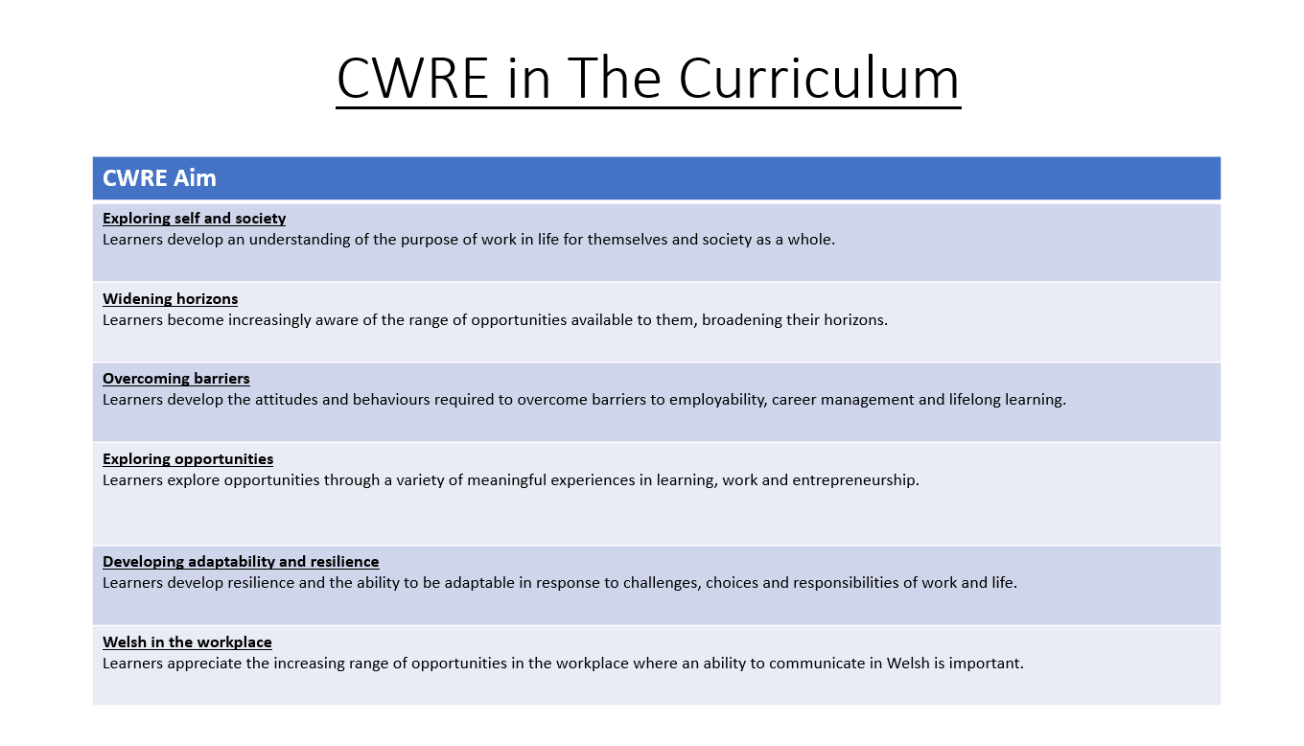

Slide 2
Lower School Plan
Subject: CWRE Progression
Term | 1 | 2 | 3
Year 7 | 1a: Who am I? 1b. Exploring Possibilities – Dream Jobs! | 2a. What is a career in my subject? 2b. What is an entrepreneur? Can my subject lead me to be one? | 3a. What is work-life balance? 3b. Careers and the future
Year 8 | 1a. What are my interests? 1b. Job applications and CV’s – how can my subject enhance mine? | 2a. Challenges and rewards of work 2b. Creating the life you want – how can skill development in my subject help? Create a vision board | 3a. What does success mean to me? What does it look like in my subject? 3b. Careers and the climate
Year 9 | 1a. What are my skills? 1b. What comes after school? Learning pathways for my subject | 2a. Decision making – choosing what to study at KS4. 2b. Taking control of your career journey. How to overcome potential barriers | 3a. Working and earning, managing your money 3b. What is the labour market and what is it saying about jobs in your subject sector?

Slide 3
Upper School Plan
Subject: CWRE Progression
Term | 1 | 2 | 3
Year 10 | 1a: Interests and Skills Profile – what makes you good at this subject? How will your skills transfer into the world of work? 1b. Preparing to go on work experience. How is skill development in my subject helping you prepare? | 2a. In person, hybrid, remote. What works best for your subject sector? 2b. Taking control of your career journey. How to overcome potential barriers | 3a. Wellbeing in the workplace. Discuss jobs linked to your subject and the possible challenges employees may face. 3b. What are my employability skills? How does my subject make students employable.
Year 11 | 1a. Post 16 Choices in my subject 1b. Decision making – choosing your post 16 pathway. What pathways are available linked to your subject? | 2a. Money talks – apprenticeships vs higher education in your subject

Slide 4
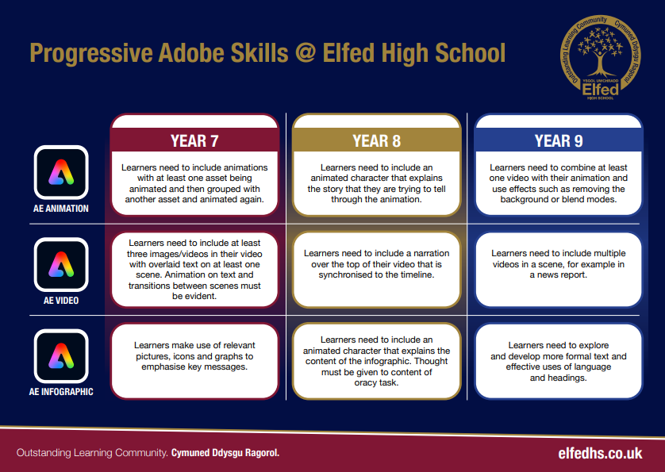

Slide 5
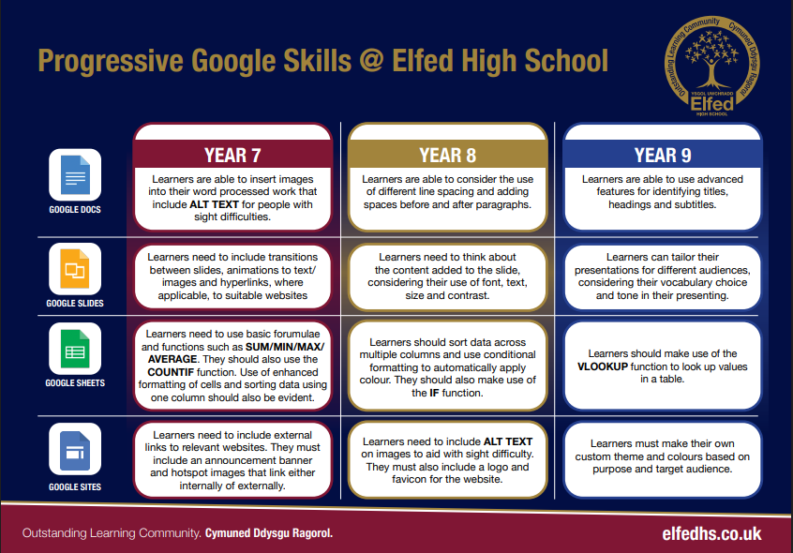

Slide 6
Lower School Plan
Subject: RVE DCF
Term | 1 | 2 |  | 3
Year 7 | Creation stories from alternative religions or worldviews Using search techniques and a variety of sources.
Year 8 |  |  | Anthony Walker news article Learners are able to consider the use of different line spacing and adding spaces before and after paragraphs.
Year 9 |  |  | Humanism infographic Learners need to use formal text and effective use of language and headings.

Slide 7
Lower School Plan
Subject: RVE Literacy
Term | 1 | 2 |  | 3
Year 7 | Writing - Extended writing about the existence of God I can form simple, compound and complex sentences. I can competently spell and use subject specific words (Tier 3 vocabulary). I can organise my writing into accurate paragraphs. Speaking & Listening - DEBATE I can use Standard English appropriately to present a point of view, listen and respond. | Speaking & Listening – PRESENTSATION & PITCH on multi faith space design. I can use Standard English appropriately to present a point of view, listen and respond. |  | Writing - Extended writing about religion in Wales I can form simple, compound and complex sentences. I can competently spell and use subject specific words (Tier 3 vocabulary). I can organise my writing into accurate paragraphs.
Year 8 | Writing - Extended writing about the existence of Jesus I know the key terminology in each subject and how to accurately spell these words in my books. I regularly use subject specific (Tier 3) terminology in my books and spell these terms accurately. I know how to use discourse markers to link paragraphs logically. Speaking & Listening - COLLABORATIVE INQUIRY - I can use Standard English appropriately to present a point of view, listen and respond. |  | Writing - Extended writing about equality I know the key terminology in each subject and how to accurately spell these words in my books. I regularly use subject specific (Tier 3) terminology in my books and spell these terms accurately. I know how to use discourse markers to link paragraphs logically. Speaking & Listening – CAMPAIGN - I can use Standard English appropriately to present a point of view, listen and respond.
Year 9 | Writing - Extended writing about the afterlife I know the key terminology in each subject and can accurately spell these words in my books. I know how to use discourse markers to link paragraphs logically. |  | Writing - Extended writing about the Humanism I know the key terminology in each subject and can accurately spell these words in my books. I know how to use discourse markers to link paragraphs logically.

Slide 8
Lower School Plan
Subject: RVE Numeracy
Term | 1 | 2 |  | 3
Year 7 | n/a | n/a |  | Religion in Wales: I can interpret bar charts, including dual bar charts.
Year 8 | n/a |  | Equality, discrimination & prejudice: I can collect my own data for a survey, e.g. through designing a questionnaire.
Year 9 | n/a |  | Worldviews across Wales: I can interpret a frequency diagram.

Slide 9
