Slide 1
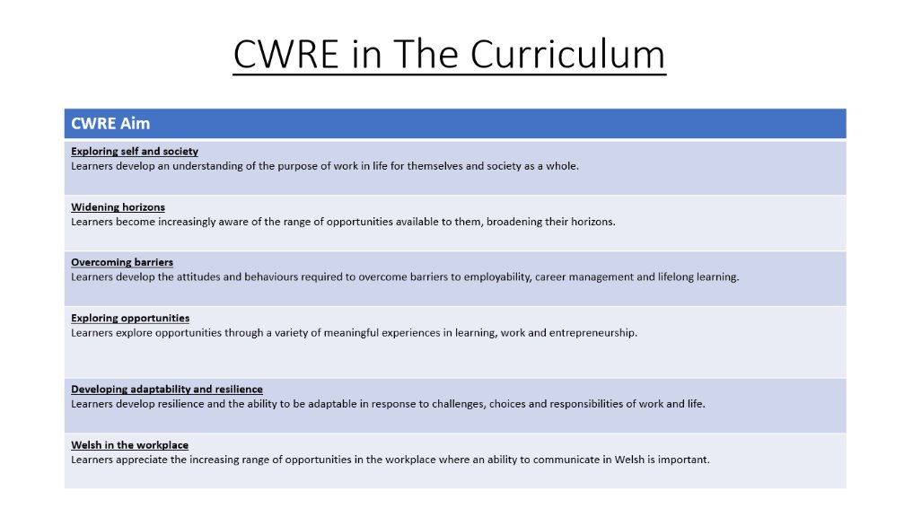

Slide 2

Lower School Plan
Subject: Drama CWRE Progression
Term | 1 | 2 | 3
Year 7 | 1a: Who am I? 1b. Exploring Possibilities – Dream Jobs! | 2a. What is a career in my subject? 2b. What is an entrepreneur? Can my subject lead me to be one? | 3a. What is work-life balance? 3b. Careers and the future
Year 8 | 1a. What are my interests? 1b. Job applications and CV’s – how can my subject enhance mine? | 2a. Challenges and rewards of work 2b. Creating the life you want – how can skill development in my subject help? Create a vision board | 3a. What does success mean to me? What does it look like in my subject? 3b. Careers and the climate
Year 9 | 1a. What are my skills? 1b. What comes after school? Learning pathways for my subject | 2a. Decision making – choosing what to study at KS4. 2b. Taking control of your career journey. How to overcome potential barriers | 3a. Working and earning, managing your money 3b. What is the labour market and what is it saying about jobs in your subject sector?

Slide 3
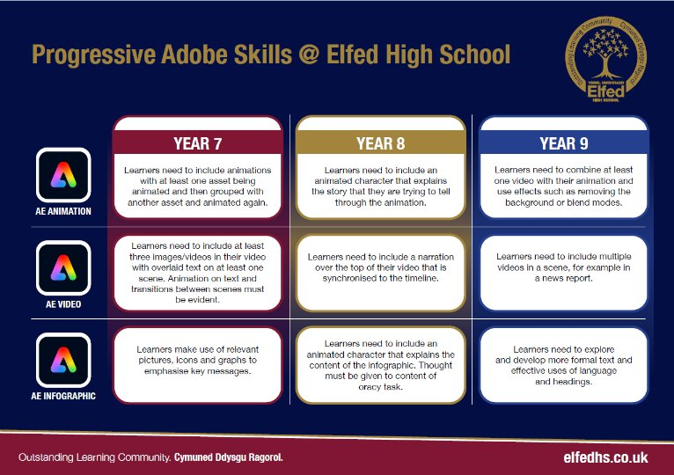

Slide 4
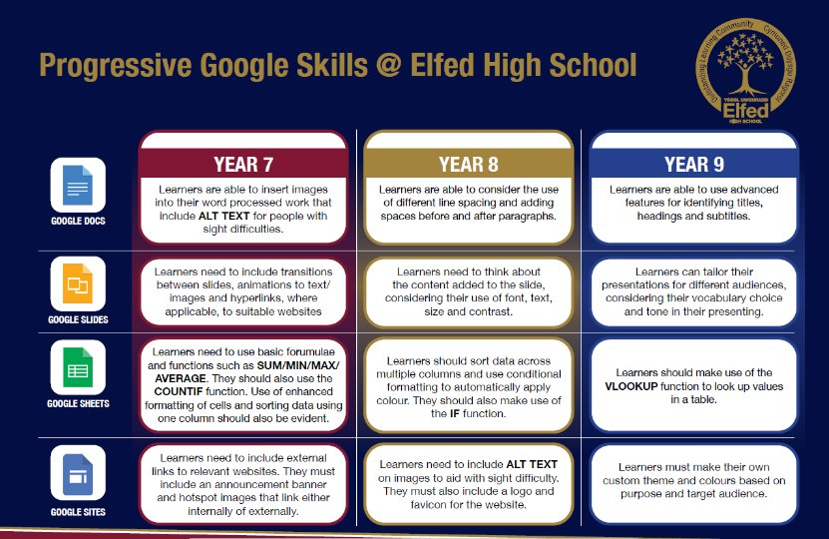

Slide 5

Consider what progression step you are pitching your content at when planning your lessons
Subject: Drama Year 9
Topic: Genre
Key Question:
Independent learning.
I can work as part of a small group
I can work collaboratively as part of a group
I can offer suggestion as part of a group
I can discuss my ideas as part of a group
I can demonstrate leadership skills within a group.
Knowledge and Understanding.
I have basic understanding of new terminology
I have a broader understanding of terminology
I have a deeper understanding of terminology
I have a detailed understanding of new terminology
I have a developed understanding of terminology and can explain differences
Recall:
I can recall basic knowledge
I can recall broader knowledge
I can recall previous learning and make links
I can recall more detailed, accurate and complex knowledge
I can revisit previous learning and develop ideas further
Overview: In this unit pupils will be introduced to various Genre of performance including realism, surrealism and melodrama.
No. of lessons 6 Lesson objectives
Content
Introduction to genre. Explore Realism | I will understand what is meant by realism and will be able to perform and example of it.
Introduction to melodrama | I will understand what melodrama is and will be able to perform an example of it.
Introduction to surrealism. | I will understand what is meant by surrealism and will be able to perform an example of it.
Recap on all 3 genre explored so far. . | I will choose to explore a genre in greater depth and prepare a performance ready for assessment.
Rehearsal of the final performance. | I will rehearse the final piece ready to share to the group and assessment. I will have an extract ready to share by the end of the lesson.
Final performance. | I will bring in costumes and props ready for my final performance that will be shared with the class and assessed.
Key Words:
Genre
Realism
Melodrama
Surrealism
English
Understand the importance of dialogue in helping create a style of performance.
Welsh
Health and Wellbeing
Working collaboratively with peers.
Humanities
Understanding genre from different cultures from around the world.
Performing and sharing work as a group to the rest of the class.
Performing Arts
Assessments (linked to progression steps)
Pupils will perform and present their work at the end of every lesson in the scheme. Evaluation and feedback is given verbally at the end of each performance.
Pupils will have the opportunity to work as part a group and create a performance that is ready for assessment
Learning Experiences
Universal Experience
To work as part of a group and understand the different genre that is being explored.

