Slide 1
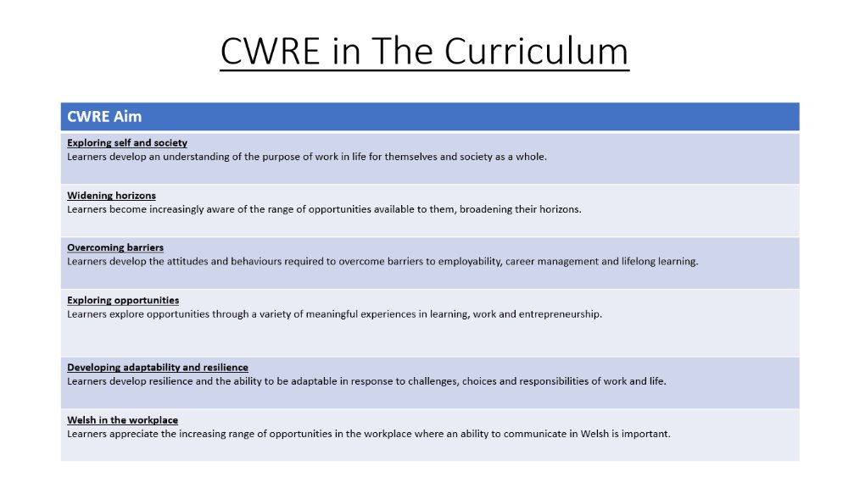

Slide 2

Lower School Plan
Subject: Drama CWRE Progression
Term | 1 | 2 | 3
Year 7 | 1a: Who am I? 1b. Exploring Possibilities – Dream Jobs! | 2a. What is a career in my subject? 2b. What is an entrepreneur? Can my subject lead me to be one? | 3a. What is work-life balance? 3b. Careers and the future
Year 8 | 1a. What are my interests? 1b. Job applications and CV’s – how can my subject enhance mine? | 2a. Challenges and rewards of work 2b. Creating the life you want – how can skill development in my subject help? Create a vision board | 3a. What does success mean to me? What does it look like in my subject? 3b. Careers and the climate
Year 9 | 1a. What are my skills? 1b. What comes after school? Learning pathways for my subject | 2a. Decision making – choosing what to study at KS4. 2b. Taking control of your career journey. How to overcome potential barriers | 3a. Working and earning, managing your money 3b. What is the labour market and what is it saying about jobs in your subject sector?

Slide 3
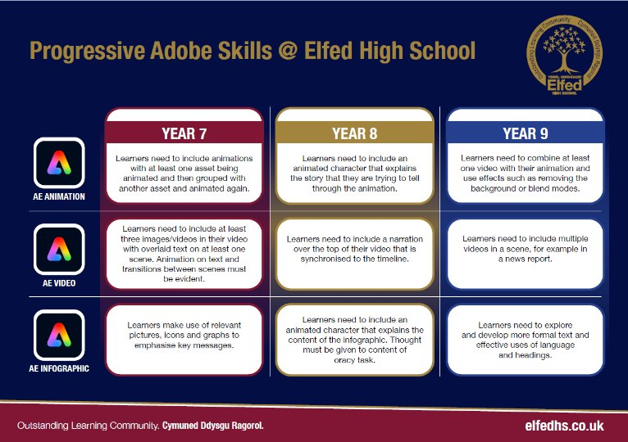

Slide 4
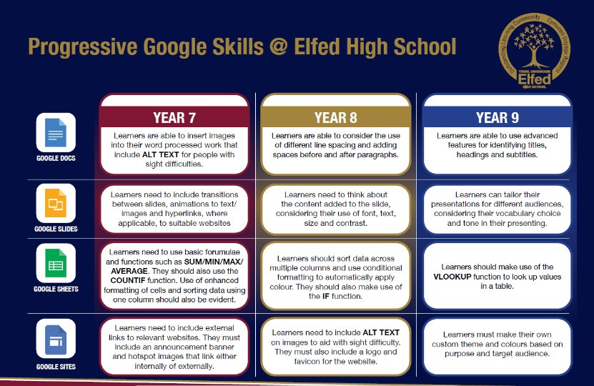

Slide 5

Consider what progression step you are pitching your content at when planning your lessons
Subject: Drama Year 8
Topic: TIE
Independent learning.
I can work as part of a small group
I can work collaboratively as part of a group
I can offer suggestion as part of a group
I can discuss my ideas as part of a group
I can demonstrate leadership skills within a group.
Knowledge and Understanding
I have basic understanding of new terminology
I have a broader understanding of terminology
I have a deeper understanding of terminology
I have a detailed understanding of new terminology
I have a developed understanding of terminology and can explain differences
Making Links.
I can make basic links between social media and performance
I can make more developed links between social media and TIE
I am able to detail the links between social media and TIE
I am able to create engaging links between social media and TIE
I can create engaging and informative links between social media and TIE.
Overview: In this unit pupils will be introduced to Theatre in Education.
They will learn the importance of drama instructing and teaching young people about life and issues that they may face.
No. of lessons 6 Lesson objectives
Content
Introduction to Theatre in Education (TIE) | I will understand what is meant by Theatre in Education and begin to discuss the dangers of social media
Target Audience | I will understand the importance of target audience for TIE.
Characters and plots around social media | I will begin creating my devised TIE piece. We will add in ‘Breaking the Fourth Wall’.
Narration and multi-rolling | Within my group, we will now add in narration and each of us play more than one character.
Bringing all ideas and techniques together, to create the final performance | As part of my group, I will bring every that we have learnt together to create the final TIE piece.
Final Performance | I will rehearse and perform my final TIE performance to the group.
Key Words:
Theatre in Education
Multi-rolling
Target Audience
Narration
Breaking the Fourth Wall
English
Using and understanding drama termionoloy
Welsh
Health and Wellbeing
Working collaboratively with peers.
Humanities
Performing and sharing work as a group to the rest of the class.
Performing Arts
Assessments (linked to progression steps)
Pupils will perform and present their work at the end of every lesson in the scheme. Evaluation and feedback is given verbally at the end of each performance.
Learning Experiences
Universal Experience
Understand the dangers of social media and educate young people about it, using drama.

