Slide 1

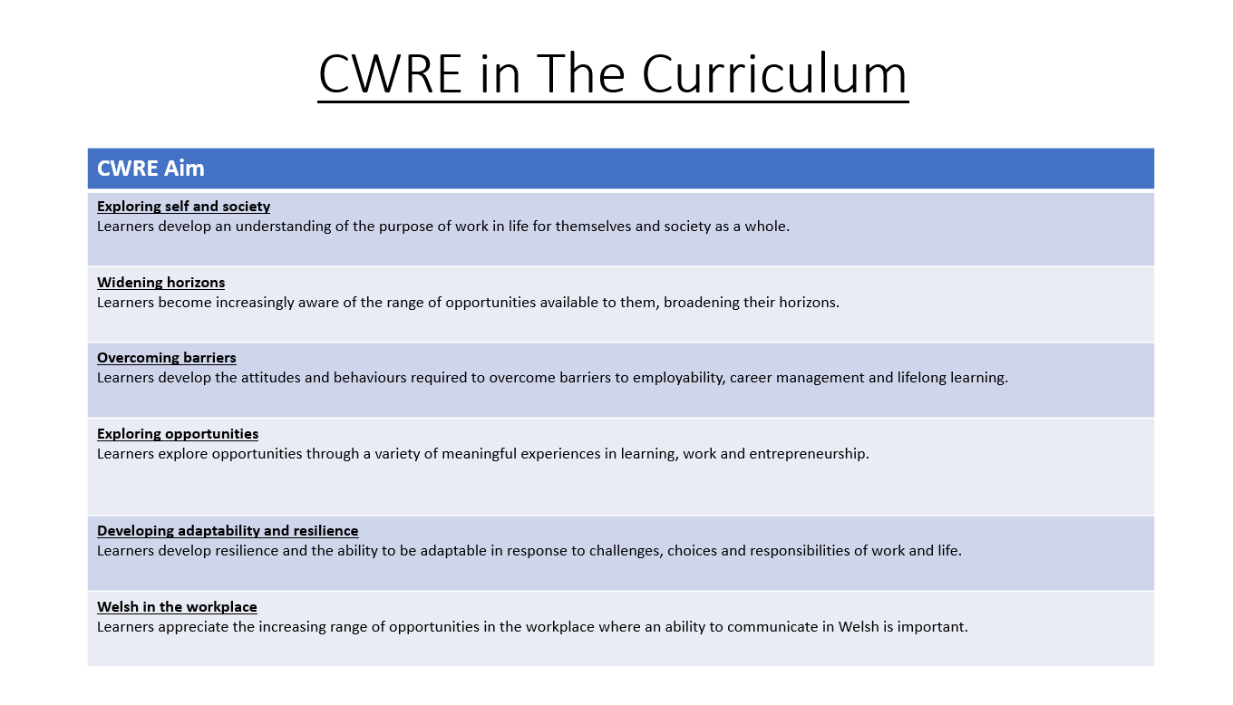

Slide 2
Lower School Plan
Subject: Drama CWRE Progression
Term | 1 | 2 | 3
Year 7 | 1a: Who am I? 1b. Exploring Possibilities – Dream Jobs! | 2a. What is a career in my subject? 2b. What is an entrepreneur? Can my subject lead me to be one? | 3a. What is work-life balance? 3b. Careers and the future
Year 8 | 1a. What are my interests? 1b. Job applications and CV’s – how can my subject enhance mine? | 2a. Challenges and rewards of work 2b. Creating the life you want – how can skill development in my subject help? Create a vision board | 3a. What does success mean to me? What does it look like in my subject? 3b. Careers and the climate
Year 9 | 1a. What are my skills? 1b. What comes after school? Learning pathways for my subject | 2a. Decision making – choosing what to study at KS4. 2b. Taking control of your career journey. How to overcome potential barriers | 3a. Working and earning, managing your money 3b. What is the labour market and what is it saying about jobs in your subject sector?

Slide 3
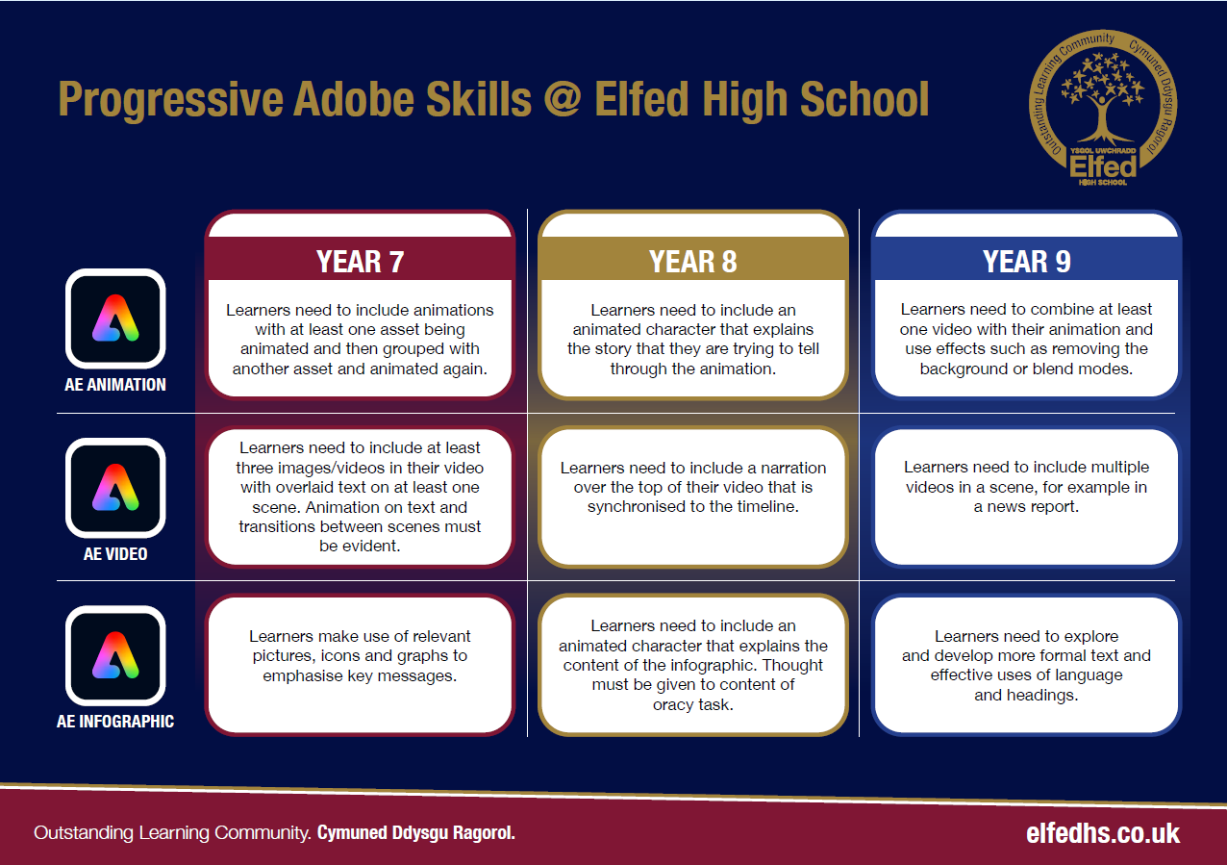

Slide 4
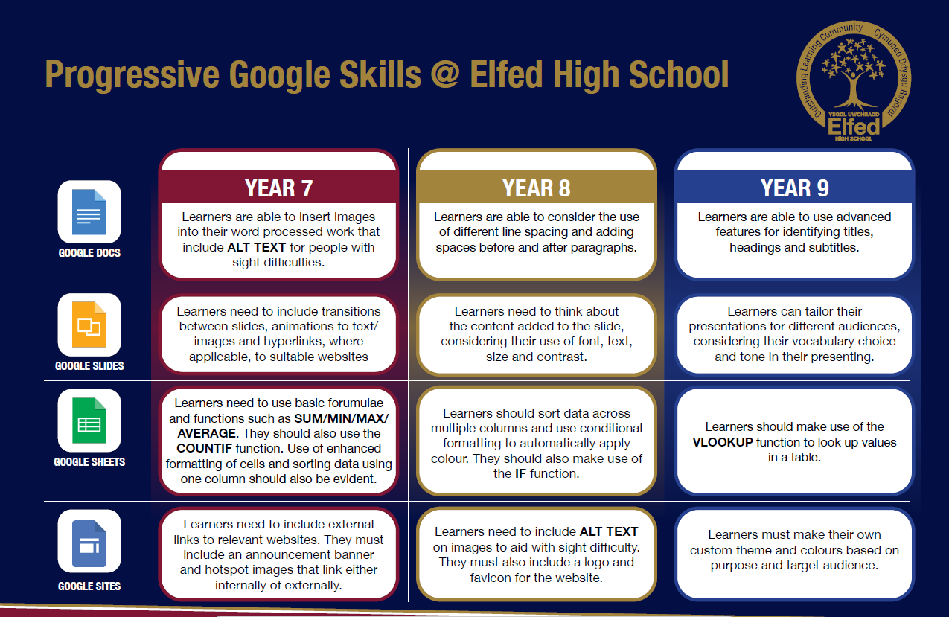

Slide 5

Consider what progression step you are pitching your content at when planning your lessons
Subject: Drama Year 8
Topic: Soap Opera
Independent learning
I can work as part of a small group
I can work collaboratively as part of a group
I can offer suggestion as part of a group
I can discuss my ideas as part of a group
I can demonstrate leadership skills within a group.
Knowledge and Understanding.
I have basic understanding of new terminology
I have a broader understanding of terminology
I have a deeper understanding of terminology
I have a detailed understanding of new terminology
I have a developed understanding of terminology and can explain differences
Subject Specific Skills:
I can create a simple stereotype
I can create a simple character
I can use facial expressions
I can use facial expressions and body language
I can use facial expressions, body language and voice.
Overview: In this unit pupils will be introduced to the television style of Soap Opera and ‘episodic drama’.
They will learn the importance of there being multiple plot lines that run simultaneously in a soap opera.
They will also learn and utilise the technique of ‘cross-cutting’ that will allow them to show these multiple plot lines develop.
Students will take on a character that they will play for the duration of the scheme, allowing them to fully develop their chosen character.
No. of lessons 18 Lesson objectives
Content
Introduction to Soap Opera | I will understand a soap opera and how it is important in British popular culture.
Creating at least two plot lines for the soap opera | I will understand the importance of having at least two plot lines to create a soap opera. I will understand that the plot lines will need to run simultaneously.
Developing the chosen plot lines, introducing ‘cross-cutting’ as a way of developing plots simultaneously. | I will understand and use the drama technique of ‘cross-cutting’ so that I can show two or more plot lines developing at the same time.
Introducing the importance of a ‘cliff-hanger’ and intriguing storylines that will keep the audience returning to watch. | I will introduce a cliff-hanger at the end of each ‘episode’ that will keep our audience intrigued and want to continue to watch.
Introducing a theme tune, opening credits that best suits our soap opera. | I will introduce a theme tune, opening and closing credits for our soap opera, that will best suit the style of our soap opera.
Students will be able to put together their soap opera, which will include several episodes. | I will put together our soap opera playing a character that will develop throughout the duration of the episodes.
Key Words
Episode
Cross-cutting
Plot development
English
Adopting the correct dialogue that would be fitting for a soap opera.
Welsh
Health and Wellbeing
Working collaboratively with peers.
Humanities
Understanding stories from different cultures from around the world.
Performing and sharing work as a group to the rest of the class.
Performing Arts
Assessments (linked to progression steps)
Pupils will perform and present their work at the end of every lesson in the scheme. Evaluation and feedback is given verbally at the end of each performance.
Pupils will have the opportunity to choose a myth, fable or legend as their final assessment of the scheme. They will be encouraged to add sound effects and narration.
Learning Experiences
Universal Experience
Understanding soap opera style and its place in popular culture.

