Slide 1

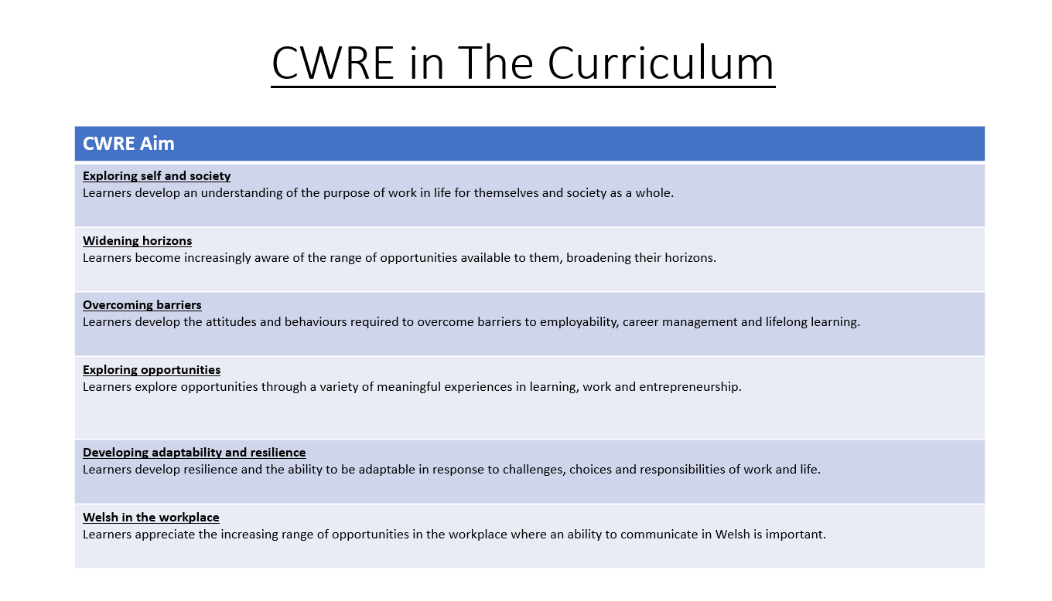

Slide 2
Lower School Plan
Subject: Drama CWRE Progression
Term | 1 | 2 | 3
Year 7 | 1a: Who am I? 1b. Exploring Possibilities – Dream Jobs! | 2a. What is a career in my subject? 2b. What is an entrepreneur? Can my subject lead me to be one? | 3a. What is work-life balance? 3b. Careers and the future
Year 8 | 1a. What are my interests? 1b. Job applications and CV’s – how can my subject enhance mine? | 2a. Challenges and rewards of work 2b. Creating the life you want – how can skill development in my subject help? Create a vision board | 3a. What does success mean to me? What does it look like in my subject? 3b. Careers and the climate
Year 9 | 1a. What are my skills? 1b. What comes after school? Learning pathways for my subject | 2a. Decision making – choosing what to study at KS4. 2b. Taking control of your career journey. How to overcome potential barriers | 3a. Working and earning, managing your money 3b. What is the labour market and what is it saying about jobs in your subject sector?

Slide 3
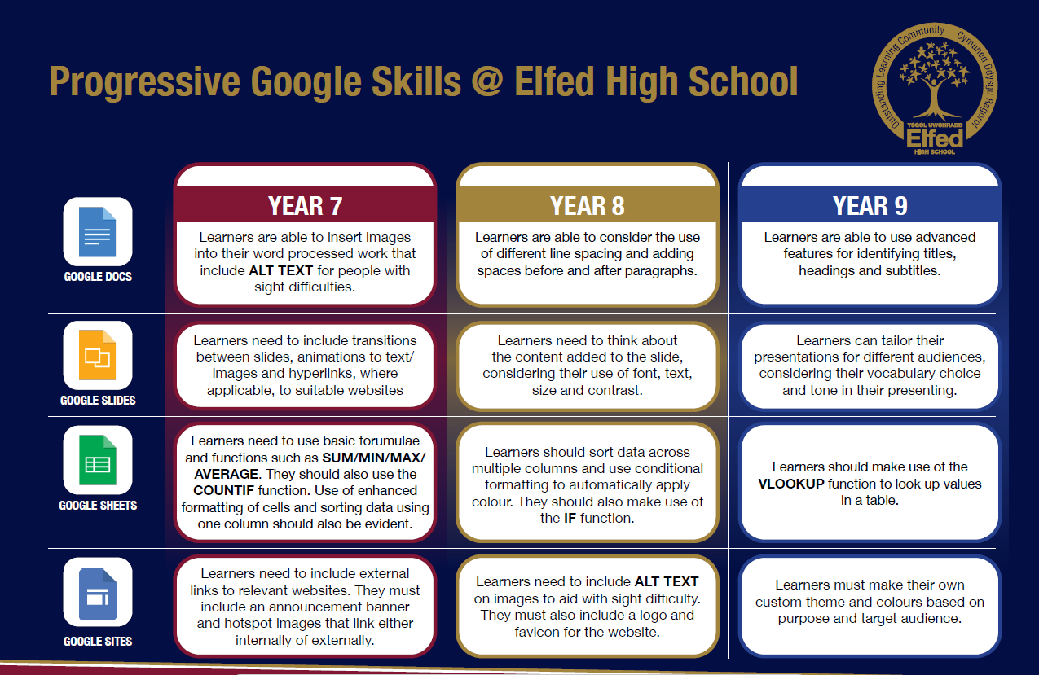

Slide 4
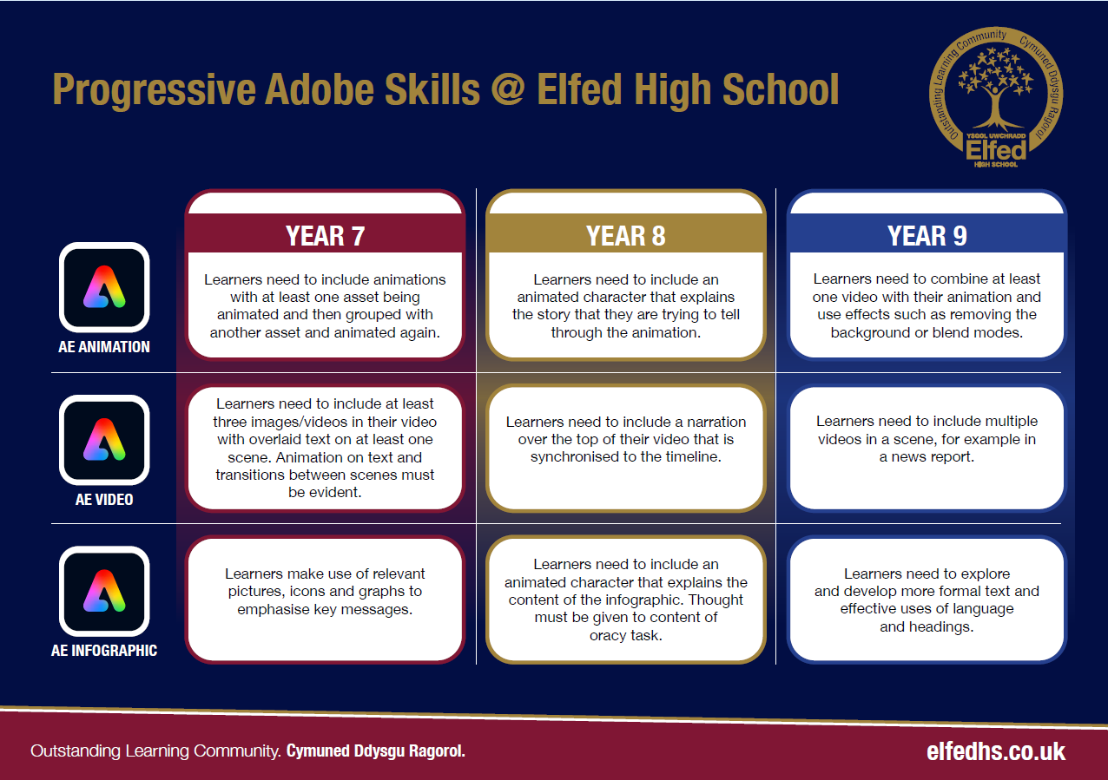

Slide 5

Consider what progression step you are pitching your content at when planning your lessons
Subject: Drama
Topic: Shakespeare Year 8
Independent learning.
I can work as part of a small group
I can work collaboratively as part of a group
I can offer suggestion as part of a group
I can discuss my ideas as part of a group
I can demonstrate leadership skills within a group.
Recall.
I can recall basic knowledge
I can recall broader knowledge
I can recall previous learning and make links
I can recall more detailed, accurate and complex knowledge
I can revisit previous learning and develop ideas further
Making Link
I can make simple links with the information given and performance
I can make some links with the information and performance.
I can make secure links between the information and performance.
I can make engaging and accurate links between information and performance.
I can demonstrate strong links with the information that we have been given and performance.
Overview: In this unit pupils will be introduced to a selection of Shakespeare plays. We will explore the styles of Shakespeare plays. They will be introduced to stage combat for Romeo and Juliet.
No. of lessons 6 Lesson objectives
Content
Shakespeare versus soap opera. Introduce the storylines that Shakespeare used, make them contemporary. AS You Like It. | I will understand Jaques monologue in As You Like It. The seven Ages of Man. I will reinact this with my group.
Romeo and Juliet. Exploration of the street scene between the Montagues and Capulets. Stage combat – 2 basic moves. | I will explore and reinact the street scene from R&J. I will learn stage combat, 2 basic moves of a ‘punch’ and ‘hair pull’.
Romeo and Just combined with stage combat. We will put together the street scene with stage combat and add in the prologue to the play to make a complete performance. | I will put together the street scene with the stage combat learnt. As a group, we will also add in the prologue to the play to complete the performance.
Macbeth. Introduction to the play, focusing on the darker elements to Shakespeare and the supernatural. | I will understand the genre of Macbeth and create a scene from the ‘heath’. We will explore the supernatural and add techniques to create atmosphere.
Shakespeare of choice. Students will choose one of the three plays explored to create their final performance of the unit. | I will work with my group and choose one of the three plays explored. We will work on the piece, rehearsing it and adding techniques for effect.
Final performance for assessment. | I will rehearse my Shakespeare piece, ready for performance. .
Key Words
Monologue
Stage Combat
Supernatural
Verse
English
Understand the importance of storytelling, using language to create tension and interest.
Welsh
Health and Wellbeing
Working collaboratively with peers.
Humanities
Performing and sharing work as a group to the rest of the class.
Performing Arts
Assessments (linked to progression steps)
Pupils will perform and present their work at the end of every lesson in the scheme. Evaluation and feedback is given verbally at the end of each performance.
Learning Experiences
Universal Experience
Celebrate the works of Shakespeare.

