Slide 1

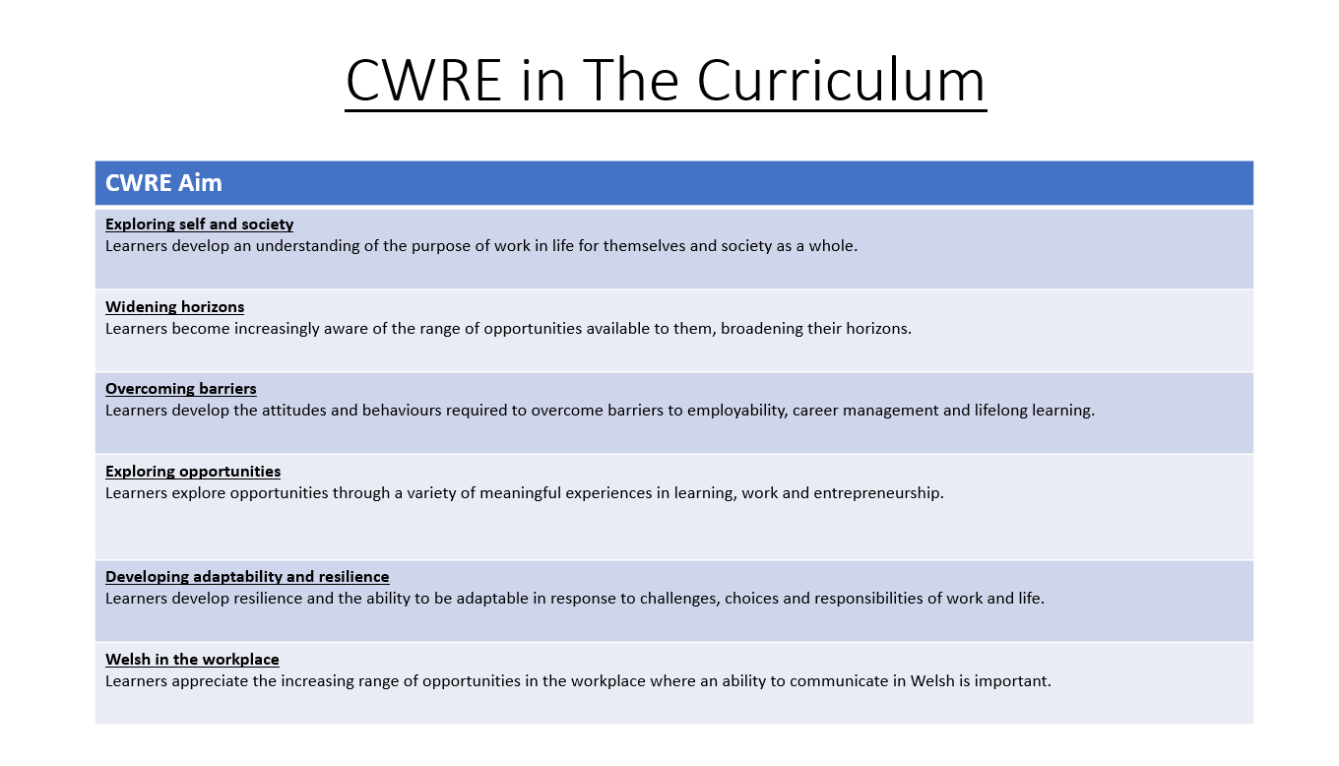

Slide 2
Lower School Plan
Subject: Drama CWRE Progression
Term | 1 | 2 | 3
Year 7 | 1a: Who am I? 1b. Exploring Possibilities – Dream Jobs! | 2a. What is a career in my subject? 2b. What is an entrepreneur? Can my subject lead me to be one? | 3a. What is work-life balance? 3b. Careers and the future
Year 8 | 1a. What are my interests? 1b. Job applications and CV’s – how can my subject enhance mine? | 2a. Challenges and rewards of work 2b. Creating the life you want – how can skill development in my subject help? Create a vision board | 3a. What does success mean to me? What does it look like in my subject? 3b. Careers and the climate
Year 9 | 1a. What are my skills? 1b. What comes after school? Learning pathways for my subject | 2a. Decision making – choosing what to study at KS4. 2b. Taking control of your career journey. How to overcome potential barriers | 3a. Working and earning, managing your money 3b. What is the labour market and what is it saying about jobs in your subject sector?

Slide 3
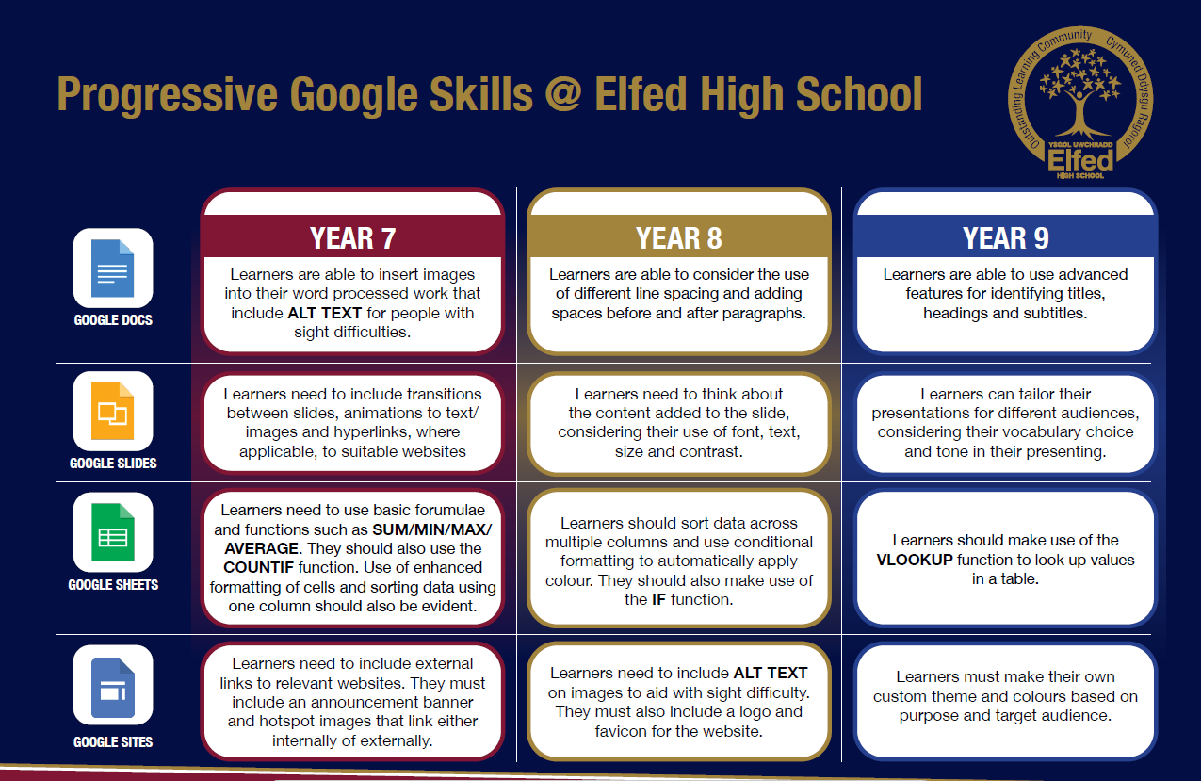

Slide 4
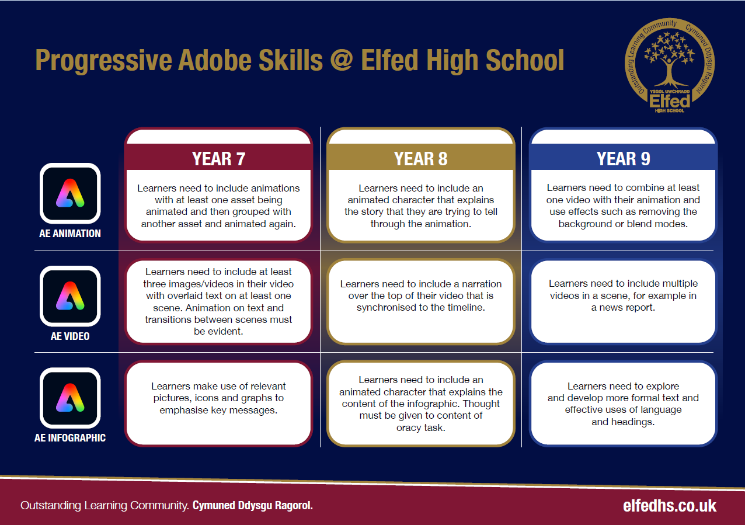

Slide 5

Consider what progression step you are pitching your content at when planning your lessons
Subject: Drama Year 9 2a
Topic: Practitioners
Independent learning.
I can work as part of a small group
I can work collaboratively as part of a group
I can offer suggestion as part of a group
I can discuss my ideas as part of a group
I can demonstrate leadership skills within a group.
Subject Specific Skills
I can create a simple stereotype using Realsim or Gestus
I can create a simple character Realism or Gestus
I can use facial expressions, some elements of Realism, Epic or Theatre of Cruelty
I can use facial expressions and body language that are appropriate to Realism, Epic or Theatre of Cruelty.
I can use facial expressions, body language and voice effectively in Realism, Epic or Theatre of Cruelty.
Knowledge and Understanding
I have basic understanding of new terminology
I have a broader understanding of terminology
I have a deeper understanding of terminology
I have a detailed understanding of new terminology
I have a developed understanding of terminology and can explain differences.
Overview: In this unit pupils will be introduced to various theatre practitioners that have helped shape theatre and drama styles over history.
Lesson objectives
Content
Introduction to Konstantin Stanislavski and Realism | I will understand the importance of Stanislavski and how he introduced Realism, how it changed theatre style in history. I will learn parts of Stanislavski’s ‘System’.
Introduction to Bertolt Brecht and Epic Theatre | I will understand how Brecht was a contemporary of Stanislavski but wanted to promote a completely different style of theatre that would ‘change the world’.
Introduction to the work of Antonin Artaud and Theatre of Cruelty. | I will learn how Artaud was also a contemporary of Stanislavski and Brecht, yet believed theatre should be something entirely different. I will experiment with elements of Theatre of Cruelty.
Developing a chosen practitioner to develop further. | I can compare the three different styles of theatre and make a selection of what I would like to develop further for assessment.
Rehearsing and developing the chosen practitioner | I will adopt as many of the techniques that are associated with my chosen practitioner to further develop my piece of drama for assessment.
Performance of theatre practitioners for assessment. | I can perform my chosen practitioner style for an audience ready for assessment. I will include as many theatre techniques that are associated with my chosen practitioner.
Key Words
Stanislavski
Brecht
Artaud
Epic
Theatre of Cruelty
English
Using the correct style of dialogue and register that suits the style of practitioner
Welsh
Health and Wellbeing
Working collaboratively with peers.
Humanities
Understanding different styles of performance from around the world.
Performing and sharing work as a group to the rest of the class.
Performing Arts
Assessments (linked to progression steps)
.
Pupils will perform and present their work at the end of every lesson in the scheme. Evaluation and feedback is given verbally at the end of each performance.
Pupils will have the opportunity to choose a myth, fable or legend as their final assessment of the scheme. They will be encouraged to add sound effects and narration.
Learning Experiences
Universal Experience
Experience different styles of performance from different theatre practitioners. .

