Slide 1

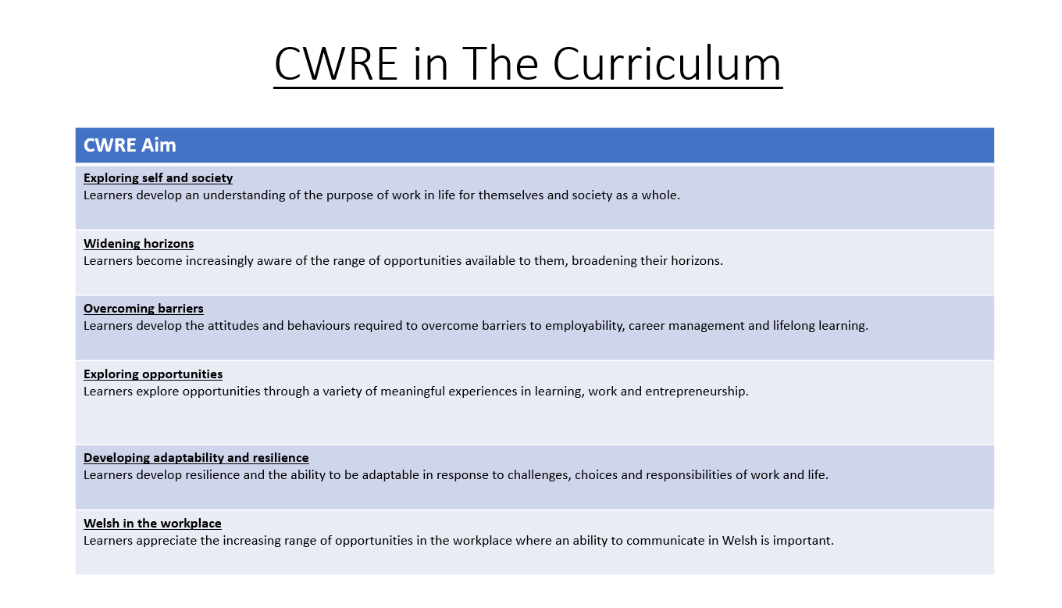

Slide 2
Lower School Plan
Subject: Drama CWRE Progression
Term | 1 | 2 | 3
Year 7 | 1a: Who am I? 1b. Exploring Possibilities – Dream Jobs! | 2a. What is a career in my subject? 2b. What is an entrepreneur? Can my subject lead me to be one? | 3a. What is work-life balance? 3b. Careers and the future
Year 8 | 1a. What are my interests? 1b. Job applications and CV’s – how can my subject enhance mine? | 2a. Challenges and rewards of work 2b. Creating the life you want – how can skill development in my subject help? Create a vision board | 3a. What does success mean to me? What does it look like in my subject? 3b. Careers and the climate
Year 9 | 1a. What are my skills? 1b. What comes after school? Learning pathways for my subject | 2a. Decision making – choosing what to study at KS4. 2b. Taking control of your career journey. How to overcome potential barriers | 3a. Working and earning, managing your money 3b. What is the labour market and what is it saying about jobs in your subject sector?

Slide 3
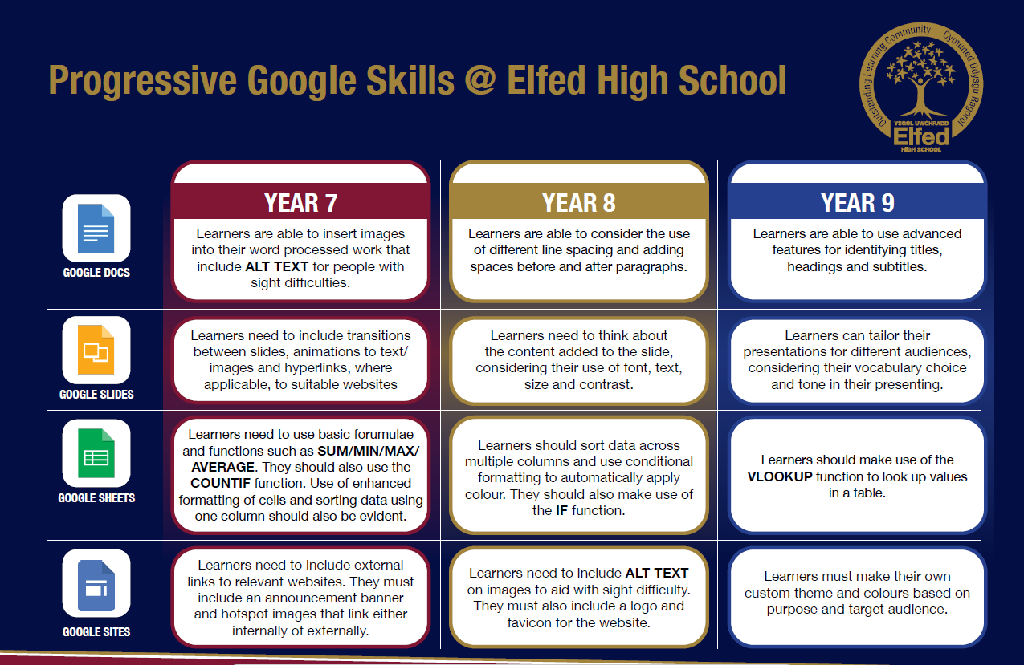

Slide 4
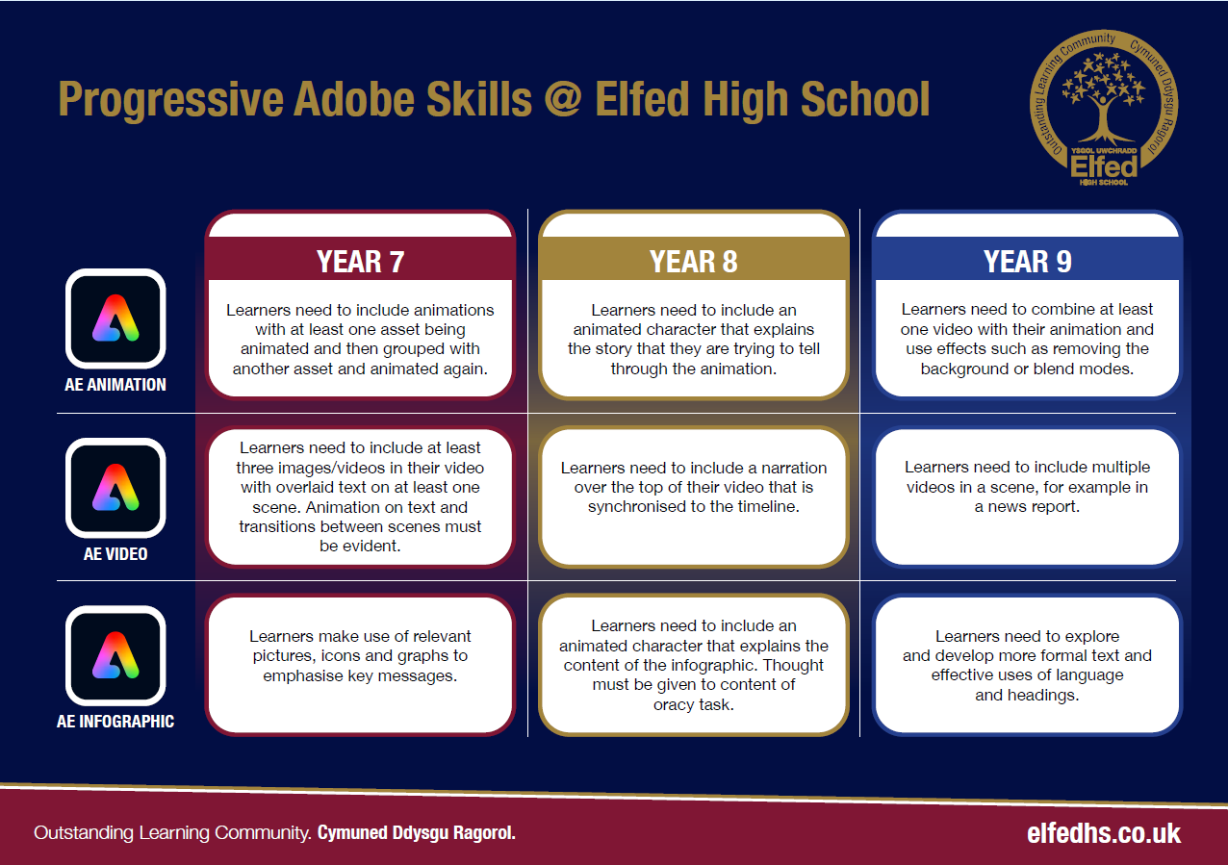

Slide 5

Subject: Drama Year 8 3a
Topic: Melodrama
Consider what progression step you are pitching your content at when planning your lessons
Independent learning.
I can work as part of a small group
I can work collaboratively as part of a group
I can offer suggestion as part of a group
I can discuss my ideas as part of a group
I can demonstrate leadership skills within a group.
Subject Specific Skills
I can create a simple stock character.
I can create a simple stock character adding accent to my voice.
I can create a stock character and add exaggeration to my performance.
I can portray a stock character with exaggeration, voice and humour.
I can effectively create a melodramatic performance using stock characters, humour, exaggeration, voice and sound.
Knowledge and Understanding.
I have basic understanding of new terminology
I have a broader understanding of terminology
I have a deeper understanding of terminology
I have a detailed understanding of new terminology
I have a developed understanding of terminology and can explain differences
Overview: In this unit pupils will be introduced to the performance style of Melodrama. They will learn about its traditions and history, as well as the characters that feature in the genre of theatre.
Lesson objectives
Content
Introduction to Melodrama | I will understand what Melodrama is as a style of performance, its history and traditions.
Performance using stock characters | I will work with my group to create a piece of performance that uses four of the stock characters that feature in Melodrama: Victim, Villain, Hero, Sidekick
Creating a performance with music. | I will create a piece of performance in the melodramatic style that will take its influence from the silent movie era. I will use music to add atmosphere to my performance.
Adding comedy to Melodrama | I will work with my group to create a piece of performance that is influenced by Melodrama and Slapstick comedy from the silent movie era.
Creating a piece of Melodrama, adding placards and captions from the silent movie era | I will create a piece of performance influenced by Melodrama and the silent movie era, adding placards and captions.
Creating a piece of Melodrama that brings together all the elements that have been taught in the scheme. | I will create a piece of performance that draws together all of the influences from Melodrama and the silent movie era.
Key Words
Melodrama
Stock
Slapstick
Placard
English
Using the correct dialect that is appropriate to the tradition of Melodrama.
Welsh
Health and Wellbeing
Working collaboratively with peers.
Humanities
Understanding traditions and history of film and theatre.
Performing and sharing work as a group to the rest of the class.
Performing Arts
Assessments (linked to progression steps)
Pupils will perform and present their work at the end of every lesson in the scheme. Evaluation and feedback is given verbally at the end of each performance.
Pupils will have the opportunity to choose a myth, fable or legend as their final assessment of the scheme. They will be encouraged to add sound effects and narration.
Learning Experiences
Universal Experience
Creating performances that have been influenced by the traditions of melodrama and the silent movie era.

