Slide 1

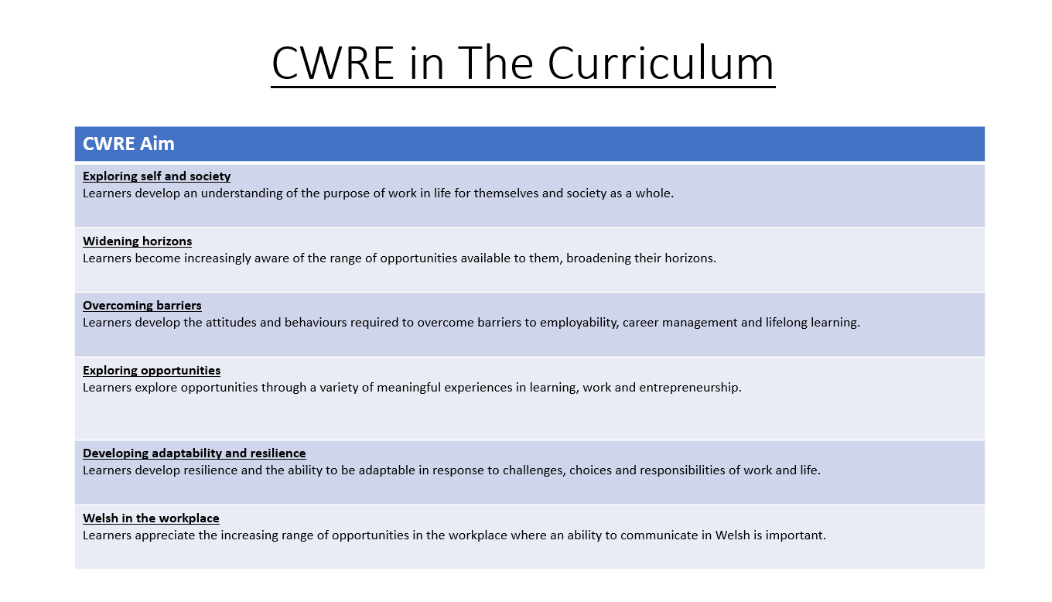

Slide 2
Lower School Plan
Subject: Drama CWRE Progression
Term | 1 | 2 | 3
Year 7 | 1a: Who am I? 1b. Exploring Possibilities – Dream Jobs! | 2a. What is a career in my subject? 2b. What is an entrepreneur? Can my subject lead me to be one? | 3a. What is work-life balance? 3b. Careers and the future
Year 8 | 1a. What are my interests? 1b. Job applications and CV’s – how can my subject enhance mine? | 2a. Challenges and rewards of work 2b. Creating the life you want – how can skill development in my subject help? Create a vision board | 3a. What does success mean to me? What does it look like in my subject? 3b. Careers and the climate
Year 9 | 1a. What are my skills? 1b. What comes after school? Learning pathways for my subject | 2a. Decision making – choosing what to study at KS4. 2b. Taking control of your career journey. How to overcome potential barriers | 3a. Working and earning, managing your money 3b. What is the labour market and what is it saying about jobs in your subject sector?

Slide 3
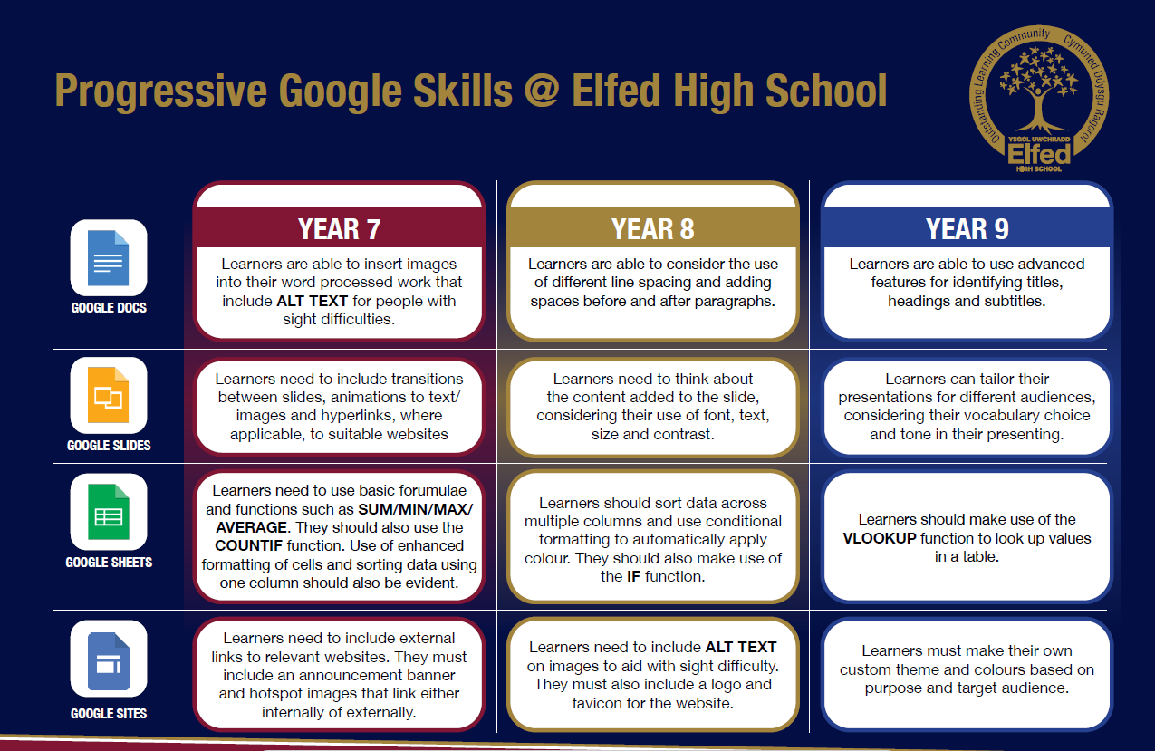

Slide 4
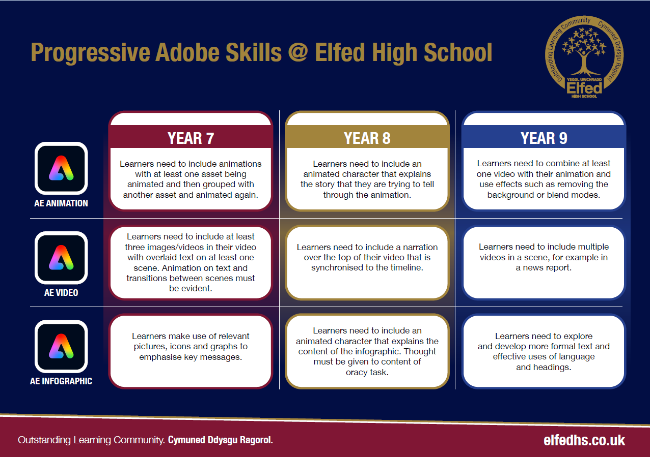

Slide 5

Consider what progression step you are pitching your content at when planning your lessons
Subject: Drama
Topic: Myths, Fables and Legends
Key Question:
Independent learning.
I can work as part of a small group
I can work collaboratively as part of a group
I can offer suggestion as part of a group
I can discuss my ideas as part of a group
I can demonstrate leadership skills within a group.
Recall.
I can recall basic knowledge
I can recall broader knowledge
I can recall previous learning and make links
I can recall more detailed, accurate and complex knowledge
I can revisit previous learning and develop ideas further
Knowledge and Understanding.
I have basic understanding of new terminology
I have a broader understanding of terminology
I have a deeper understanding of terminology
I have a detailed understanding of new terminology
I have a developed understanding of terminology and can explain differences
Overview: In this unit pupils will be introduced to various myths, fables and legends from around the globe. They will also understand the difference between a myth, fable and a legend.
They will continue to learn drama specific vocabulary as they are introduced to drama skills.
Pupils will learn the importance of storytelling within out culture and other cultures.
No. of lessons 18 Lesson objectives
Content
Introduction to a fable. Use the drama skill of narration. | I will understand what a fable is and the importance of storytelling in a culture.
Retelling a fable from the previous lesson | I will understand the moral of the fable and why fables are used to teach children morals.
Introductions to legends. How does a legend differ from a fable. Use sound effects to add impact to the story. | I will know the difference between a legend and a fable. I will understand the importance of sound effects to add impact and atmosphere.
Introduction to the legend of Gelert. | I will understand a legend from the welsh culture,
Create a ‘documentary’ of the story of Gelert. | I will use narration and journalistic techniques to recreate the legend of Gelert.
Introduction to myths. Understand what the difference is between a myth, legend and fable. | I will know the difference between a myth, legend and fable.
Key Words:
Sound effects
Narration
Myth
Legend
Fable
English
Understand the importance of storytelling, using language to create tension and interest.
Welsh
Health and Wellbeing
Working collaboratively with peers.
Humanities
Understanding stories from different cultures from around the world.
Performing and sharing work as a group to the rest of the class.
Performing Arts
Assessments (linked to progression steps)
Explore the traditional legend of Gelert.
Pupils will perform and present their work at the end of every lesson in the scheme. Evaluation and feedback is given verbally at the end of each performance.
Pupils will have the opportunity to choose a myth, fable or legend as their final assessment of the scheme. They will be encouraged to add sound effects and narration.
Learning Experiences
Universal Experience
Celebrate stories from different cultures from around the world including Wales.

