Slide 1

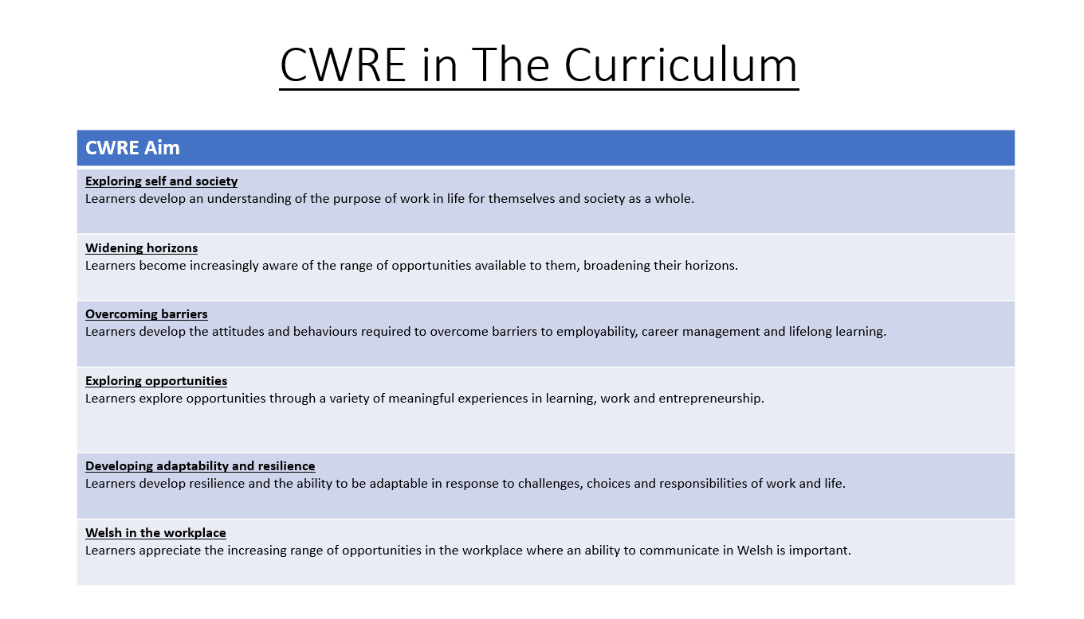

Slide 2
Lower School Plan
Subject: Drama CWRE Progression
Term | 1 | 2 | 3
Year 7 | 1a: Who am I? 1b. Exploring Possibilities – Dream Jobs! | 2a. What is a career in my subject? 2b. What is an entrepreneur? Can my subject lead me to be one? | 3a. What is work-life balance? 3b. Careers and the future
Year 8 | 1a. What are my interests? 1b. Job applications and CV’s – how can my subject enhance mine? | 2a. Challenges and rewards of work 2b. Creating the life you want – how can skill development in my subject help? Create a vision board | 3a. What does success mean to me? What does it look like in my subject? 3b. Careers and the climate
Year 9 | 1a. What are my skills? 1b. What comes after school? Learning pathways for my subject | 2a. Decision making – choosing what to study at KS4. 2b. Taking control of your career journey. How to overcome potential barriers | 3a. Working and earning, managing your money 3b. What is the labour market and what is it saying about jobs in your subject sector?

Slide 3
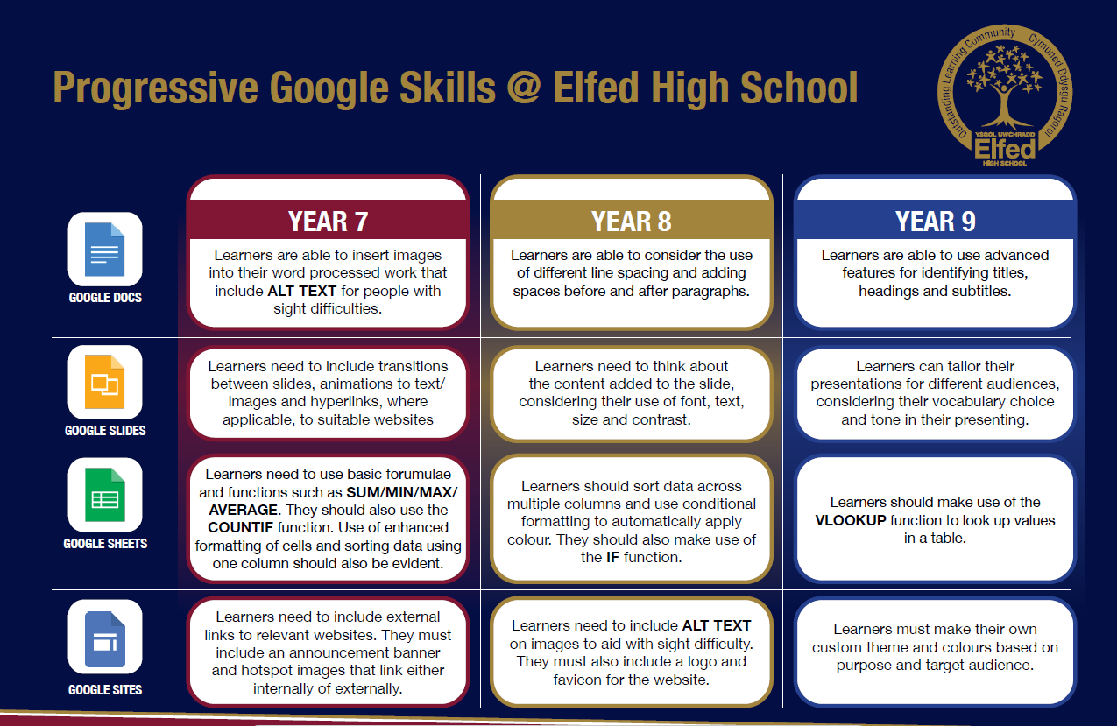

Slide 4
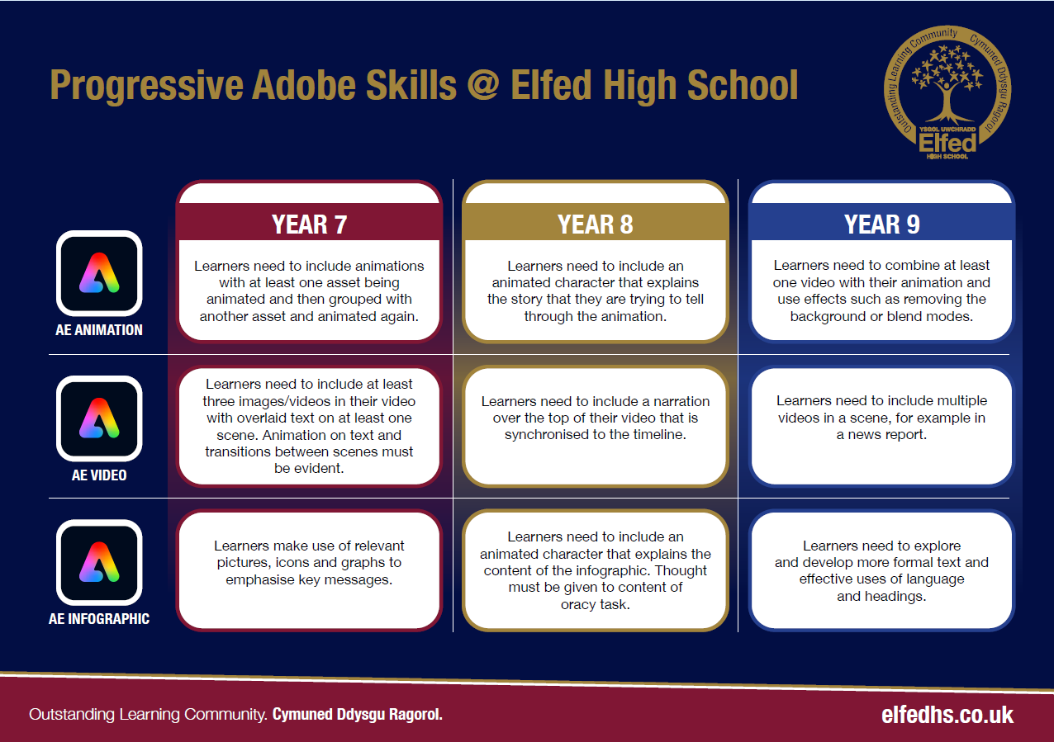

Slide 5

Subject: Drama Year 9
Topic: Comedy
Consider what progression step you are pitching your content at when planning your lessons
Independent learning.
I can work as part of a small group
I can work collaboratively as part of a group
I can offer suggestion as part of a group
I can discuss my ideas as part of a group
I can demonstrate leadership skills within a group.
Recall.
I can recall basic knowledge
I can recall broader knowledge
I can recall previous learning and make links
I can recall more detailed, accurate and complex knowledge
I can revisit previous learning and develop ideas further
Knowledge and Understanding.
I have basic understanding of new terminology
I have a broader understanding of terminology
I have a deeper understanding of terminology
I have a detailed understanding of new terminology
I have a developed understanding of terminology and can explain differences
Overview: In this unit pupils will be introduced to various genre of comedy. We will focus on the origins of comedy as well as the styles of ‘slapstick’, ‘parody’ and ‘Sitcom’.
No. of lessons 6 Lesson objectives
Content
Introduction to comedy. Slap Stick | I will understand what ’Slap Stick’ comedy is and be able to create a practical example.
Introduction to parody. | I will understand what Parody comedy is and create a practical example.
Introduction to Sitcom. | I will understand what sitcom is and be able to give a practical example.
Introduction to ‘mockumentary’ style comedy | I will understand what mockumentary is and be able to give a practical example.
Recap on all 4 styles of comedy | I will understand the differences between the 4 styles of comedy that we have explored. I will choose one style to develop further.
Final performance of chosen comedy style. | I will rehearse my chosen comedy piece in preparation for the final performance.
Key Words
Slapstick
Parody
Sitcom
Mockumentary
English
Use the correct dramatic terminology
Welsh
Health and Wellbeing
Working collaboratively with peers.
Humanities
.
Performing and sharing work as a group to the rest of the class.
Performing Arts
Assessments (linked to progression steps)
.
Pupils will perform and present their work at the end of every lesson in the scheme. Evaluation and feedback is given verbally at the end of each performance.
Learning Experiences
Universal Experience
Celebrate stories from different cultures from around the world including Wales.

