Slide 1

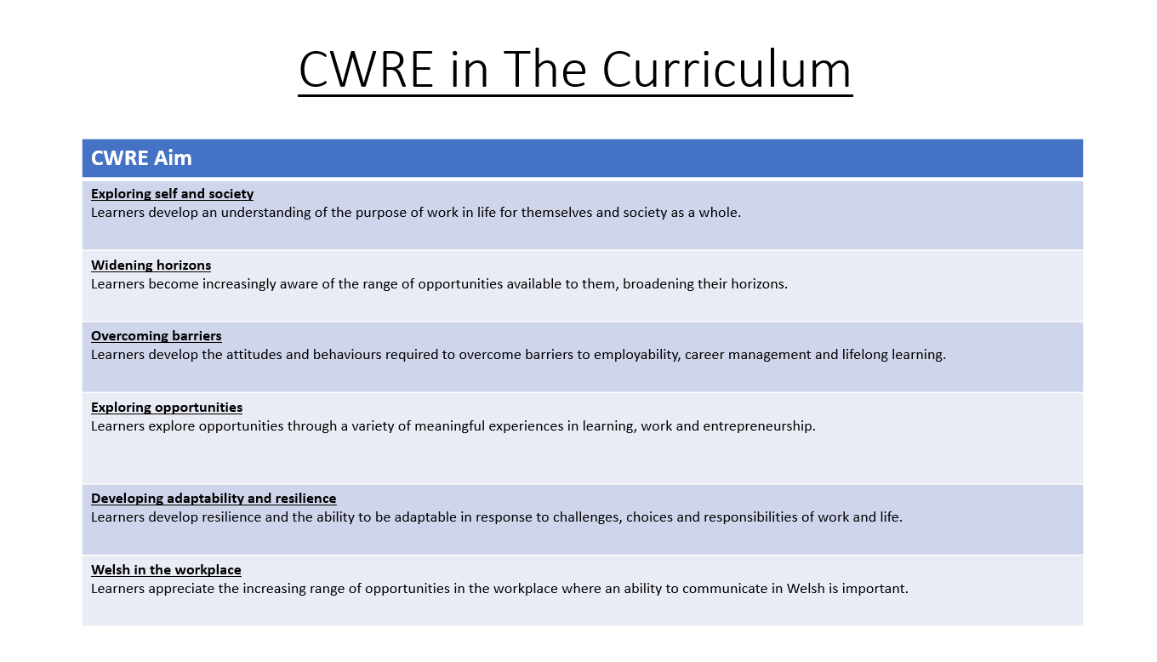

Slide 2
Lower School Plan
Subject: CWRE Progression
Term | 1 | 2 | 3
Year 7 | 1a: Who am I? 1b. Exploring Possibilities – Dream Jobs! | 2a. What is a career in my subject? 2b. What is an entrepreneur? Can my subject lead me to be one? | 3a. What is work-life balance? 3b. Careers and the future
Year 8 | 1a. What are my interests? 1b. Job applications and CV’s – how can my subject enhance mine? | 2a. Challenges and rewards of work 2b. Creating the life you want – how can skill development in my subject help? Create a vision board | 3a. What does success mean to me? What does it look like in my subject? 3b. Careers and the climate
Year 9 | 1a. What are my skills? 1b. What comes after school? Learning pathways for my subject | 2a. Decision making – choosing what to study at KS4. 2b. Taking control of your career journey. How to overcome potential barriers | 3a. Working and earning, managing your money 3b. What is the labour market and what is it saying about jobs in your subject sector?

Slide 3
 | Reading | Writing | Speaking | Listening
Year 7 | I can use a range of strategies including skimming to identify themes, ideas and genre, and scanning to gain a detailed understanding of a text. I can identify quotations from printed and digital texts to support a viewpoint. I have read at least 6 reading-age appropriate books by the end of Year 7 – via the curriculum across AoLEs, reading lessons, and access to the school library in English lessons. | I can form simple, compound and complex sentences. I can use a comma accurately. I can competently spell and use subject specific words (Tier 3 vocabulary). I can organise my writing into accurate paragraphs. | I can use Standard English appropriately to present a point of view. I can use sentence stems to organise my talk in a detailed and accurate manner. I can select an appropriate register for my talk. | I can listen attentively to the viewpoints of others. I can respond to the viewpoint of others by offering a critical comment upon what they have heard.
E.P | I can identify a range of quotations to support a point of view and begin to identify patterns in the way language is used. | I regularly use subject specific (Tier 3) terminology in my books and spell these terms accurately. | I can vary my register for a variety of purposes and audiences. | I can listen attentively to the viewpoints of others for an extended period.

Slide 4
Years 6 / 7 | I can collect information by voting or sorting. I can collect relevant data to answer posed questions. I can collect my own data for a survey, e.g. through designing a questionnaire. NA | I can accurately draw a pictogram, including a sensible key, where the symbols are ¼, ½ and ¾. I can accurately draw a bar chart using success criteria: Bars are of equal width Labels for your x and y axis Axis and scales (choosing own suitable scale) Same size space between bars Title for your graph I can accurately draw a line graph with my own suitable scale. NA | I can calculate the mode, median and range of a set of data. I can calculate the mean of a set of data, including decimal numbers. I can interpret pictograms where the symbols are ¼, ½ and ¾. I can interpret bar charts, including dual bar charts. I can read and interpret bus and train timetables. I can use the language of probability. NA

Slide 5
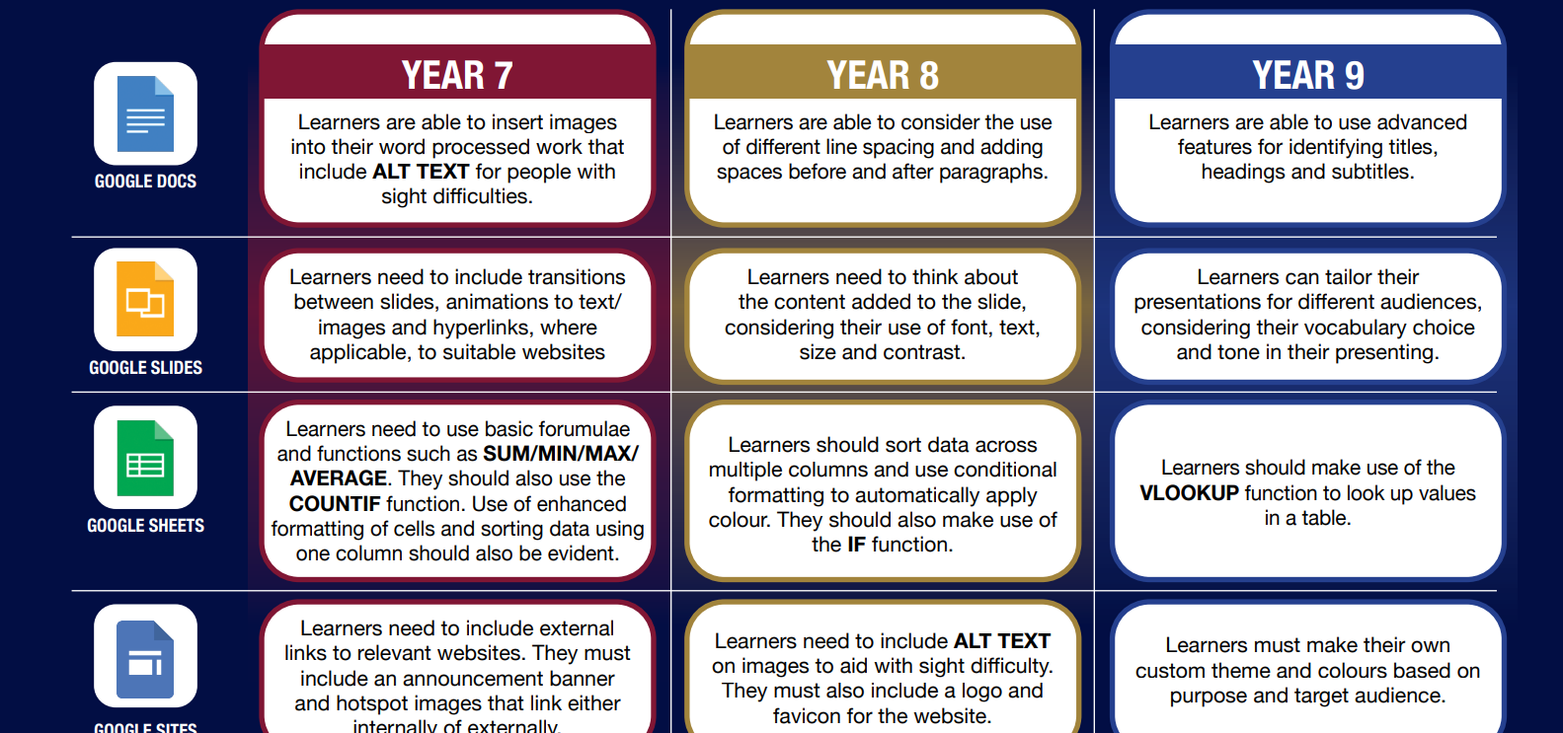

Slide 6

Consider what progression step you are pitching your content at when planning your lessons
Subject: Drama Year 7
Topic: Characterisation and Stereotypes
Key Question:
Independent learning.
I can work as part of a small group
I can work collaboratively as part of a group
I can offer suggestion as part of a group
I can discuss my ideas as part of a group
I can demonstrate leadership skills within a group.
Subject Specific Skills
I can create a simple stereotype
I can create a simple character
I can use facial expressions
I can use facial expressions and body language
I can use facial expressions, body language and voice.
Knowledge and Understanding.
I have basic understanding of new terminology
I have a broader understanding of terminology
I have a deeper understanding of terminology
I have a detailed understanding of new terminology
I have a developed understanding of terminology and can explain differences
Overview: In this unit pupils will be introduced to the basics of performance. They will explore how to create a character and understand stereotypes. They will also learn how stereotypes can be positive in theatre and drama.
No. of lessons 6 Lesson objectives
Content
Introduction to character and stereotypes. | I will understand how to create a character using facial expressions, body language and voice. I can create a simple character.
Developing character | I will understand how to develop my performance of a simple character to a more thoughtful character using facial expressions, body language, voice and accent.
Developing characters from stereotypes. | I will be given a character from my teacher which I will then develop using the skills that I have learnt so far.
Hot seating and monologues | I will understand and use the technique of hot seating to learn more about my character. I will learn and use the technique of monologue to add greater depth to my character.
Creating a devised piece based on characters. | I will work as part of a group, devising an interesting and entertaining piece of performance. It will include monologues from our characters.
Final rehearsal and performance. | I will rehearse our group piece ready for the final performance.
Key Words:
Characterisation
Stereotypes
Hot seating
Monologue
English
Understand the importance of storytelling, using language to create tension and interest.
Welsh
Health and Wellbeing
Working collaboratively with peers.
Humanities
Understanding stories from different cultures from around the world.
Performing and sharing work as a group to the rest of the class.
Performing Arts
Assessments (linked to progression steps)
Explore the traditional legend of Gelert.
Pupils will perform and present their work at the end of every lesson in the scheme. Evaluation and feedback is given verbally at the end of each performance.
Pupils will have the opportunity to work in a group and create a piece of drama ready for performance. .
Learning Experiences
Universal Experience
To work as part of a group. Understand how to create a character.

