Slide 1
PE Unit Overviews

Slide 2

Subject: PE
Overview of Topics
Term | 1A | 1B | 2A | 2B | 3A | 3B
Year 7 | Teams Games/Fitness | Creative/ Swimming | Swimming | Fitness | Athletics | Striking and Fielding
Year 8 | Teams Games/Fitness | Creative/ Swimming | Swimming | Fitness | Athletics | Striking and Fielding
Year 9 | Teams Games/Fitness | Creative/ Swimming | Swimming | Fitness | Athletics | Striking and Fielding
Year 10 | Teams Games/Fitness | Teams Games | Health and fitness | Fitness | Athletics | Striking and Fielding
Year 11 | Teams Games/Fitness | Teams Games | Fitness | Fitness

Slide 3
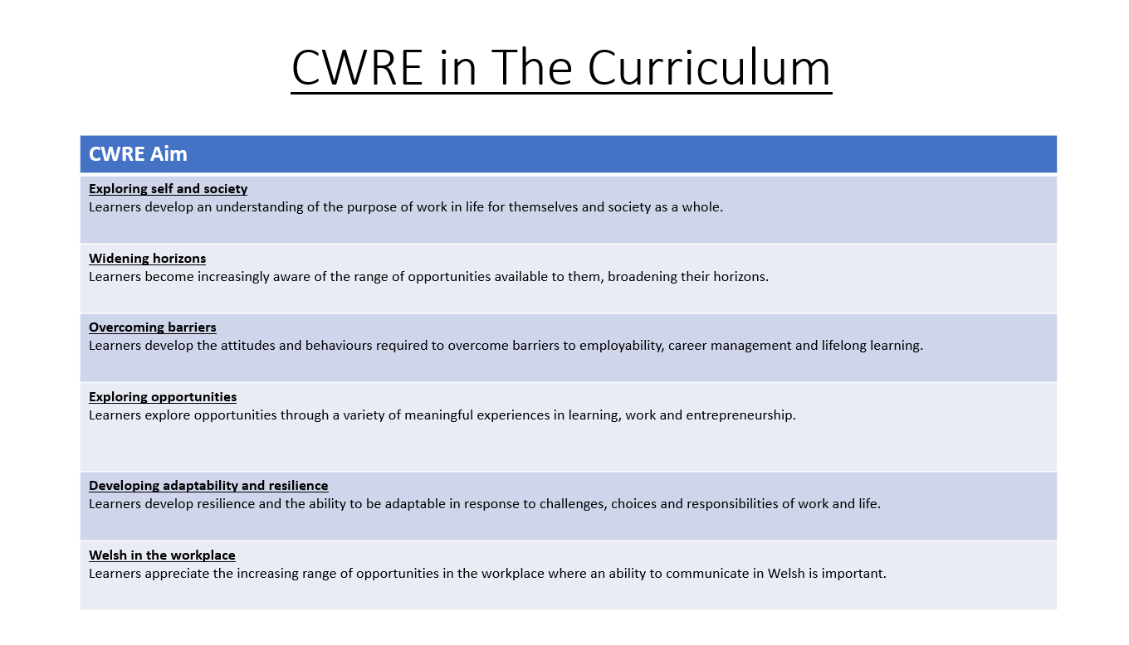

Slide 4
PE Plan – Lower School
Careers
Term | 1 | 2 | 3
Year 7 | 1a: Who am I? 1b. Exploring Possibilities – Dream Jobs! | 2a. What is a career in my subject? 2b. What is an entrepreneur? Can my subject lead me to be one? | 3a. What is work-life balance? 3b. Careers and the future
Year 8 | 1a. What are my interests? 1b. Job applications and CV’s – how can my subject enhance mine? | 2a. Challenges and rewards of work 2b. Creating the life you want – how can skill development in my subject help? Create a vision board | 3a. What does success mean to me? What does it look like in my subject? 3b. Careers and the climate
Year 9 | 1a. What are my skills? 1b. What comes after school? Learning pathways for my subject | 2a. Decision making – choosing what to study at KS4. 2b. Taking control of your career journey. How to overcome potential barriers | 3a. Working and earning, managing your money 3b. What is the labour market and what is it saying about jobs in your subject sector?

Slide 5
PE Plan Upper School
Careers
Term | 1 | 2 | 3
Year 10 | 1a: Interests and Skills Profile – what makes you good at this subject? How will your skills transfer into the world of work? 1b. Preparing to go on work experience. How is skill development in my subject helping you prepare? | 2a. In person, hybrid, remote. What works best for your subject sector? 2b. Taking control of your career journey. How to overcome potential barriers | 3a. Wellbeing in the workplace. Discuss jobs linked to your subject and the possible challenges employees may face. 3b. What are my employability skills? How does my subject make students employable.
Year 11 | 1a. Post 16 Choices in my subject 1b. Decision making – choosing your post 16 pathway. What pathways are available linked to your subject? | 2a. Money talks – apprenticeships vs higher education in your subject

Slide 6
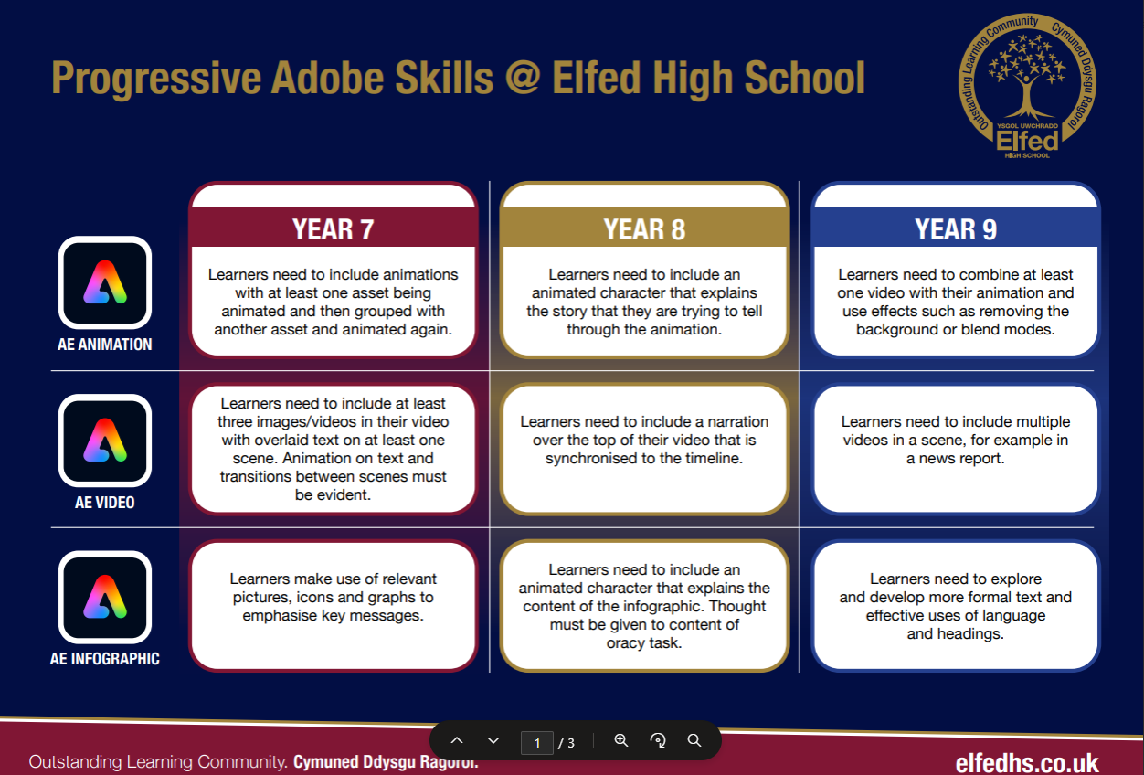

Slide 7
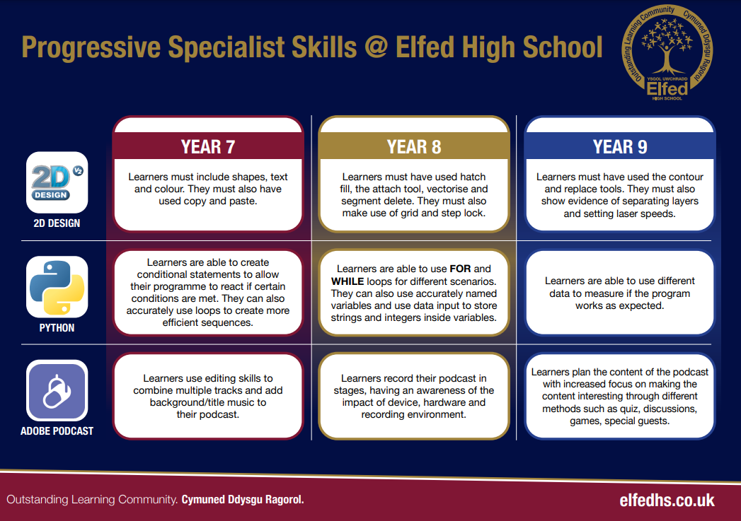

Slide 8
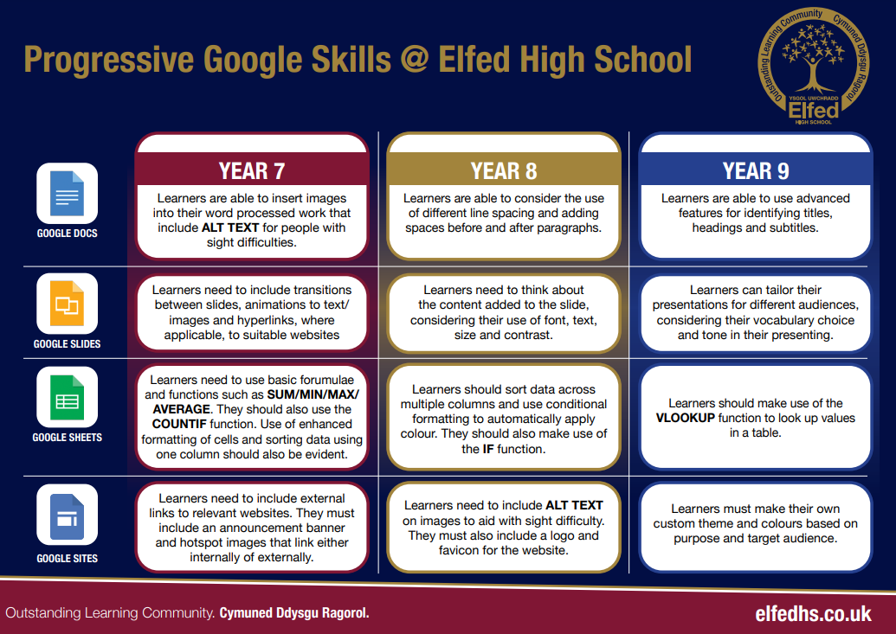

Slide 9
Computational Thinking for Dance Sequence
Year Group | Decomposition (breaking down task) | Pattern Recognition (spotting similarities/repetition) | Abstraction (focusing on essentials) | Algorithmic Thinking (step-by-step instructions)
Year 7 | Break down a short dance into simple moves (e.g., jump, clap, turn). | Notice repeated moves or rhythms in the sequence. | Focus only on the main moves (ignore small variations like hand position). | Write a set of instructions for a partner to copy the sequence.
Year 8 | Break down a longer sequence into sections (intro, main, ending). | Identify repeating motifs or sequences across the sections. | Simplify the sequence by grouping similar moves into categories (e.g., spins, steps, gestures). | Design a flowchart or pseudocode to show the order of moves.
Year 9 | Break a complex performance into layers (footwork, upper body, timing, group formations). | Compare different dance sequences to find shared patterns. | Abstract style-specific details (e.g., hip hop vs ballet) and describe a generalised sequence. | Create an algorithm that can be repeated with variations (loops, conditional steps like “if music slows, do X”).

Slide 10
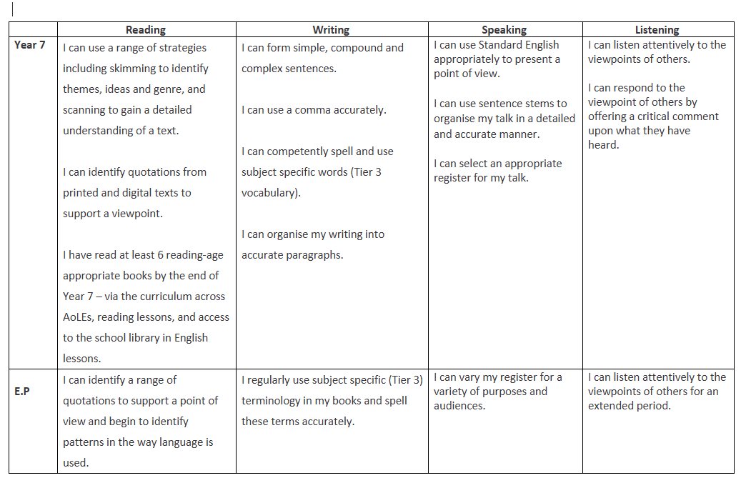
PE Plan
Literacy Progression

Slide 11
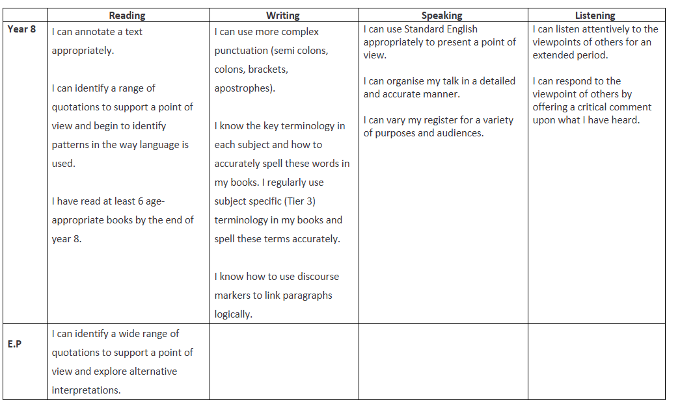
PE Plan
Literacy Progression

Slide 12
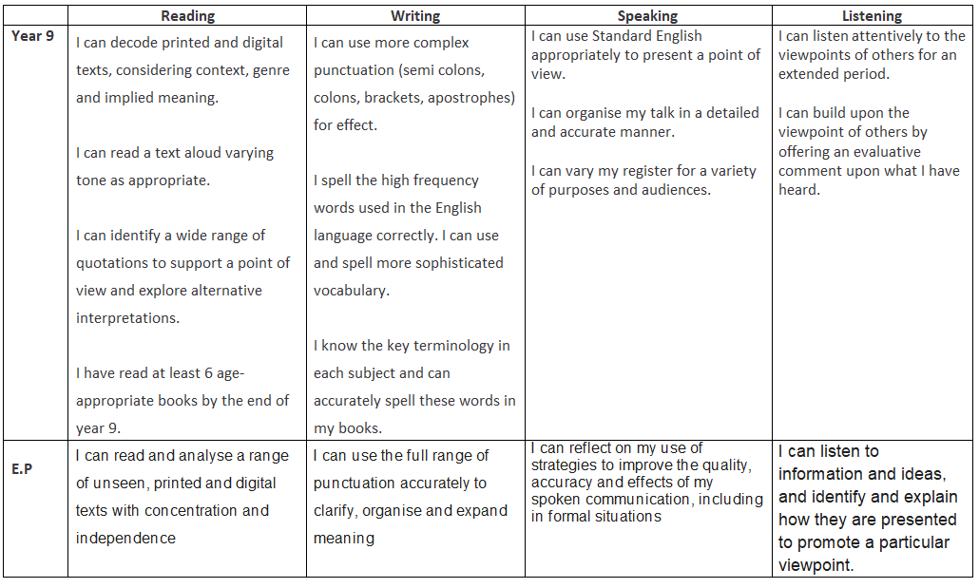
PE Plan
Literacy Progression

Slide 13
Oracy & Key Words in Physical Education (Progression)
Year Group | Oracy Focus (speaking & listening skills) | Key Words / Vocabulary | Progressive Task Example
Year 7 | Use simple, clear sentences to describe actions and explain choices. Listen to peers and repeat key ideas. | Pass, defend, attack, warm-up, cool-down, fitness, teamwork, space, movement | Pupils describe the rules of a game in pairs, using key words to explain what they are doing.
Year 8 | Begin to justify decisions and give feedback to peers using correct terminology. Use extended sentences. | Agility, coordination, accuracy, balance, strength, speed, tactics, strategy, communication | In small groups, pupils explain the tactics used in a game, giving feedback with at least three subject-specific terms.
Year 9 | Lead discussions, debates or team talks, using precise vocabulary. Evaluate performance and suggest improvements with evidence. | Cardiovascular endurance, muscular endurance, flexibility, power, reaction time, resilience, leadership, evaluation | Pupils deliver a mini-coaching session, explaining techniques, giving constructive feedback, and summarising improvements using advanced vocabulary.

Slide 14
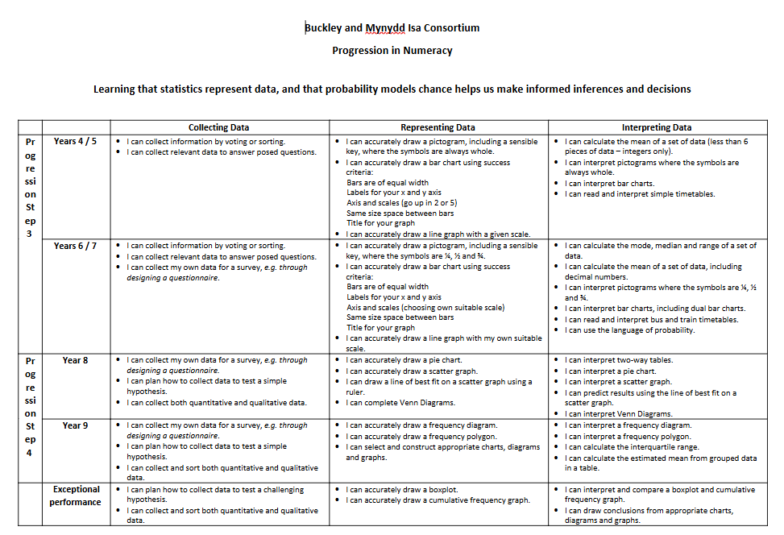

Slide 15
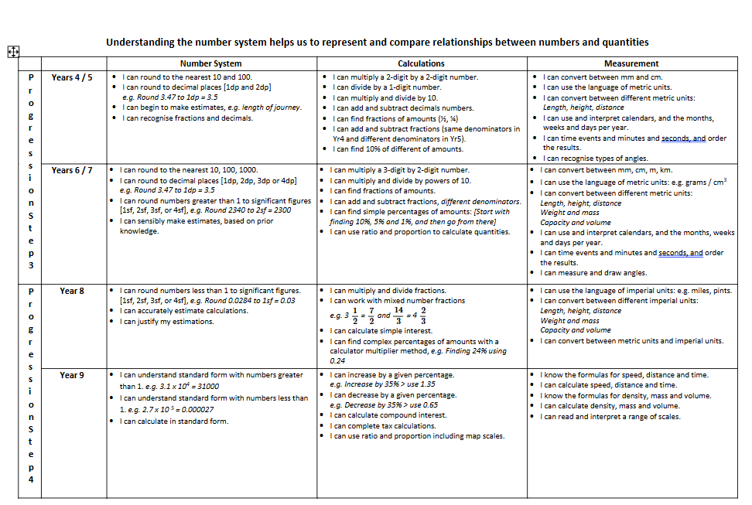

Slide 17
Numeracy in Physical Education (Progression)
Year Group | Numeracy Focus | Key Skills | Progressive Task Example
Year 7 | Basic counting, measuring, and timing. | - Counting repetitions - Using stopwatches - Measuring distance/height | Pupils record how many passes are made in 1 minute, or measure how far they can throw a ball.
Year 8 | Interpreting and comparing data. | - Averages (mean) - Simple percentages - Reading tables/graphs | Pupils time 3 sprints, calculate their average sprint time, and compare with peers’ results.
Year 9 | Applying data analysis to performance. | - Speed = distance ÷ time - Heart rate zones - Percentages for improvement - Interpreting line/bar graphs | Pupils record heart rates before/after exercise, calculate percentage increase, and present results on a graph to evaluate fitness levels.

Slide 18
Year 7

Slide 19
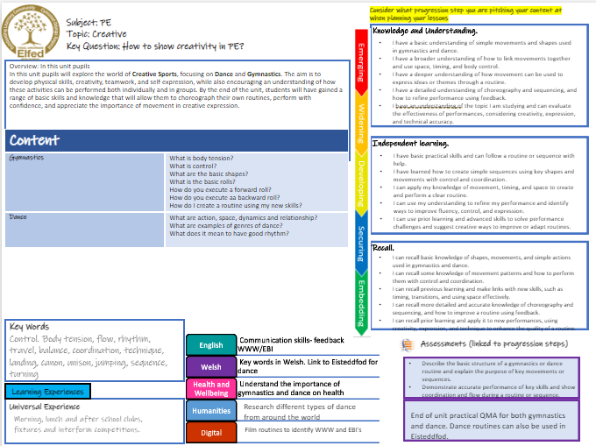

Slide 20

Subject: PE
Topic: Health & fitness
Key Question:
Knowledge and understanding
I have a basic understanding of the importance of regular exercise and how different activities can improve my fitness.
I have a broader understanding of how to take part in group fitness activities and can follow simple routines to stay active.
I have a deeper understanding of how fitness components like strength, flexibility, and endurance work together to improve my overall health.
I have a detailed understanding of different fitness strategies and can apply them to set personal goals and improve my performance in PE.
I understand the importance of teamwork, fair play, and can reflect on how fitness activities help develop life skills such as motivation, resilience, and cooperation.
In this unit, pupils will build on their understanding of how exercise helps improve health, fitness, and overall wellbeing. Health and fitness activities in PE for Year 7 include cross country running, swimming, and fitness-based challenges. These activities help pupils improve key areas such as stamina, strength, flexibility, and endurance. They will learn how the body responds to exercise and how to warm up, cool down, and train safely. Pupils will set personal goals, challenge themselves, and begin to understand the importance of staying active for both physical and mental health. This unit encourages pupils to develop resilience, motivation, and a positive attitude toward lifelong fitness. Lesson objective
Independent learning
I have basic practical skills and can take part in fitness activities by following instructions with support.
I have learned how to take responsibility for my participation and can follow safety rules during fitness tasks and exercises.
I can apply my knowledge of fitness techniques and movement to improve my personal performance during PE lessons.
I can use my understanding to reflect on my performance and suggest ways to improve my fitness and overall effort.
I can use advanced skills and prior learning to solve problems during physical challenges and suggest different exercises or strategies to meet fitness goals.
Content
Cross County Can I explain what endurance means and why it is important? Can I pace myself effectively? Can I demonstrate the correct running technique? | I know what the correct technique of running is. I can show how I pace myself effectively during a long-distance run. I understand what endurance means and why it is important in PE.
Fitness What are the components of fitness? Can I measure my fitness using simple tests? What body parts are used for different exercises? | I know what the different components of fitness are and what exercise I can do to develop these. I can take part in fitness activities safely and with the correct techniques. I understand how regular exercise benefits my physical, mental and social health.
Swimming What is water confidence? What are the basic swimming strokes? What are the different body positions to move efficiently through the water? | I know what water confidence is and why it is important to stay safe. I can perform the 4 basic swimming strokes with the correct technique. I can identify different body positions to move efficiently through the water. I understand why it is important to be safe in the water and develop key life-saving skills.
Questioning
I can ask and answer basic questions about the benefits of physical activity and why fitness is important for my health.
I can ask questions about different types of exercise and respond by explaining how they help improve strength, flexibility, and endurance.
I can use questioning to explore previous learning and respond by making links with new skills, such as goal setting, teamwork, and motivation.
I can ask more detailed questions and give accurate responses about how specific exercises and techniques support different fitness goals and overall wellbeing.
I can ask and respond to questions that apply prior learning to create fitness plans, solve challenges, and improve personal health and performance.
Key Words
Running, pace, endurance, breathing, self-motivation, floating, water confidence, gliding, treading water, warm up, cool down, fitness, components of fitness.
English
Welsh
Health and Wellbeing
Humanities
Digital
Assessments (linked to progression steps)
Communicate with teammates
Discuss names of sports and skills in Welsh
Describe what health and fitness is and why it is important in your daily life.
Demonstrate accurate performance technique and safety during a competitive scenario or skills activity.
Learning Experiences
Appreciate the importance of a healthy lifestyle
Universal Experience
Morning, lunch and after school clubs, fixtures and interform competitions.
Discuss the origin of each sport and countries' national sports
End of unit practical QMA for each area of learning.
Record and analyse skill technique

Slide 21
Subject: PE
Topic: Striking & Fielding
Key Question:
Independent learning.
Problem solving.
Knowledge and Understanding.
I have a basic understanding of the rules and roles in striking and fielding games, such as batting, bowling, and fielding.
I understand how to work effectively as part of a team and can apply simple tactics, like choosing where to hit the ball or where to field.
I have a deeper understanding of how teamwork, communication, and fielding positions impact success in cricket and rounders.
I can explain and apply more advanced game strategies, such as setting a fielding formation or rotating the batting order for best results.
I understand the importance of teamwork, fair play, and can reflect on how striking and fielding games help build life skills like leadership, decision-making, and cooperation.
Overview: Year 7 pupils will enjoy fun and active games like rounders and cricket, where they work together as a team to score runs and get the other team out. These games help improve skills such as throwing, catching, hitting, and running, while also encouraging quick thinking and good teamwork.
By playing rounders and cricket, pupils will learn how to communicate, share, and support each other, as well as how to follow rules and play fairly. These games also help build fitness, confidence, and friendships. It’s a great way to stay active and learn what it means to be a valuable team player.
No. of lessons__________ Lesson objectives
Content
Rounders/Softball What are the basic rules and roles? What is the correct technique to hit a ball? What are the most effective ways to bowl? What are the most effective ways to field? | I know what the basic rules and roles are in rounders/softball. I can show the basic skills of rounders/softball in a competitive scenario I understand the correct technique of bowling/fielding and batting and can show this in a competitive game.
Cricket What are the basic rules of and positions in cricket? How do I bat and bowl with the correct technique? How do I work effectively with teammates during a match | I know what cricket is and what the basic skills are, such as bowling, batting and fielding. I can show the basic skills of cricket in a competitive scenario. I understand how to work effectively with team mates to score runs and get the opposition out in a game.
I have basic practical skills and can take part in striking and fielding games by following instructions and working with support.
I have learned how to take on different roles such as batter, bowler, and fielder, and can follow the rules to contribute to the game.
I can use my understanding of simple tactics and fielding positions to help my team perform more effectively during a game.
I can reflect on my own performance in batting, bowling, and fielding, and suggest ways to improve teamwork and tactics.
I can apply advanced skills and previous experience to solve problems during gameplay and suggest tactical changes or fielding formations to support my team.
I can identify and solve basic problems in striking and fielding games, such as deciding when to bat or bowl and how to score effectively.
I can analyze key roles and positions during gameplay and make decisions about where to hit or throw to gain an advantage.
I can use my understanding of communication, teamwork, and game awareness to solve challenges and adapt strategies during play.
I can evaluate different game strategies and adjust my role (e.g., wicketkeeper, backstop, deep fielder) to support overall team performance in response to changing situations.
I can apply problem-solving skills and tactical thinking from previous lessons to new game scenarios, helping my team improve performance and respond effectively under pressure.
Key Words
Teamwork, communication, respect, rules, positions, tactics, batting, bowling, fielding, technique
English
Welsh
Health and Wellbeing
Humanities
Digital
Communicate with teammates
Assessments (linked to progression steps)
Discuss names of sports and skills in Welsh
Describe the structure of a cricket/rounders team and the roles or positions of some key players.
Demonstrate accurate performance and teamwork during a small-sided game or skills activity.
Learning Experiences
Appreciate the importance of a healthy lifestyle
Universal Experience
Morning, lunch and after school clubs, fixtures and interform competitions.
Discuss the origin of each sport and countries' national sports
End of unit practical QMA for each team game taught.
Record and analyse skill technique

Slide 22
Consider what progression step you are pitching your content at when planning your lessons
Subject: PE
Topic: Team Games Yr 7
Key Question:
Independent learning.
Skills.
Knowledge and Understanding.
I have a basic understanding of the rules and roles in team games.
I have a broader understanding of how to work as part of a team and use basic tactics during games.
I have a deeper understanding of how teamwork, communication, and positioning affect performance in different team games.
I have a detailed understanding of game strategies and can apply them in different sporting situations.
I have an understanding of the importance of teamwork, fair play, and can reflect on how team games help develop life skills such as leadership and cooperation.
Overview: In this unit pupils will build on their basic knowledge of team games. Team games in PE for Year 7 pupils are fun and active games where they will work together with others to try and win as a team. These games, like football, netball, hockey and rugby, help you get better at moving, thinking quickly, and working with others. They also teach you important skills such as sharing, listening, and being kind to teammates. By playing team games, you get fitter, make friends, and learn how to play fairly and follow rules. It’s a great way to enjoy being active while learning how to be part of a team. No. of lessons__________ Lesson objectives
Content
Football What is passing? What is dribbling? How do you attack/defend in football? What are the positions in a game? | I know what football is and what the basic skills, such as passing and dribbling, in are. I can show the basic skills of football in a competitive scenario I understand basic tactics such as attacking/defending and the positions in a game
Netball What is passing? What is footwork? How do you attack/defend in netball? What are the positions in a game? | I know what netball is and what the basic skills, such as passing and footwork, in are. I can show the basic skills of netball in a competitive scenario I understand basic tactics such as attacking/defending and the positions in a game
Hockey | I know what hockey is and what the basic skills, such as passing and dribbling, in are. I can show the basic skills of hockey in a competitive scenario I understand basic tactics such as attacking/defending and the positions in a game
Rugby | I know what rugby is and what the basic skills, such as passing and tackling, in rugby are. I can show the basic skills of rugby in a competitive scenario I understand basic tactics such as attacking/defending and the positions in a game
Rules | I can understand and apply the basic rules of team games, demonstrating fair play and respect for others during gameplay
I have basic practical skills and can take part in team games by following instructions with help.
I have learned how to take on different roles in a team and can follow rules to contribute to the game.
I can apply my knowledge of tactics and positions to help my team perform better during a game.
I can use my understanding to reflect on my performance and suggest ways to improve teamwork and strategy.
I can use advanced skills and prior learning to solve problems in gameplay and suggest different tactics or formations to support my team.
What is passing?
What is dribbling?
How do you attack/defend in a game?
When do you use your strong stick/reverse?
I can perform basic team game skills such as passing, catching, and moving into space following the main rules.
I can understand simple team roles and positions and use basic tactics like passing to a teammate or marking an opponent.
I can combine previous skills with communication and teamwork to support my team during play.
I can demonstrate more accurate and controlled team game skills and begin to apply simple strategies to improve team performance.
I can use my skills in different game situations, adapting my technique to support my team’s tactics and overall success.
What is passing?
What is tackling?
How do you attack/defend in a game?
Key Words
Teamwork, communication, respect, rules, positions, tactics, passing, dribbling, tackling, footwork, rules.
English
Welsh
Health and Wellbeing
Humanities
Digital
Assessments (linked to progression steps)
Communicate with teammates
Discuss names of sports and skills in Welsh
Describe the structure of a team game and the roles or positions of some key players.
Demonstrate accurate performance and teamwork during a small-sided game or skills activity.
Learning Experiences
Appreciate the importance of a healthy lifestyle
Universal Experience
Morning, lunch and after school clubs, fixtures and interform competitions.
Discuss the origin of each sport and countries' national sports
End of unit practical QMA for each team game taught.
Record and analyse skill technique

