Slide 1
PE Unit Overviews

Slide 2

Subject: PE
Overview of Topics
Term | 1A | 1B | 2A | 2B | 3A | 3B
Year 7 | Teams Games/Fitness | Creative/ Swimming | Swimming | Fitness | Athletics | Striking and Fielding
Year 8 | Teams Games/Fitness | Creative/ Swimming | Swimming | Fitness | Athletics | Striking and Fielding
Year 9 | Teams Games/Fitness | Creative/ Swimming | Swimming | Fitness | Athletics | Striking and Fielding
Year 10 | Teams Games/Fitness | Teams Games | Health and fitness | Fitness | Athletics | Striking and Fielding
Year 11 | Teams Games/Fitness | Teams Games | Fitness | Fitness

Slide 3
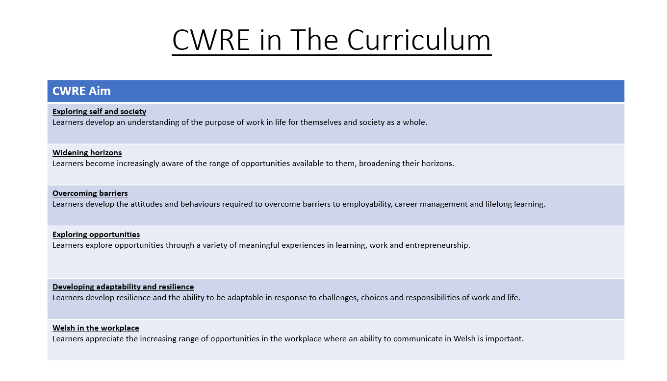

Slide 4
PE Plan – Lower School
Careers
Term | 1 | 2 | 3
Year 7 | 1a: Who am I? 1b. Exploring Possibilities – Dream Jobs! | 2a. What is a career in my subject? 2b. What is an entrepreneur? Can my subject lead me to be one? | 3a. What is work-life balance? 3b. Careers and the future
Year 8 | 1a. What are my interests? 1b. Job applications and CV’s – how can my subject enhance mine? | 2a. Challenges and rewards of work 2b. Creating the life you want – how can skill development in my subject help? Create a vision board | 3a. What does success mean to me? What does it look like in my subject? 3b. Careers and the climate
Year 9 | 1a. What are my skills? 1b. What comes after school? Learning pathways for my subject | 2a. Decision making – choosing what to study at KS4. 2b. Taking control of your career journey. How to overcome potential barriers | 3a. Working and earning, managing your money 3b. What is the labour market and what is it saying about jobs in your subject sector?

Slide 5
PE Plan Upper School
Careers
Term | 1 | 2 | 3
Year 10 | 1a: Interests and Skills Profile – what makes you good at this subject? How will your skills transfer into the world of work? 1b. Preparing to go on work experience. How is skill development in my subject helping you prepare? | 2a. In person, hybrid, remote. What works best for your subject sector? 2b. Taking control of your career journey. How to overcome potential barriers | 3a. Wellbeing in the workplace. Discuss jobs linked to your subject and the possible challenges employees may face. 3b. What are my employability skills? How does my subject make students employable.
Year 11 | 1a. Post 16 Choices in my subject 1b. Decision making – choosing your post 16 pathway. What pathways are available linked to your subject? | 2a. Money talks – apprenticeships vs higher education in your subject

Slide 6
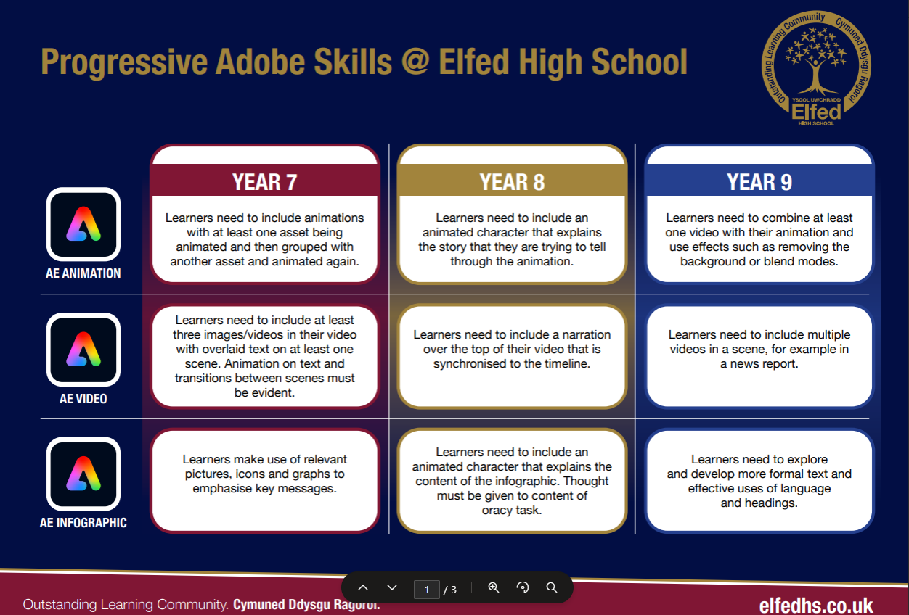

Slide 7
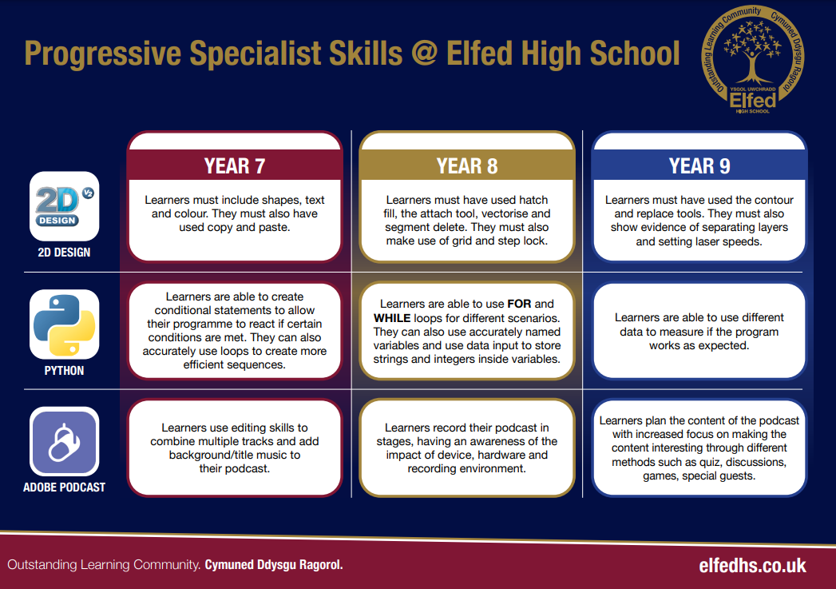

Slide 8
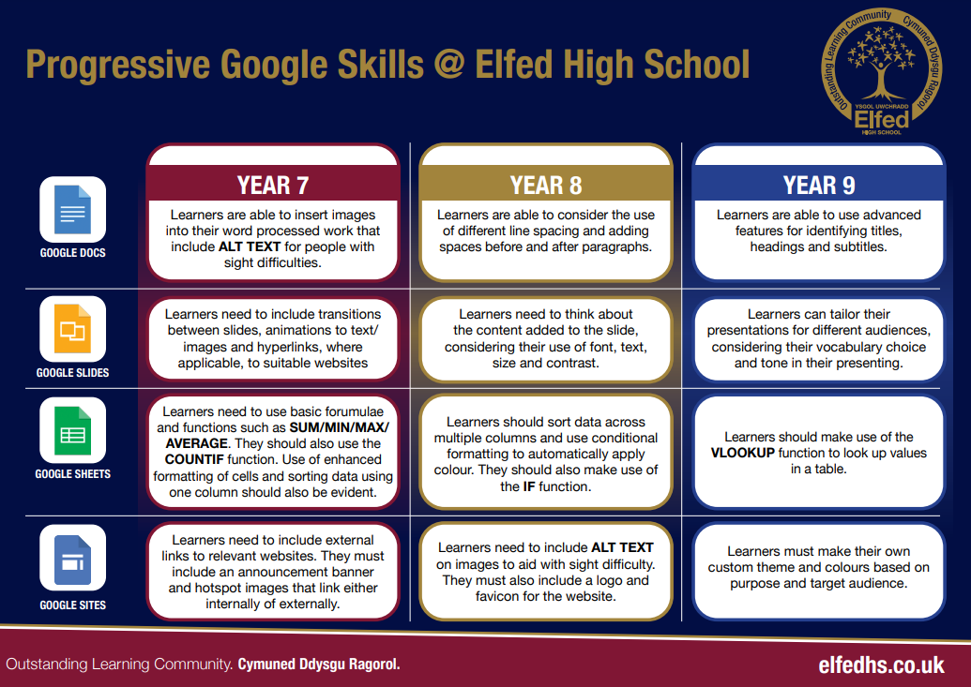

Slide 9
Computational Thinking for Dance Sequence
Year Group | Decomposition (breaking down task) | Pattern Recognition (spotting similarities/repetition) | Abstraction (focusing on essentials) | Algorithmic Thinking (step-by-step instructions)
Year 7 | Break down a short dance into simple moves (e.g., jump, clap, turn). | Notice repeated moves or rhythms in the sequence. | Focus only on the main moves (ignore small variations like hand position). | Write a set of instructions for a partner to copy the sequence.
Year 8 | Break down a longer sequence into sections (intro, main, ending). | Identify repeating motifs or sequences across the sections. | Simplify the sequence by grouping similar moves into categories (e.g., spins, steps, gestures). | Design a flowchart or pseudocode to show the order of moves.
Year 9 | Break a complex performance into layers (footwork, upper body, timing, group formations). | Compare different dance sequences to find shared patterns. | Abstract style-specific details (e.g., hip hop vs ballet) and describe a generalised sequence. | Create an algorithm that can be repeated with variations (loops, conditional steps like “if music slows, do X”).

Slide 10
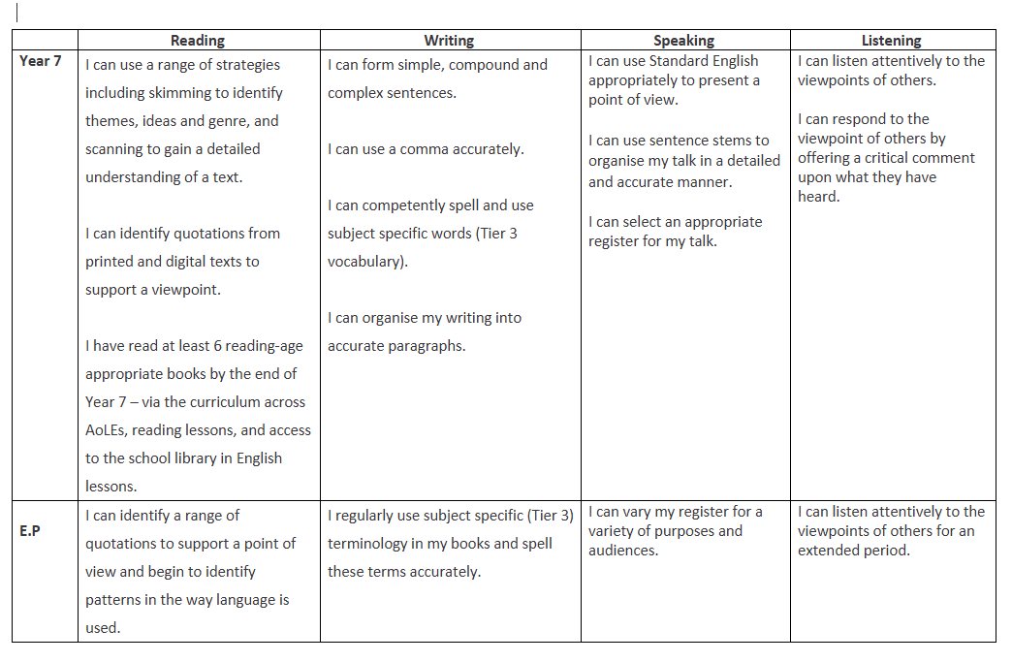
PE Plan
Literacy Progression

Slide 11
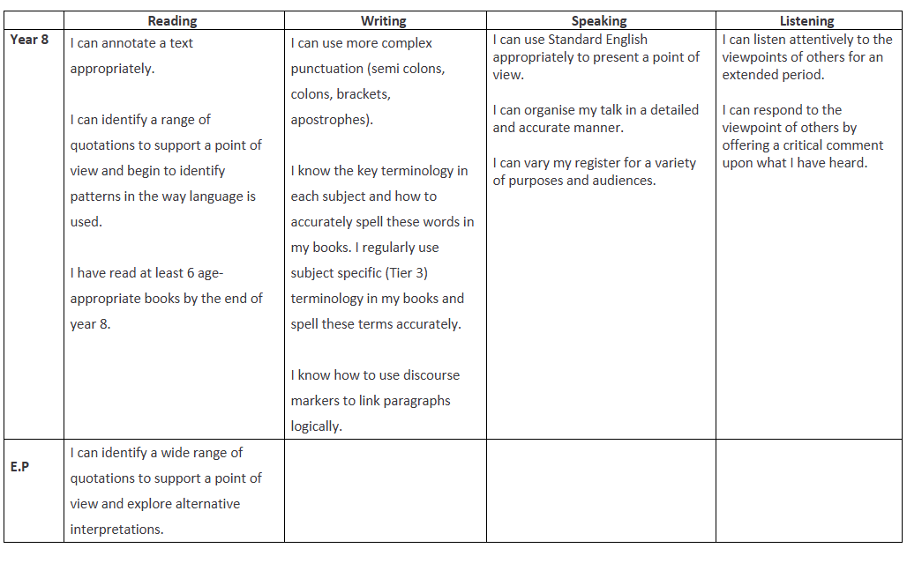
PE Plan
Literacy Progression

Slide 12
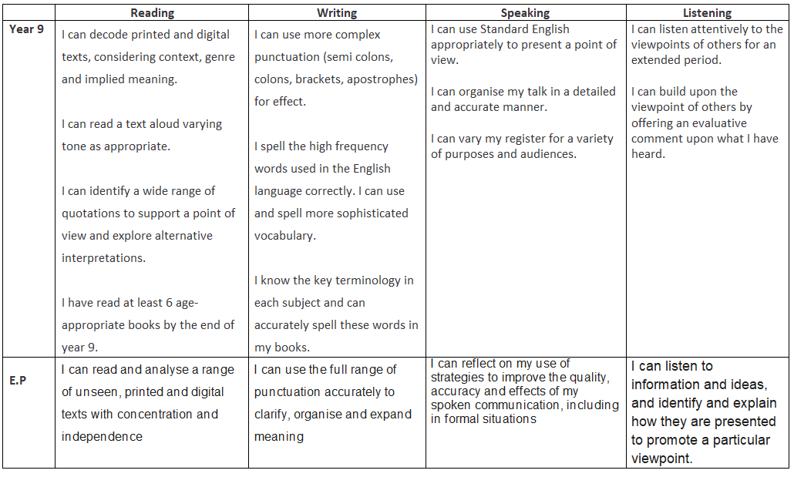
PE Plan
Literacy Progression

Slide 13
Oracy & Key Words in Physical Education (Progression)
Year Group | Oracy Focus (speaking & listening skills) | Key Words / Vocabulary | Progressive Task Example
Year 7 | Use simple, clear sentences to describe actions and explain choices. Listen to peers and repeat key ideas. | Pass, defend, attack, warm-up, cool-down, fitness, teamwork, space, movement | Pupils describe the rules of a game in pairs, using key words to explain what they are doing.
Year 8 | Begin to justify decisions and give feedback to peers using correct terminology. Use extended sentences. | Agility, coordination, accuracy, balance, strength, speed, tactics, strategy, communication | In small groups, pupils explain the tactics used in a game, giving feedback with at least three subject-specific terms.
Year 9 | Lead discussions, debates or team talks, using precise vocabulary. Evaluate performance and suggest improvements with evidence. | Cardiovascular endurance, muscular endurance, flexibility, power, reaction time, resilience, leadership, evaluation | Pupils deliver a mini-coaching session, explaining techniques, giving constructive feedback, and summarising improvements using advanced vocabulary.

Slide 14
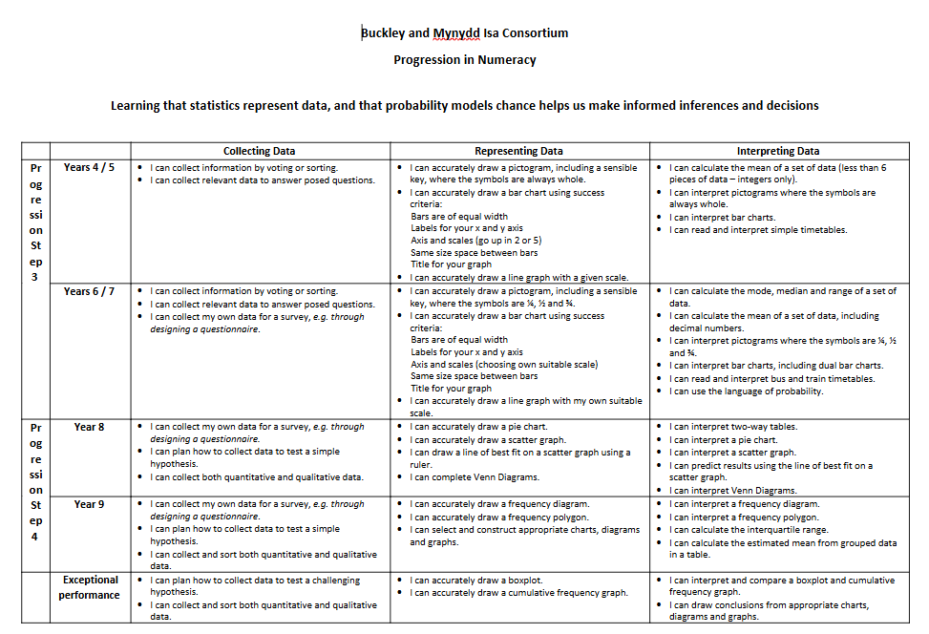

Slide 15
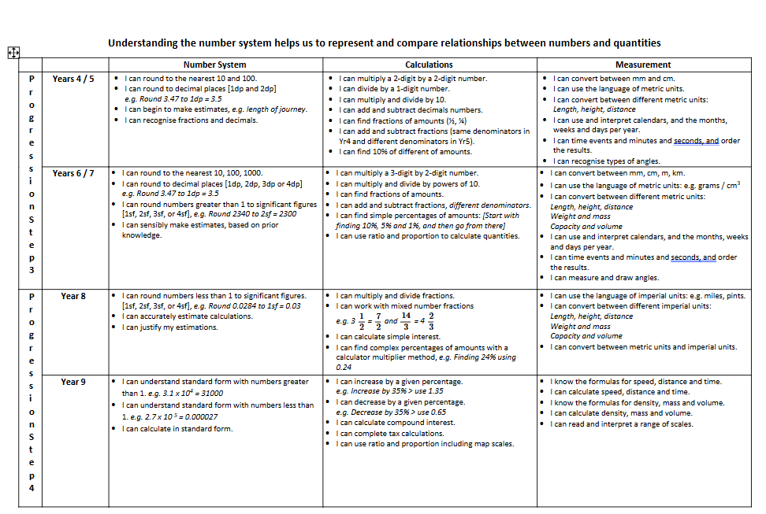

Slide 17
Numeracy in Physical Education (Progression)
Year Group | Numeracy Focus | Key Skills | Progressive Task Example
Year 7 | Basic counting, measuring, and timing. | - Counting repetitions - Using stopwatches - Measuring distance/height | Pupils record how many passes are made in 1 minute, or measure how far they can throw a ball.
Year 8 | Interpreting and comparing data. | - Averages (mean) - Simple percentages - Reading tables/graphs | Pupils time 3 sprints, calculate their average sprint time, and compare with peers’ results.
Year 9 | Applying data analysis to performance. | - Speed = distance ÷ time - Heart rate zones - Percentages for improvement - Interpreting line/bar graphs | Pupils record heart rates before/after exercise, calculate percentage increase, and present results on a graph to evaluate fitness levels.

Slide 18
Year 9

Slide 19
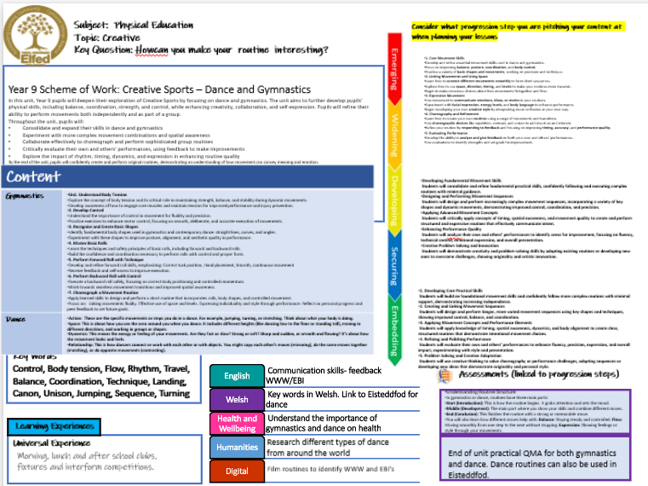

Slide 20

Consider what progression step you are pitching your content at when planning your lessons
Subject: PE
Topic: Health & Fitness
Key Question:
Independent learning.
Questioning.
Knowledge and Understanding.
I have a well-developed understanding of how regular physical activity supports physical, mental, and emotional health, and I can explain how different types of training target specific aspects of fitness.
I can confidently participate in and lead aspects of group fitness activities, showing initiative, adaptability, and the ability to support others in maintaining motivation and focus.
I can analyse how the components of fitness—such as muscular strength, cardiovascular endurance, flexibility, agility, and power—combine to influence performance across different physical activities.
I can design, implement, and evaluate a personal fitness plan, using a variety of training methods and data to track progress, make adjustments, and improve overall performance.
IIn this unit, pupils will extend their understanding of how exercise influences physical health, fitness, and overall wellbeing, with a focus on long-term lifestyle management. Year 9 activities may include advanced cross country running, competitive swimming, high-intensity circuit training, and varied fitness challenges targeting cardiovascular endurance, muscular strength, flexibility, power, and agility. Pupils will critically explore the physiological and psychological adaptations the body undergoes in response to different training methods. They will develop skills to design and implement effective warm-ups and cool-downs tailored to specific activities and understand the principles of safe, efficient, and progressive training. This unit encourages pupils to cultivate self-discipline, leadership, and a lifelong commitment to physical fitness and healthy living. Lesson objective
Content
Cross County Can I use self-monitoring techniques, such as heart rate or perceived exertion, to regulate pace and enhance endurance during runs. | I understand the science behind endurance training, including energy systems and recovery, and apply this knowledge to improve my performance. I can use self-monitoring techniques, such as heart rate or perceived exertion, to regulate pace and enhance endurance during runs.
Fitness Can I explain in detail the components of fitness and how they interrelate to influence athletic performance across a variety of sports? | I can design safe and effective training plans that incorporate varied exercises targeting multiple fitness components, adapting these plans based on progress and feedback. I understand and can articulate the broader benefits of exercise on mental health, stress management, and social wellbeing, supporting a holistic approach to fitness. .
Swimming Can I perform, analyse, and refine the technical aspects of all competitive swimming strokes, including starts, turns, and finishes? | I demonstrate leadership in promoting water safety, including the ability to perform key life-saving skills and assist others in emergency situations. I use video analysis and other feedback methods to critically evaluate my swimming technique and plan targeted improvements to enhance performance and endurance.
I demonstrate confident and refined practical skills across a variety of fitness activities, showing control, accuracy, and an ability to follow complex instructions independently.
I take full responsibility for preparing safely and working effectively in fitness tasks, applying knowledge of safe practice and risk assessment without needing supervision.
I can adapt and apply advanced fitness techniques and movement skills to enhance my performance, and I understand how to modify exercises to suit different goals or contexts.
I regularly evaluate my performance in detail, using feedback and fitness data to set challenging targets and make informed decisions about how to improve my overall fitness and effort.
I can analyze and discuss the complex physical, mental, and social benefits of consistent physical activity, including its role in preventing lifestyle-related diseases.
I can critically assess a variety of exercise types and training methods, explaining how they develop specific fitness components such as anaerobic capacity, muscular power, agility, and flexibility, and how these relate to different sports and activities.
I can use reflective questioning to integrate prior knowledge with advanced concepts such as periodization, psychological skills (e.g., focus, resilience), leadership roles, and motivation strategies in team and individual performance contexts.
I can formulate detailed questions and provide evidence-based responses about how tailored training programs, exercise techniques, and sports science principles support specific performance goals and overall health optimization.
I can independently design, implement, and evaluate personalized fitness and training plans, incorporating problem-solving to overcome performance barriers and promote long-term physical and mental wellbeing.
Key Words
Muscular strength, power, muscular endurance, training zones, aerobic, anaerobic.
English
Welsh
Health and Wellbeing
Humanities
Digital
Assessments (linked to progression steps)
Communicate with teammates
Discuss names of sports and skills in Welsh
Describe what health and fitness is and why it is important in your daily life.
Demonstrate accurate performance technique and safety during a competitive scenario or skills activity.
Learning Experiences
Appreciate the importance of a healthy lifestyle
Universal Experience
Morning, lunch and after school clubs, fixtures and interform competitions.
Discuss the origin of each sport and countries' national sports
End of unit practical QMA for each area of learning.
Record and analyse skill technique

Slide 21
Consider what progression step you are pitching your content at when planning your lessons
Subject: PE
Topic: Striking & Fielding
Key Question:
Independent learning.
Problem solving.
Knowledge and Understanding.
I have a confident and detailed understanding of the rules, roles, and responsibilities in rounders and cricket, and I can apply them accurately in competitive game situations.
I can contribute to team performance by using tactical decision-making, such as anticipating play, manipulating shot placement, and organising the field based on evolving match scenarios.
I understand how advanced communication, tactical positioning, and quick decision-making impact performance and can lead to team success in striking and fielding games.
I can explain and implement complex strategies, including dynamic fielding adjustments, flexible batting orders, and adapting plans mid-game to exploit the opposition’s weaknesses.
Through games like rounders and cricket, students will refine their understanding of advanced rules, specialised fielding roles, and complex tactical thinking. They will take increased ownership of team responsibilities—such as bowler, backstop, batter, or fielder—and make strategic decisions based on gameplay, such as manipulating field placements or exploiting weaknesses in the opposition. Pupils will also enhance key teamwork qualities, including clear leadership, decision-making under pressure, reading the game, and adapting tactics confidently during play to influence the outcome.
Content
Rounders/Softball How can I refine my technique to increase both accuracy and power when batting under pressure? What advanced techniques can I apply to bowl with greater control, consistency, and variation? How can I analyse the field to make tactical decisions about where to place the ball when batting? What rules and regulations must I follow to ensure fair play and strategic success in competitive rounders? | I have a secure understanding of the rules, roles, and scoring systems in rounders/softball and can apply them confidently in games. I can demonstrate consistent and effective use of key skills in rounders/softball during competitive situations. I understand and apply correct techniques for bowling, fielding, and batting, and can adapt them to improve performance in gameplay.
Cricket What are the key rules and tactical responsibilities of different roles and fielding positions in cricket? How can I refine my batting and bowling techniques to improve consistency and performance under pressure? | I have a detailed understanding of cricket rules and can explain how specific fielding roles contribute to tactical decision-making. I can apply rules confidently and adjust fielding positions to support changing team strategies during competitive play. I can consistently perform accurate batting and bowling techniques, making technical adjustments to improve outcomes. I communicate clearly with teammates and adapt team strategy effectively in response to the flow of the game.
I confidently apply practical skills in rounders and cricket, showing independence and control in game situations.
I take on key roles and apply rules accurately to support consistent team performance.
I use tactical awareness and positioning to influence gameplay and support strategic decisions.
I reflect critically on my roles and identify clear ways to improve team and personal performance.
I adapt advanced skills and tactics during play, adjusting strategies to respond effectively to challenges.
I can critically analyze complex game situations to make strategic decisions in batting, bowling, and field placement that maximize my team’s chances of success.
I can evaluate and adapt my understanding of specialist roles and positions, anticipating opponents’ tactics and responding effectively with precise hitting, throwing, or fielding choices.
I can lead and facilitate effective communication, teamwork, and tactical adjustments under pressure to solve challenges during high-stakes game situations.
I can synthesize knowledge of advanced strategies, including opposition analysis and situational awareness, to modify my role (e.g., wicketkeeper, backstop, deep fielder) in ways that optimize team performance.
I can independently design and implement problem-solving approaches and tactical plans that respond to unpredictable game scenarios, helping my team to outperform opponents consistently.
Key Words
Teamwork, communication, respect, rules, positions, tactics, batting, bowling, fielding, technique
English
Welsh
Health and Wellbeing
Humanities
Digital
Assessments (linked to progression steps)
Communicate with teammates
Discuss names of sports and skills in Welsh
Analyse the structure of a cricket/rounders team and evaluate how key roles contribute to team strategy and success.
Demonstrate consistent skill execution and tactical teamwork during competitive gameplay or advanced drills.
Learning Experiences
Appreciate the importance of a healthy lifestyle
Universal Experience
Morning, lunch and after school clubs, fixtures and interform competitions.
Discuss the origin of each sport and countries' national sports
End of unit practical QMA for each team game taught.
Record and analyse skill technique

Slide 22
Consider what progression step you are pitching your content at when planning your lessons
Subject: PE
Topic: Team Games Yr 9
Key Question:
Independent learning.
Skills.
Knowledge and Understanding.
I have a secure understanding of the rules, positions, and responsibilities in a range of team games.
I can work effectively within a team, applying a variety of tactics and making decisions based on the flow of the game.
I have a deeper understanding of how communication, positioning, and decision-making influence team performance.
I can analyse and apply more advanced game strategies, adapting them to different situations and opponents.
I understand the wider impact of teamwork, leadership, and fair play, and can reflect on how team games help build resilience, confidence, and cooperation.
Overview: In this unit, pupils will deepen their understanding of team games by building on the tactical knowledge, skill development, and teamwork introduced in earlier years. Through sports such as football, netball, hockey, and rugby, students will focus on refining technical skills, making effective decisions under pressure, and applying more advanced tactics during competitive gameplay. Pupils will also develop greater positional awareness, communication, and leadership within a team setting. The emphasis will be on understanding how to adapt strategies in response to the flow of the game, working collaboratively to solve problems in play, and taking responsibility for both individual and team performance. tives
Content
Football How can I use different types of passes effectively in game situations. How can I improve my decision-making when under pressure? How do I create and exploit space when attacking or defending? | I can select and perform the most effective type of pass depending on space, positioning and pressure from opponents. I know what factors influence decision-making in a game (e.g. time, space, opposition movement) I understand how manipulating space can give my team a tactical advantage in both attacking and defending phases of play.
Netball How can I use a range of passes effectively under pressure? How do the roles of different positions contribute to overall team success? How do I create and use space to support attacking paly? | I understand how timing, positioning and movement affect the success of passing in competitive situations. I can play effectively in different positions, fulfilling my role and supporting my team. I know how to use movement techniques such as dodging, driving and positioning to get free from a defender.
Hockey How can improve the accuracy, control and speed of my passing in game situations? What strategies can I use to maintain possession and move the ball up the pitch effectively? How do I create and use space to support attacking play? | I know the correct techniques for push pass, slap pass, and hitting in hockey. I can make effective decisions to retain possession and transition the ball through midfield into attacking areas. I understand how intelligent movement and spatial awareness improve attacking opportunities and scoring chances.
Rugby How can I improve the accuracy, timing and distance of my passing under pressure? How can I use communication and support play to maintain possession and progress up the pitch? What strategies can I use to defend as a team and regain possession? | I understand how pressure, positioning, and timing affect the success of passing and ball retention in attack. I can communicate clearly and move into supporting positions to create attacking options. I can apply team-based defensive strategies such as drift defence or blitzing to put pressure on the opposition.
I can demonstrate a range of practical skills and take part confidently in team games, showing control and understanding of the rules.
I can perform effectively in different roles within a team, adapting to the demands of the game and contributing to team success.
I can apply tactical awareness and positional knowledge to influence the outcome of competitive situations.
I can reflect on my own and others’ performance to identify strengths and suggest improvements to teamwork and game strategy.
I can consistently use advanced techniques and prior learning to solve challenges in gameplay and adapt tactics or formations to support my team.
I can execute advanced team game skills with precision, speed, and strategic intent during high-pressure situations.
I can master specialist roles and positions, contributing to complex tactical systems such as zonal defense or structured attacks.
I can lead and coordinate communication and teamwork, combining technical skill and tactical awareness to influence team performance.
I can demonstrate a high level of skill adaptability, modifying techniques and tactics in response to evolving game contexts.
I can consistently apply and refine my skills to maximize team effectiveness, demonstrating leadership and an in-depth understanding of game dynamics.
Assessments (linked to progression steps)
English
Welsh
Health and Wellbeing
Humanities
Digital
Learning Experiences
Communicate with teammates
Explain the tactical structure of a team game and analyse how different positions contribute to overall team strategy.
Demonstrate consistent technical accuracy, decision-making, and effective teamwork during small-sided games and competitive scenarios.
Key Words
Teamwork, communication, respect, rules, positions, tactics, passing, dribbling, tackling, footwork, rules.
Discuss names of sports and skills in Welsh
Appreciate the importance of a healthy lifestyle
Universal Experience
Morning, lunch and after school clubs, fixtures and interform competitions.
Discuss the origin of each sport and countries' national sports
End of unit practical QMA for each team game taught.
Record and analyse skill technique

