Slide 1
PE Unit Overviews

Slide 2

Subject: PE
Overview of Topics
Term | 1A | 1B | 2A | 2B | 3A | 3B
Year 7 | Teams Games/Fitness | Creative/ Swimming | Swimming | Fitness | Athletics | Striking and Fielding
Year 8 | Teams Games/Fitness | Creative/ Swimming | Swimming | Fitness | Athletics | Striking and Fielding
Year 9 | Teams Games/Fitness | Creative/ Swimming | Swimming | Fitness | Athletics | Striking and Fielding
Year 10 | Teams Games/Fitness | Teams Games | Health and fitness | Fitness | Athletics | Striking and Fielding
Year 11 | Teams Games/Fitness | Teams Games | Fitness | Fitness

Slide 3
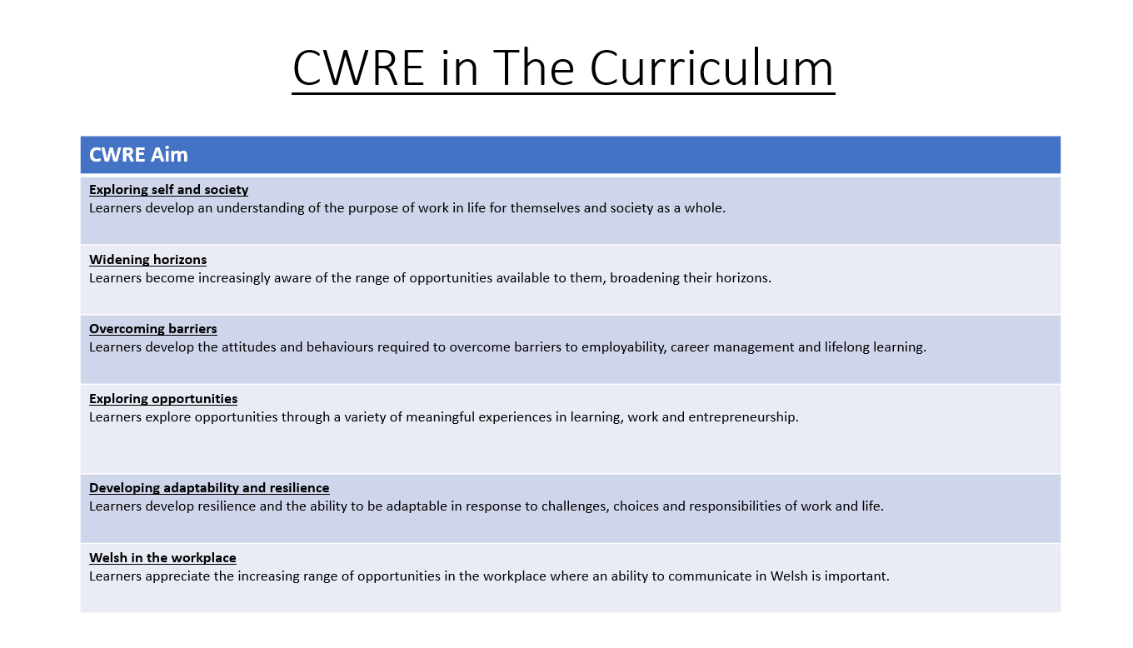

Slide 4
PE Plan – Lower School
Careers
Term | 1 | 2 | 3
Year 7 | 1a: Who am I? 1b. Exploring Possibilities – Dream Jobs! | 2a. What is a career in my subject? 2b. What is an entrepreneur? Can my subject lead me to be one? | 3a. What is work-life balance? 3b. Careers and the future
Year 8 | 1a. What are my interests? 1b. Job applications and CV’s – how can my subject enhance mine? | 2a. Challenges and rewards of work 2b. Creating the life you want – how can skill development in my subject help? Create a vision board | 3a. What does success mean to me? What does it look like in my subject? 3b. Careers and the climate
Year 9 | 1a. What are my skills? 1b. What comes after school? Learning pathways for my subject | 2a. Decision making – choosing what to study at KS4. 2b. Taking control of your career journey. How to overcome potential barriers | 3a. Working and earning, managing your money 3b. What is the labour market and what is it saying about jobs in your subject sector?

Slide 5
PE Plan Upper School
Careers
Term | 1 | 2 | 3
Year 10 | 1a: Interests and Skills Profile – what makes you good at this subject? How will your skills transfer into the world of work? 1b. Preparing to go on work experience. How is skill development in my subject helping you prepare? | 2a. In person, hybrid, remote. What works best for your subject sector? 2b. Taking control of your career journey. How to overcome potential barriers | 3a. Wellbeing in the workplace. Discuss jobs linked to your subject and the possible challenges employees may face. 3b. What are my employability skills? How does my subject make students employable.
Year 11 | 1a. Post 16 Choices in my subject 1b. Decision making – choosing your post 16 pathway. What pathways are available linked to your subject? | 2a. Money talks – apprenticeships vs higher education in your subject

Slide 6
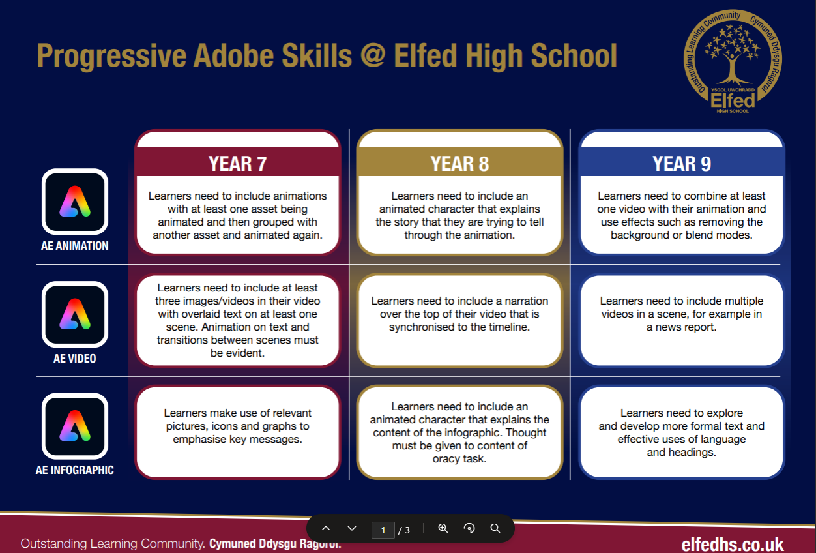

Slide 7
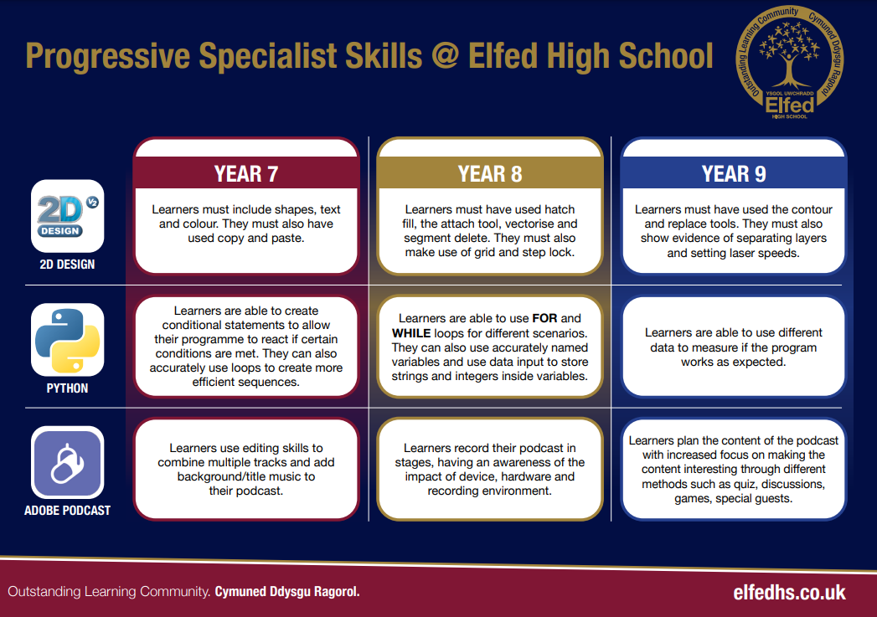

Slide 8
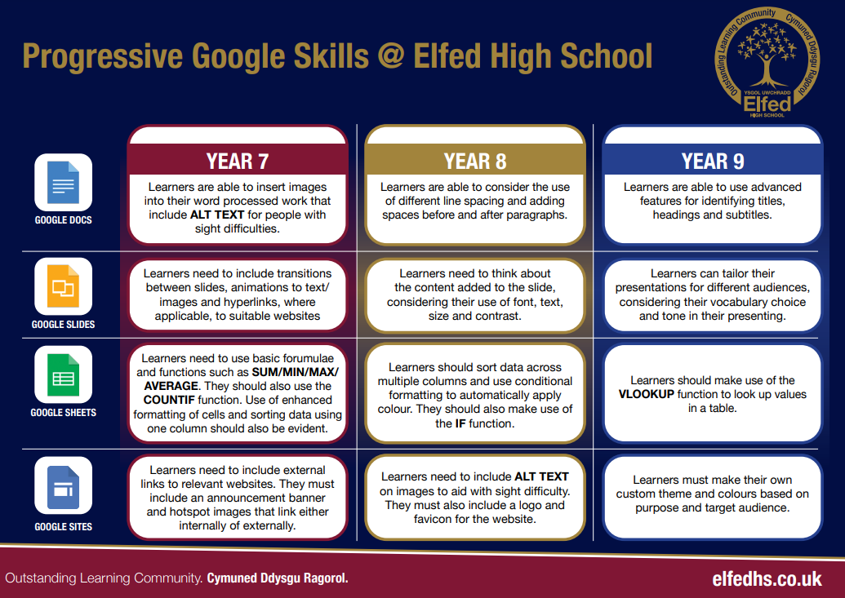

Slide 9
Computational Thinking for Dance Sequence
Year Group | Decomposition (breaking down task) | Pattern Recognition (spotting similarities/repetition) | Abstraction (focusing on essentials) | Algorithmic Thinking (step-by-step instructions)
Year 7 | Break down a short dance into simple moves (e.g., jump, clap, turn). | Notice repeated moves or rhythms in the sequence. | Focus only on the main moves (ignore small variations like hand position). | Write a set of instructions for a partner to copy the sequence.
Year 8 | Break down a longer sequence into sections (intro, main, ending). | Identify repeating motifs or sequences across the sections. | Simplify the sequence by grouping similar moves into categories (e.g., spins, steps, gestures). | Design a flowchart or pseudocode to show the order of moves.
Year 9 | Break a complex performance into layers (footwork, upper body, timing, group formations). | Compare different dance sequences to find shared patterns. | Abstract style-specific details (e.g., hip hop vs ballet) and describe a generalised sequence. | Create an algorithm that can be repeated with variations (loops, conditional steps like “if music slows, do X”).

Slide 10
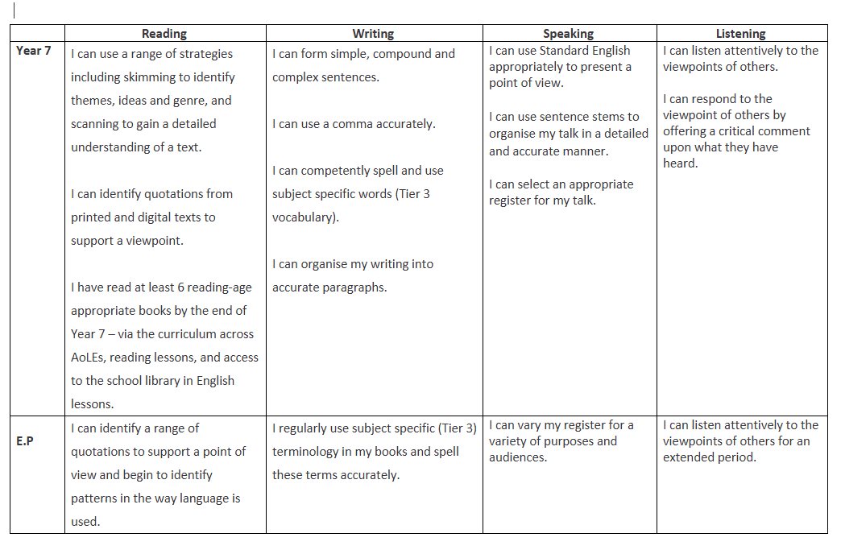
PE Plan
Literacy Progression

Slide 11
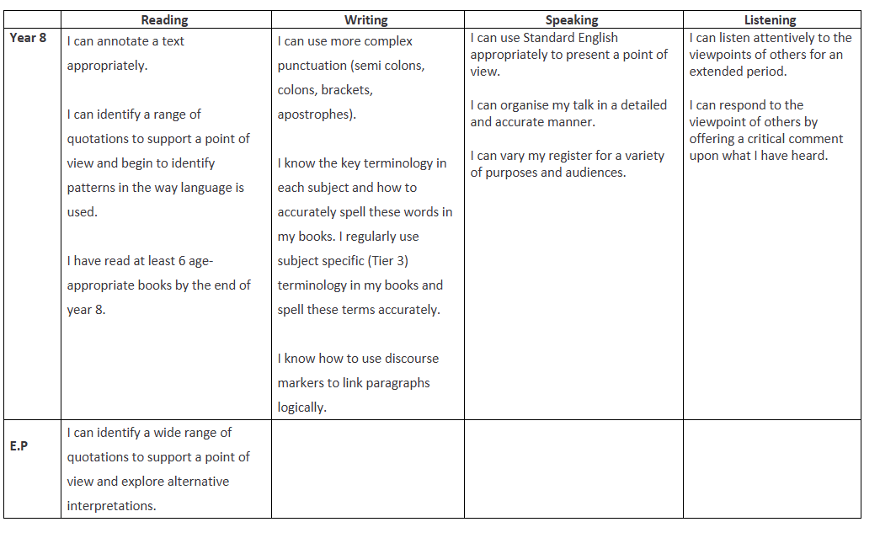
PE Plan
Literacy Progression

Slide 12
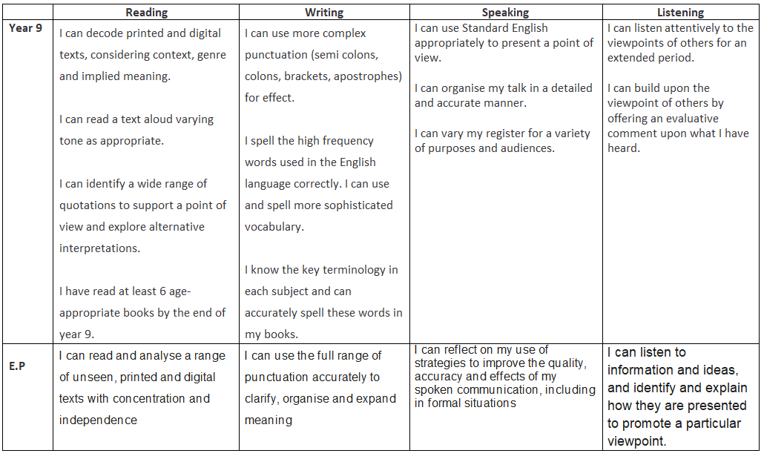
PE Plan
Literacy Progression

Slide 13
Oracy & Key Words in Physical Education (Progression)
Year Group | Oracy Focus (speaking & listening skills) | Key Words / Vocabulary | Progressive Task Example
Year 7 | Use simple, clear sentences to describe actions and explain choices. Listen to peers and repeat key ideas. | Pass, defend, attack, warm-up, cool-down, fitness, teamwork, space, movement | Pupils describe the rules of a game in pairs, using key words to explain what they are doing.
Year 8 | Begin to justify decisions and give feedback to peers using correct terminology. Use extended sentences. | Agility, coordination, accuracy, balance, strength, speed, tactics, strategy, communication | In small groups, pupils explain the tactics used in a game, giving feedback with at least three subject-specific terms.
Year 9 | Lead discussions, debates or team talks, using precise vocabulary. Evaluate performance and suggest improvements with evidence. | Cardiovascular endurance, muscular endurance, flexibility, power, reaction time, resilience, leadership, evaluation | Pupils deliver a mini-coaching session, explaining techniques, giving constructive feedback, and summarising improvements using advanced vocabulary.

Slide 14
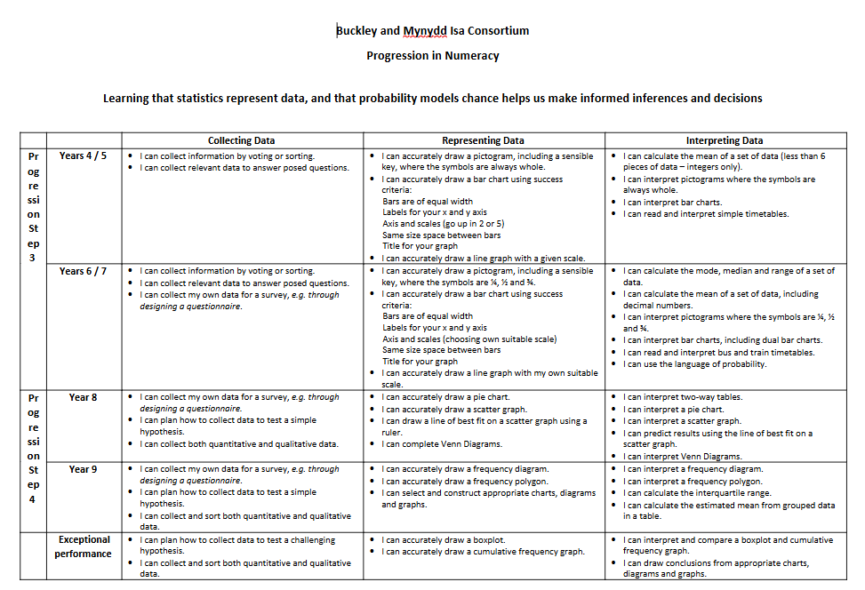

Slide 15
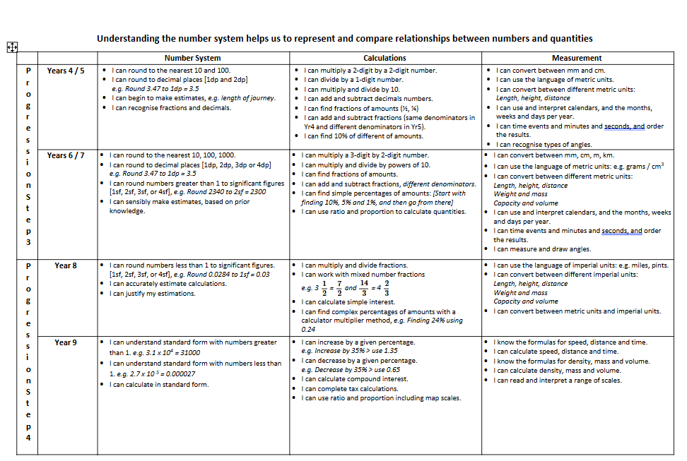

Slide 17
Numeracy in Physical Education (Progression)
Year Group | Numeracy Focus | Key Skills | Progressive Task Example
Year 7 | Basic counting, measuring, and timing. | - Counting repetitions - Using stopwatches - Measuring distance/height | Pupils record how many passes are made in 1 minute, or measure how far they can throw a ball.
Year 8 | Interpreting and comparing data. | - Averages (mean) - Simple percentages - Reading tables/graphs | Pupils time 3 sprints, calculate their average sprint time, and compare with peers’ results.
Year 9 | Applying data analysis to performance. | - Speed = distance ÷ time - Heart rate zones - Percentages for improvement - Interpreting line/bar graphs | Pupils record heart rates before/after exercise, calculate percentage increase, and present results on a graph to evaluate fitness levels.

Slide 18
Year 8

Slide 19
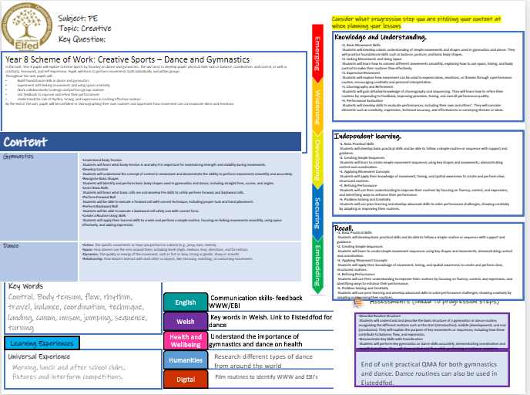

Slide 20

Subject: PE
Topic: Team Games
Key Question:
Independent learning.
Skills.
Knowledge and Understanding.
I have a developing understanding of the key rules, positions, and roles in team sports such as netball, football, hockey, and rugby.
I can work effectively as part of a team and apply basic tactics, such as creating space, marking opponents, or supporting the ball carrier.
I have a deeper understanding of how communication, teamwork, and positional play impact performance across different team games.
I can explain and apply more advanced strategies, such as set plays, transitions, and defensive structures, depending on the sport and game situation.
I recognise the value of teamwork, respect, and fair play, and can reflect on how participating in team sports helps develop important life skills like leadership, communication, and cooperation.
Overview: In this unit, pupils will build on their existing knowledge and experience of team games developed in Year 7. They will develop more advanced skills in games such as football, netball, hockey, and rugby, with a greater focus on tactical awareness, decision-making, and teamwork under pressure. Pupils will be encouraged to take on different roles within a team, adapt to changing game situations, and use communication to support effective team play. They will deepen their understanding of strategies, formations, and how to apply them to improve team performance. jectives
Content
Football How can I improve the accuracy and power of my passing and shooting? How can I use dribbling to keep possession and create space? What is my role in a specific position during a game? What makes an effective team in football? | I can use the correct technique to improve the accuracy and power of my passing and shooting in game situations. I know how dribbling can help me maintain possession and create attacking opportunities. I understand how to carry out the responsibilities of my position to support both attacking and defending phases of play. I can work effectively as part of a team, showing communication, support and tactical understanding to help achieve success.
Netball How can I improve the accuracy and speed of my passing in a game? How do I use footwork correctly to maintain possession? What are the responsibilities of different playing positions in netball? | I can use the correct passing techniques to improve the speed and accuracy of my passes during a game. I can apply the correct footwork rule consistently to keep possession and avoid giving away penalties. I understand how each position supports team play and how to adapt my movement and decisions based on my role
Hockey How can improve the accuracy and control of my passing in hockey? How do I use the correct grip and body position when tackling or intercepting? What are the key rules of hockey that I need to follow during a match? | I can demonstrate accurate and controlled passing using the appropriate technique. I know the correct grip and footwork required for a block or jab tackle. I understand the rules of hockey and how following them helps the game flow.
Rugby How can I improve the accuracy and distance of my passing? What are the roles and responsibilities of different positions in rugby? When should I pass, run or kick the ball during a game? | I know the correct hand position, grip and body shape needed for accurate passing. I can play in different positions and carry out the specific roles expected of them in a game. I understand how game awareness and decision-making affect possession, territory and scoring opportunities
I have developing practical skills and can take part in team games like netball, football, hockey, and rugby by following instructions and working with support.
I can take on different roles and positions within a team, follow the rules of the game, and make a positive contribution during play.
I can apply my knowledge of tactics—such as creating space, marking, pressing, and supporting play—to help my team improve performance.
I can reflect on my own performance across different roles and suggest ways to improve skills, teamwork, and overall strategy.
I can apply more advanced techniques and prior experience to make decisions in games and suggest tactical changes or formations that support my team’s success.
I can perform a wider range of team game skills with greater accuracy, control, and decision-making under pressure.
I can understand and apply different roles and positions effectively, adjusting tactics like attacking options and defensive formations.
I can integrate communication and teamwork skills with my technical skills to improve team cohesion and performance.
I can apply refined technical skills and strategic understanding to support my team’s game plan in competitive situations.
I can adapt my skills and tactics in response to game situations, demonstrating consistency and awareness to help my team succeed.
English
Welsh
Health and Wellbeing
Humanities
Digital
Assessments (linked to progression steps)
Key Words
Teamwork, communication, respect, rules, positions, tactics, passing, dribbling, tackling, footwork, rules.
Communicate with teammates
Discuss names of sports and skills in Welsh
Explain the structure and flow of a full team game and describe the responsibilities of a range of positions, including how they contribute to team strategy.
Demonstrate consistently accurate skills and apply tactical understanding to support teamwork and decision-making in game situations or competitive practices.
Learning Experiences
Appreciate the importance of a healthy lifestyle
Universal Experience
Morning, lunch and after school clubs, fixtures and interform competitions.
Discuss the origin of each sport and countries' national sports
End of unit practical QMA for each team game taught.
Record and analyse skill technique

Slide 21
Subject: PE
Topic: Health and fitness YEAR 8
Key Question:
Knowledge and understanding
I have a sound understanding of the long-term benefits of regular exercise and can explain how different types of physical activity contribute to my overall fitness and wellbeing.
I can take an active role in group fitness activities, follow structured routines with confidence, and begin to support and motivate others during sessions.
I can explain how key components of fitness—such as strength, flexibility, endurance, and coordination—interact to improve performance and maintain a healthy lifestyle.
I can use a range of fitness strategies to set meaningful personal goals, monitor my progress, and make informed choices to improve my performance in PE.
I understand how teamwork and fair play contribute to success in fitness tasks and can evaluate how these activities help develop essential life skills like self-motivation, resilience, leadership, and cooperation.
In this unit, pupils will build on their previous knowledge of how exercise impacts health, fitness, and overall wellbeing. Health and fitness activities for Year 8 may include cross country running, swimming, circuit training, and fitness-based challenges designed to test and improve stamina, strength, flexibility, and endurance. Pupils will deepen their understanding of how the body responds and adapts to different types of physical activity. They will learn how to warm up and cool down effectively and explore how to train safely and efficiently. Throughout the unit, pupils will set personal fitness goals, monitor their progress, and develop greater awareness of the long-term benefits of an active lifestyle for both physical and mental health. This unit also promotes resilience, self-motivation, and a positive mindset toward lifelong participation in fitness and sport Lesson objective
Content
Cross County Can I explain the concept of endurance in detail and discuss its role in improving overall fitness and performance? Can I effectively plan and adjust my pacing strategy during different stages of a long-distance run? Can I demonstrate and analyse advanced running techniques to improve efficiency and reduce injury risk? | I understand the biomechanical principles behind correct running technique and can apply these consistently during runs. I can monitor and regulate my pace throughout a long-distance run to maintain optimal performance and energy levels. I understand how endurance training benefits cardiovascular health and overall physical fitness.
Fitness Can I identify and describe the key components of fitness and explain how they contribute to performance in different sports and activities? Can I accurately measure and interpret my fitness levels using a variety of standardized fitness tests? Can I explain the role of different muscle groups and body parts in various exercises and movements? | I understand the specific exercises and training methods that target different components of fitness and can design sessions to develop these effectively. I consistently apply safe practice and correct technique during fitness activities to maximise benefits and minimise injury. I understand and can explain the holistic benefits of regular exercise, including its impact on physical, mental, and social wellbeing.
Swimming Can I explain what water confidence means and discuss strategies to build it for different swimmers? Can I perform and analyse the four main swimming strokes, identifying technical improvements for efficiency? | I understand the importance of water safety and can demonstrate key life-saving skills and safe practices in and around water. I can assess my swimming technique and set goals to improve stroke efficiency, endurance, and overall water confidence.
Independent learning
I have developed more confident practical skills and can take part in a range of fitness activities by following instructions independently and demonstrating good technique.
I take responsibility for my actions during fitness activities and consistently apply safety rules and correct use of equipment without reminders.
I can apply a wider range of fitness techniques and movement patterns to improve my performance and adapt them to suit different types of physical activities.
I regularly reflect on my performance in PE, identifying strengths and areas for improvement, and I can suggest specific actions to develop my fitness and effort levels.
I can draw on previous learning and apply more advanced skills to solve physical challenges, confidently recommending appropriate exercises or strategies to help meet personal or group fitness goals.
Questioning
I can confidently ask and answer detailed questions about the physical, mental, and social benefits of regular physical activity and its impact on long-term health.​
I can critically evaluate different types of exercise, explaining how each specifically improves components of fitness such as muscular strength, cardiovascular endurance, flexibility, and body composition.​
I can use questioning and reflection to connect prior learning with new concepts like advanced goal setting, effective teamwork strategies, leadership, and motivation techniques in sport and exercise contexts.​
I can ask in-depth questions and provide well-informed responses about how specific training methods, exercise techniques, and sports skills contribute to achieving personal fitness goals and overall wellbeing.​
I can apply prior knowledge and problem-solving skills to design, adapt, and evaluate comprehensive fitness plans aimed at enhancing performance, overcoming challenges, and promoting lifelong health.​
Key Words
Striding, pace, respiration, heart rate, repetitions, sets, intensity, dynamic stretching, pulse raiser, cardio-vascular endurance
English
Welsh
Health and Wellbeing
Humanities
Digital
Assessments (linked to progression steps)
Communicate with teammates
Discuss names of sports and skills in Welsh
Describe what health and fitness is and why it is important in your daily life.
Demonstrate accurate performance technique and safety during a competitive scenario or skills activity.
Learning Experiences
Appreciate the importance of a healthy lifestyle
Universal Experience
Morning, lunch and after school clubs, fixtures and interform competitions.
Discuss the origin of each sport and countries' national sports
End of unit practical QMA for each area of learning.
Record and analyse skill technique

Slide 22
Consider what progression step you are pitching your content at when planning your lessons
Subject: PE
Topic: Striking & Fielding
Key Question:
Independent learning.
Problem solving.
Knowledge and Understanding.
I have a secure understanding of the rules, roles, and responsibilities in rounders and cricket, including batting, bowling, and various fielding positions.
I can work effectively as part of a team by using tactical awareness, such as choosing when and where to hit the ball, setting up in the correct fielding position, and responding to different game situations.
I understand how effective communication, strategic positioning, and decision-making contribute to team success in rounders and cricket.
I can explain and apply more advanced strategies, including fielding formations, batting order rotation, and adapting tactics based on the strengths and weaknesses of opponents.
I understand how teamwork, fair play, and leadership are developed through striking and fielding games, and I can reflect on how these experiences support personal growth and cooperation both in and out of sport.
Overview: Through games like rounders and cricket, students will deepen their understanding of more complex rules, fielding positions, and tactical decision-making. They will take greater responsibility in team roles—such as bowler, backstop, batter, or fielder—and begin to apply strategies to outwit opponents, such as placing the ball in space when batting or adjusting fielding formations based on the strengths of the other team. Pupils will also develop more advanced teamwork skills, including communication under pressure, anticipating play, and adapting tactics mid-game.
Content
Rounders/Softball How can I improve the accuracy and power of my batting? What techniques can I use to bowl consistently? How can I decide where to hit the ball? What are the key rules of rounders that I need to follow in a competitive game? | I know how to improve the accuracy and power of my batting. I can use appropriate techniques to bowl accurately and consistently under pressure. I can apply correct batting technique to improve the accuracy and power of my hits. I can make decisions about where to place the ball when batting to avoid fielders and support scoring opportunities.
Cricket How can I apply the key rules and use positional awareness to support my team? How can I refine my batting and bowling techniques to improve consistency? How can I communicate and adapt with teammates to make tactical decisions during a match? | I know the key rules of cricket and how different fielding positions support team strategy. I can apply the key rules and use my understanding of fielding positions to support team tactics during a match. I can refine and consistently perform correct batting and bowling techniques in competitive situations. I can communicate effectively with teammates and adapt our strategy based on the match situation
I have developed practical skills in rounders and cricket and can participate confidently in games, following instructions with increasing independence.
I can take on a variety of roles, including batter, bowler, and fielder, and apply the rules consistently to contribute positively to my team's performance.
I can use tactical understanding and positional awareness to make decisions that support my team's success during competitive gameplay.
I can reflect on my performance in all roles and suggest specific improvements to enhance both individual and team effectiveness.
I can apply more advanced skills and past experiences to respond to challenges in gameplay, using tactical thinking and adapting strategies such as fielding formations or batting decisions to support my team.
I can analyze and respond to game situations by making effective decisions about batting, bowling, and scoring to give my team a tactical advantage.
I can evaluate key roles and positions in more depth and adapt my actions, such as where to hit or throw, based on the evolving dynamics of the game.
I can apply communication, teamwork, and advanced game awareness skills to solve problems and adjust strategies during competitive play.
I can critically assess different tactical approaches and modify my role (e.g., wicketkeeper, backstop, deep fielder) to improve overall team performance under varying conditions.
I can confidently apply problem-solving and tactical thinking learned from past lessons to new, complex game scenarios to help my team succeed in challenging situations.
Key Words
Teamwork, communication, respect, rules, positions, tactics, batting, bowling, fielding, technique
English
Welsh
Health and Wellbeing
Humanities
Digital
Communicate with teammates
Assessments (linked to progression steps)
Discuss names of sports and skills in Welsh
Explain the structure of a cricket/rounders team and describe the responsibilities of key roles such as bowler, batter, and fielder.
Demonstrate effective technique and cooperative teamwork during a small-sided game or in structured skill-based activities.
Learning Experiences
Appreciate the importance of a healthy lifestyle
Universal Experience
Morning, lunch and after school clubs, fixtures and interform competitions.
Discuss the origin of each sport and countries' national sports
End of unit practical QMA for each team game taught.
Record and analyse skill technique

