Slide 1

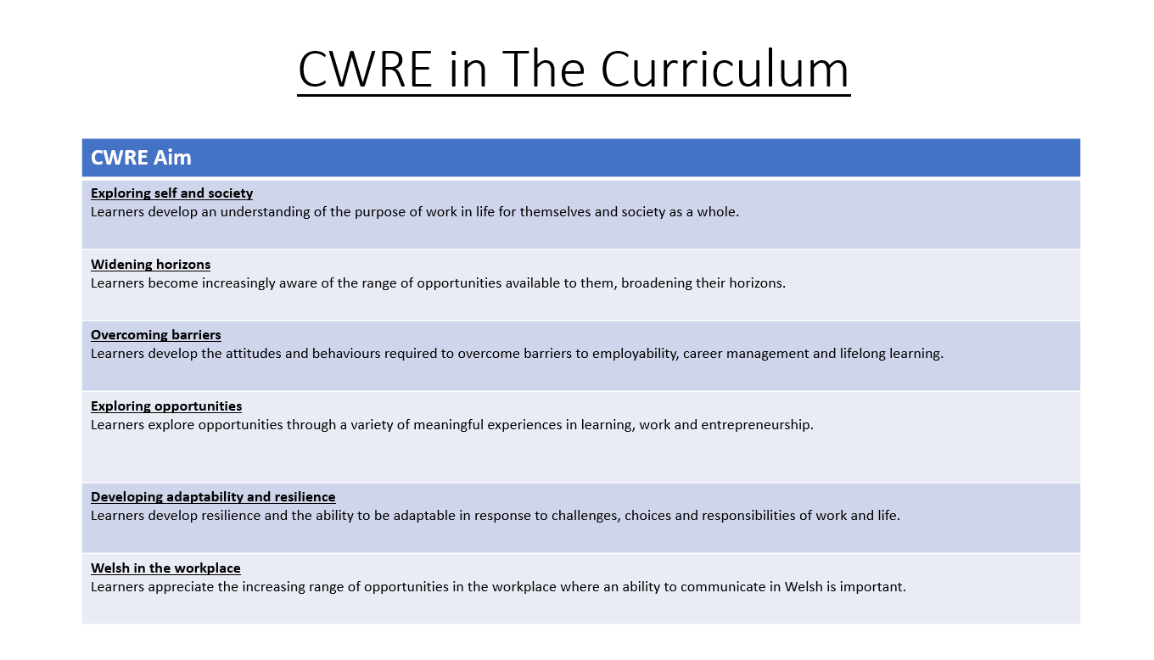

Slide 2
Lower School Plan
Subject: Maths CWRE Progression
Term | 1 | 2 | 3
Year 7 | 1a: Who am I? 1b. Exploring Possibilities – Dream Jobs! | 2a. What is a career in my subject? 2b. What is an entrepreneur? Can my subject lead me to be one? | 3a. What is work-life balance? 3b. Careers and the future
Year 8 | 1a. What are my interests? 1b. Job applications and CV’s – how can my subject enhance mine? | 2a. Challenges and rewards of work 2b. Creating the life you want – how can skill development in my subject help? Create a vision board | 3a. What does success mean to me? What does it look like in my subject? 3b. Careers and the climate
Year 9 | 1a. What are my skills? 1b. What comes after school? Learning pathways for my subject | 2a. Decision making – choosing what to study at KS4. 2b. Taking control of your career journey. How to overcome potential barriers | 3a. Working and earning, managing your money 3b. What is the labour market and what is it saying about jobs in your subject sector?

Slide 3
Upper School Plan
Subject: Maths CWRE Progression
Term | 1 | 2 | 3
Year 10 | 1a: Interests and Skills Profile – what makes you good at this subject? How will your skills transfer into the world of work? 1b. Preparing to go on work experience. How is skill development in my subject helping you prepare? | 2a. In person, hybrid, remote. What works best for your subject sector? 2b. Taking control of your career journey. How to overcome potential barriers | 3a. Wellbeing in the workplace. Discuss jobs linked to your subject and the possible challenges employees may face. 3b. What are my employability skills? How does my subject make students employable.
Year 11 | 1a. Post 16 Choices in my subject 1b. Decision making – choosing your post 16 pathway. What pathways are available linked to your subject? | 2a. Money talks – apprenticeships vs higher education in your subject

Slide 4
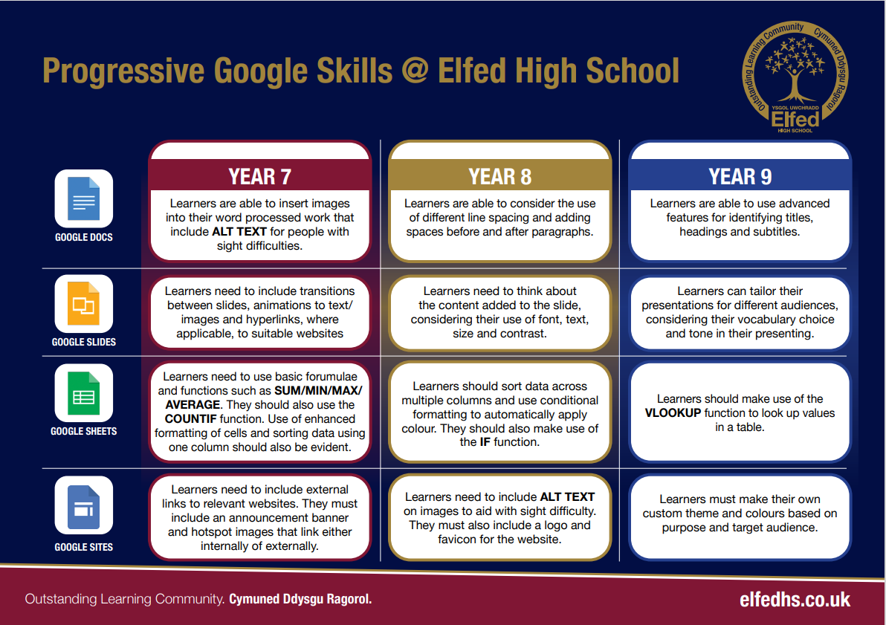

Slide 5
Lower School Plan
Subject: Maths
Skill: Digital Skills Progression
Term​ | 1​ | 2​ | 3​
Year 7​ | ​ | Term 2a Students using the COUNTIF formula on Google Sheets to calculate probabilities. | ​
Year 8​ | ​ |  | ​Term 3a Students using the IF formula on Google Sheets to classify angles based on their size.
Year 9​ Foundation Lower | ​ |  | ​Term 3a Students using the VLOOKUP formula on Google Sheets to complete a code breaker activity.
Year 9 Higher / Foundation |  |  | Term 3a Students using the VLOOKUP formula on Google Sheets to assign grades based on assessment scores.

Slide 6
Lower School Plan
Subject: Maths
Skill: Literacy Skills Progression
Term​ | 1​ | 2​ | 3​
Year 7​ | Speaking I can use Standard English appropriately to present a point of view. Listening I can listen attentively to the viewpoints of others. I can respond to the viewpoint of others by offering a critical comment upon what they have heard. Reading when analysing data during Term 2a I can use a range of strategies including skimming to identify key pieces of information and gain a detailed understanding of the graph, chart or problem. | Speaking - I can use Standard English appropriately to present a point of view. Listening - I can listen attentively to the viewpoints of others. - I can respond to the viewpoint of others by offering a critical comment upon what they have heard. Reading when analysing data - I can use a range of strategies including skimming to identify key pieces of information and gain a detailed understanding of the graph, chart or problem.
Year 8​ | ​Speaking I can use Standard English appropriately to present a point of view. I can organise my talk in a detailed and accurate manner. Listening I can listen attentively to the viewpoints of others for an extended period. I can respond to the viewpoint of others by offering a critical comment upon what I have heard. Reading when analysing data during Term 2a I can use a range of strategies including skimming to identify key pieces of information and gain a detailed understanding of the graph, chart or problem.
Year 9​ Foundation Lower | ​Speaking I can use Standard English appropriately to present a point of view. I can organise my talk in a detailed and accurate manner. Listening I can listen attentively to the viewpoints of others for an extended period. I can respond to the viewpoint of others by offering a critical comment upon what I have heard. Reading when analysing data during Term 2a I can use a range of strategies including skimming to identify key pieces of information and gain a detailed understanding of the graph, chart or problem.
Year 9 Higher / Foundation | Speaking I can reflect on my use of strategies to improve the quality, accuracy and effects of my spoken communication, including in formal situations Listening I can listen to information and ideas, and identify and explain how they are presented to promote a particular viewpoint. Reading when analysing data during Term 2a I can use a range of strategies including skimming to identify key pieces of information and gain a detailed understanding of the graph, chart or problem.

Slide 7
Subject: Mathematics / Mathemateg Topic: Number 5 Key Question: What are some practical ways to start saving money and managing personal finances effectively?
Conceptual Understanding
I can demonstrate a basic understanding of the concepts with support. I can represent the basic concepts in 1 way. E.g. Give a simple example/non-example.
I can demonstrate a broader understanding of the concepts, with support where needed. I can represent the concepts in different ways – verbal/concrete/visual/digital/abstract.
I can demonstrate a deeper understanding of the concepts independently. I can begin to apply my understanding to problems in new contexts and make connections.
I can confidently and accurately demonstrate my understanding of the concepts. I can apply my understanding to more complex problems in new contexts.
I can independently apply my understanding of the concepts to solve increasingly complex problems in new contexts.
Fluency
I can recall some previous knowledge of facts, relationships and techniques with support. I can demonstrate facts, relationships and techniques for new concepts with support.
I can recall broader previous knowledge of facts, relationships and techniques with prompts where needed. I can demonstrate a broader understanding of facts, relationships and technique with support if needed.
I can recall previous knowledge of facts, relationships and techniques more independently. I can demonstrate a deeper understanding of facts, relationships and techniques more independently.
I can use previous knowledge of facts, relationships and techniques independently. I can use facts, relationships and techniques in more detail and accurately.
I can use, with confidence and fluency, facts, relationships and techniques learnt. They are firmly established and memorable.
Strategic Competence
I can recognise and apply simple mathematical ideas and strategies to solve basic problems with support.
I can recognise and apply a range of mathematical ideas and strategies to solve a variety of problems with support where needed.
I can connect multiple mathematical ideas and strategies to solve problems independently.
I can confidently connect mathematical ideas and strategies to solve detailed problems, accurately with confidence.
I can confidently connect complex mathematical ideas and strategies, linking new concepts.
Emerging
Overview: We want you to understand the importance of Number, which is the symbol system for describing and comparing quantities. This will help improve your reasoning and decision making, and improve your fluency in the four basic arithmetic operations.
No. of weeks: 8
Content
▪Read values of a scale; | ▪Equivalent fractions;
▪Place value;
▪Add and subtract integers and decimals;
▪Money calculations;
▪Round a number to the nearest 10, 100 and 1000;
▪Rounding to decimal places;
▪Ordering numbers;
▪Multiply and divide by 10, 100 and 1000;
▪Fractions of an amount;
Widening
Developing
Securing
Embedding
Key Words Scale, integer, place value, money, fractions, ascending, descending
Learning Experiences Maths in a box, The Big Question Lesson
Literacy | I can organise my talk in a detailed and accurate manner. I can listen attentively to the viewpoints of others for an extended period
CWRE | What are my interests?
Cross Cutting Themes | Careers and work related experiences
RSE | Diversity and Respect in the classroom
DCF | N/A
Assessments (Linked to your mathematical proficiencies) Your QMA is a formative worksheet on:

Slide 8
Subject: Mathematics / Mathemateg Topic: Number 6 Key Question: What are some practical ways to start saving money and managing personal finances effectively?
Conceptual Understanding
I can demonstrate a basic understanding of the concepts with support. I can represent the basic concepts in 1 way. E.g. Give a simple example/non-example.
I can demonstrate a broader understanding of the concepts, with support where needed. I can represent the concepts in different ways – verbal/concrete/visual/digital/abstract.
I can demonstrate a deeper understanding of the concepts independently. I can begin to apply my understanding to problems in new contexts and make connections.
I can confidently and accurately demonstrate my understanding of the concepts. I can apply my understanding to more complex problems in new contexts.
I can independently apply my understanding of the concepts to solve increasingly complex problems in new contexts.
Fluency
I can recall some previous knowledge of facts, relationships and techniques with support. I can demonstrate facts, relationships and techniques for new concepts with support.
I can recall broader previous knowledge of facts, relationships and techniques with prompts where needed. I can demonstrate a broader understanding of facts, relationships and technique with support if needed.
I can recall previous knowledge of facts, relationships and techniques more independently. I can demonstrate a deeper understanding of facts, relationships and techniques more independently.
I can use previous knowledge of facts, relationships and techniques independently. I can use facts, relationships and techniques in more detail and accurately.
I can use, with confidence and fluency, facts, relationships and techniques learnt. They are firmly established and memorable.
Strategic Competence
I can recognise and apply simple mathematical ideas and strategies to solve basic problems with support.
I can recognise and apply a range of mathematical ideas and strategies to solve a variety of problems with support where needed.
I can connect multiple mathematical ideas and strategies to solve problems independently.
I can confidently connect mathematical ideas and strategies to solve detailed problems, accurately with confidence.
I can confidently connect complex mathematical ideas and strategies, linking new concepts.
Emerging
Overview: We want you to understand the importance of Number, which is the symbol system for describing and comparing quantities. This will help improve your reasoning and decision making, and improve your fluency in the four basic arithmetic operations.
No. of weeks: 8
Content
▪Round a number to the nearest 10, 100 and 1000; | ▪Equivalent fractions;
▪Place value; | ▪Calculating with negative numbers;
▪Ordering numbers; | ▪Identify square and cube numbers;
▪Add and subtract decimals; | ▪Arithmetic with fractions;
▪Written multiplication and division of integers;
▪Order of operations;
▪Rounding to decimal places;
▪Using a calculator to carry out calculations;
▪Fractions of an amount;
▪Simplifying fractions;
Widening
Developing
Securing
Embedding
Key Words Scale, integer, place value, money, fractions, ascending, descending
Learning Experiences Maths in a box, The Big Question Lesson
Literacy | I can organise my talk in a detailed and accurate manner. I can listen attentively to the viewpoints of others for an extended period
CWRE | What are my interests?
Cross Cutting Themes | Careers and work related experiences
RSE | Diversity and Respect in the classroom
DCF | N/A
Assessments (Linked to your mathematical proficiencies) Your QMA is a formative worksheet on:

Slide 9
Subject: Mathematics / Mathemateg Topic: Number 7 Key Question: What are some practical ways to start saving money and managing personal finances effectively?
Conceptual Understanding
I can demonstrate a basic understanding of the concepts with support. I can represent the basic concepts in 1 way. E.g. Give a simple example/non-example.
I can demonstrate a broader understanding of the concepts, with support where needed. I can represent the concepts in different ways – verbal/concrete/visual/digital/abstract.
I can demonstrate a deeper understanding of the concepts independently. I can begin to apply my understanding to problems in new contexts and make connections.
I can confidently and accurately demonstrate my understanding of the concepts. I can apply my understanding to more complex problems in new contexts.
I can independently apply my understanding of the concepts to solve increasingly complex problems in new contexts.
Fluency
I can recall some previous knowledge of facts, relationships and techniques with support. I can demonstrate facts, relationships and techniques for new concepts with support.
I can recall broader previous knowledge of facts, relationships and techniques with prompts where needed. I can demonstrate a broader understanding of facts, relationships and technique with support if needed.
I can recall previous knowledge of facts, relationships and techniques more independently. I can demonstrate a deeper understanding of facts, relationships and techniques more independently.
I can use previous knowledge of facts, relationships and techniques independently. I can use facts, relationships and techniques in more detail and accurately.
I can use, with confidence and fluency, facts, relationships and techniques learnt. They are firmly established and memorable.
Strategic Competence
I can recognise and apply simple mathematical ideas and strategies to solve basic problems with support.
I can recognise and apply a range of mathematical ideas and strategies to solve a variety of problems with support where needed.
I can connect multiple mathematical ideas and strategies to solve problems independently.
I can confidently connect mathematical ideas and strategies to solve detailed problems, accurately with confidence.
I can confidently connect complex mathematical ideas and strategies, linking new concepts.
Emerging
Overview: We want you to understand the importance of Number, which is the symbol system for describing and comparing quantities. This will help improve your reasoning and decision making, and improve your fluency in the four basic arithmetic operations.
No. of weeks: 8
Content
▪Arithmetic of decimals; | ▪Product of prime factors and use this to find the HCF and LCM;
▪Ordering numbers; | ▪Index laws;
▪Round a number to the nearest 10, 100 and 1000; | ▪Writing numbers in standard form;
▪Simplify a fraction; | ▪Finding the reciprocal of a number;
▪Factors, multiples and primes;
▪Calculating with negative numbers;
▪Order of operations;
▪Rounding to decimal places and significant figures;
▪Estimating calculations;
▪Using a calculator to carry out calculations;
▪Arithmetic with fractions;
▪Equivalent fractions;
Widening
Developing
Securing
Embedding
Key Words Arithmetic, rounding, factors, multiples, primes, fractions, indices
Learning Experiences Maths in a box, The Big Question Lesson
Literacy | I can organise my talk in a detailed and accurate manner. I can listen attentively to the viewpoints of others for an extended period
CWRE | What are my interests?
Cross Cutting Themes | Careers and work related experiences
RSE | Diversity and Respect in the classroom
DCF | N/A
Assessments (Linked to your mathematical proficiencies) Your QMA is a formative worksheet on:

Slide 10
Subject: Mathematics / Mathemateg Topic: Number 8 Key Question: What are some practical ways to start saving money and managing personal finances effectively?
Conceptual Understanding
I can demonstrate a basic understanding of the concepts with support. I can represent the basic concepts in 1 way. E.g. Give a simple example/non-example.
I can demonstrate a broader understanding of the concepts, with support where needed. I can represent the concepts in different ways – verbal/concrete/visual/digital/abstract.
I can demonstrate a deeper understanding of the concepts independently. I can begin to apply my understanding to problems in new contexts and make connections.
I can confidently and accurately demonstrate my understanding of the concepts. I can apply my understanding to more complex problems in new contexts.
I can independently apply my understanding of the concepts to solve increasingly complex problems in new contexts.
Fluency
I can recall some previous knowledge of facts, relationships and techniques with support. I can demonstrate facts, relationships and techniques for new concepts with support.
I can recall broader previous knowledge of facts, relationships and techniques with prompts where needed. I can demonstrate a broader understanding of facts, relationships and technique with support if needed.
I can recall previous knowledge of facts, relationships and techniques more independently. I can demonstrate a deeper understanding of facts, relationships and techniques more independently.
I can use previous knowledge of facts, relationships and techniques independently. I can use facts, relationships and techniques in more detail and accurately.
I can use, with confidence and fluency, facts, relationships and techniques learnt. They are firmly established and memorable.
Strategic Competence
I can recognise and apply simple mathematical ideas and strategies to solve basic problems with support.
I can recognise and apply a range of mathematical ideas and strategies to solve a variety of problems with support where needed.
I can connect multiple mathematical ideas and strategies to solve problems independently.
I can confidently connect mathematical ideas and strategies to solve detailed problems, accurately with confidence.
I can confidently connect complex mathematical ideas and strategies, linking new concepts.
Emerging
Overview: We want you to understand the importance of Number, which is the symbol system for describing and comparing quantities. This will help improve your reasoning and decision making, and improve your fluency in the four basic arithmetic operations.
No. of weeks: 8
Content
▪Calculating with negative numbers; | ▪Estimate powers and roots of any positive integer;
▪Calculating with powers and roots; | ▪Surds;
▪Product of prime factors and use this to find the HCF and LCM; | ▪Negative indices;
▪Rounding to decimal places and significant figures; | ▪Fractional indices;
▪Order of operations;
▪Estimating calculations;
▪Using a calculator to carry out calculations;
▪Index laws;
▪Finding the reciprocal of a number;
▪Writing numbers in standard form and carrying out calculations with numbers in standard form;
▪Arithmetic with fractions including mixed numbers;
Widening
Developing
Securing
Embedding
Key Words Primes, factors, multiples, indices, reciprocal, surds, standard form
Learning Experiences Maths in a box, The Big Question Lesson
Literacy | I can organise my talk in a detailed and accurate manner. I can listen attentively to the viewpoints of others for an extended period
CWRE | What are my interests?
Cross Cutting Themes | Careers and work related experiences
RSE | Diversity and Respect in the classroom
DCF | N/A
Assessments (Linked to your mathematical proficiencies) Your QMA is a formative worksheet on:

