Slide 1

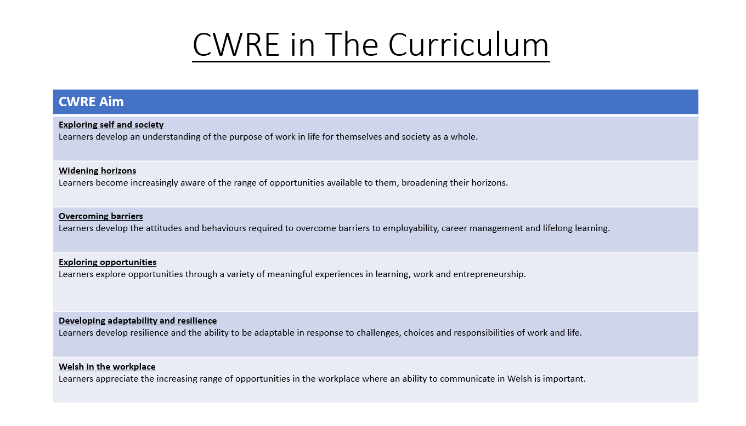

Slide 2
Lower School Plan
Subject: CWRE Progression
Term | 1 | 2 | 3
Year 7 | 1a: Who am I? 1b. Exploring Possibilities – Dream Jobs! | 2a. What is a career in my subject? 2b. What is an entrepreneur? Can my subject lead me to be one? | 3a. What is work-life balance? 3b. Careers and the future
Year 8 | 1a. What are my interests? 1b. Job applications and CV’s – how can my subject enhance mine? | 2a. Challenges and rewards of work 2b. Creating the life you want – how can skill development in my subject help? Create a vision board | 3a. What does success mean to me? What does it look like in my subject? 3b. Careers and the climate
Year 9 | 1a. What are my skills? 1b. What comes after school? Learning pathways for my subject | 2a. Decision making – choosing what to study at KS4. 2b. Taking control of your career journey. How to overcome potential barriers | 3a. Working and earning, managing your money 3b. What is the labour market and what is it saying about jobs in your subject sector?

Slide 3
Upper School Plan
Subject: CWRE Progression
Term | 1 | 2 | 3
Year 10 | 1a: Interests and Skills Profile – what makes you good at this subject? How will your skills transfer into the world of work? 1b. Preparing to go on work experience. How is skill development in my subject helping you prepare? | 2a. In person, hybrid, remote. What works best for your subject sector? 2b. Taking control of your career journey. How to overcome potential barriers | 3a. Wellbeing in the workplace. Discuss jobs linked to your subject and the possible challenges employees may face. 3b. What are my employability skills? How does my subject make students employable.
Year 11 | 1a. Post 16 Choices in my subject 1b. Decision making – choosing your post 16 pathway. What pathways are available linked to your subject? | 2a. Money talks – apprenticeships vs higher education in your subject

Slide 4
Lower School Plan
Subject: French
Skill: Digital Skills Progression
Term | 1 | 2 | 3
Year 7 |  |  | Food; Google Slides Learners will need to describe how to have a healthy lifestyle. They will need to include transitions between slides, animations to text/images.
Year 8 |  |  | Holidays; AE Infographic Learners need to create a poster based on a travel diary. This is to include an animated character explaining where they want, with whom and when?
Year 9 |  | Technology & Social Media: Learners must create a digital poster outlining how the dangers of the internet and how to protect themselves. They need to consider tone and their audience.

Slide 5
Lower School Plan
Subject: French
Skill: Literacy Progression
Term | 1 | 2 | 3
Year 7 | My personal world To improve my understanding of written French texts, I identify cognates. I can identify between 1^{st,} 2nd, 3rd person singular; therefore I can describe myself and other people. | School I can offer opinions and justifications by using connectives. I underline cognates and chunks of language I know to help my reading comprehension. | Leisure I can create sentences which include a time expression, opinions and justifications. I can make inferences based on the context of the written text.
Year 8 | Perfect Tense I can identify a subject pronoun, auxiliary verb and past particles in written French. I can conjugate a verb according to 1st, 2nd or 3rd person singular or plural. | Home & Local Area I can combine positive and negative sentences using connectives. I can extend my answers by using opinions, justifications and detailing what activities one can do in the town. | Holidays I can form the immediate future in French. I can write a paragraph which includes both perfect and immediate future tenses.
Year 9 | Entertainment & Leisure I can identify the direct object and turn this into a direct object pronoun. | Technology I can use a variety of impersonal structures combined with infinitives. | French-speaking world I can apply a variety of reading strategies such as: Identifying cognates, set phrases which suggest if something is positive or negative and different tenses.

Slide 6
Lower School Plan
Subject: French
Skill: Numeracy Progression
Term | 1 | 2 | 3
Year 7 | My personal world I can count up to 31 in French. I can complete basic maths equations | School I can interpret a school timetable. | Leisure I can tell the time in both analog and digital formats. I can interpret data relating to footballer players and their track record.
Year 8 |  |  | Food I can interpret my findings based on a classroom survey in terms of percentages.
Year 9 | Entertainment & Leisure I can interpret a graph to be able to complete a reading comprehension task

Slide 7

Subject: French, Year 9 Term 1a
Topic: Past Tense
Key Question: How to form the past tense using auxiliary verb 'avoir'
Recall
Knowledge and Understanding.
Skills-grammar
I have basic understanding of new terminology​
I have broader understanding of new terminology​
I have a deeper understanding of new terminology​
I have a detailed understanding of new terminology and can construct simple sentences​ in the perfect tense.
I have an excellent understanding of new terminology and can construct a paragraph in the perfect tense.
I can recall some knowledge​
I can recall broader knowledge​
I can recall previous learning and make links to new learning​
I can recall more detailed, accurate and complex knowledge.​
I can revisit previous learning and apply language to develop answers​.
I can conjugate ‘avoir’
I can conjugate ‘avoir’ and sometimes successfully change regular and irregular verbs into the perfect tense.
I can change​ a whole paragraph into the perfect tense accurately.
I can change a whole paragraph into the perfect tense very accurately.
I can conjugate ‘avoir’ and change regular verbs into the perfect tense.
Pupils will be able to form the perfect tense using verbs that take 'avoir'. Firstly, they will be introduced to subject pronoun, followed by ‘avoir’. They will learn how to conjugate 'avoir' according to subject pronoun (J’ai, Tu as, Il a etc.). Then, they will look at regular and irregular verbs and will be taught the rules on how to change the infinitive to the past participle.
Terminology: perfect tense, subject pronouns, auxiliary verbs, infinitives and past participles.
Phonics: é grapheme
No. of lessons: 7
Content
Revision of past tense in English | I can identify sentences which are in the past tense in English. I can change infinitives to the past participle in English
Introduction to subject pronouns and ‘avoir’ | I can identify the subject pronouns I can conjugate ‘avoir’ according to subject pronoun
Discussion on infinitives | I can identify infinitives in French
Changing regular verbs to the perfect tense Analysing a piece of literature | I can change regular –er verbs to the perfect tense I can change regular –re verbs to the perfect tense I can change regular –ir verbs to the perfect tense
Consolidation | I can identity gaps in my knowledge
Changing common irregular verbs into the perfect tense | I can change irregular verbs into the past tense.
QMA- Transforming sentences into perfect tense | I can conjugate ‘avoir’ I can change regular and irregular verbs into the perfect tense
Retrieval opportunities
Verbs relating to previous topics
Faire- jouer- habiter-manger
English
Welsh
Grammatical comparisons in the perfect tense
Metalanguage used
Assessments (linked to progression steps)
.
Learning Experiences
Grammatical comparisons in the perfect tense
Metalanguage used
Formative assessment: Pupils to complete multiple choice questions and translation activities on regular and irregular verbs that take ‘avoir’ in the perfect tense.
Ability to communicate in French in the perfect tense. Using authentic texts to see the grammar in context.
.

Slide 8
Subject: French, Year 9 Term 1b
Topic: Past Tense
Key Question: How to form the past tense using auxiliary verb ‘être’
Independent learning
Skills-grammar
I can identify some of my errors.
I can identify some of my errors and correct them.
I can identify almost all of my errors and correct them.
I can identify the gaps in my knowledge and have developed an effective revision sheet.
I can recall some knowledge​
I can recall broader knowledge​
I can recall previous learning and make links to new learning​
I can recall more detailed, accurate and complex knowledge.​
I can revisit previous learning and apply language to develop answers​.
I can conjugate ‘être’
I can conjugate ‘être’ and sometimes successfully change regular and irregular verbs into the perfect tense.
I know how to make past participles agree
I can change a whole paragraph into the perfect tense very accurately.
I can conjugate ‘être’ and change regular verbs into the perfect tense.
Recall
I can identify the gaps in my knowledge, can justify my corrections and have created an effective revision sheet.
Pupils will be able to form the perfect tense using verbs that take ‘être’. Firstly, they will be introduced to ‘être’ and how it conjugates depending on subject pronoun (Je suis, Tu es, Il est etc.). Then, they will look at regular verbs and be taught the rules on how to change the infinitive to the past participle.
Terminology: perfect tense, auxiliary verbs, infinitives, subject pronouns and past participles.
Phonics: ‘ou’ graphene
No. of lessons: 7
Content
Revision of past tense – verbs taking ‘avoir’ | I can identity gaps in my knowledge I know how to change sentences to the perfect tense
Introduction to ‘être’ and how to conjugate the verb | I can recall the subject pronouns I can conjugate ‘être’ according to subject pronoun.
Introduction to verbs which take ‘être’ | I can differentiate between verbs which take ‘avoir’ and ‘être’.
Revision on changing regular –er, -re & -ir verbs Discussion on irregular verbs | I can change regular verbs which take être. I can change irregular verbs which take être.
Verbal agreements on past participles | I know how to make verbs agree according to subject pronoun and number.
Consolidation on the perfect tense ‘Blurting Method’ | I can identity gaps in my knowledge I know how to change sentences to the perfect tense
Summative assessment | I can change regular and irregular verbs into the perfect tense. I know which verbs take ‘avoir’ and ‘être’. I know how to make verbs agree according to subject pronoun and number.
Retrieval opportunities
English
Welsh
Assessments (linked to progression steps)
Grammatical comparisons in the perfect tense
Metalanguage used
Summative assessment: Pupils to complete multiple choice questions and translation activities on regular and irregular verbs that take ‘avoir’ and ‘être’ in the perfect tense.
Verbs relating to previous topics
.
Learning Experiences
Grammatical comparisons in the perfect tense
Metalanguage used
-Ability to communicate in French in the perfect tense.
- Developing revision strategies such as ‘Blurting’
.

