Slide 1

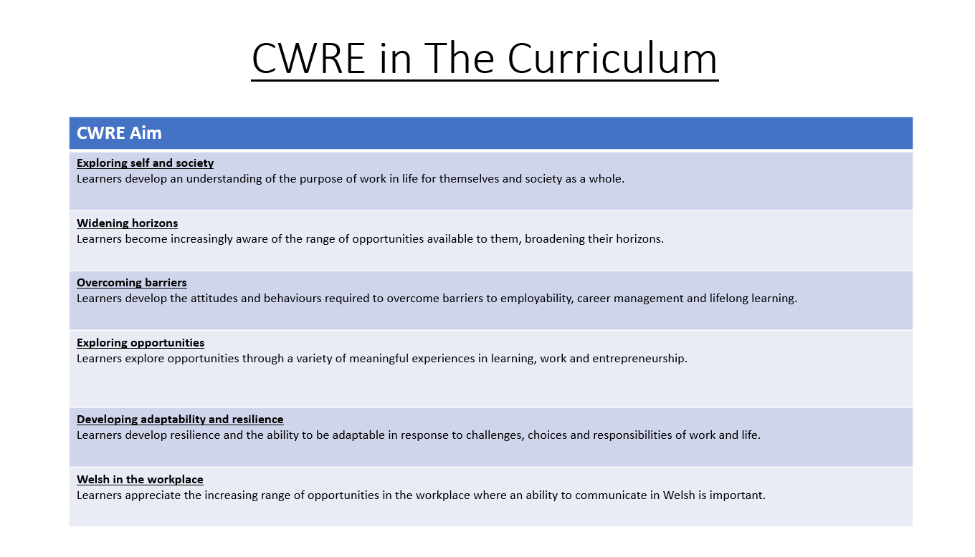

Slide 2
Lower School Plan
Subject: CWRE Progression
Term | 1 | 2 | 3
Year 7 | 1a: Who am I? 1b. Exploring Possibilities – Dream Jobs! | 2a. What is a career in my subject? 2b. What is an entrepreneur? Can my subject lead me to be one? | 3a. What is work-life balance? 3b. Careers and the future
Year 8 | 1a. What are my interests? 1b. Job applications and CV’s – how can my subject enhance mine? | 2a. Challenges and rewards of work 2b. Creating the life you want – how can skill development in my subject help? Create a vision board | 3a. What does success mean to me? What does it look like in my subject? 3b. Careers and the climate
Year 9 | 1a. What are my skills? 1b. What comes after school? Learning pathways for my subject | 2a. Decision making – choosing what to study at KS4. 2b. Taking control of your career journey. How to overcome potential barriers | 3a. Working and earning, managing your money 3b. What is the labour market and what is it saying about jobs in your subject sector?

Slide 3
Upper School Plan
Subject: CWRE Progression
Term | 1 | 2 | 3
Year 10 | 1a: Interests and Skills Profile – what makes you good at this subject? How will your skills transfer into the world of work? 1b. Preparing to go on work experience. How is skill development in my subject helping you prepare? | 2a. In person, hybrid, remote. What works best for your subject sector? 2b. Taking control of your career journey. How to overcome potential barriers | 3a. Wellbeing in the workplace. Discuss jobs linked to your subject and the possible challenges employees may face. 3b. What are my employability skills? How does my subject make students employable.
Year 11 | 1a. Post 16 Choices in my subject 1b. Decision making – choosing your post 16 pathway. What pathways are available linked to your subject? | 2a. Money talks – apprenticeships vs higher education in your subject

Slide 4
Lower School Plan
Subject: French
Skill: Digital Skills Progression
Term | 1 | 2 | 3
Year 7 |  |  | Food; Google Slides Learners will need to describe how to have a healthy lifestyle. They will need to include transitions between slides, animations to text/images.
Year 8 |  |  | Holidays; AE Infographic Learners need to create a poster based on a travel diary. This is to include an animated character explaining where they want, with whom and when?
Year 9 |  | Technology & Social Media: Learners must create a digital poster outlining how the dangers of the internet and how to protect themselves. They need to consider tone and their audience.

Slide 5
Lower School Plan
Subject: French
Skill: Literacy Progression
Term | 1 | 2 | 3
Year 7 | My personal world To improve my understanding of written French texts, I identify cognates. I can identify between 1^{st,} 2nd, 3rd person singular; therefore I can describe myself and other people. | School I can offer opinions and justifications by using connectives. I underline cognates and chunks of language I know to help my reading comprehension. | Leisure I can create sentences which include a time expression, opinions and justifications. I can make inferences based on the context of the written text.
Year 8 | Perfect Tense I can identify a subject pronoun, auxiliary verb and past particles in written French. I can conjugate a verb according to 1st, 2nd or 3rd person singular or plural. | Home & Local Area I can combine positive and negative sentences using connectives. I can extend my answers by using opinions, justifications and detailing what activities one can do in the town. | Holidays I can form the immediate future in French. I can write a paragraph which includes both perfect and immediate future tenses.
Year 9 | Entertainment & Leisure I can identify the direct object and turn this into a direct object pronoun. | Technology I can use a variety of impersonal structures combined with infinitives. | French-speaking world I can apply a variety of reading strategies such as: Identifying cognates, set phrases which suggest if something is positive or negative and different tenses.

Slide 6
Lower School Plan
Subject: French
Skill: Numeracy Progression
Term | 1 | 2 | 3
Year 7 | My personal world I can count up to 31 in French. I can complete basic maths equations | School I can interpret a school timetable. | Leisure I can tell the time in both analog and digital formats. I can interpret data relating to footballer players and their track record.
Year 8 |  |  | Food I can interpret my findings based on a classroom survey in terms of percentages.
Year 9 | Entertainment & Leisure I can interpret a graph to be able to complete a reading comprehension task

Slide 7

Subject: French, Year 7 Term 1a
Topic: Je me présente
Key Question: Describe myself (greetings, name, age, birthday)
Recall.
I can recall some knowledge
I can recall broader knowledge
I can recall previous learning and make links to new learning
I can recall more detailed, accurate and complex knowledge.
I can revisit previous learning and apply this knowledge to new discoveries.
Knowledge and Understanding.
I have basic understanding of new terminology
I have broader understanding of new terminology
I have a deeper understanding of new terminology.
I have a detailed understanding of new terminology and can construct simple sentences.
I have an excellent understanding of new terminology and can construct a paragraph.
Skills- Reading
I can identify cognates and key vocabulary
I can successfully respond to some questions
I can successfully respond to most questions
I can successfully respond to all questions and understand French texts.
I can successfully respond to all questions and understand French texts without scaffolds.
Students will be introduced to vocabulary relating to greetings, numbers and months.
At the end of the unit: they will be able to introduce themselves, describe their age, birthday and where they live.
Lexical chunks: Je m'appelle / J'ai 11/12 ans/J'habite à / Mon anniversaire, c'est …
Learning strategies: number patterns, cognates and repeated vocabulary.
Phonics: silent letter (final consonants)
No. of lessons: 7
Content
Discussion on why we should learn languages Introduction of greetings | I can use vocabulary relating to greetings
Phonics: silent letter (final consonant) Ask and respond to Comment t'appelles-tu? | I understand that final consonants are generally silent. I can ask and respond to the question: Comment t'appelles-tu?
Introduction to numbers from 1 to 12 Ask and respond to: Quel âge as-tu? | I can recall numbers from 1-12. I can ask and respond to the question: Quel âge as-tu?
Reading strategy: cognates and repeated vocab. | I can apply my new knowledge. I can identify mistakes and respond to feedback.
Introduction to numbers from 13-31 Ask and respond to: Ton anniversaire, cest quand? | I can recall numbers from 13-31 I can ask and respond to the question: Ton anniversaire, c'est quand?
Ask and respond to Tu habites où? | I can ask and respond to the question: Tu habites où
Summative Assessment | I can apply different reading strategies I understand spoken French.
Lexical chunks
Je m'appelle ...
J'ai 11/12 ans
Mon anniversaire, c'est ...
J'habite à ...
English
Welsh
Numeracy
Identify cognates
Make connections between word and sound patterns.
Assessments (linked to progression steps)
Identify cognates between Welsh and French
Summative assessment:.
Reading, listening and writing tasks.
Learning Experiences
Identify patterns to help remember numbers
Identify differences between French & English
Benefits of learning languages
Developing reading strategies

Slide 8
Subject: French, Year 7 Term 1b
Topic: Mon monde perso (Personality, family, and physical characteristics)
Key Question: Describe yourself, your friends and family
Recall.
I can recall some knowledge
I can recall broader knowledge
I can recall previous learning and make links to new learning
I can recall more detailed, accurate and complex knowledge.
I can revisit previous learning and apply this knowledge to new discoveries.
Knowledge and Understanding.
I have basic understanding of new terminology
I have broader understanding of new terminology
I have a deeper understanding of new terminology
I have a detailed understanding of the meaning of new terminology and can construct simple sentences
I have developed understanding of new terminology and can construct a paragraph
Skills- Listening
I can identify cognates and key vocabulary in spoken French.
I can successfully respond to some questions based on what I hear.
I can successfully respond to most questions based on what I hear.
I can successfully respond to all questions and understand spoken French.
I can successfully respond to all questions and understand spoken French without scaffolds.
Students will be introduced to vocabulary relating to personality, physical characteristics, family and friends. At the end of the unit: they will be able to describe their own personality and their physical characteristics, as well as those of their friends and family.
Lexical chunks: Je suis + adjective, je suis quelqu’un de + adjective, j’ai/il a/ella a + physical characteristic, depuis.
Learning strategies: Apply phonics knowledge to listening tasks.
Phonics: silent letters (final consonants) and difference between masculine and feminine forms
No. of lessons: 7
Content
J’ai + physical characteristics | I can use vocabulary relating to physical characteristics. I can describe my own physical characteristics.
Phonics: Silent letter (final consonant) Masculine and feminine forms | I can recall silent final consonants and its exceptions to this rule: CaReFuL I can differentiate between masculine and feminine adj. forms .
Personality traits Je suis + personality trait | I can describe my own personality.
Personality traits Masculine and feminine forms | I recognise that adjectives have both masculine and feminine forms.
Consolidation QMA- Listening comprehension | I can recall vocabulary relating to personality and physical characteristics. I can differentiate between masculine and feminine forms.
Describing family members Introduction to 3rd person singular | I can recall vocabulary to family members. I can describe them by using 3rd person singular: il/elle est, il/elle a
Describing friends How long you have known them | I can describe my friends. I can say how long I have known them using depuis.
Summative Assessment- reading and listening comprehension | I can apply my knowledge to listening and reading comprehension tasks.
Assessments (linked to progression steps)
English
Welsh
Well-being
Recognise the difference between 1st, 2nd and 3rd person singular in English and French.
QMA:
Listening comprehension
Summative assessment:
Reading and listening comprehension
Lexical chunks
Je suis Je suis quelqu’un de J’ai
Il/elle est Il/elle a
Recognise the difference between 1st, 2nd and 3rd person singular in English and French.
Learning Experiences
Developing grammar knowledge
Apply complex structures
Acquisition of vocabulary to cover the diverse French- speaking world.

