Slide 1
PE Unit Overviews

Slide 2

Subject: PE
Overview of Topics
Term | 1A | 1B | 2A | 2B | 3A | 3B
Year 7 | Teams Games/Fitness | Creative/ Swimming | Swimming | Fitness | Athletics | Striking and Fielding
Year 8 | Teams Games/Fitness | Creative/ Swimming | Swimming | Fitness | Athletics | Striking and Fielding
Year 9 | Teams Games/Fitness | Creative/ Swimming | Swimming | Fitness | Athletics | Striking and Fielding
Year 10 | Teams Games/Fitness | Teams Games | Health and fitness | Fitness | Athletics | Striking and Fielding
Year 11 | Teams Games/Fitness | Teams Games | Fitness | Fitness

Slide 3
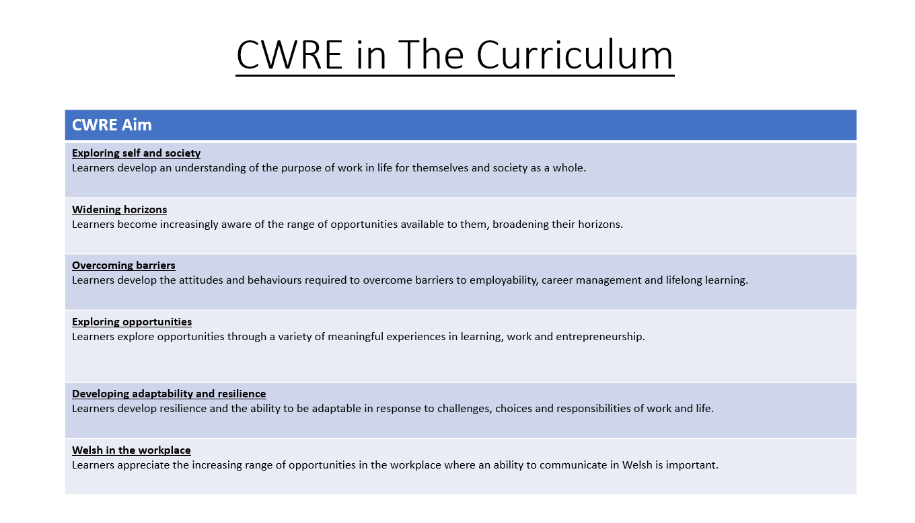

Slide 4
PE Plan – Lower School
Careers
Term | 1 | 2 | 3
Year 7 | 1a: Who am I? 1b. Exploring Possibilities – Dream Jobs! | 2a. What is a career in my subject? 2b. What is an entrepreneur? Can my subject lead me to be one? | 3a. What is work-life balance? 3b. Careers and the future
Year 8 | 1a. What are my interests? 1b. Job applications and CV’s – how can my subject enhance mine? | 2a. Challenges and rewards of work 2b. Creating the life you want – how can skill development in my subject help? Create a vision board | 3a. What does success mean to me? What does it look like in my subject? 3b. Careers and the climate
Year 9 | 1a. What are my skills? 1b. What comes after school? Learning pathways for my subject | 2a. Decision making – choosing what to study at KS4. 2b. Taking control of your career journey. How to overcome potential barriers | 3a. Working and earning, managing your money 3b. What is the labour market and what is it saying about jobs in your subject sector?

Slide 5
PE Plan Upper School
Careers
Term | 1 | 2 | 3
Year 10 | 1a: Interests and Skills Profile – what makes you good at this subject? How will your skills transfer into the world of work? 1b. Preparing to go on work experience. How is skill development in my subject helping you prepare? | 2a. In person, hybrid, remote. What works best for your subject sector? 2b. Taking control of your career journey. How to overcome potential barriers | 3a. Wellbeing in the workplace. Discuss jobs linked to your subject and the possible challenges employees may face. 3b. What are my employability skills? How does my subject make students employable.
Year 11 | 1a. Post 16 Choices in my subject 1b. Decision making – choosing your post 16 pathway. What pathways are available linked to your subject? | 2a. Money talks – apprenticeships vs higher education in your subject

Slide 6
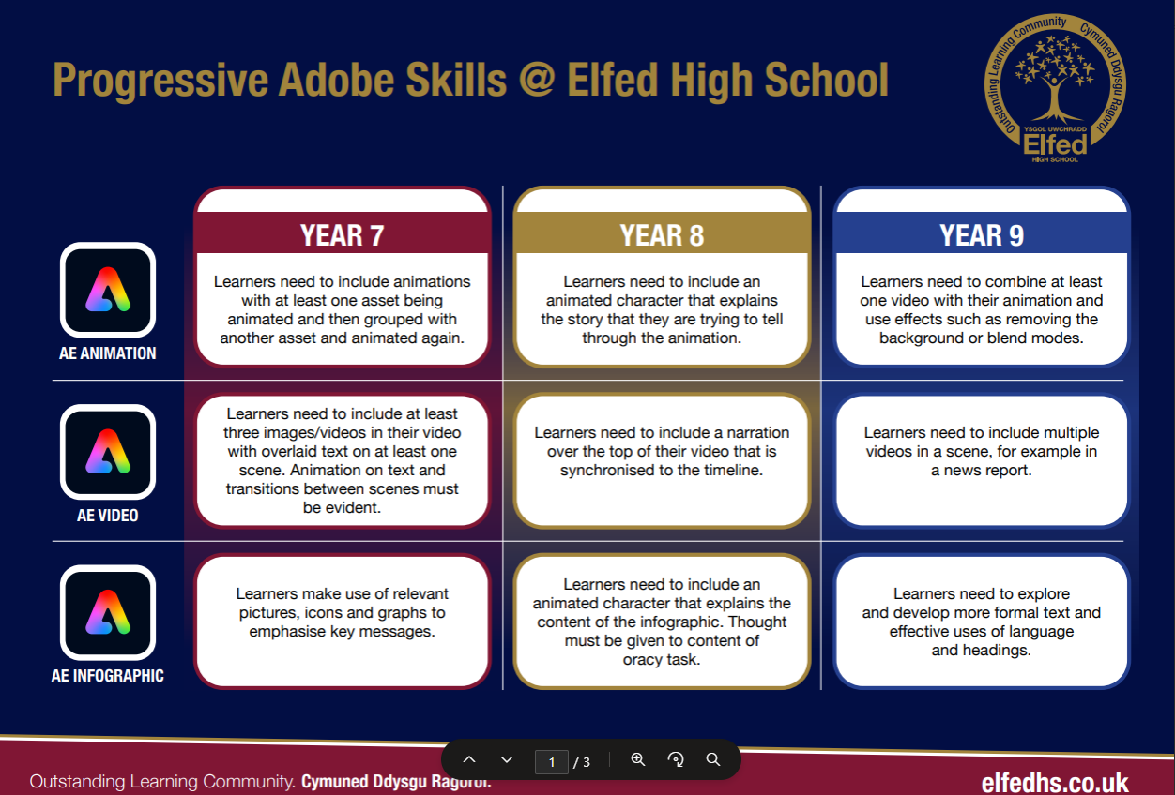

Slide 7
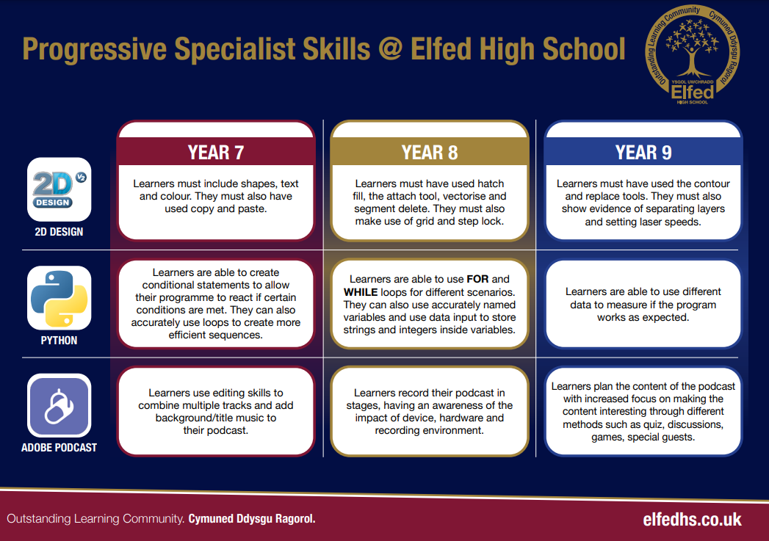

Slide 8
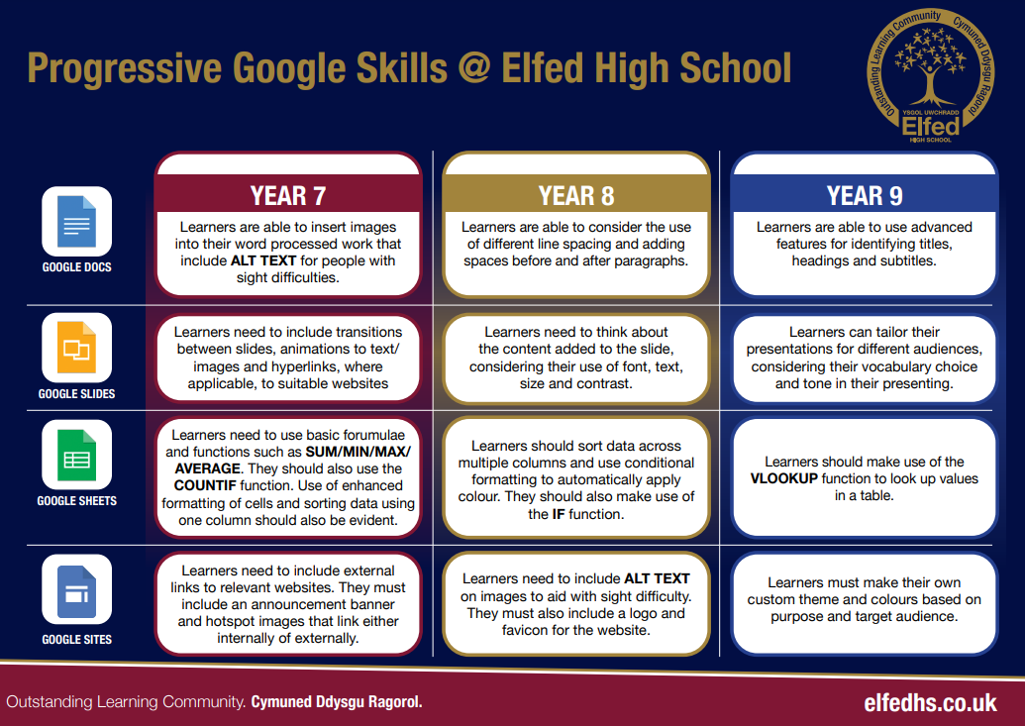

Slide 9
DCF task in PE yr 7, 8 and 9

Slide 10
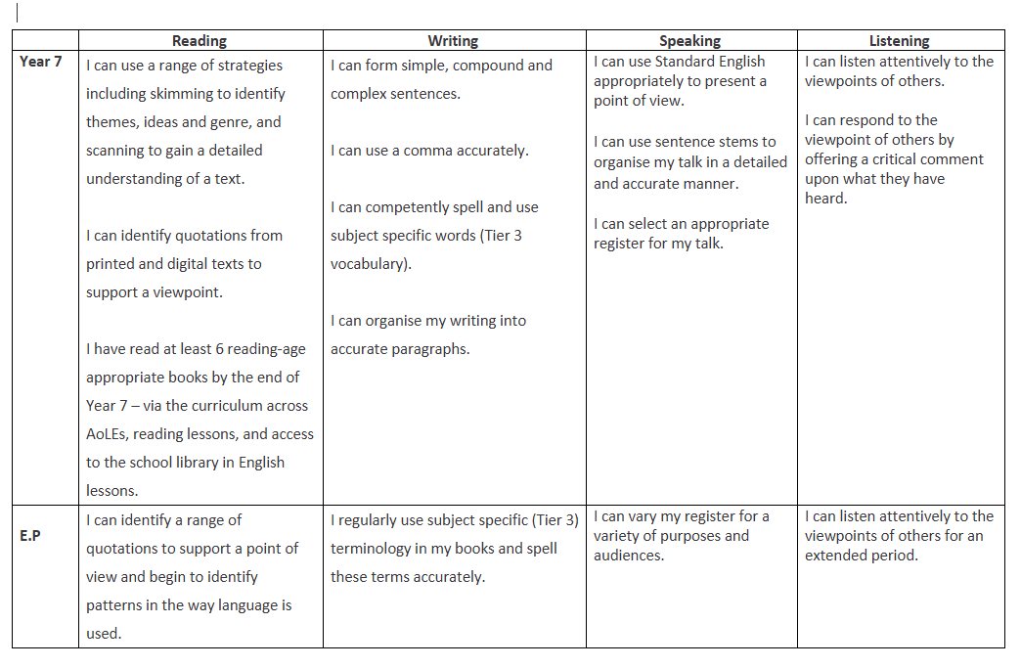
PE Plan
Literacy Progression

Slide 11
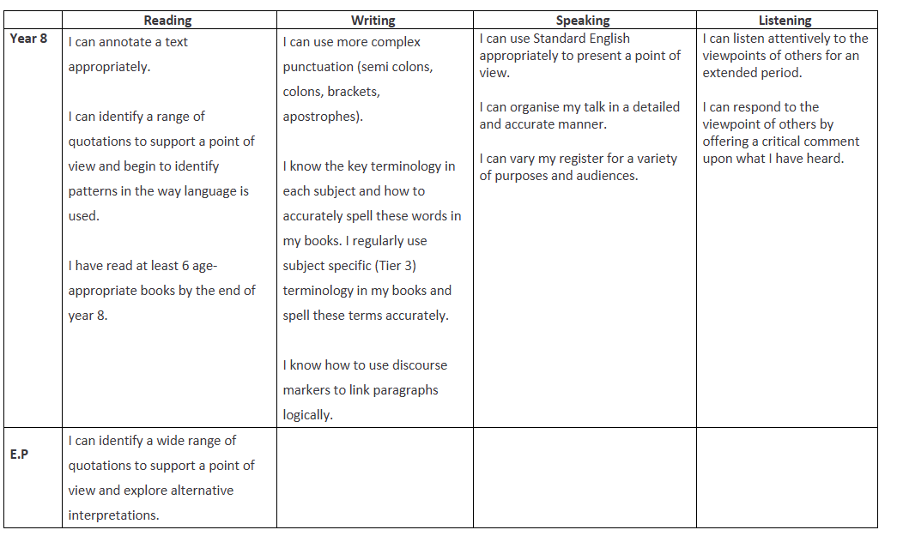
PE Plan
Literacy Progression

Slide 12
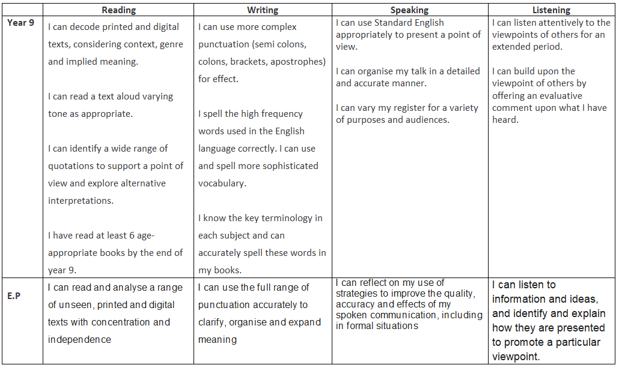
PE Plan
Literacy Progression

Slide 13
Lit plan year 7, 8 and 9 in PE

Slide 14
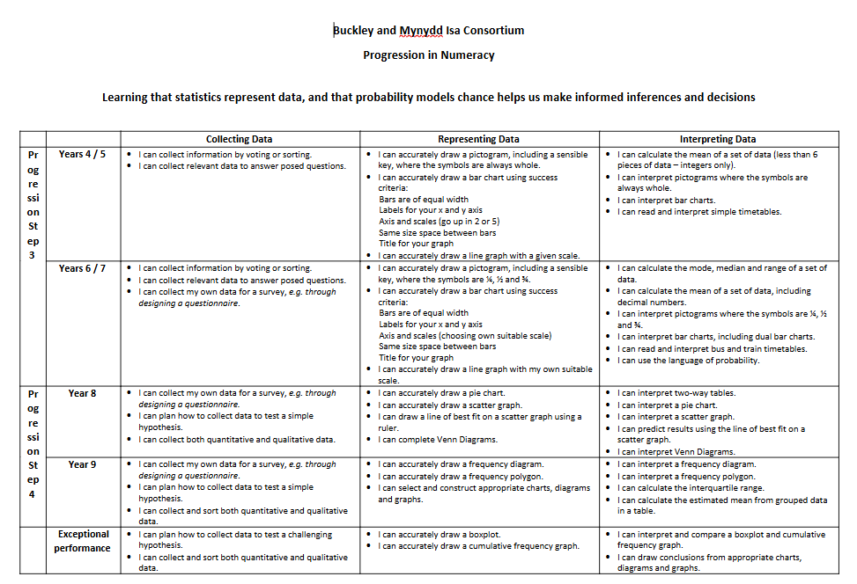

Slide 15
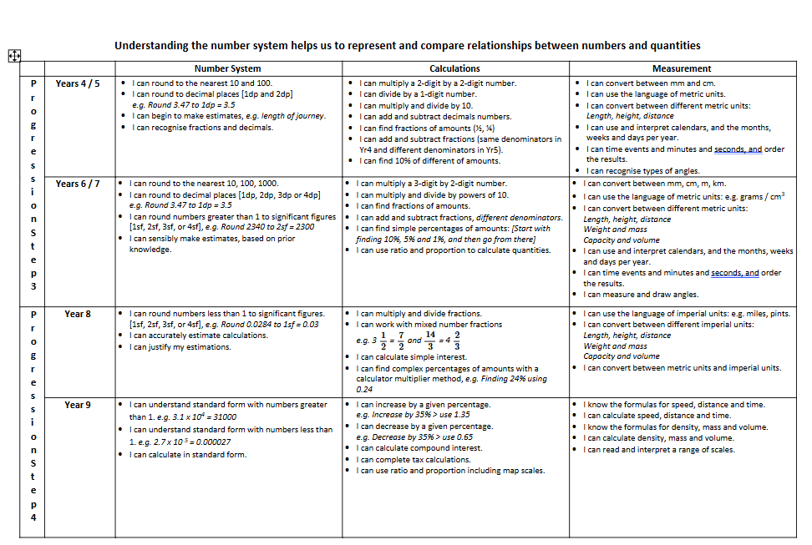

Slide 17
Num task 7,8, 9 in PE

Slide 18
Year 7

Slide 19
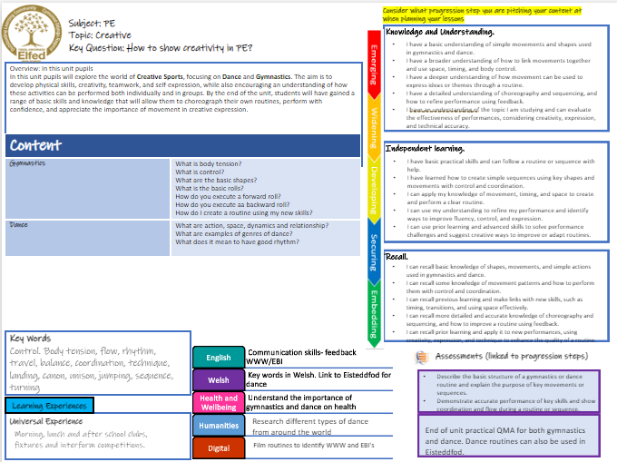

Slide 20

Subject: PE
Topic: Health & fitness
Key Question:
Knowledge and understanding
I have a basic understanding of the importance of regular exercise and how different activities can improve my fitness.
I have a broader understanding of how to take part in group fitness activities and can follow simple routines to stay active.
I have a deeper understanding of how fitness components like strength, flexibility, and endurance work together to improve my overall health.
I have a detailed understanding of different fitness strategies and can apply them to set personal goals and improve my performance in PE.
I understand the importance of teamwork, fair play, and can reflect on how fitness activities help develop life skills such as motivation, resilience, and cooperation.
In this unit, pupils will build on their understanding of how exercise helps improve health, fitness, and overall wellbeing. Health and fitness activities in PE for Year 7 include cross country running, swimming, and fitness-based challenges. These activities help pupils improve key areas such as stamina, strength, flexibility, and endurance. They will learn how the body responds to exercise and how to warm up, cool down, and train safely. Pupils will set personal goals, challenge themselves, and begin to understand the importance of staying active for both physical and mental health. This unit encourages pupils to develop resilience, motivation, and a positive attitude toward lifelong fitness. Lesson objective
Independent learning
I have basic practical skills and can take part in fitness activities by following instructions with support.
I have learned how to take responsibility for my participation and can follow safety rules during fitness tasks and exercises.
I can apply my knowledge of fitness techniques and movement to improve my personal performance during PE lessons.
I can use my understanding to reflect on my performance and suggest ways to improve my fitness and overall effort.
I can use advanced skills and prior learning to solve problems during physical challenges and suggest different exercises or strategies to meet fitness goals.
Content
Cross County Can I explain what endurance means and why it is important? Can I pace myself effectively? Can I demonstrate the correct running technique? | I know what the correct technique of running is. I can show how I pace myself effectively during a long-distance run. I understand what endurance means and why it is important in PE.
Fitness What are the components of fitness? Can I measure my fitness using simple tests? What body parts are used for different exercises? | I know what the different components of fitness are and what exercise I can do to develop these. I can take part in fitness activities safely and with the correct techniques. I understand how regular exercise benefits my physical, mental and social health.
Swimming What is water confidence? What are the basic swimming strokes? What are the different body positions to move efficiently through the water? | I know what water confidence is and why it is important to stay safe. I can perform the 4 basic swimming strokes with the correct technique. I can identify different body positions to move efficiently through the water. I understand why it is important to be safe in the water and develop key life-saving skills.
Questioning
I can ask and answer basic questions about the benefits of physical activity and why fitness is important for my health.
I can ask questions about different types of exercise and respond by explaining how they help improve strength, flexibility, and endurance.
I can use questioning to explore previous learning and respond by making links with new skills, such as goal setting, teamwork, and motivation.
I can ask more detailed questions and give accurate responses about how specific exercises and techniques support different fitness goals and overall wellbeing.
I can ask and respond to questions that apply prior learning to create fitness plans, solve challenges, and improve personal health and performance.
Key Words
Running, pace, endurance, breathing, self-motivation, floating, water confidence, gliding, treading water, warm up, cool down, fitness, components of fitness.
English
Welsh
Health and Wellbeing
Humanities
Digital
Assessments (linked to progression steps)
Communicate with teammates
Discuss names of sports and skills in Welsh
Describe what health and fitness is and why it is important in your daily life.
Demonstrate accurate performance technique and safety during a competitive scenario or skills activity.
Learning Experiences
Appreciate the importance of a healthy lifestyle
Universal Experience
Morning, lunch and after school clubs, fixtures and interform competitions.
Discuss the origin of each sport and countries' national sports
End of unit practical QMA for each area of learning.
Record and analyse skill technique

Slide 21
Subject: PE
Topic: Striking & Fielding
Key Question:
Independent learning.
Problem solving.
Knowledge and Understanding.
I have a basic understanding of the rules and roles in striking and fielding games, such as batting, bowling, and fielding.
I understand how to work effectively as part of a team and can apply simple tactics, like choosing where to hit the ball or where to field.
I have a deeper understanding of how teamwork, communication, and fielding positions impact success in cricket and rounders.
I can explain and apply more advanced game strategies, such as setting a fielding formation or rotating the batting order for best results.
I understand the importance of teamwork, fair play, and can reflect on how striking and fielding games help build life skills like leadership, decision-making, and cooperation.
Overview: Year 7 pupils will enjoy fun and active games like rounders and cricket, where they work together as a team to score runs and get the other team out. These games help improve skills such as throwing, catching, hitting, and running, while also encouraging quick thinking and good teamwork.
By playing rounders and cricket, pupils will learn how to communicate, share, and support each other, as well as how to follow rules and play fairly. These games also help build fitness, confidence, and friendships. It’s a great way to stay active and learn what it means to be a valuable team player.
No. of lessons__________ Lesson objectives
Content
Rounders/Softball What are the basic rules and roles? What is the correct technique to hit a ball? What are the most effective ways to bowl? What are the most effective ways to field? | I know what the basic rules and roles are in rounders/softball. I can show the basic skills of rounders/softball in a competitive scenario I understand the correct technique of bowling/fielding and batting and can show this in a competitive game.
Cricket What are the basic rules of and positions in cricket? How do I bat and bowl with the correct technique? How do I work effectively with teammates during a match | I know what cricket is and what the basic skills are, such as bowling, batting and fielding. I can show the basic skills of cricket in a competitive scenario. I understand how to work effectively with team mates to score runs and get the opposition out in a game.
I have basic practical skills and can take part in striking and fielding games by following instructions and working with support.
I have learned how to take on different roles such as batter, bowler, and fielder, and can follow the rules to contribute to the game.
I can use my understanding of simple tactics and fielding positions to help my team perform more effectively during a game.
I can reflect on my own performance in batting, bowling, and fielding, and suggest ways to improve teamwork and tactics.
I can apply advanced skills and previous experience to solve problems during gameplay and suggest tactical changes or fielding formations to support my team.
I can identify and solve basic problems in striking and fielding games, such as deciding when to bat or bowl and how to score effectively.
I can analyze key roles and positions during gameplay and make decisions about where to hit or throw to gain an advantage.
I can use my understanding of communication, teamwork, and game awareness to solve challenges and adapt strategies during play.
I can evaluate different game strategies and adjust my role (e.g., wicketkeeper, backstop, deep fielder) to support overall team performance in response to changing situations.
I can apply problem-solving skills and tactical thinking from previous lessons to new game scenarios, helping my team improve performance and respond effectively under pressure.
Key Words
Teamwork, communication, respect, rules, positions, tactics, batting, bowling, fielding, technique
English
Welsh
Health and Wellbeing
Humanities
Digital
Communicate with teammates
Assessments (linked to progression steps)
Discuss names of sports and skills in Welsh
Describe the structure of a cricket/rounders team and the roles or positions of some key players.
Demonstrate accurate performance and teamwork during a small-sided game or skills activity.
Learning Experiences
Appreciate the importance of a healthy lifestyle
Universal Experience
Morning, lunch and after school clubs, fixtures and interform competitions.
Discuss the origin of each sport and countries' national sports
End of unit practical QMA for each team game taught.
Record and analyse skill technique

Slide 22
Consider what progression step you are pitching your content at when planning your lessons
Subject: PE
Topic: Team Games Yr 7
Key Question:
Independent learning.
Skills.
Knowledge and Understanding.
I have a basic understanding of the rules and roles in team games.
I have a broader understanding of how to work as part of a team and use basic tactics during games.
I have a deeper understanding of how teamwork, communication, and positioning affect performance in different team games.
I have a detailed understanding of game strategies and can apply them in different sporting situations.
I have an understanding of the importance of teamwork, fair play, and can reflect on how team games help develop life skills such as leadership and cooperation.
Overview: In this unit pupils will build on their basic knowledge of team games. Team games in PE for Year 7 pupils are fun and active games where they will work together with others to try and win as a team. These games, like football, netball, hockey and rugby, help you get better at moving, thinking quickly, and working with others. They also teach you important skills such as sharing, listening, and being kind to teammates. By playing team games, you get fitter, make friends, and learn how to play fairly and follow rules. It’s a great way to enjoy being active while learning how to be part of a team. No. of lessons__________ Lesson objectives
Content
Football What is passing? What is dribbling? How do you attack/defend in football? What are the positions in a game? | I know what football is and what the basic skills, such as passing and dribbling, in are. I can show the basic skills of football in a competitive scenario I understand basic tactics such as attacking/defending and the positions in a game
Netball What is passing? What is footwork? How do you attack/defend in netball? What are the positions in a game? | I know what netball is and what the basic skills, such as passing and footwork, in are. I can show the basic skills of netball in a competitive scenario I understand basic tactics such as attacking/defending and the positions in a game
Hockey | I know what hockey is and what the basic skills, such as passing and dribbling, in are. I can show the basic skills of hockey in a competitive scenario I understand basic tactics such as attacking/defending and the positions in a game
Rugby | I know what rugby is and what the basic skills, such as passing and tackling, in rugby are. I can show the basic skills of rugby in a competitive scenario I understand basic tactics such as attacking/defending and the positions in a game
Rules | I can understand and apply the basic rules of team games, demonstrating fair play and respect for others during gameplay
I have basic practical skills and can take part in team games by following instructions with help.
I have learned how to take on different roles in a team and can follow rules to contribute to the game.
I can apply my knowledge of tactics and positions to help my team perform better during a game.
I can use my understanding to reflect on my performance and suggest ways to improve teamwork and strategy.
I can use advanced skills and prior learning to solve problems in gameplay and suggest different tactics or formations to support my team.
What is passing?
What is dribbling?
How do you attack/defend in a game?
When do you use your strong stick/reverse?
I can perform basic team game skills such as passing, catching, and moving into space following the main rules.
I can understand simple team roles and positions and use basic tactics like passing to a teammate or marking an opponent.
I can combine previous skills with communication and teamwork to support my team during play.
I can demonstrate more accurate and controlled team game skills and begin to apply simple strategies to improve team performance.
I can use my skills in different game situations, adapting my technique to support my team’s tactics and overall success.
What is passing?
What is tackling?
How do you attack/defend in a game?
Key Words
Teamwork, communication, respect, rules, positions, tactics, passing, dribbling, tackling, footwork, rules.
English
Welsh
Health and Wellbeing
Humanities
Digital
Assessments (linked to progression steps)
Communicate with teammates
Discuss names of sports and skills in Welsh
Describe the structure of a team game and the roles or positions of some key players.
Demonstrate accurate performance and teamwork during a small-sided game or skills activity.
Learning Experiences
Appreciate the importance of a healthy lifestyle
Universal Experience
Morning, lunch and after school clubs, fixtures and interform competitions.
Discuss the origin of each sport and countries' national sports
End of unit practical QMA for each team game taught.
Record and analyse skill technique

Slide 23
Year 8

Slide 24
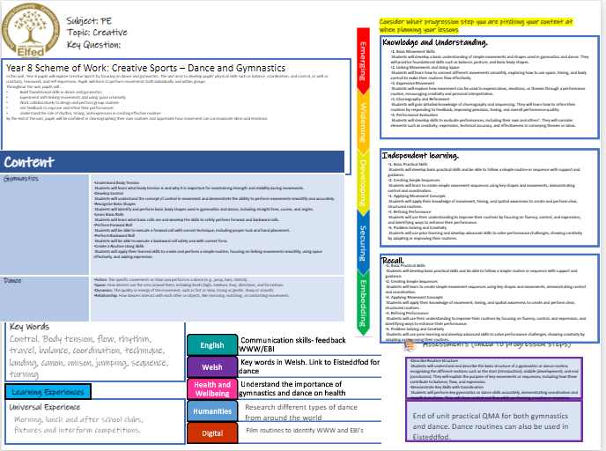

Slide 25
Subject: PE
Topic: Team Games
Key Question:
Independent learning.
Skills.
Knowledge and Understanding.
I have a developing understanding of the key rules, positions, and roles in team sports such as netball, football, hockey, and rugby.
I can work effectively as part of a team and apply basic tactics, such as creating space, marking opponents, or supporting the ball carrier.
I have a deeper understanding of how communication, teamwork, and positional play impact performance across different team games.
I can explain and apply more advanced strategies, such as set plays, transitions, and defensive structures, depending on the sport and game situation.
I recognise the value of teamwork, respect, and fair play, and can reflect on how participating in team sports helps develop important life skills like leadership, communication, and cooperation.
Overview: In this unit, pupils will build on their existing knowledge and experience of team games developed in Year 7. They will develop more advanced skills in games such as football, netball, hockey, and rugby, with a greater focus on tactical awareness, decision-making, and teamwork under pressure. Pupils will be encouraged to take on different roles within a team, adapt to changing game situations, and use communication to support effective team play. They will deepen their understanding of strategies, formations, and how to apply them to improve team performance. jectives
Content
Football How can I improve the accuracy and power of my passing and shooting? How can I use dribbling to keep possession and create space? What is my role in a specific position during a game? What makes an effective team in football? | I can use the correct technique to improve the accuracy and power of my passing and shooting in game situations. I know how dribbling can help me maintain possession and create attacking opportunities. I understand how to carry out the responsibilities of my position to support both attacking and defending phases of play. I can work effectively as part of a team, showing communication, support and tactical understanding to help achieve success.
Netball How can I improve the accuracy and speed of my passing in a game? How do I use footwork correctly to maintain possession? What are the responsibilities of different playing positions in netball? | I can use the correct passing techniques to improve the speed and accuracy of my passes during a game. I can apply the correct footwork rule consistently to keep possession and avoid giving away penalties. I understand how each position supports team play and how to adapt my movement and decisions based on my role
Hockey How can improve the accuracy and control of my passing in hockey? How do I use the correct grip and body position when tackling or intercepting? What are the key rules of hockey that I need to follow during a match? | I can demonstrate accurate and controlled passing using the appropriate technique. I know the correct grip and footwork required for a block or jab tackle. I understand the rules of hockey and how following them helps the game flow.
Rugby How can I improve the accuracy and distance of my passing? What are the roles and responsibilities of different positions in rugby? When should I pass, run or kick the ball during a game? | I know the correct hand position, grip and body shape needed for accurate passing. I can play in different positions and carry out the specific roles expected of them in a game. I understand how game awareness and decision-making affect possession, territory and scoring opportunities
I have developing practical skills and can take part in team games like netball, football, hockey, and rugby by following instructions and working with support.
I can take on different roles and positions within a team, follow the rules of the game, and make a positive contribution during play.
I can apply my knowledge of tactics—such as creating space, marking, pressing, and supporting play—to help my team improve performance.
I can reflect on my own performance across different roles and suggest ways to improve skills, teamwork, and overall strategy.
I can apply more advanced techniques and prior experience to make decisions in games and suggest tactical changes or formations that support my team’s success.
I can perform a wider range of team game skills with greater accuracy, control, and decision-making under pressure.
I can understand and apply different roles and positions effectively, adjusting tactics like attacking options and defensive formations.
I can integrate communication and teamwork skills with my technical skills to improve team cohesion and performance.
I can apply refined technical skills and strategic understanding to support my team’s game plan in competitive situations.
I can adapt my skills and tactics in response to game situations, demonstrating consistency and awareness to help my team succeed.
English
Welsh
Health and Wellbeing
Humanities
Digital
Assessments (linked to progression steps)
Key Words
Teamwork, communication, respect, rules, positions, tactics, passing, dribbling, tackling, footwork, rules.
Communicate with teammates
Discuss names of sports and skills in Welsh
Explain the structure and flow of a full team game and describe the responsibilities of a range of positions, including how they contribute to team strategy.
Demonstrate consistently accurate skills and apply tactical understanding to support teamwork and decision-making in game situations or competitive practices.
Learning Experiences
Appreciate the importance of a healthy lifestyle
Universal Experience
Morning, lunch and after school clubs, fixtures and interform competitions.
Discuss the origin of each sport and countries' national sports
End of unit practical QMA for each team game taught.
Record and analyse skill technique

Slide 26
Subject: PE
Topic: Health and fitness YEAR 8
Key Question:
Knowledge and understanding
I have a sound understanding of the long-term benefits of regular exercise and can explain how different types of physical activity contribute to my overall fitness and wellbeing.
I can take an active role in group fitness activities, follow structured routines with confidence, and begin to support and motivate others during sessions.
I can explain how key components of fitness—such as strength, flexibility, endurance, and coordination—interact to improve performance and maintain a healthy lifestyle.
I can use a range of fitness strategies to set meaningful personal goals, monitor my progress, and make informed choices to improve my performance in PE.
I understand how teamwork and fair play contribute to success in fitness tasks and can evaluate how these activities help develop essential life skills like self-motivation, resilience, leadership, and cooperation.
In this unit, pupils will build on their previous knowledge of how exercise impacts health, fitness, and overall wellbeing. Health and fitness activities for Year 8 may include cross country running, swimming, circuit training, and fitness-based challenges designed to test and improve stamina, strength, flexibility, and endurance. Pupils will deepen their understanding of how the body responds and adapts to different types of physical activity. They will learn how to warm up and cool down effectively and explore how to train safely and efficiently. Throughout the unit, pupils will set personal fitness goals, monitor their progress, and develop greater awareness of the long-term benefits of an active lifestyle for both physical and mental health. This unit also promotes resilience, self-motivation, and a positive mindset toward lifelong participation in fitness and sport Lesson objective
Content
Cross County Can I explain the concept of endurance in detail and discuss its role in improving overall fitness and performance? Can I effectively plan and adjust my pacing strategy during different stages of a long-distance run? Can I demonstrate and analyse advanced running techniques to improve efficiency and reduce injury risk? | I understand the biomechanical principles behind correct running technique and can apply these consistently during runs. I can monitor and regulate my pace throughout a long-distance run to maintain optimal performance and energy levels. I understand how endurance training benefits cardiovascular health and overall physical fitness.
Fitness Can I identify and describe the key components of fitness and explain how they contribute to performance in different sports and activities? Can I accurately measure and interpret my fitness levels using a variety of standardized fitness tests? Can I explain the role of different muscle groups and body parts in various exercises and movements? | I understand the specific exercises and training methods that target different components of fitness and can design sessions to develop these effectively. I consistently apply safe practice and correct technique during fitness activities to maximise benefits and minimise injury. I understand and can explain the holistic benefits of regular exercise, including its impact on physical, mental, and social wellbeing.
Swimming Can I explain what water confidence means and discuss strategies to build it for different swimmers? Can I perform and analyse the four main swimming strokes, identifying technical improvements for efficiency? | I understand the importance of water safety and can demonstrate key life-saving skills and safe practices in and around water. I can assess my swimming technique and set goals to improve stroke efficiency, endurance, and overall water confidence.
Independent learning
I have developed more confident practical skills and can take part in a range of fitness activities by following instructions independently and demonstrating good technique.
I take responsibility for my actions during fitness activities and consistently apply safety rules and correct use of equipment without reminders.
I can apply a wider range of fitness techniques and movement patterns to improve my performance and adapt them to suit different types of physical activities.
I regularly reflect on my performance in PE, identifying strengths and areas for improvement, and I can suggest specific actions to develop my fitness and effort levels.
I can draw on previous learning and apply more advanced skills to solve physical challenges, confidently recommending appropriate exercises or strategies to help meet personal or group fitness goals.
Questioning
I can confidently ask and answer detailed questions about the physical, mental, and social benefits of regular physical activity and its impact on long-term health.​
I can critically evaluate different types of exercise, explaining how each specifically improves components of fitness such as muscular strength, cardiovascular endurance, flexibility, and body composition.​
I can use questioning and reflection to connect prior learning with new concepts like advanced goal setting, effective teamwork strategies, leadership, and motivation techniques in sport and exercise contexts.​
I can ask in-depth questions and provide well-informed responses about how specific training methods, exercise techniques, and sports skills contribute to achieving personal fitness goals and overall wellbeing.​
I can apply prior knowledge and problem-solving skills to design, adapt, and evaluate comprehensive fitness plans aimed at enhancing performance, overcoming challenges, and promoting lifelong health.​
Key Words
Striding, pace, respiration, heart rate, repetitions, sets, intensity, dynamic stretching, pulse raiser, cardio-vascular endurance
English
Welsh
Health and Wellbeing
Humanities
Digital
Assessments (linked to progression steps)
Communicate with teammates
Discuss names of sports and skills in Welsh
Describe what health and fitness is and why it is important in your daily life.
Demonstrate accurate performance technique and safety during a competitive scenario or skills activity.
Learning Experiences
Appreciate the importance of a healthy lifestyle
Universal Experience
Morning, lunch and after school clubs, fixtures and interform competitions.
Discuss the origin of each sport and countries' national sports
End of unit practical QMA for each area of learning.
Record and analyse skill technique

Slide 27
Consider what progression step you are pitching your content at when planning your lessons
Subject: PE
Topic: Striking & Fielding
Key Question:
Independent learning.
Problem solving.
Knowledge and Understanding.
I have a secure understanding of the rules, roles, and responsibilities in rounders and cricket, including batting, bowling, and various fielding positions.
I can work effectively as part of a team by using tactical awareness, such as choosing when and where to hit the ball, setting up in the correct fielding position, and responding to different game situations.
I understand how effective communication, strategic positioning, and decision-making contribute to team success in rounders and cricket.
I can explain and apply more advanced strategies, including fielding formations, batting order rotation, and adapting tactics based on the strengths and weaknesses of opponents.
I understand how teamwork, fair play, and leadership are developed through striking and fielding games, and I can reflect on how these experiences support personal growth and cooperation both in and out of sport.
Overview: Through games like rounders and cricket, students will deepen their understanding of more complex rules, fielding positions, and tactical decision-making. They will take greater responsibility in team roles—such as bowler, backstop, batter, or fielder—and begin to apply strategies to outwit opponents, such as placing the ball in space when batting or adjusting fielding formations based on the strengths of the other team. Pupils will also develop more advanced teamwork skills, including communication under pressure, anticipating play, and adapting tactics mid-game.
Content
Rounders/Softball How can I improve the accuracy and power of my batting? What techniques can I use to bowl consistently? How can I decide where to hit the ball? What are the key rules of rounders that I need to follow in a competitive game? | I know how to improve the accuracy and power of my batting. I can use appropriate techniques to bowl accurately and consistently under pressure. I can apply correct batting technique to improve the accuracy and power of my hits. I can make decisions about where to place the ball when batting to avoid fielders and support scoring opportunities.
Cricket How can I apply the key rules and use positional awareness to support my team? How can I refine my batting and bowling techniques to improve consistency? How can I communicate and adapt with teammates to make tactical decisions during a match? | I know the key rules of cricket and how different fielding positions support team strategy. I can apply the key rules and use my understanding of fielding positions to support team tactics during a match. I can refine and consistently perform correct batting and bowling techniques in competitive situations. I can communicate effectively with teammates and adapt our strategy based on the match situation
I have developed practical skills in rounders and cricket and can participate confidently in games, following instructions with increasing independence.
I can take on a variety of roles, including batter, bowler, and fielder, and apply the rules consistently to contribute positively to my team's performance.
I can use tactical understanding and positional awareness to make decisions that support my team's success during competitive gameplay.
I can reflect on my performance in all roles and suggest specific improvements to enhance both individual and team effectiveness.
I can apply more advanced skills and past experiences to respond to challenges in gameplay, using tactical thinking and adapting strategies such as fielding formations or batting decisions to support my team.
I can analyze and respond to game situations by making effective decisions about batting, bowling, and scoring to give my team a tactical advantage.
I can evaluate key roles and positions in more depth and adapt my actions, such as where to hit or throw, based on the evolving dynamics of the game.
I can apply communication, teamwork, and advanced game awareness skills to solve problems and adjust strategies during competitive play.
I can critically assess different tactical approaches and modify my role (e.g., wicketkeeper, backstop, deep fielder) to improve overall team performance under varying conditions.
I can confidently apply problem-solving and tactical thinking learned from past lessons to new, complex game scenarios to help my team succeed in challenging situations.
Key Words
Teamwork, communication, respect, rules, positions, tactics, batting, bowling, fielding, technique
English
Welsh
Health and Wellbeing
Humanities
Digital
Communicate with teammates
Assessments (linked to progression steps)
Discuss names of sports and skills in Welsh
Explain the structure of a cricket/rounders team and describe the responsibilities of key roles such as bowler, batter, and fielder.
Demonstrate effective technique and cooperative teamwork during a small-sided game or in structured skill-based activities.
Learning Experiences
Appreciate the importance of a healthy lifestyle
Universal Experience
Morning, lunch and after school clubs, fixtures and interform competitions.
Discuss the origin of each sport and countries' national sports
End of unit practical QMA for each team game taught.
Record and analyse skill technique

Slide 28
Year 9

Slide 29
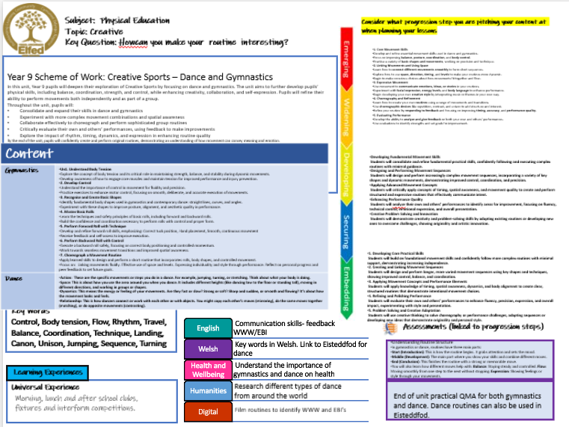

Slide 30
Consider what progression step you are pitching your content at when planning your lessons
Subject: PE
Topic: Health & Fitness
Key Question:
Independent learning.
Questioning.
Knowledge and Understanding.
I have a well-developed understanding of how regular physical activity supports physical, mental, and emotional health, and I can explain how different types of training target specific aspects of fitness.
I can confidently participate in and lead aspects of group fitness activities, showing initiative, adaptability, and the ability to support others in maintaining motivation and focus.
I can analyse how the components of fitness—such as muscular strength, cardiovascular endurance, flexibility, agility, and power—combine to influence performance across different physical activities.
I can design, implement, and evaluate a personal fitness plan, using a variety of training methods and data to track progress, make adjustments, and improve overall performance.
IIn this unit, pupils will extend their understanding of how exercise influences physical health, fitness, and overall wellbeing, with a focus on long-term lifestyle management. Year 9 activities may include advanced cross country running, competitive swimming, high-intensity circuit training, and varied fitness challenges targeting cardiovascular endurance, muscular strength, flexibility, power, and agility. Pupils will critically explore the physiological and psychological adaptations the body undergoes in response to different training methods. They will develop skills to design and implement effective warm-ups and cool-downs tailored to specific activities and understand the principles of safe, efficient, and progressive training. This unit encourages pupils to cultivate self-discipline, leadership, and a lifelong commitment to physical fitness and healthy living. Lesson objective
Content
Cross County Can I use self-monitoring techniques, such as heart rate or perceived exertion, to regulate pace and enhance endurance during runs. | I understand the science behind endurance training, including energy systems and recovery, and apply this knowledge to improve my performance. I can use self-monitoring techniques, such as heart rate or perceived exertion, to regulate pace and enhance endurance during runs.
Fitness Can I explain in detail the components of fitness and how they interrelate to influence athletic performance across a variety of sports? | I can design safe and effective training plans that incorporate varied exercises targeting multiple fitness components, adapting these plans based on progress and feedback. I understand and can articulate the broader benefits of exercise on mental health, stress management, and social wellbeing, supporting a holistic approach to fitness. .
Swimming Can I perform, analyse, and refine the technical aspects of all competitive swimming strokes, including starts, turns, and finishes? | I demonstrate leadership in promoting water safety, including the ability to perform key life-saving skills and assist others in emergency situations. I use video analysis and other feedback methods to critically evaluate my swimming technique and plan targeted improvements to enhance performance and endurance.
I demonstrate confident and refined practical skills across a variety of fitness activities, showing control, accuracy, and an ability to follow complex instructions independently.
I take full responsibility for preparing safely and working effectively in fitness tasks, applying knowledge of safe practice and risk assessment without needing supervision.
I can adapt and apply advanced fitness techniques and movement skills to enhance my performance, and I understand how to modify exercises to suit different goals or contexts.
I regularly evaluate my performance in detail, using feedback and fitness data to set challenging targets and make informed decisions about how to improve my overall fitness and effort.
I can analyze and discuss the complex physical, mental, and social benefits of consistent physical activity, including its role in preventing lifestyle-related diseases.
I can critically assess a variety of exercise types and training methods, explaining how they develop specific fitness components such as anaerobic capacity, muscular power, agility, and flexibility, and how these relate to different sports and activities.
I can use reflective questioning to integrate prior knowledge with advanced concepts such as periodization, psychological skills (e.g., focus, resilience), leadership roles, and motivation strategies in team and individual performance contexts.
I can formulate detailed questions and provide evidence-based responses about how tailored training programs, exercise techniques, and sports science principles support specific performance goals and overall health optimization.
I can independently design, implement, and evaluate personalized fitness and training plans, incorporating problem-solving to overcome performance barriers and promote long-term physical and mental wellbeing.
Key Words
Muscular strength, power, muscular endurance, training zones, aerobic, anaerobic.
English
Welsh
Health and Wellbeing
Humanities
Digital
Assessments (linked to progression steps)
Communicate with teammates
Discuss names of sports and skills in Welsh
Describe what health and fitness is and why it is important in your daily life.
Demonstrate accurate performance technique and safety during a competitive scenario or skills activity.
Learning Experiences
Appreciate the importance of a healthy lifestyle
Universal Experience
Morning, lunch and after school clubs, fixtures and interform competitions.
Discuss the origin of each sport and countries' national sports
End of unit practical QMA for each area of learning.
Record and analyse skill technique

Slide 31
Consider what progression step you are pitching your content at when planning your lessons
Subject: PE
Topic: Striking & Fielding
Key Question:
Independent learning.
Problem solving.
Knowledge and Understanding.
I have a confident and detailed understanding of the rules, roles, and responsibilities in rounders and cricket, and I can apply them accurately in competitive game situations.
I can contribute to team performance by using tactical decision-making, such as anticipating play, manipulating shot placement, and organising the field based on evolving match scenarios.
I understand how advanced communication, tactical positioning, and quick decision-making impact performance and can lead to team success in striking and fielding games.
I can explain and implement complex strategies, including dynamic fielding adjustments, flexible batting orders, and adapting plans mid-game to exploit the opposition’s weaknesses.
Through games like rounders and cricket, students will refine their understanding of advanced rules, specialised fielding roles, and complex tactical thinking. They will take increased ownership of team responsibilities—such as bowler, backstop, batter, or fielder—and make strategic decisions based on gameplay, such as manipulating field placements or exploiting weaknesses in the opposition. Pupils will also enhance key teamwork qualities, including clear leadership, decision-making under pressure, reading the game, and adapting tactics confidently during play to influence the outcome.
Content
Rounders/Softball How can I refine my technique to increase both accuracy and power when batting under pressure? What advanced techniques can I apply to bowl with greater control, consistency, and variation? How can I analyse the field to make tactical decisions about where to place the ball when batting? What rules and regulations must I follow to ensure fair play and strategic success in competitive rounders? | I have a secure understanding of the rules, roles, and scoring systems in rounders/softball and can apply them confidently in games. I can demonstrate consistent and effective use of key skills in rounders/softball during competitive situations. I understand and apply correct techniques for bowling, fielding, and batting, and can adapt them to improve performance in gameplay.
Cricket What are the key rules and tactical responsibilities of different roles and fielding positions in cricket? How can I refine my batting and bowling techniques to improve consistency and performance under pressure? | I have a detailed understanding of cricket rules and can explain how specific fielding roles contribute to tactical decision-making. I can apply rules confidently and adjust fielding positions to support changing team strategies during competitive play. I can consistently perform accurate batting and bowling techniques, making technical adjustments to improve outcomes. I communicate clearly with teammates and adapt team strategy effectively in response to the flow of the game.
I confidently apply practical skills in rounders and cricket, showing independence and control in game situations.
I take on key roles and apply rules accurately to support consistent team performance.
I use tactical awareness and positioning to influence gameplay and support strategic decisions.
I reflect critically on my roles and identify clear ways to improve team and personal performance.
I adapt advanced skills and tactics during play, adjusting strategies to respond effectively to challenges.
I can critically analyze complex game situations to make strategic decisions in batting, bowling, and field placement that maximize my team’s chances of success.
I can evaluate and adapt my understanding of specialist roles and positions, anticipating opponents’ tactics and responding effectively with precise hitting, throwing, or fielding choices.
I can lead and facilitate effective communication, teamwork, and tactical adjustments under pressure to solve challenges during high-stakes game situations.
I can synthesize knowledge of advanced strategies, including opposition analysis and situational awareness, to modify my role (e.g., wicketkeeper, backstop, deep fielder) in ways that optimize team performance.
I can independently design and implement problem-solving approaches and tactical plans that respond to unpredictable game scenarios, helping my team to outperform opponents consistently.
Key Words
Teamwork, communication, respect, rules, positions, tactics, batting, bowling, fielding, technique
English
Welsh
Health and Wellbeing
Humanities
Digital
Assessments (linked to progression steps)
Communicate with teammates
Discuss names of sports and skills in Welsh
Analyse the structure of a cricket/rounders team and evaluate how key roles contribute to team strategy and success.
Demonstrate consistent skill execution and tactical teamwork during competitive gameplay or advanced drills.
Learning Experiences
Appreciate the importance of a healthy lifestyle
Universal Experience
Morning, lunch and after school clubs, fixtures and interform competitions.
Discuss the origin of each sport and countries' national sports
End of unit practical QMA for each team game taught.
Record and analyse skill technique

Slide 32
Consider what progression step you are pitching your content at when planning your lessons
Subject: PE
Topic: Team Games Yr 9
Key Question:
Independent learning.
Skills.
Knowledge and Understanding.
I have a secure understanding of the rules, positions, and responsibilities in a range of team games.
I can work effectively within a team, applying a variety of tactics and making decisions based on the flow of the game.
I have a deeper understanding of how communication, positioning, and decision-making influence team performance.
I can analyse and apply more advanced game strategies, adapting them to different situations and opponents.
I understand the wider impact of teamwork, leadership, and fair play, and can reflect on how team games help build resilience, confidence, and cooperation.
Overview: In this unit, pupils will deepen their understanding of team games by building on the tactical knowledge, skill development, and teamwork introduced in earlier years. Through sports such as football, netball, hockey, and rugby, students will focus on refining technical skills, making effective decisions under pressure, and applying more advanced tactics during competitive gameplay. Pupils will also develop greater positional awareness, communication, and leadership within a team setting. The emphasis will be on understanding how to adapt strategies in response to the flow of the game, working collaboratively to solve problems in play, and taking responsibility for both individual and team performance. tives
Content
Football How can I use different types of passes effectively in game situations. How can I improve my decision-making when under pressure? How do I create and exploit space when attacking or defending? | I can select and perform the most effective type of pass depending on space, positioning and pressure from opponents. I know what factors influence decision-making in a game (e.g. time, space, opposition movement) I understand how manipulating space can give my team a tactical advantage in both attacking and defending phases of play.
Netball How can I use a range of passes effectively under pressure? How do the roles of different positions contribute to overall team success? How do I create and use space to support attacking paly? | I understand how timing, positioning and movement affect the success of passing in competitive situations. I can play effectively in different positions, fulfilling my role and supporting my team. I know how to use movement techniques such as dodging, driving and positioning to get free from a defender.
Hockey How can improve the accuracy, control and speed of my passing in game situations? What strategies can I use to maintain possession and move the ball up the pitch effectively? How do I create and use space to support attacking play? | I know the correct techniques for push pass, slap pass, and hitting in hockey. I can make effective decisions to retain possession and transition the ball through midfield into attacking areas. I understand how intelligent movement and spatial awareness improve attacking opportunities and scoring chances.
Rugby How can I improve the accuracy, timing and distance of my passing under pressure? How can I use communication and support play to maintain possession and progress up the pitch? What strategies can I use to defend as a team and regain possession? | I understand how pressure, positioning, and timing affect the success of passing and ball retention in attack. I can communicate clearly and move into supporting positions to create attacking options. I can apply team-based defensive strategies such as drift defence or blitzing to put pressure on the opposition.
I can demonstrate a range of practical skills and take part confidently in team games, showing control and understanding of the rules.
I can perform effectively in different roles within a team, adapting to the demands of the game and contributing to team success.
I can apply tactical awareness and positional knowledge to influence the outcome of competitive situations.
I can reflect on my own and others’ performance to identify strengths and suggest improvements to teamwork and game strategy.
I can consistently use advanced techniques and prior learning to solve challenges in gameplay and adapt tactics or formations to support my team.
I can execute advanced team game skills with precision, speed, and strategic intent during high-pressure situations.
I can master specialist roles and positions, contributing to complex tactical systems such as zonal defense or structured attacks.
I can lead and coordinate communication and teamwork, combining technical skill and tactical awareness to influence team performance.
I can demonstrate a high level of skill adaptability, modifying techniques and tactics in response to evolving game contexts.
I can consistently apply and refine my skills to maximize team effectiveness, demonstrating leadership and an in-depth understanding of game dynamics.
Assessments (linked to progression steps)
English
Welsh
Health and Wellbeing
Humanities
Digital
Learning Experiences
Communicate with teammates
Explain the tactical structure of a team game and analyse how different positions contribute to overall team strategy.
Demonstrate consistent technical accuracy, decision-making, and effective teamwork during small-sided games and competitive scenarios.
Key Words
Teamwork, communication, respect, rules, positions, tactics, passing, dribbling, tackling, footwork, rules.
Discuss names of sports and skills in Welsh
Appreciate the importance of a healthy lifestyle
Universal Experience
Morning, lunch and after school clubs, fixtures and interform competitions.
Discuss the origin of each sport and countries' national sports
End of unit practical QMA for each team game taught.
Record and analyse skill technique

