Slide 1

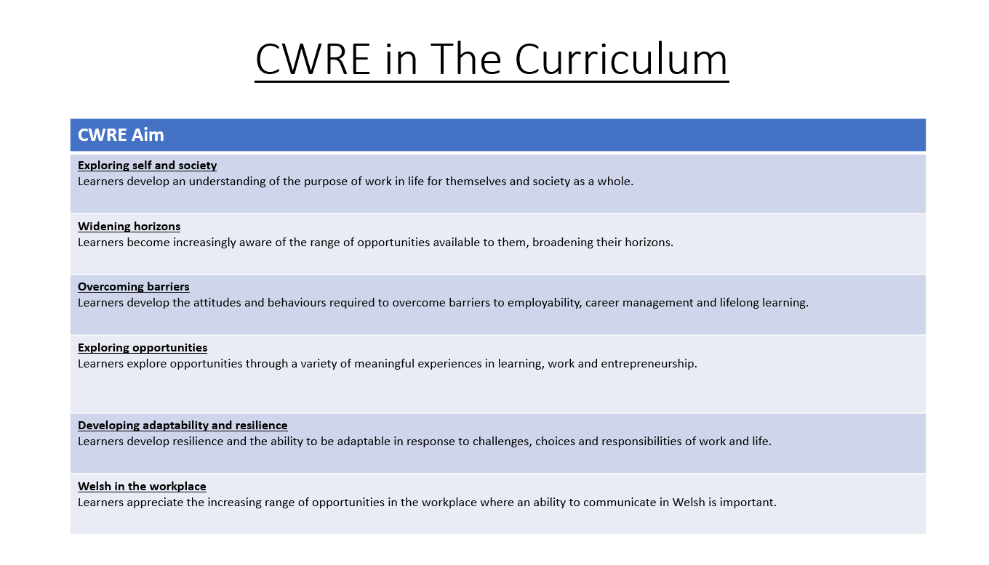

Slide 2
Lower School Plan
CWRE Progression
Term | 1 | 2 | 3
Year 7 | 1a: Who am I? 1b. Exploring Possibilities – Dream Jobs! | 2a. What is a career in my subject? 2b. What is an entrepreneur? Can my subject lead me to be one? | 3a. What is work-life balance? 3b. Careers and the future
Year 8 | 1a. What are my interests? 1b. Job applications and CV’s – how can my subject enhance mine? | 2a. Challenges and rewards of work 2b. Creating the life you want – how can skill development in my subject help? Create a vision board | 3a. What does success mean to me? What does it look like in my subject? 3b. Careers and the climate
Year 9 | 1a. What are my skills? 1b. What comes after school? Learning pathways for my subject | 2a. Decision making – choosing what to study at KS4. 2b. Taking control of your career journey. How to overcome potential barriers | 3a. Working and earning, managing your money 3b. What is the labour market and what is it saying about jobs in your subject sector?

Slide 3
Upper School Plan
CWRE Progression
Term | 1 | 2 | 3
Year 10 | 1a: Interests and Skills Profile – what makes you good at this subject? How will your skills transfer into the world of work? 1b. Preparing to go on work experience. How is skill development in my subject helping you prepare? | 2a. In person, hybrid, remote. What works best for your subject sector? 2b. Taking control of your career journey. How to overcome potential barriers | 3a. Wellbeing in the workplace. Discuss jobs linked to your subject and the possible challenges employees may face. 3b. What are my employability skills? How does my subject make students employable.
Year 11 | 1a. Post 16 Choices in my subject 1b. Decision making – choosing your post 16 pathway. What pathways are available linked to your subject? | 2a. Money talks – apprenticeships vs higher education in your subject

Slide 4
Lower School Plan
Subject: Cymraeg
Skill: Digital Skills Progression
Term | 1 | 2 | 3
Year 7 |  | Stori Gelert – Learners will create a video illustrating the Story of Gelert. Learners need to include at least three images/videos with overlaid text on at least one scene. Animation on text and transitions between scenes must be evident.
Year 8 |  | Gwyliau – Learners will create a video describing a holiday they have been on in the past tense. Learners need to include a narration over the top of their video that is synchronised to the timeline.
Year 9 |  | S4C - Learners will create a video about s4C. In their video, they can express opinion about a variety of programmes available on s4c. Learners should include narration over the top and multiple videos in a scene.

Slide 5
Lower School Plan
Subject: Cymraeg
Skill: Literacy Progression
Term | 1 | 2 | 3
Blwyddyn 7 | 1A – Ni ac eraill I can form simple, compound and complex sentences. 1B – Ysgol I can identify quotations from printed and digital texts to support a viewpoint. | Diwylliant Cymru I can organise my writing into accurate paragraphs. I can form simple, compound and complex sentences. I can use a comma accurately. | 3A – Teulu ac hunaniaeth I can competently spell and use subject specific words 3B – Cwpan y Byd I can listen attentively to the viewpoints of others.
Blwyddyn 8 | 1A – Pam dysgu Cymraeg? I can use Standard Welsh appropriately to present a point of view. I can organise my talk in a detailed and accurate manner. 1B - Chwaraeon I know the key terminology in each subject and how to accurately spell these words in my books. | Gwyliau I can organise my talk in a detailed and accurate manner. I can vary my register for a variety of purposes and audiences. | 1A – Hedd Wyn I can annotate a text appropriately. 1B – Cwpan y Byd I can listen attentively to the viewpoints of others for an extended period.
Blwyddyn 9 | Y Gorffennol I spell the high frequency words used in the English language correctly. I can use and spell more sophisticated vocabulary. | S4C I can use Standard English appropriately to present a point of view. I can organise my talk in a detailed and accurate manner. | 3A – Y Ffair I can read a text aloud varying tone as appropriate. 3B – Caerdydd I know the key terminology in each subject and can accurately spell these words in my books.

Slide 6

Pwnc: CYMRAEG (Blwyddyn 7, Tymor 1a)
Topig: Ni ac eraill (Ourselves and Others)
Cwestiwn allweddol: Pwy ydw i?
Knowledge and Understanding
I have a basic understanding of new vocabulary.
I have a broader understanding of new vocabulary.
I have a deeper understanding of new vocabulary.
I have a detailed understanding of new vocabulary and can construct simple sentences.
I have a detailed understanding of new vocabulary and can construct extended sentences.
.
Overview: In this unit, the focus will be on ourselves and others. There will be an initial opportunity for pupils to recap the Welsh vocabulary they have learnt in primary school by creating a simple profile about themselves. Pupils will then build on this by revising how to ask for and give information about themselves. They will develop their vocabulary by learning how to describe themselves and others using a range of adjectives. In addition, pupils will look at the Welsh alphabet and discuss fundamental differences between English, Welsh and other European languages. To conclude the topic, we will do some work on cognates with the aim of developing pupils’ problem solving skills and ability to work out what words mean when tackling reading tasks.
Problem solving
I understand what a cognate is.
I know a couple of cognates in Welsh and English.
I know a variety of cognates between Welsh and English.
I can make connections between different languages using cognates.
I can apply knowledge of cognates to develop my reading skills.
.
Cynnwys
QMA -Kim’s profile | I can understand a simple profile in Welsh. I can create a profile about myself in Welsh.
The Alphabet | I know the Welsh alphabet and how it is different to the English alphabet. I can explain some fundamental differences between the English, Welsh and other European languages.
Myself and others | I know question words in Welsh. I can answer and respond to questions. I know adjectives in Welsh. I know how to understand information about others. I can apply my reading skills to understand a range of texts. I know how to use a variety of reading strategies. I can understand and share information about others.
Summative – speaking task | I can have a short dialogue with a friend asking for and giving information about yourself. I can speak with confidence.
Cognates | I know what a cognate is. I know how to make connections between different languages. I can apply my skills to work out what words mean by looking for cognates.
Questioning
I know most of the question words in Welsh.
I can construct some basic questions using prompts.
I can ask a few questions from memory.
I can ask a variety of questions from memory.
I can confidently ask a variety of questions from memory.
.
Key Words
Pupils will be given a ‘Sentence Builder’ sheet containing key vocabulary.
English
QMA – Kim’s profile
Assessments (linked to progression steps)
Literacy will be embedded naturally in to the lessons.
Learning Experiences
Pupils will record their conversations for their summative assessments.
Summative - Dialogue

