Slide 1

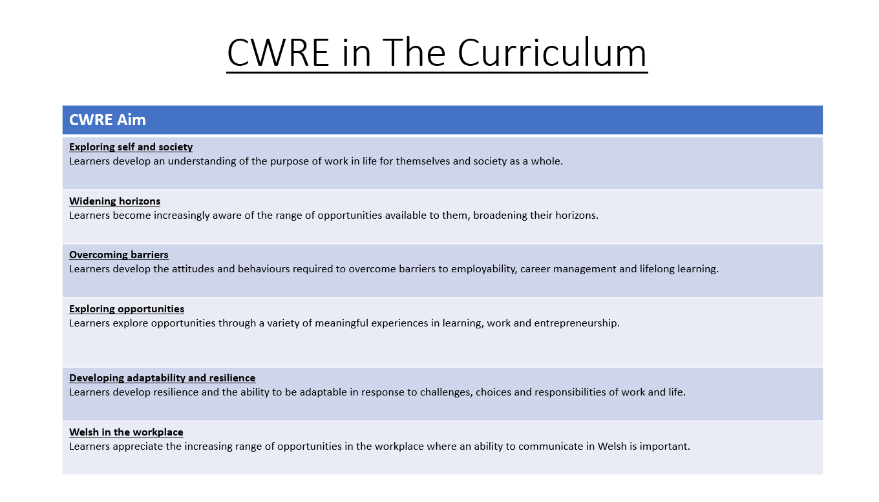

Slide 2
Lower School Plan
Subject: Drama CWRE Progression
Term | 1 | 2 | 3
Year 7 | 1a: Who am I? 1b. Exploring Possibilities – Dream Jobs! | 2a. What is a career in my subject? 2b. What is an entrepreneur? Can my subject lead me to be one? | 3a. What is work-life balance? 3b. Careers and the future
Year 8 | 1a. What are my interests? 1b. Job applications and CV’s – how can my subject enhance mine? | 2a. Challenges and rewards of work 2b. Creating the life you want – how can skill development in my subject help? Create a vision board | 3a. What does success mean to me? What does it look like in my subject? 3b. Careers and the climate
Year 9 | 1a. What are my skills? 1b. What comes after school? Learning pathways for my subject | 2a. Decision making – choosing what to study at KS4. 2b. Taking control of your career journey. How to overcome potential barriers | 3a. Working and earning, managing your money 3b. What is the labour market and what is it saying about jobs in your subject sector?

Slide 3
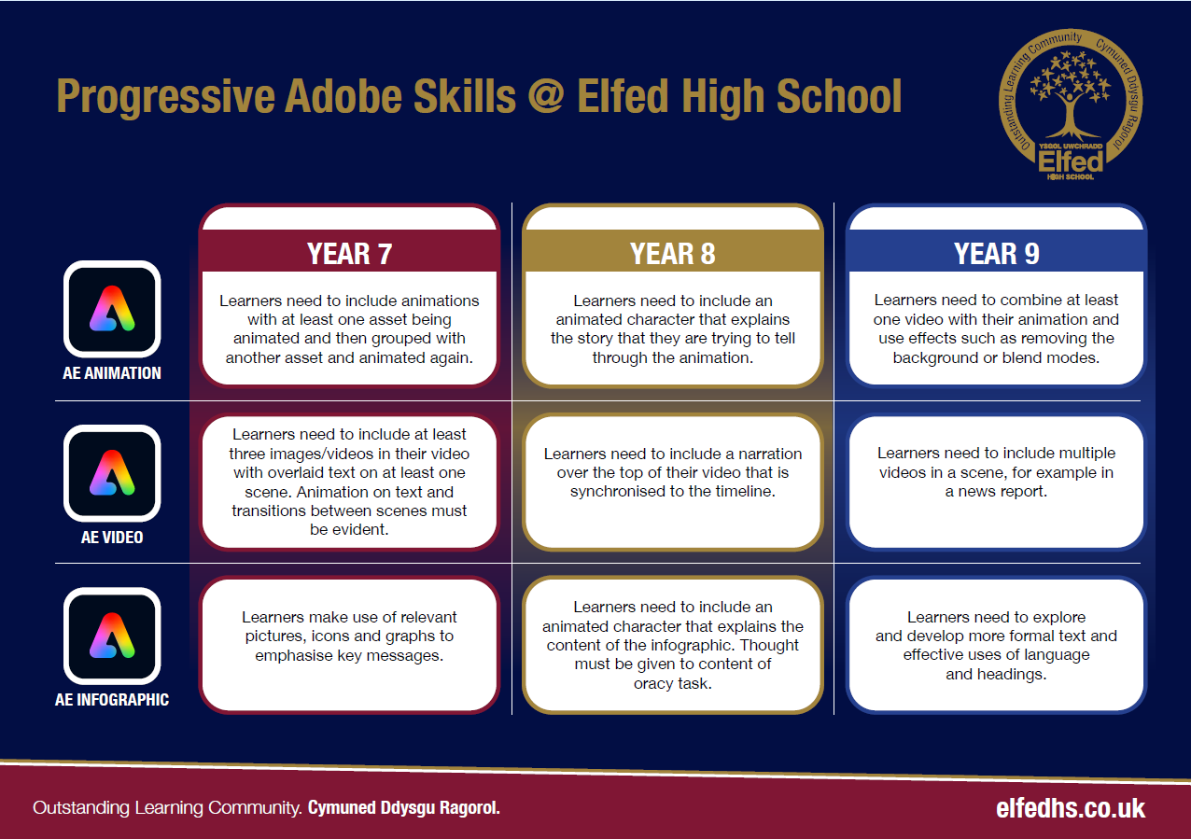

Slide 4
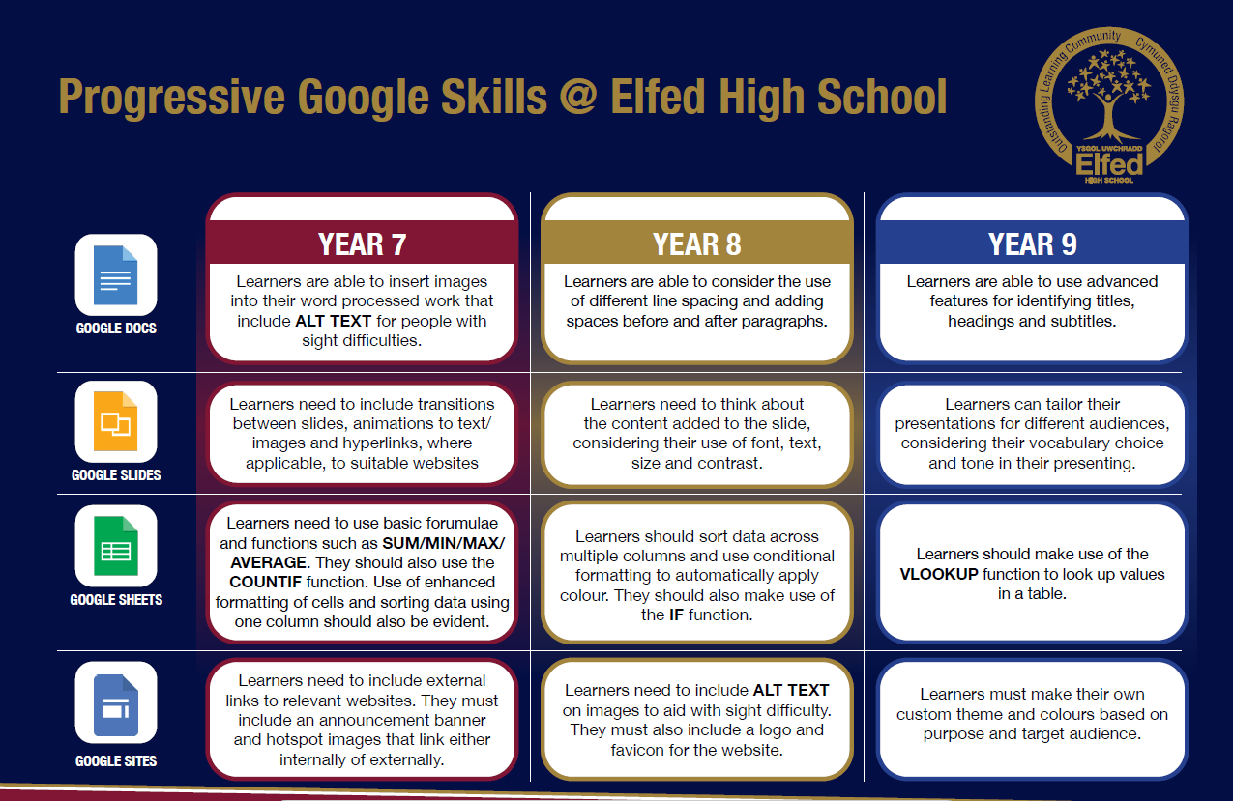

Slide 5
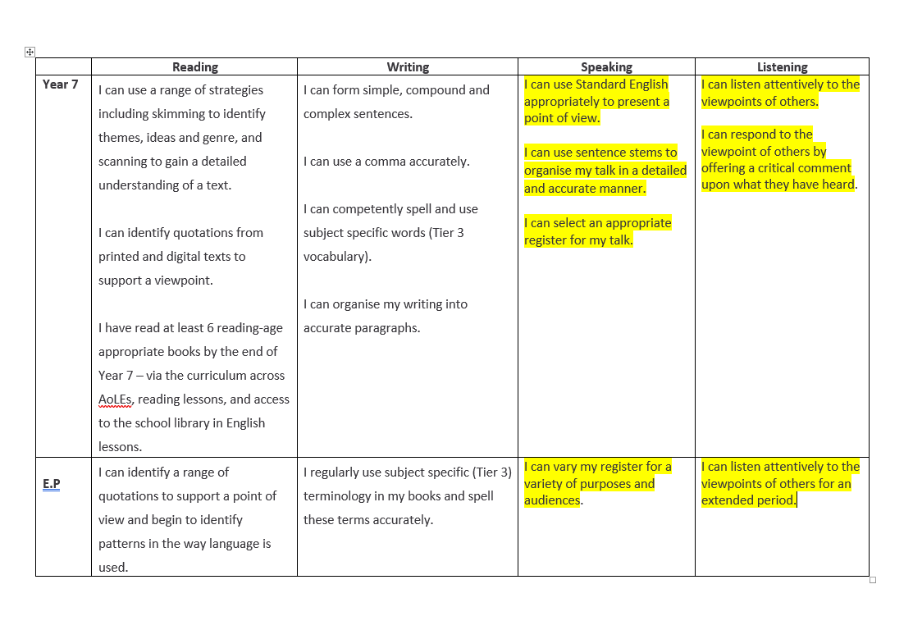

Slide 6
