Slide 1

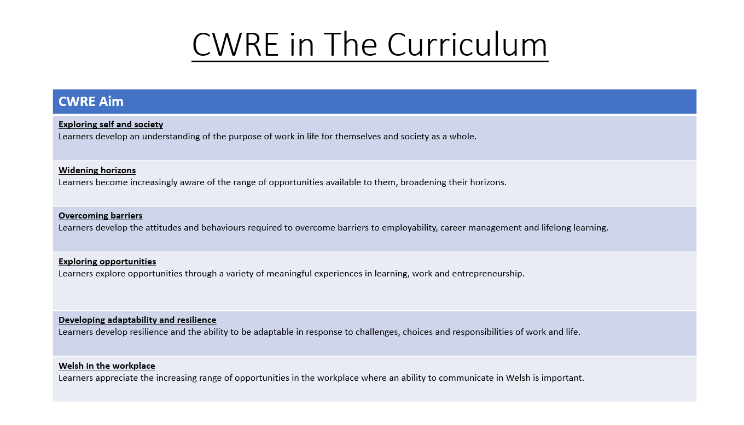

Slide 2
Lower School Plan
Subject: CWRE Progression
Term | 1 | 2 | 3
Year 7 | 1a: Who am I? 1b. Exploring Possibilities – Dream Jobs! | 2a. What is a career in my subject? 2b. What is an entrepreneur? Can my subject lead me to be one? | 3a. What is work-life balance? 3b. Careers and the future
Year 8 | 1a. What are my interests? 1b. Job applications and CV’s – how can my subject enhance mine? | 2a. Challenges and rewards of work 2b. Creating the life you want – how can skill development in my subject help? Create a vision board | 3a. What does success mean to me? What does it look like in my subject? 3b. Careers and the climate
Year 9 | 1a. What are my skills? 1b. What comes after school? Learning pathways for my subject | 2a. Decision making – choosing what to study at KS4. 2b. Taking control of your career journey. How to overcome potential barriers | 3a. Working and earning, managing your money 3b. What is the labour market and what is it saying about jobs in your subject sector?

Slide 3
Upper School Plan
Subject: CWRE Progression
Term | 1 | 2 | 3
Year 10 | 1a: Interests and Skills Profile – what makes you good at this subject? How will your skills transfer into the world of work? 1b. Preparing to go on work experience. How is skill development in my subject helping you prepare? | 2a. In person, hybrid, remote. What works best for your subject sector? 2b. Taking control of your career journey. How to overcome potential barriers | 3a. Wellbeing in the workplace. Discuss jobs linked to your subject and the possible challenges employees may face. 3b. What are my employability skills? How does my subject make students employable.
Year 11 | 1a. Post 16 Choices in my subject 1b. Decision making – choosing your post 16 pathway. What pathways are available linked to your subject? | 2a. Money talks – apprenticeships vs higher education in your subject

Slide 4
Lower School Plan
Subject: Art
Skill: Digital Skills Progression
Year | Term | Digital Task
Year 7 | 2 | Kandinsky inspired composition: Learners need to: Understand the Illustrator workspace (toolbars, artboards, layers). Use basic shape tools (Rectangle, Ellipse, Polygon). Apply fill and stroke properties. Copy, paste and transform the size of shapes. Save/export files in appropriate formats (AI, PDF, PNG). Create basic compositions using shapes and colour.
Year 8 | 2 | Julien Opie Portrait. Learners need to: Use Pen Tool for custom paths and shapes. Work with layers and group objects effectively. Use the opacity tool. Use transform and align tools accurately. Export assets for print and digital formats.
Year 9 | 2 | Digital Pattern Illustration Learners need to: Master the Pen Tool and anchor point manipulation. Use the Appearance panel to refine their illustration. Create vector tracings from raster images. Work to a set design brief.

Slide 5
Lower School Plan
Subject: Art
Skill: Literacy Progression
Term | 1 | 2 | 3
Year 7 | Sketchbook annotation: Writing: I can competently spell and use subject specific words (Tier 3 vocabulary). | Kandinsky Research and Analysis: Reading: I can use a range of strategies including skimming to identify themes, ideas and genre, and scanning to gain a detailed understanding of a text. Writing: I can competently spell and use subject specific words (Tier 3 vocabulary). | Steam punk research: II can use a range of strategies including skimming to identify themes, ideas and genre, and scanning to gain a detailed understanding of a text.
Year 8 | Elaine Hughes analysis: Reading: I can identify a range of quotations to support a point of view and begin to identify patterns in the way language is used. Writing: I know the key terminology in each subject and how to accurately spell these words in my books. | Venn diagram: Writing: I know the key terminology in each subject and how to accurately spell these words in my books. | Sketchbook Annotation: Writing: I know the key terminology in each subject and how to accurately spell these words in my books.
Year 9 | Zine annotation: Writing: I know the key terminology in each subject and can accurately spell these words in my books. | Artist research and analysis: Reading: I can decode printed and digital texts, considering context, genre and implied meaning. Writing: I spell the high frequency words used in the English language correctly. I can use and spell more sophisticated vocabulary. I know the key terminology in each subject and can accurately spell these words in my books. | Sketchbook annotation: Writing: I know the key terminology in each subject and can accurately spell these words in my books.

Slide 6
Lower School Plan
Subject: Art
Skill: Numeracy Progression
Year | Term | Numeracy Task
Year 7 | 2 | Colour mixing of primary, secondary and tertiary colours: I can use ratio and proportion to calculate quantities.
Year 8 | 2 | Realistic Portrait: I can use fractions to determine correct facial proportions. Venn diagram: I can complete Venn diagrams.
Year 9 | 1 | Drawing using the grid method: I can use ratio and proportion including map scales.

Slide 7
Art
Natural Forms
How can I explore the formal elements of art and take risks in my experiments to create a mixed media outcome?
Skill – 2D making skills
I can draw basic shapes and can control some of the materials and techniques with support.
I can draw recognisable shapes and demonstrate some control of the materials and techniques explored.
With some accuracy, I can handle the materials and techniques explored to create a zine, giving some consideration to the formal elements.
I can confidently handle most of the materials and techniques explored to create a visually appealing zine, with clear consideration given to the formal elements.
I can skilfully handle all the materials and techniques explored to create a highly original zine, with creative consideration given to the formal elements.
Overview:
In this unit pupils will be introduced to the theme for the year: Structures. The stimulus for this project will be 'Natural Forms'. They will explore each of the formal elements and experiment with a range of materials and techniques to create a mixed media zine.
No. of lessons:15
Content:
Mind Map | I can generate and document a range of ideas on the theme of Structures.
Painting | I will experiment with a range of watercolour techniques to create a textured background.
Drawing | I will explore line, tone and textural drawings using a range of materials. I will learn the grid technique to achieve a successful observational drawing.
Printing | I will experiment with relief and surface printing techniques.
Transfers and sewing | I will experiment with transferring images and sewing techniques.
Text and Mark Making | I will experiment with using text and mark making to add further texture and meaning.
Reflecting | I can use keywords appropriately to reflect on my work and others.
Knowledge and Understanding
I am starting to learn about the formal elements.
I can give simple definitions to some of the formal elements learnt.
I can give definitions of the formal elements learnt and I’m starting to use them to describe my own work.
I understand the formal elements learnt and can use them confidently to describe my own work.
I can demonstrate a strong understanding of the formal elements through describing and making judgements about my own and other’s artwork.
Independent learning.
I can ask questions, and I am starting to understand the need to take risks.
I am asking more appropriate questions, starting to take risks and develop my resilience.
I am starting to seek my own solutions independently. I am willing to take risks and learn from my mistakes.
I can work with others to seek out solutions, confidently take risks and demonstrate resilience to improve my work.
I can seek out solutions independently, apply new and prior knowledge and skills to develop my work in an original, creative way.
Keywords:
Line, tone, mark making, texture, subject matter, relief/reduction print, colour, composition, text, mixed media, pattern, shape, positive/negative space, proportion.
Links
English | Developing oracy skills through discussions on own and other's work.
Assessment
2D Making skills– your zine will be assessed for this skill.
Knowledge and Understanding – Class discussions and a keyword worksheet will be used to assess this skill.
Independent Learning – Class discussions, your work ethic and all artwork produced will be used to assess this skill.
LearningExperiences:
Experimenting and taking risks with a range of materials and techniques.

Slide 8
Insert Unit Overview – Independent Learning Task once completed.

Slide 9
Insert Unit Overview – Daemons once completed.

