Slide 1

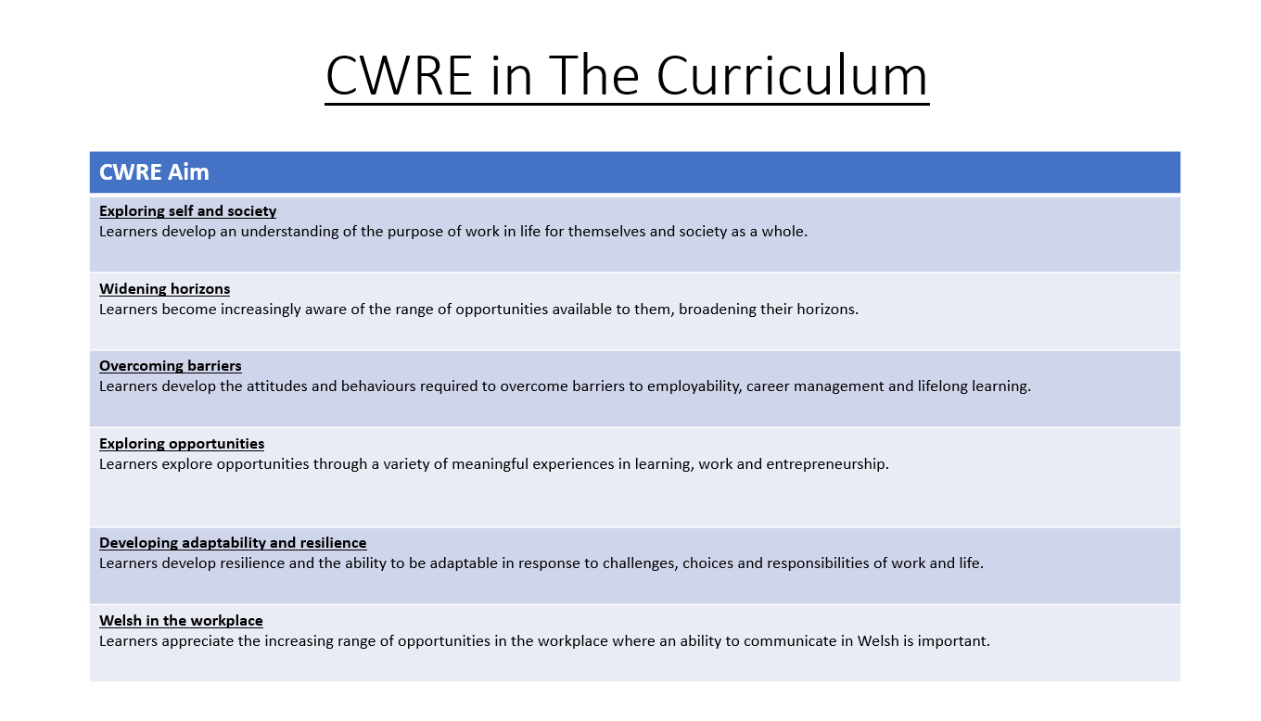

Slide 2
Lower School Plan
Subject: CWRE Progression
Term | 1 | 2 | 3
Year 7 | 1a: Who am I? 1b. Exploring Possibilities – Dream Jobs! | 2a. What is a career in my subject? 2b. What is an entrepreneur? Can my subject lead me to be one? | 3a. What is work-life balance? 3b. Careers and the future
Year 8 | 1a. What are my interests? 1b. Job applications and CV’s – how can my subject enhance mine? | 2a. Challenges and rewards of work 2b. Creating the life you want – how can skill development in my subject help? Create a vision board | 3a. What does success mean to me? What does it look like in my subject? 3b. Careers and the climate
Year 9 | 1a. What are my skills? 1b. What comes after school? Learning pathways for my subject | 2a. Decision making – choosing what to study at KS4. 2b. Taking control of your career journey. How to overcome potential barriers | 3a. Working and earning, managing your money 3b. What is the labour market and what is it saying about jobs in your subject sector?

Slide 3
Upper School Plan
Subject: CWRE Progression
Term | 1 | 2 | 3
Year 10 | 1a: Interests and Skills Profile – what makes you good at this subject? How will your skills transfer into the world of work? 1b. Preparing to go on work experience. How is skill development in my subject helping you prepare? | 2a. In person, hybrid, remote. What works best for your subject sector? 2b. Taking control of your career journey. How to overcome potential barriers | 3a. Wellbeing in the workplace. Discuss jobs linked to your subject and the possible challenges employees may face. 3b. What are my employability skills? How does my subject make students employable.
Year 11 | 1a. Post 16 Choices in my subject 1b. Decision making – choosing your post 16 pathway. What pathways are available linked to your subject? | 2a. Money talks – apprenticeships vs higher education in your subject

Slide 4
Lower School Plan
Subject: Art
Skill: Digital Skills Progression
Year | Term | Digital Task
Year 7 | 2 | Kandinsky inspired composition: Learners need to: Understand the Illustrator workspace (toolbars, artboards, layers). Use basic shape tools (Rectangle, Ellipse, Polygon). Apply fill and stroke properties. Copy, paste and transform the size of shapes. Save/export files in appropriate formats (AI, PDF, PNG). Create basic compositions using shapes and colour.
Year 8 | 2 | Julien Opie Portrait. Learners need to: Use Pen Tool for custom paths and shapes. Work with layers and group objects effectively. Use the opacity tool. Use transform and align tools accurately. Export assets for print and digital formats.
Year 9 | 2 | Digital Pattern Illustration Learners need to: Master the Pen Tool and anchor point manipulation. Use the Appearance panel to refine their illustration. Create vector tracings from raster images. Work to a set design brief.

Slide 5
Lower School Plan
Subject: Art
Skill: Literacy Progression
Term | 1 | 2 | 3
Year 7 | Sketchbook annotation: Writing: I can competently spell and use subject specific words (Tier 3 vocabulary). | Kandinsky Research and Analysis: Reading: I can use a range of strategies including skimming to identify themes, ideas and genre, and scanning to gain a detailed understanding of a text. Writing: I can competently spell and use subject specific words (Tier 3 vocabulary). | Steam punk research: II can use a range of strategies including skimming to identify themes, ideas and genre, and scanning to gain a detailed understanding of a text.
Year 8 | Elaine Hughes analysis: Reading: I can identify a range of quotations to support a point of view and begin to identify patterns in the way language is used. Writing: I know the key terminology in each subject and how to accurately spell these words in my books. | Venn diagram: Writing: I know the key terminology in each subject and how to accurately spell these words in my books. | Sketchbook Annotation: Writing: I know the key terminology in each subject and how to accurately spell these words in my books.
Year 9 | Zine annotation: Writing: I know the key terminology in each subject and can accurately spell these words in my books. | Artist research and analysis: Reading: I can decode printed and digital texts, considering context, genre and implied meaning. Writing: I spell the high frequency words used in the English language correctly. I can use and spell more sophisticated vocabulary. I know the key terminology in each subject and can accurately spell these words in my books. | Sketchbook annotation: Writing: I know the key terminology in each subject and can accurately spell these words in my books.

Slide 6
Lower School Plan
Subject: Art
Skill: Numeracy Progression
Year | Term | Numeracy Task
Year 7 | 2 | Colour mixing of primary, secondary and tertiary colours: I can use ratio and proportion to calculate quantities.
Year 8 | 2 | Realistic Portrait: I can use fractions to determine correct facial proportions. Venn diagram: I can complete Venn diagrams.
Year 9 | 1 | Drawing using the grid method: I can use ratio and proportion including map scales.

Slide 7
Art
Sense of Place
How can I communicate my thoughts and connection with Wales in my artwork?
Skill – 2D making skills
I can paint my own papers and collage a basic landscape with support.
I can paint my own papers with mark making and collage a simple, recognisable landscape.
With some accuracy, I can handle the materials and techniques explored to create a Welsh landscape, giving some consideration to the formal elements.
I can confidently handle most of the materials and techniques explored to create a personal Welsh landscape, with clear consideration given to the formal elements.
I can skilfully handle all the materials and techniques explored to create a highly original Welsh landscape, with creative consideration given to the formal elements.
Overview:
In this unit pupils will be introduced to the theme for the year: Identity. The stimulus for this project will be 'A Sense of Place' and they will create artwork inspired by Wales. They will explore the work of Elaine Hughes and experiment with mark making, composition, collage and sewing techniques to create their own original artwork.
No. of lessons:15
Content:
Mind Map | I can generate and document a range of ideas on the theme of Wales.
Mark Making | I will explore a range of mark making techniques.
Analysis | I will analyse the work of Elaine Hughes using appropriate keywords.
Compositions | I will explore a range of composition ideas to communicate my thoughts on Wales.
Making papers | I will use painting, printing and mark making techniques to create my own papers to collage with.
Final Outcome | I will create a mixed media outcome inspired by Elaine Hughes and my connection with Wales.
Reflection | I can reflect on my work and compare it with the artist, using keywords appropriately.
Problem Solving
I can generate one simple landscape idea with support.
I can generate some simple landscape ideas.
With some accuracy, I can generate a range of ideas inspired by Welsh landscapes.
With accuracy, I can generate and develop a range of original ideas that communicate my own connection with Wales and an understanding of the artist's work.
I can generate and develop creative, complex ideas using new and prior knowledge and skills to develop my work in an original way, demonstrating a strong understanding of selected artists' work.
Independent learning.
I can ask questions, and I am starting to understand the need to take risks.
I am asking more appropriate questions, starting to take risks and develop my resilience.
I am starting to seek my own solutions independently. I am willing to take risks and learn from my mistakes.
I can work with others to seek out solutions, confidently take risks and demonstrate resilience to improve my work.
I can seek out solutions independently, apply new and prior knowledge and skills to develop my work in an original, creative way.
Keywords:
Mark making, texture, subject matter, technique, material, colour, composition, viewpoint, text, collage, textiles.
Links
Welsh | Students will be using Welsh words in their artwork.
Assessment
2D Making skills– your final outcome and any experiments will be assessed for this skill
Problem Solving – your mind map, design ideas and how you develop this into your final outcome will be assessed for this skill.
Independent Learning – Class discussions, your work ethic and all artwork produced will be used to assess this skill.
Learning Experiences:
Exploring the work of current artist and your identity. Moel Famau?

Slide 8
Insert Unit Overview – Portraiture once completed.

Slide 9
Insert Unit Overview – Daemons once completed.

