Slide 1

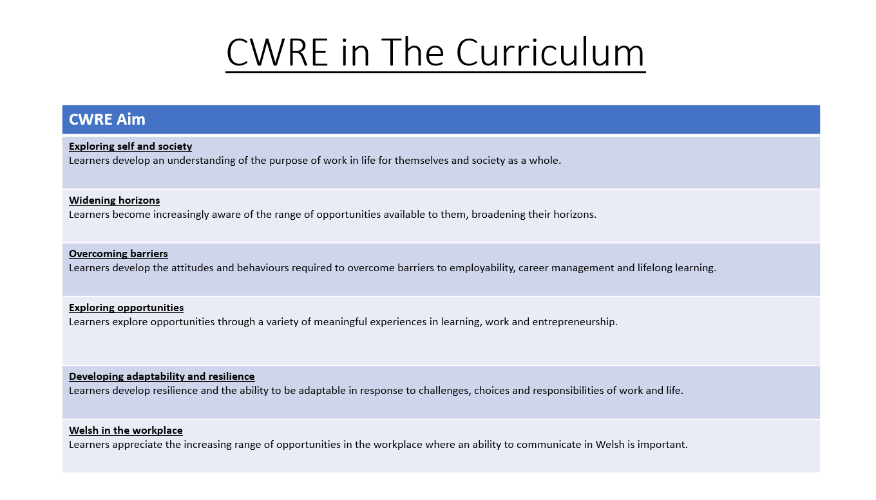

Slide 2
Lower School Plan
Subject: CWRE Progression
Term | 1 | 2 | 3
Year 7 | 1a: Who am I? 1b. Exploring Possibilities – Dream Jobs! | 2a. What is a career in my subject? 2b. What is an entrepreneur? Can my subject lead me to be one? | 3a. What is work-life balance? 3b. Careers and the future
Year 8 | 1a. What are my interests? 1b. Job applications and CV’s – how can my subject enhance mine? | 2a. Challenges and rewards of work 2b. Creating the life you want – how can skill development in my subject help? Create a vision board | 3a. What does success mean to me? What does it look like in my subject? 3b. Careers and the climate
Year 9 | 1a. What are my skills? 1b. What comes after school? Learning pathways for my subject | 2a. Decision making – choosing what to study at KS4. 2b. Taking control of your career journey. How to overcome potential barriers | 3a. Working and earning, managing your money 3b. What is the labour market and what is it saying about jobs in your subject sector?

Slide 3
Upper School Plan
Subject: CWRE Progression
Term | 1 | 2 | 3
Year 10 | 1a: Interests and Skills Profile – what makes you good at this subject? How will your skills transfer into the world of work? 1b. Preparing to go on work experience. How is skill development in my subject helping you prepare? | 2a. In person, hybrid, remote. What works best for your subject sector? 2b. Taking control of your career journey. How to overcome potential barriers | 3a. Wellbeing in the workplace. Discuss jobs linked to your subject and the possible challenges employees may face. 3b. What are my employability skills? How does my subject make students employable.
Year 11 | 1a. Post 16 Choices in my subject 1b. Decision making – choosing your post 16 pathway. What pathways are available linked to your subject? | 2a. Money talks – apprenticeships vs higher education in your subject

Slide 4
Lower School Plan
Subject: Art
Skill: Digital Skills Progression
Year | Term | Digital Task
Year 7 | 2 | Kandinsky inspired composition: Learners need to: Understand the Illustrator workspace (toolbars, artboards, layers). Use basic shape tools (Rectangle, Ellipse, Polygon). Apply fill and stroke properties. Copy, paste and transform the size of shapes. Save/export files in appropriate formats (AI, PDF, PNG). Create basic compositions using shapes and colour.
Year 8 | 2 | Julien Opie Portrait. Learners need to: Use Pen Tool for custom paths and shapes. Work with layers and group objects effectively. Use the opacity tool. Use transform and align tools accurately. Export assets for print and digital formats.
Year 9 | 2 | Digital Pattern Illustration Learners need to: Master the Pen Tool and anchor point manipulation. Use the Appearance panel to refine their illustration. Create vector tracings from raster images. Work to a set design brief.

Slide 5
Lower School Plan
Subject: Art
Skill: Literacy Progression
Term | 1 | 2 | 3
Year 7 | Sketchbook annotation: Writing: I can competently spell and use subject specific words (Tier 3 vocabulary). | Kandinsky Research and Analysis: Reading: I can use a range of strategies including skimming to identify themes, ideas and genre, and scanning to gain a detailed understanding of a text. Writing: I can competently spell and use subject specific words (Tier 3 vocabulary). | Steam punk research: II can use a range of strategies including skimming to identify themes, ideas and genre, and scanning to gain a detailed understanding of a text.
Year 8 | Elaine Hughes analysis: Reading: I can identify a range of quotations to support a point of view and begin to identify patterns in the way language is used. Writing: I know the key terminology in each subject and how to accurately spell these words in my books. | Venn diagram: Writing: I know the key terminology in each subject and how to accurately spell these words in my books. | Sketchbook Annotation: Writing: I know the key terminology in each subject and how to accurately spell these words in my books.
Year 9 | Zine annotation: Writing: I know the key terminology in each subject and can accurately spell these words in my books. | Artist research and analysis: Reading: I can decode printed and digital texts, considering context, genre and implied meaning. Writing: I spell the high frequency words used in the English language correctly. I can use and spell more sophisticated vocabulary. I know the key terminology in each subject and can accurately spell these words in my books. | Sketchbook annotation: Writing: I know the key terminology in each subject and can accurately spell these words in my books.

Slide 6
Lower School Plan
Subject: Art
Skill: Numeracy Progression
Year | Term | Numeracy Task
Year 7 | 2 | Colour mixing of primary, secondary and tertiary colours: I can use ratio and proportion to calculate quantities.
Year 8 | 2 | Realistic Portrait: I can use fractions to determine correct facial proportions. Venn diagram: I can complete Venn diagrams.
Year 9 | 1 | Drawing using the grid method: I can use ratio and proportion including map scales.

Slide 7
Art
Hybrid Animals
What is line, tone, texture and neutral colour and how can I use these in my own observational drawings?
Skill – Observational drawing skills
I can draw a basic shape with a small amount of detail, using the same type of tone and mark all over.
I can draw a recognisable shape and record some detail using light and dark tones, alongside some attempt at mark making.
With some accuracy, I can draw a recognisable shape and record some detail using light, mid and dark tones and some mark making techniques.
I can draw the majority of the shape and detail accurately using a range of tone to describe form and appropriate range of marks to describe texture.
I can draw all the shape and detail accurately, fluently blending a range of tone to describe form and a wide range of appropriate marks to describe texture.
Overview:
In this unit pupils will be introduced to the theme for the year: Imaginarium. They will be exploring the imaginative work of Sharlena Wood and use collage techniques to create their own hybrid animal. They will be introduced to the formal elements of line, tone, texture and neutral colour and will explore how they can use them in their own observational drawings and artwork. In addition, they will create 2D relief clay tiles to explore applied texture.
No. of lessons:10
Content:
Collage ideas | I can generate a range of ideas for my hybrid animal.
Observational Drawing: Line | I will explore a range of line techniques to draw.
Observational Drawing: Tone | I will understand how to apply tone to my drawing to describe form.
Texture | I will explore the difference between implied and applied texture.
Observational Drawing: Texture | I will apply mark making techniques to create implied texture in my drawings.
Final Outcome | I will use chalk and charcoal to create a final outcome of my hybrid animal, demonstrating my understanding of tone and mark making to describe form and texture.
Reflection | I can reflect on my work and compare it with the artist, using keywords appropriately.
Problem Solving
I can generate one simple idea with support.
I can generate some simple ideas.
I can generate a range of ideas with some accuracy.
I can generate and develop a range of original ideas with accuracy.
I can generate and develop creative, complex ideas using new and prior knowledge and skills to develop my work in an original way.
Knowledge and Understanding
I am starting to learn about the formal elements.
I can give simple definitions to some of the formal elements learnt.
I can give definitions of the formal elements learnt and I’m starting to use them to describe my own work.
I understand the formal elements learnt and can use them confidently to describe my own work.
I can demonstrate a strong understanding of the formal elements through describing and making judgements about my own and other’s artwork.
Assessment
Observational Drawing Skills – All the drawings produced within the project will be used to assess these skills.
Problem Solving – Collage ideas and developed drawings will be assessed for this skill.
Knowledge and Understanding – Class discussions, keyword worksheet and written annotation will be used to assess your understanding.
Keywords:
Line, tone, form, mark making, texture, applied, implied , neutral colour, proportion.
Links
English | Learning and applying new keywords. Written reflection.
Learning Experiences:
Exploring the work of current artist.
Developing creativity and imagination.

Slide 8
Insert Unit Overview – Music Abstraction once amended.

Slide 9
Insert Unit Overview – Steampunk once amended.

