Slide 1

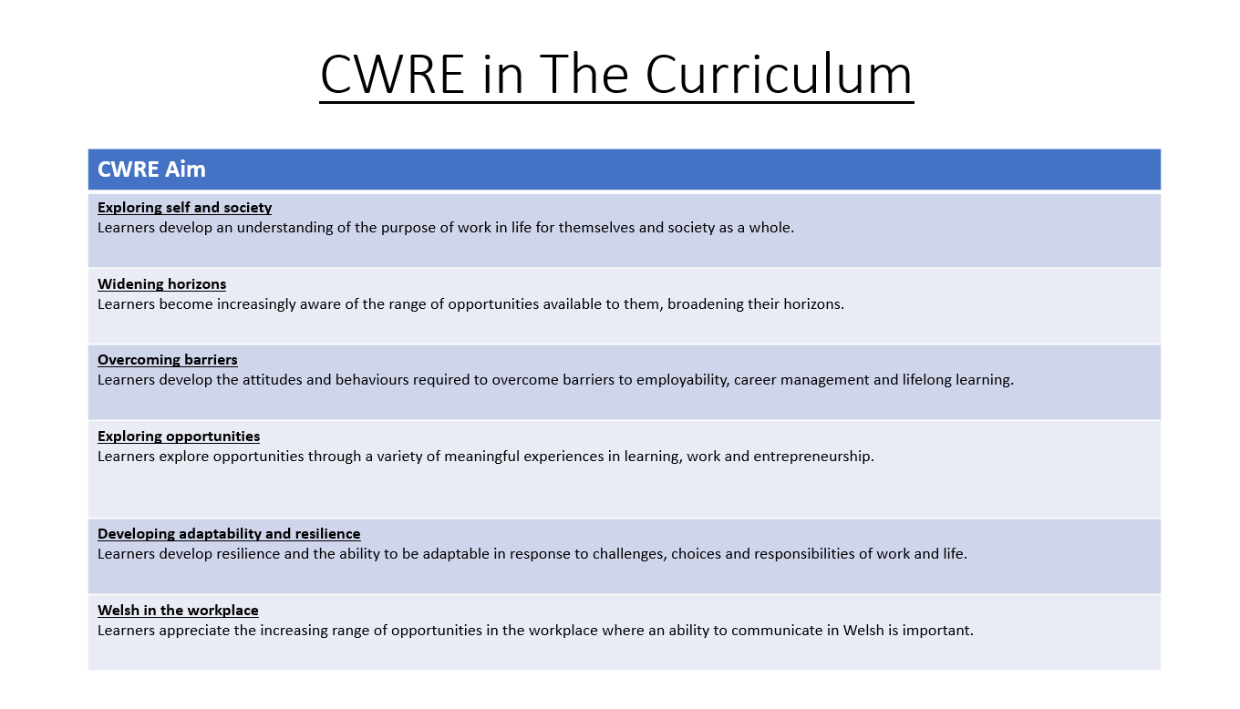

Slide 2
Lower School Plan
Subject: CWRE Progression
Term | 1 | 2 | 3
Year 7 | 1a: Who am I? 1b. Exploring Possibilities – Dream Jobs! | 2a. What is a career in my subject? 2b. What is an entrepreneur? Can my subject lead me to be one? | 3a. What is work-life balance? 3b. Careers and the future
Year 8 | 1a. What are my interests? 1b. Job applications and CV’s – how can my subject enhance mine? | 2a. Challenges and rewards of work 2b. Creating the life you want – how can skill development in my subject help? Create a vision board | 3a. What does success mean to me? What does it look like in my subject? 3b. Careers and the climate
Year 9 | 1a. What are my skills? 1b. What comes after school? Learning pathways for my subject | 2a. Decision making – choosing what to study at KS4. 2b. Taking control of your career journey. How to overcome potential barriers | 3a. Working and earning, managing your money 3b. What is the labour market and what is it saying about jobs in your subject sector?

Slide 3
Upper School Plan
Subject: CWRE Progression
Term | 1 | 2 | 3
Year 10 | 1a: Interests and Skills Profile – what makes you good at this subject? How will your skills transfer into the world of work? 1b. Preparing to go on work experience. How is skill development in my subject helping you prepare? | 2a. In person, hybrid, remote. What works best for your subject sector? 2b. Taking control of your career journey. How to overcome potential barriers | 3a. Wellbeing in the workplace. Discuss jobs linked to your subject and the possible challenges employees may face. 3b. What are my employability skills? How does my subject make students employable.
Year 11 | 1a. Post 16 Choices in my subject 1b. Decision making – choosing your post 16 pathway. What pathways are available linked to your subject? | 2a. Money talks – apprenticeships vs higher education in your subject

Slide 4
Lower School Plan
Subject: History
Skill: Digital Skills Progression
Term | 1 | 2 | 3
Year 7 |  | Llywelyn Adobe Infographic: Learners need to include animations with at least one asset being animated and then grouped with another asset and animated again.
Year 8 |  | Spanish Armada Google sites: Learners need to include ALT TEXT on images to aid with sight difficulty. They must also include a logo and favicon for the website.
Year 9 |  | World War One Google Sites: Learners must make their own custom theme and colours based on purpose and target audience.

Slide 5
Lower School Plan
Subject: History
Skill: Literacy Progression
Term | 1 | 2 | 3
Year 7 | Battle of Hastings Source Analysis: I can identify quotations from printed and digital texts to support a viewpoint. | Llywelyn the Great and Last: I can organise my writing into accurate paragraphs. | History Project Owain Glyndwr: I can use a range of strategies including skimming to identify themes, ideas and genre, and scanning to gain a detailed understanding of a text.
Year 8 | The Tudors - Henry VIII and the dissolution of the monasteries: I regularly use subject specific (Tier 3) terminology in my books and spell these terms accurately. | The Stuarts - Charles I: I can annotate a text appropriately. | History Project The British Empire: I can identify a range of quotations to support a point of view and begin to identify patterns in the way language is used.
Year 9 | 18th and 19th Century Crimes JTR: I can use Standard English appropriately to present a point of view. I can decode printed and digital texts, considering context, genre and implied meaning. | World War One: I can decode printed and digital texts, considering context, genre and implied meaning. | Nazi Germany: I can identify a wide range of quotations to support a point of view and explore alternative interpretations.

Slide 6
Lower School Plan
Subject: History
Skill: Numeracy Progression
Term | 1 | 2 | 3
Year 7 | Battle of Hastings: I can accurately draw a bar chart using the success criteria: Bars are of equal width Labels for your x and y axis Axis and scales (choosing own suitable scale) Same size space between bars Title for your graph |  | Native Americans: I can accurately draw a line graph with my own suitable scale.
Year 8 | Tudor Monarchs: I can accurately draw a pie chart. | Witches: I can accurately draw a scatter graph. | I can accurately draw a scatter graph. I can draw a line of best fit on a scatter graph using a ruler.
Year 9 | Jack the Ripper: I can select and construct appropriate charts, diagrams and graphs. | World War One: I can select and construct appropriate charts, diagrams and graphs. | Hitler: I can select and construct appropriate charts, diagrams and graphs.

Slide 7

Subject: History
Topic: The Tudors
Key Question: What impact did the Tudors have on England and Wales?
Consider what progression step you are pitching your content at when planning your lessons
Knowledge and Understanding.
I have a basic understanding of The Tudors and can write a basic description to show this.
I have a limited understanding of The Tudors and can write a limited description to show this.
I am developing my knowledge of The Tudors and can write a detailed description to show this.
I have a detailed understanding of The Tudors and can write an explanation to show this.
I have an excellent understanding of The Tudors and can write a detailed explanation to show this.
Overview: In this unit, pupils will learn about the Tudors and the impact they had on British society. They will discover the role of each Tudor monarch and discover the impact that they had on Britain during the 15th and 16th Centuries. Pupils will look at conflict and possible invasions whilst discovering the importance of the monarchy at this time.
No. of lessons 21 objectives
Content
What happened at the Battle of Bosworth? What problems with Henry VII face? | I know who was involved in the battle. I can describe the problems that Henry VII faced?
What do you know about Henry VIII? Who were Henry VIII wives? | I know what young Henry VIII was like. I can describe what happened to each of his wives.
What did Henry VIII eat? What did Henry do to the monasteries? | I know What Henry VIII liked to eat. I can explain what Henry did to the monasteries.
Why did Henry fall out with the Pope? What was the Act of Union? Did England and Wales have a religious rollercoaster? | I know why Henry fell out with the Pope. I can describe the importance of the Acts of Union.
What do Elizabeth’s portraits tell us? What was Elizabeth’s middle way? | I know what the secret messages were in Elizabeth’s portraits. I can explain the middle way and how this impacted England and Wales.
What caused the attack from the Spanish Armada? Who will win? England vs Spain? | I know what caused the Spanish Armada. I can predict who I think will win and why.
What were the events of the Spanish Armada? | I know the events of the Armada attack. I can explain what went wrong and why.
DCF Website | I know how to create a website. I can create a detailed website about the Spanish Armada.
Questioning and Responding.
I can start to ask basic questions about The Tudors.
I can ask questions to gather more information about The Tudors.
I can ask questions to develop my own opinion about The Tudors.
I can ask questions to support the different viewpoints in my argument/opinion about The Tudors.
I can ask questions to evaluate my judgements on The Tudors.
Recall.
I can recall basic historical knowledge of The Tudors.
I can recall some historical knowledge of The Tudors.
I can recall the changes that happened in England and start to link with Wales.
I can recall detailed historical knowledge and draw links between the impact The Tudors had on both England and Wales.
I can recall and link my previous knowledge to The Tudors.
Key Words: Tudor, Monarchy, Act, Union, Armada, Catholic, Protestant, Pope, Dissolution, Monasteries.
Assessments (linked to progression steps)
Literacy | I regularly use subject specific (Tier 3) terminology in my books and spell these terms accurately.
Numeracy | I can accurately draw a pie chart.
DCF | I can create a website about the Spanish Armada.
Why did Henry VIII break away from Rome?
Pupils will answer the following explain question:
Learning Experiences
Universal Experience: Design and create a banquet for Henry VIII.

Slide 8
Subject: History
Topic: The Stuarts
Key Question: What did the Stuarts do for us?
Consider what progression step you are pitching your content at when planning your lessons
Knowledge and Understanding.
I have a basic understanding of life during the 17th Century and can write a basic description to show this.
I have a limited understanding of life during the 17th Century and can write a limited description to show this.
I am developing my knowledge of life during the 17th Century and can write a detailed description to show this.
I have a detailed understanding of life during the 17th Century and can write an explanation to show this.
I have an excellent understanding of life during the 17th Century and can write a detailed explanation to show this.
Overview: In this unit, pupils will discover what changes the Stuarts brought to Britain. They will look at James I and how he unified Scotland with England and Wales. Pupils will discover what James was interested in, such as, Witches. They will also analyse evidence regarding the Gun Powder Plot.
No. of lessons: 10 Lesson
Content
Who was James I? | I know who James the I was. I can describe what James I was interested in.
What happened on the 5th November 1605? | I know what happened on the 5th November 1605. I can analyse the evidence to help draw my own conclusions.
How can you identify a Witch? | I know what the main characteristics were to spot a witch. I can describes the ways people could identify a witch in the 17th Century.
How were Witches tried and punished? | I know how witches were tried and punished. I can include evidence from sources when describing how witches were tried and punished.
Were witches just tried in Britain? | I know where the trials took place. I can explain how witch trials took place all over the world.
What was the English Civil War? | I know the events of the Civil War. I can describe and explain who was involved in the way and why it happened.
Why was Charles I put on trial? | I know Why Charles I was put on trial. I can analyse the evidence to help draw my own conclusions.
Was Charles I guilty? | I know if Charles was guilty of treason or not. I can analyse the evidence to help draw my own conclusions.
Who was Oliver Cromwell and what changes did he bring to Britain? | I know who Oliver Cromwell was and how he impacted Britain. I can explain what Oliver Cromwell did and decide if it was effective.
Skills – Historical Skill.
I am able to identify the key features of a source.
I am able to identify when the source was made.
I am able to identify who the author was and start to suggest it’s purpose.
I am able to link both the date and the author of the source to help question it’s reliability.
I am able to suggest how reliable a source is by discussing the strengths and weaknesses of the source.
Recall.
I can recall basic historical knowledge of 17th Century Britain.
I can recall some historical knowledge of 17th Century Britain.
I can recall the changes that happened in 17th Century Britain.
I can recall detailed historical knowledge and draw links between 17th Century Britain.
I can recall and link my previous knowledge to 17th Century Britain.
Key Words: King, Stuart, Gunpowder, Witches, Civil War, Execution, Trial, and Heir.
Literacy | I can annotate a text appropriately.
Numeracy | I can accurately draw a scatter graph.
Assessments (linked to progression steps)
How and why did Britain change during the 17th Century?
Pupils will answer the following explain question:
Learning Experiences
Universal Experience:
Design and create your own witch trial.

Slide 9
Subject: History
Topic: Industrial Revolution
Key Question: How did the Industrial Revolution change the lives of people in Britain?
Consider what progression step you are pitching your content at when planning your lessons
Knowledge and Understanding.
I have a basic understanding of life during the Industrial Revolution and can write a basic description to show this.
I have a limited understanding of life during the Industrial Revolution and can write a limited description to show this.
I am developing my knowledge of life during the Industrial Revolution and can write a detailed description to show this.
I have a detailed understanding of life during the Industrial Revolution and can write an explanation to show this.
I have an excellent understanding of life during the Industrial Revolution and can write a detailed explanation to show this.
Overview: In this unit, pupils will the impact the Industrial Revolution had on Britain during 1750-1900. They will discover how the country changed from villages to cities. Pupils will also look at how Britain paved the way for new ideas and inventions whilst deciding which invention was the best and why. They will also look at the darker side of the Industrial Revolution and how this impacted not just the British people but also its Empire. Pupils will also be given the opportunity to conduct an historical enquiry on the British Empire.
No. of lessons 18 L
Content
How did life change from 1750-1900? | I know how Britain changed from 1750-1900. I can describe how Britain changed. From 1750-1900.
What were the cultural changes that happened from 1750-1900? | I know that British culture changed. I can explain how British culture changed and include examples.
Why did the population explode? | I know the reasons why the population exploded. I can describe how the population exploded.
What was life like in a factory? Why inventions were created to improve the textile industry? | I know what life was like in a factory. I can analyse the evidence to help draw my own conclusions.
How were children treated during the Industrial Revolution? | I know how children were treated during the Industrial Revolution. I can describe and compare how children were treated.
What happened on Shelton Street? What were the working conditions during the Industrial Revolution? | I know what happened on Shelton Street. I can use a census to gather information to help draw my own conclusions.
How did working in a mine compare with a factory? | I know what life was like when working in a factory and coal mine. I can describe how poor the conditions in factories and coal mines.
Historical enquiry on the British Empire. | I know what the British Empire was. I can explain the role of the Empire.
Independent learning.
I am able to what information I need to research.
I am able to conduct my own research.
I am able to select which information and evidence is useful.
I am able to apply my own research and construct my findings in an appropriate way.
I am able to question the reliability of my findings and make my own conclusions.
Recall.
I can recall basic historical knowledge of the Industrial Revolution.
I can recall some historical knowledge of the Industrial Revolution.
I can recall the changes that happened in Britain during the Industrial Revolution.
I can recall detailed historical knowledge and draw links between both Britain and the Empire.
I can recall and link my previous knowledge to Industrial .
Key Words: Industry, Population, Technology, Change, Reform, Development, Labour, Revolution.
Assessments (linked to progression steps)
Literacy | I can identify a range of quotations to support a point of view and begin to identify patterns in the way language is used.
Numeracy | I can accurately draw a scatter graph. I can draw a line of best fit on a scatter graph using a ruler.
How did the Industrial Revolution impact Britain and the world?
Pupils will answer the following explain question:
Learning Experiences
Universal Experience:
Historical enquiry on the British Empire.

