Slide 1

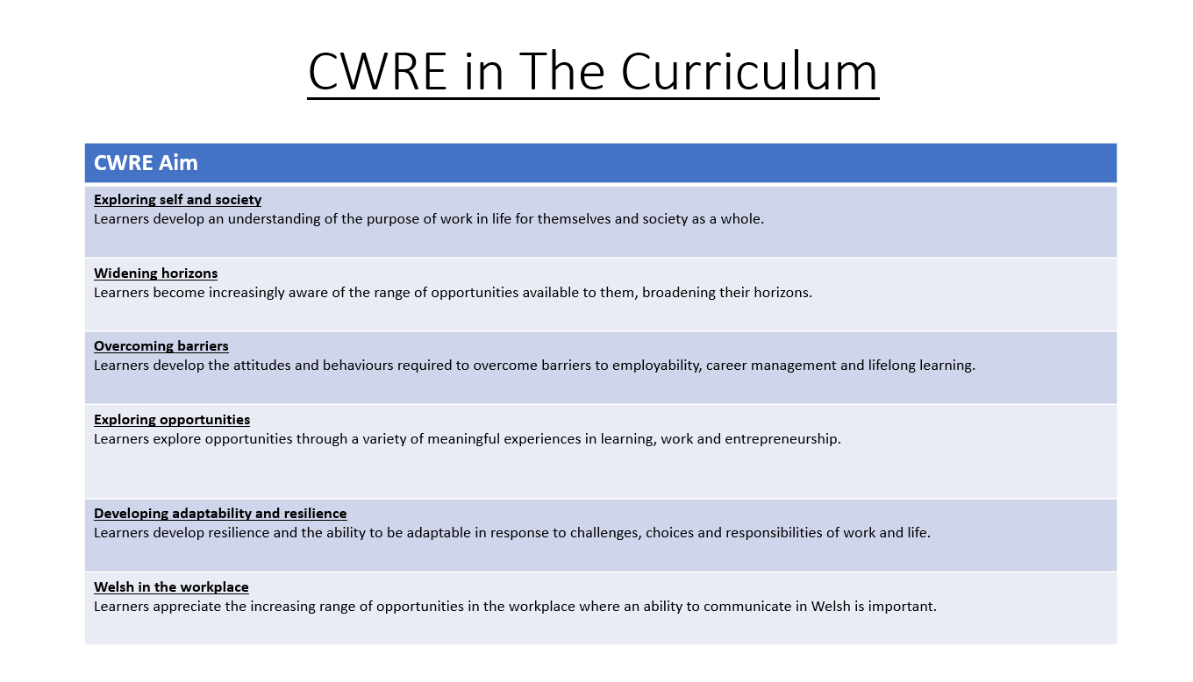

Slide 2
Lower School Plan
Subject: CWRE Progression
Term | 1 | 2 | 3
Year 7 | 1a: Who am I? 1b. Exploring Possibilities – Dream Jobs! | 2a. What is a career in my subject? 2b. What is an entrepreneur? Can my subject lead me to be one? | 3a. What is work-life balance? 3b. Careers and the future
Year 8 | 1a. What are my interests? 1b. Job applications and CV’s – how can my subject enhance mine? | 2a. Challenges and rewards of work 2b. Creating the life you want – how can skill development in my subject help? Create a vision board | 3a. What does success mean to me? What does it look like in my subject? 3b. Careers and the climate
Year 9 | 1a. What are my skills? 1b. What comes after school? Learning pathways for my subject | 2a. Decision making – choosing what to study at KS4. 2b. Taking control of your career journey. How to overcome potential barriers | 3a. Working and earning, managing your money 3b. What is the labour market and what is it saying about jobs in your subject sector?

Slide 3
Upper School Plan
Subject: CWRE Progression
Term | 1 | 2 | 3
Year 10 | 1a: Interests and Skills Profile – what makes you good at this subject? How will your skills transfer into the world of work? 1b. Preparing to go on work experience. How is skill development in my subject helping you prepare? | 2a. In person, hybrid, remote. What works best for your subject sector? 2b. Taking control of your career journey. How to overcome potential barriers | 3a. Wellbeing in the workplace. Discuss jobs linked to your subject and the possible challenges employees may face. 3b. What are my employability skills? How does my subject make students employable.
Year 11 | 1a. Post 16 Choices in my subject 1b. Decision making – choosing your post 16 pathway. What pathways are available linked to your subject? | 2a. Money talks – apprenticeships vs higher education in your subject

Slide 4
Lower School Plan
Subject: History
Skill: Digital Skills Progression
Term | 1 | 2 | 3
Year 7 |  | Llywelyn Adobe Infographic: Learners need to include animations with at least one asset being animated and then grouped with another asset and animated again.
Year 8 |  | Spanish Armada Google sites: Learners need to include ALT TEXT on images to aid with sight difficulty. They must also include a logo and favicon for the website.
Year 9 |  | World War One Google Sites: Learners must make their own custom theme and colours based on purpose and target audience.

Slide 5
Lower School Plan
Subject: History
Skill: Literacy Progression
Term | 1 | 2 | 3
Year 7 | Battle of Hastings Source Analysis: I can identify quotations from printed and digital texts to support a viewpoint. | Llywelyn the Great and Last: I can organise my writing into accurate paragraphs. | History Project Owain Glyndwr: I can use a range of strategies including skimming to identify themes, ideas and genre, and scanning to gain a detailed understanding of a text.
Year 8 | The Tudors - Henry VIII and the dissolution of the monasteries: I regularly use subject specific (Tier 3) terminology in my books and spell these terms accurately. | The Stuarts - Charles I: I can annotate a text appropriately. | History Project The British Empire: I can identify a range of quotations to support a point of view and begin to identify patterns in the way language is used.
Year 9 | 18th and 19th Century Crimes JTR: I can use Standard English appropriately to present a point of view. I can decode printed and digital texts, considering context, genre and implied meaning. | World War One: I can decode printed and digital texts, considering context, genre and implied meaning. | Nazi Germany: I can identify a wide range of quotations to support a point of view and explore alternative interpretations.

Slide 6
Lower School Plan
Subject: History
Skill: Numeracy Progression
Term | 1 | 2 | 3
Year 7 | Battle of Hastings: I can accurately draw a bar chart using the success criteria: Bars are of equal width Labels for your x and y axis Axis and scales (choosing own suitable scale) Same size space between bars Title for your graph |  | Native Americans: I can accurately draw a line graph with my own suitable scale.
Year 8 | Tudor Monarchs: I can accurately draw a pie chart. | Witches: I can accurately draw a scatter graph. | I can accurately draw a scatter graph. I can draw a line of best fit on a scatter graph using a ruler.
Year 9 | Jack the Ripper: I can select and construct appropriate charts, diagrams and graphs. | World War One: I can select and construct appropriate charts, diagrams and graphs. | Hitler: I can select and construct appropriate charts, diagrams and graphs.

Slide 7

Subject: History
Topic: Medieval Wales and England
Key Question: What was Wales and England like in Medieval times?
Consider what progression step you are pitching your content at when planning your lessons
Knowledge and Understanding.
I have a basic understanding of life in Medieval Wales and can write a basic description to show this.
I have a limited understanding of life in Medieval Wales and can write a limited description to show this.
I am developing my knowledge of life in Medieval Wales and can write a detailed description to show this.
I have a detailed understanding of life in Medieval Wales and can write an explanation to show this.
I have an excellent understanding of life in Medieval Wales and can write a detailed explanation to show this.
Overview: In this unit, pupils will discover what Wales and England was like during medieval times. They will discover how Wales was ruled, the cultures that the country had and the impact this had on it’s people. Pupils will also look at the Battle of Hastings and the invasions from the Vikings and the Normans. Pupils will also decide on the qualities that make a great King whilst looking at the problems that a King might face. Finally, pupils will also discover Castles and how this changed Wales and England whilst understanding how Castles changed over time. No. of lessons: 25
Content
What was Wales like in 1065? Who ruled over Wales? | I know what Wales was like in 1065 and how it was ruled. I can describe how Wales changed and developed during the 11th Century.
Who Should be king? | I know what qualities make a good King I can explain who should become the next King of England.
What problems did Harold face? | I know what problems Harold Godwinson faced. I can describe what problems Harold faced and suggest how he can solve them.
What happened at the battle of Stamford Bridge? | I know the events of the battle of Stamford Bridge. I can describe what went wrong for Harald Hardrada.
What happened at the battle of Hastings? How effective were the weapons? | I know the events of the battle of Stamford Bridge. I can describe what went wrong for Harald Godwinson.
What was a Motte and Bailey castle? How did Castles change over time? | I know what a Motte and Bailey Castle was and why it was introduced. I can explain how to improve a Motte and Bailey castle.
Can you build your own castle? | I know what features I would include in my own castle. I can analyse and critique the castle that I have made.
What challenges did Llyewlyn face? How did Llyewlyn extend his rule over Wales? ​Llywelyn ap Gruffudd Vs Edward I​ Who won? | I know the conflict between Llywelyn and Edward.​ I can describe the issues between both Llywelyn and Edward.​
Did Llywelyn the Great or Last succeed? | I know about both Llywelyn the Great and Last. ​ I can explain which Llywelyn was more successful. ​
Skills – Historical Skill.
I am able to identify the key features of a source.
I am able to identify when the source was made.
I am able to identify who the author was and start to suggest it’s purpose.
I am able to link both the date and the author of the source to help question it’s reliability.
I am able to suggest how reliable a source is by discussing the strengths and weaknesses of the source.
Recall.
I can recall basic historical knowledge of Medieval Britain.
I can recall some historical knowledge of Medieval Britain.
I can recall the changes that happened in England and start to link with Wales.
I can recall detailed historical knowledge and draw links between both England and Wales.
I can recall and link my previous knowledge to Medieval Wales.
Key Words: Invasion, Contender, Motte and Bailey Castle, Heir, Battle, Concentric Castle, Weapons.
Literacy | I can identify quotations from printed and digital texts to support a viewpoint. I can organise my writing into accurate paragraphs.
Numeracy | Battle of Hastings Bar Chart: I can accurately draw a bar chart using the success criteria
DCF | Infographic about the two Llywelyn’s.
Assessments (linked to progression steps)
Who should be the heir to the throne after Edward the Confessor?
What impact did Llywelyn ‘The Great’ have upon Wales? ​
Pupils will answer the following explain question:
Learning Experiences
Universal Experience: Battle of Hastings re-enactment and making or baking a castle.

Slide 8
Subject: History
Topic: Wales and America during the 15th Century.
Key Question: How does the 15th Century demonstrate complex, pluralistic and diverse nature of societies in the USA and Wales?
Consider what progression step you are pitching your content at when planning your lessons
Knowledge and Understanding.
I have a basic understanding of life in 15th Century America and Wales and can write a basic description to show this.
I have a limited understanding of life in 15th Century America and Wales and can write a limited description to show this.
I am developing my knowledge of life in 15th Century America and Wales and can write a detailed description to show this.
I have a detailed understanding of life in 15th Century America and Wales and can write an explanation to show this.
I have an excellent understanding of life in 15th Century America and Wales and can write a detailed explanation to show this.
Overview: In this unit, pupils will explore the country of America and it’s indigenous people. They will look at how and who discovered America as well as focusing on traditions and cultures of the native people. Pupils will have opportunities to create dream catchers whilst understanding the importance and the role they played in Native American life. They will also be able to compare their own knowledge of Pocahontas with that of the Disney interpretation. This will lead into questioning the reliability of sources and the information that they provide. Pupils will then conduct an independent historical enquiry about Owain Glyndwr and the impact he had on Wales.
No. of lessons: 11 Lesson ob
Independent learning.
I am able to what information I need to research.
I am able to conduct my own research.
I am able to select which information and evidence is useful.
I am able to apply my own research and construct my findings in an appropriate way.
I am able to question the reliability of my findings and make my own conclusions.
Content
Who are the Native America? | I know who the Native Americans were. I can describe how they were discovered.
What was the life and culture like for Native Americans? | I know daily life was like for a Native American. I can describe the importance of the buffalo to some tribes.
Was Pocahontas like the Disney character? | I know the real story of Pocahontas. I can compare the real story to that of Disney.
Was Pocahontas like the Disney character? | I know the real story of Pocahontas. I can compare the real story to that of Disney.
What changed for the Natives after America was discovered? | I know what changes happened to the Native Americans. I can explain why the changes happened.
How did American gain independence? | I know how American gained independence. I can explain why they wanted independence from Britain.
Who was Owain Glyndwr? | I know who Owain Glyndwr was. I can describe what Owain Glyndwr did.
How did Owain Glyndwr influence Wales? | I know how Owain Glyndwr influenced Wales. I can explain the importance of Owain Glyndwr in Welsh history.
Recall.
I can recall basic historical knowledge of 15th Century America and Wales.
I can recall some historical knowledge of 15th Century America and Wales.
I can recall the changes that happened in 15th Century America and start to link with Wales.
I can recall detailed historical knowledge and draw links between both 15th Century America and Wales.
I can recall and link my previous knowledge to 15th America and Wales.
Key Words: Native, indigenous, reliability, tipi, dreamcatcher, buffalo, hypothesis, independence.
Assessments (linked to progression steps)
Literacy | I can use a range of strategies including skimming to identify themes, ideas and genre, and scanning to gain a detailed understanding of a text.
Numeracy | I can accurately draw a line graph with my own suitable scale.
Pupils will answer the following explain question:
Learning Experiences
Was Pocahontas like the Disney character? Explain.
Universal Experience: Design and create a dream catcher.

